Slide 1
Funding of Universities- EuropeanTrends
Plenary of the Hungarian Rector’s Conference
University of Debrecen, Budapest, Hungary,
16-17 October, 2012
Maria Helena Nazaré
President of EUA
University of Aveiro (former rector),
PORTUGAL

Slide 2
EUA at a glance
2001: establishment of EUA
a representative organisation of European universities & rectors’ conferences
Members:
850 individual universities
46 countries
34 National Rectors’ Conferences
Independent Voice for the University Sector:
policy dialogue (focus: EHEA and ERA)
projects and surveys
services to its members (information, events)
Notes:
What is EUA then?

Slide 3
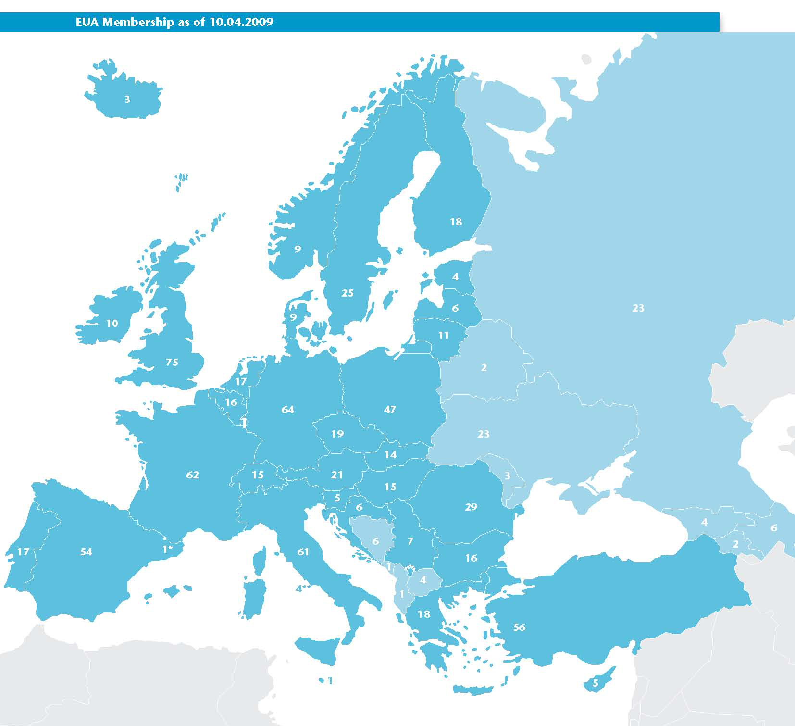
Notes:
From Reykjavik to Omsk – we cover nearly the Europe of the European Cultural Convention
3

Slide 4
Financial Sustainability
Identifying costs of all activities and projects
EUIMA - Full Costing
“Towards full costing”
Diversification of income streams
EUDIS
Sufficient and sustainable public funding
Public funding observatory
Performance-based
funding systems (DEFINE)
HORIZON 2020 debate
Universities
Funders
Public authorities

Slide 5
Why Institutional Autonomy?
Correlations (may be shown!?) between autonomy and
performance
quality
degrees of income diversification
successful internationalisation
Institutional autonomy
enables universities to determine and pursue strategic priorities according to their strengths;
does not automatically lead to better performance but is an important requisite.

Slide 6
Institutional Autonomy? What is it?
is a complex concept that consists of various interconnected elements
is contingent on the diverse cultural, political, legal and historical backgrounds of Europe’s HE systems;
cannot be measured objectively.
There is not just one model! It is context depend.
L ’Autonomie ne se decrete pas; elle est une pratique.
Leadership is essential

Slide 7
Organisational
Financial
Staffing
Academic
Selection procedure/ criteria for rector
Dismissal/ term of office of rector
Inclusion/ selection of external members in governing bodies
Deciding on academic structures
Creating legal entities
Length/ type of public funding
Keeping a surplus
Borrowing money
Owning buildings
Charging tuition fees for national/ EU students
Charging tuition fees for non-EU students
Staff recruitment procedures
Staff salaries
Staff dismissals
Staff promotions
Deciding on overall student numbers
Selecting students
Introducing/ terminating programmes
Choosing language of instruction
Selecting QA mechanisms/ providers

Slide 8
Organisational autonomy - trends
External members are now included in university governing bodies in a majority of systems, though external authorities often remain involved in their selection.
Universities in nearly all systems are free to create legal entities and decide on academic structures.
Rectors are always chosen by the universities, although external authorities often have to confirm the appointment.
Smaller governing bodies
More independence in choosing external members

Slide 9
Staffing autonomy - trends
Recruitment procedures are less prescribed than before.
In most systems, restrictions still apply to staff salaries, although these are less likely to be due to the civil servant status of university staff.
Staff dismissals and promotions remain restricted in more than half of the systems studied.
The financial crisis has strongly affected staffing policies.
Continue to fade out civil servant status
Reduce limitations on staff salaries

Slide 10
Academic autonomy - trends
Overall student numbers are limited in nearly all systems.
Universities in Europe still have little freedom in choosing QA mechanisms.
Accreditation is still compulsory for BA/MA programmes in a majority of systems.
The language of instruction can be chosen freely in approx. 2/3 of all systems.
Greater freedom in setting admission criteria
Balance autonomy and accountability, e.g. promote institutional audits instead of programme accreditation

Slide 11
Challenges
Divergence between practical and formal autonomy. Often times is not the case of NOT having Autonomy, but lacking to use it.
Need of a new set of skills and competences in leadership and management.
The level of Autonomy has increased over the last decade. However austerity measures have affected negatively sttafing and financial autonomy.

Slide 12
Funding Trends: state of play
On average, almost ¾ of universities’ funding comes from
national/regional public funding sources
Notes:
Private funding: Student financial contributions
Diverse sample, with universities not allowed to charge fees and universities receiving more than 25% of their income from student fees
Tuition and administrative fees
International students: fees collected from non-EU students represent generally less than 10% of the fees collected (exception of England – up to 1/3 or even ½ of collected fees)
Potential as an income source but ambiguous funding stream (indirect support from public authorities)

Slide 13
Financial autonomy – state of play
Universities generally receive their public funding as a block grant, although its allocation may be restricted.
Surpluses can be kept and money borrowed in a majority of systems, but in practice, various limitations still apply.
Universities in most systems are able to own their buildings, but often require external permission to sell them.
The situation is complex, but universities tend to be more free to set tuition fees for MA and non-EU students.
Longer funding periods
Avoid or minimise negative effects of the financial crisis
Balance autonomy and accountability (e.g. reporting requirements)

Slide 14
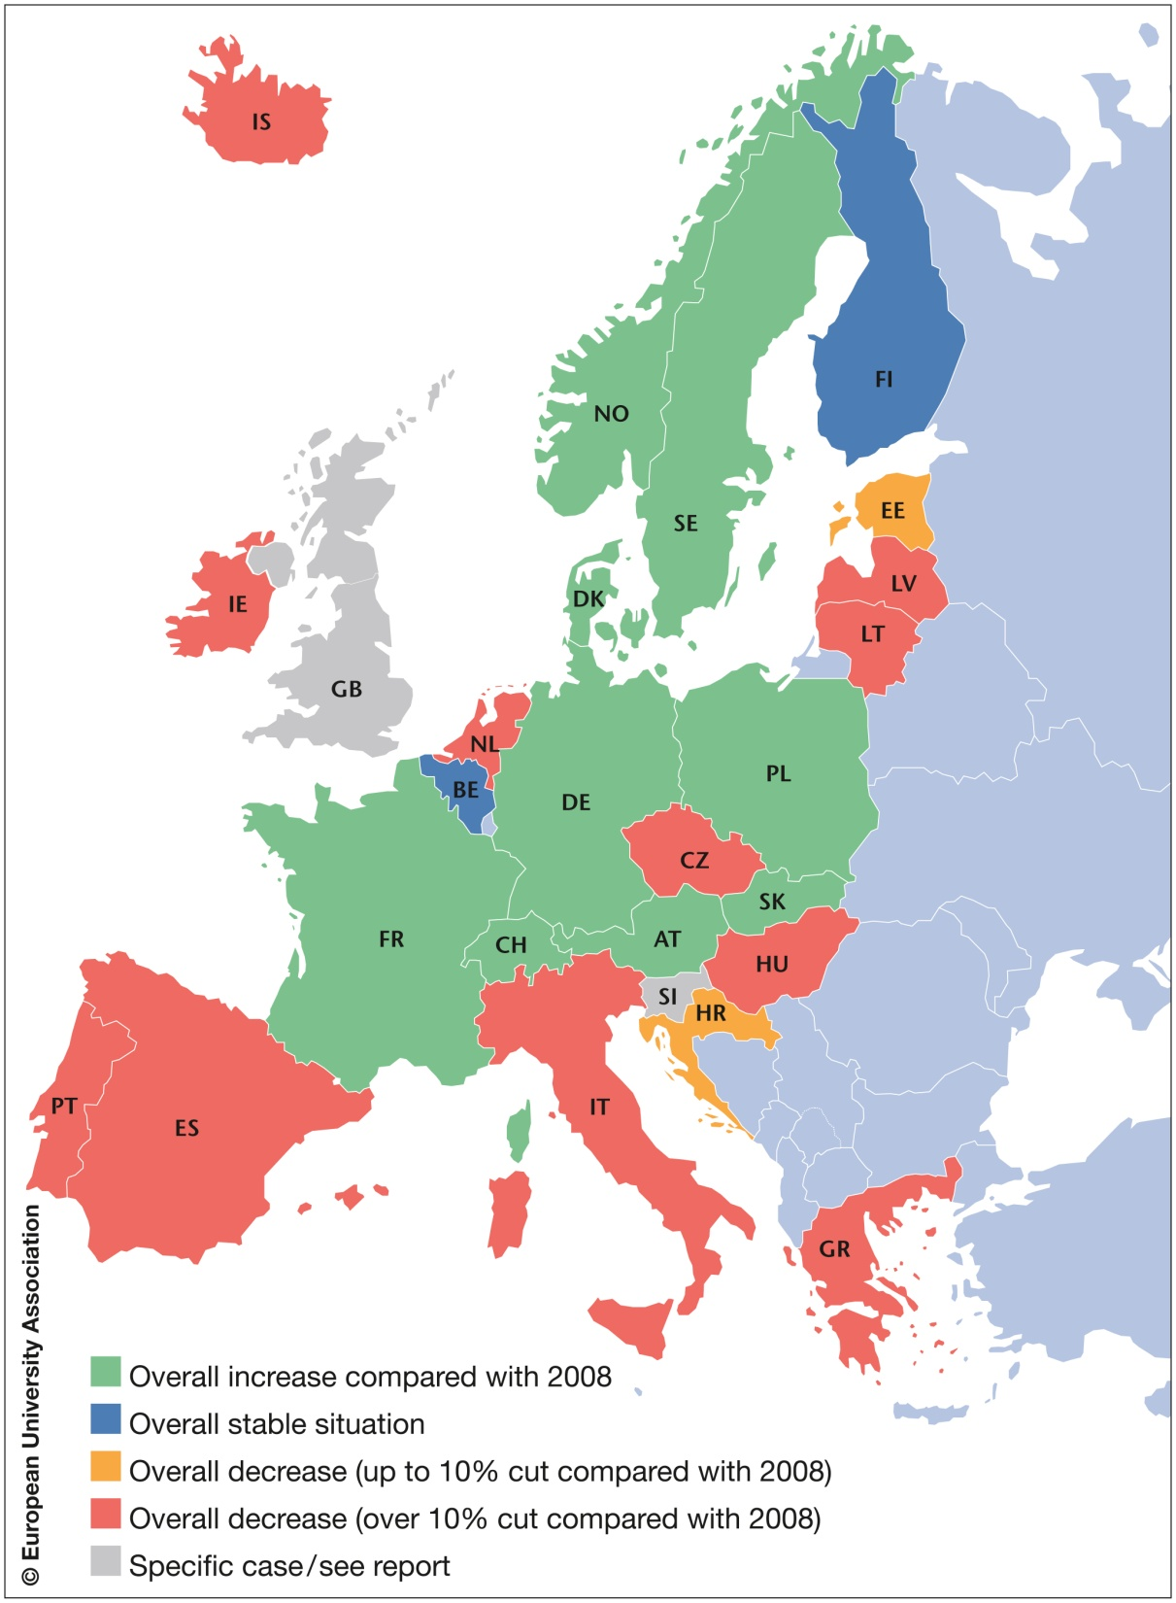
Funding Challenge1:
Trends in public funding of higher education in Europe over the period 2008-2012
Notes:
Teaching funding
Increases in funding for education in absolute figures are often due to rising numbers of students. However funding per student is often stagnating or decreasing (example: DK, DE, IS, IE, NO).
Research funding
Increase in BE (nl), DE (through targeted and competitive funding), SE
Decrease in HR, DK, EE (partially offset via EU research/structural funds), IE (indicative 10% cut announced for 2013), NL (abolition of the fund for economic structural reinforcement)
Infrastructures / capital spending
Notable cuts in Croatia, Ireland; in Slovakia, this is the main area that suffered cuts. Capital spending for research in England has been substantially cut.

Slide 15
Key messages
Divergent trends in funding could lead to major divisions across Europe in terms of levels of public investment in HE
Worrying signs that many countries in eastern and southern Europe are more affected than many in northern and western Europe
Threat of increased brain drain as staff & students leave these systems
European funding programmes need to cover costs on a full cost basis to avoid decrease in participation of these universities.
Impact on European Research and Higher Education Areas and international scientific collaboration
Investment in higher education and research needs to be maintained and increased in order to help European countries out of the economic crisis.

Slide 16
Funding challenge 2: Changing modes of public funding
More Competitive funding
More Targeted funding
Increased use of output and performance criteria
Increased shift towards tuition fees
Need to invest in support capacities
Influences strategic choices
Notes:
Increasingly relevant for universities in context of stagnating budgets – success rate may even be criterion for funding formula
Some authorities tend to cut in block grants and re-introduce targeted funding geared towards the achievement of specific objectives => restricts auonomy

Slide 17
Funding challenge 3: Increasing co-funding
Do not cover the full costs of an activity
Increase through competitive funding sources
Widens the FUNDING GAP!!
Leads to underinvestment in infrastructure and resources

Slide 18
Funding challenge 4: Complex financial management
Increasing number of funding sources
Many universities have more than a 100 funding sources!
Tendency for further increase in the future!
New funding sources represent a small % of overall budget
Different and complex accountability regimes – high costs of compliance!

Slide 19
University autonomy and funding
Correlations exist between autonomy and
Performance, quality, degrees of income diversification, more sucessful internationalisation, efficiency and effectiveness
Financial autonomy is key to allow university to develop partnerships, borrow money, keep surpluses
Staffing autonomy is key to recruit the adequate staff profiles
BUT: Holistic reforms needed, accompanied with appropriate support for skills and structure development
Notes:
The benefits of university autonomy have been demonstrated in a number of research studies (EUA Trends reports, EUDIS).
Positive correlations have been shown to exist between autonomy and performance, degrees of income diversification (strengthening the financial sustainability of universities), successful internationalisation and efficiency.
Institutional autonomy does not autonomatically lead to better performance or educational quality, but it enables universities to set the right strategies and pursue their missions in the most appropriate way.
Autonomy as a central policy issue for EUA
Included in several of its policy declarations (Lisbon Declaration 2007; Prague Declaration 2009) and addressed in a series of conferences (2007-2009)
Publication of University Autonomy in Europe I. Exploratory Study (2009)
Sketches broad trends in university autonomy and governance in 34 higher education systems in Europe
Autonomy Scorecard project (2009-2012)
Carried out in cooperation with the Danish, German and Polish national rectors’ conferences and funded under the EC’s LLP; investigates university autonomy in 28 higher education systems (26 countries); breaks down autonomy into 4 broad areas; measures and compares levels of autonomy using specially developed scoring and weighting systems.

Slide 20
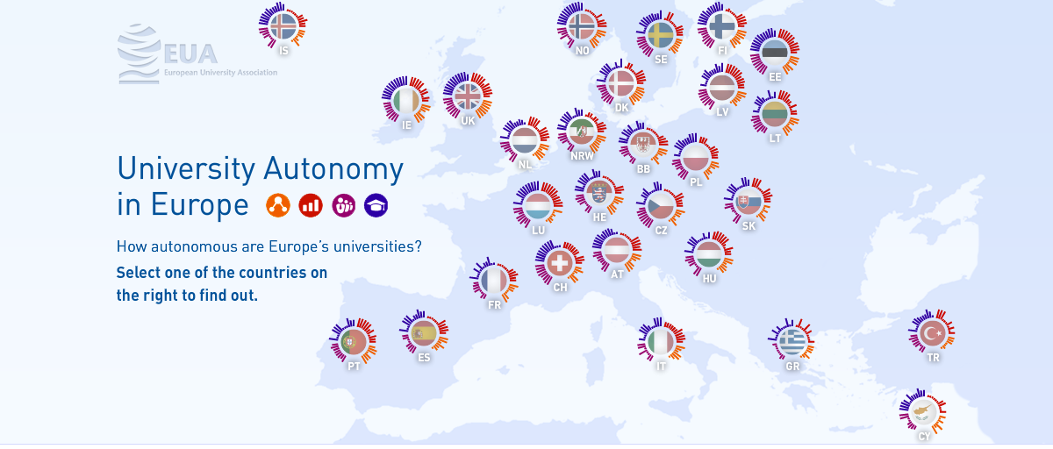
www.university-autonomy.eu

Slide 21
What can authorities do?
Implement smart funding incentives:
Matched funding schemes: instrument with much potential, under-used in Europe
Improve funding modalities:
Simplification of funding schemes
Funding on a full cost basis
Balance between performance and core funding
Support the development of full costing in universities
Improve framework conditions – autonomy and governance reforms
Support leadership development and professionalisation of management

Slide 22
What can universities do to diversify income?
Integrate income diversification in the overall strategy
Identify the strengths & specificities of the university to develop a branding strategy
Analyse perspectives for income generation of your activities
Invest in people, leadership and management
Communicate (internally and externally)
Change structures and organisation
Provide internal incentives
Notes:
Professional HR & staff recruitment – bringing experts in, including from outside higher education
Investment in new positions at all levels (from research administrative support to fundraising director and vice-rector for enterprise)
Define leadership roles, both academic and professional
Internal (creating the case for change and raising awareness)
External (projecting the brand)
Change structures and organisation
Creation of specific units (Advancement/fundraising offices)
Re-organisation of governance structure or specific competences for groups within governing bodies
Investment in information tools to guide the process
Good data and reporting/monitoring systems
Provide internal incentives
Individual rewards and incentives – eg. promotions, remuneration
Faculty/departmental rewards –eg. commercialisation revenue apportionment
Seed money for new initiatives
Making things easy for academics through better support

Slide 23
Some aspects to keep in mind
Additional funding cannot replace sufficient public funding
To foster diversification, upfront investments are necessary
All actors need to work together!

Slide 24
THANK YOU!
Presentation prepared with
Thomas Estermann.
Thomas.estermann@eua.be

