Slide 1
Ways to reduce Drop-outs in Higher Education:
Student Success Support Program (SSSP) at the University of Dunaújváros
The role of practice-oriented Higher Education in Europe
HRC-EURASHE Workshop
26 February 2016
Mónika Rajcsányi-Molnár vice-rector, UoD

Slide 2
STUDENT DROPOUT…
WHY do we need to / „have to” deal with student dropout?
WHAT is the definition of dropout? WHO can be considered a dropout student?
WHERE, at which levels/degrees, fields of study, etc. can dropout be detected more strongly? (Are there any such differences?)
WHAT ARE THE main CAUSES of dropout?
WHAT KIND OF INSTITUTIONAL ANSWERS, SOLUTIONS can be given to reduce student dropout? (Best practices)

Slide 3
STUDENT DROPOUT…
WHY?
“At a macro-level, the performance of higher education may be characterized by the ratio of college graduates in comparison to the population, the rate of student dropout, the average number of years it takes to earn a degree, and the return of investment in education.” (Grade change in higher education—directives for performance oriented higher education, 2014)
“Considering the extraordinarily low rate of unemployment among college graduates (about 5% in 2011), one of the greatest efficiency and performance related losses of higher education concerns student dropout.” (Restructuring in higher education: strategic directions, future measures_V2.5. [v12], 2013)

Slide 4
STUDENT DROPOUT…
WHAT? WHO? WHERE?
Student dropout is a more or less common phenomenon in higher education
Research indicates that if a student overcomes initial difficulties during the first year, the chances of dropping out decrease
Academic literature defines as dropout those who leave education without earning a degree
The number of students in higher education: admission, registration, completion, graduation...
Differences: educational levels/degrees, fields of study, modes of study (e.g. full time, part time), financial ways…

Slide 5
STUDENT DROPOUT…
WHAT ARE THE CAUSES?
Student dropout research (from the 1970s): risk factors
Main causes, factors of dropout, for example:
background factors (e.g. parential support, income, highschool performance, preparatory courses, friends and intercultural relations);
institutional factors (e.g. financial support, information, rules, regulations, attitude of the personell);
academic factors (e.g. teacher-student relations, counselling, learning competencies, university resources, e.g. sport, library);
social factors (e.g. friends, professional culture, social integration);
environmental factors (e.g. continuous parential support, financial resources);
attitudes, intentions, psychological factors (e.g. effectiveness of students, self-development, self-confidence, motivation, stress, alienation, persistance).

Slide 6
STUDENT DROPOUT…
INSTITUTIONAL ANSWERS, BEST PRACTICES
Student Success Support Program (SSSP)
at the
University of Dunaújváros

Slide 7
SSSP program:
Antecedents at UoD
Structural, institutionalized monitoring of students in order to reduce dropout (starting 2012/13 academic year):
Student-centered education organizational measures (see Education organizational directives (2012))
ISO, performance evalutaion: talent support and dropout is a criteria
The identification of critical subjects, courses
Supervision training (sensitize professors who teach critical courses)
The establishment of a professional mentoring system
Students participate in the project from the very beginning.

Slide 8
SSSP program :
„New educational philosophy – successful student”
The foci of SSSP:
Decrease student dropout
Establish a learning-centered environment
The efficient operation of a mentoring system, the identification of success factors
Increase student motivation

Slide 9
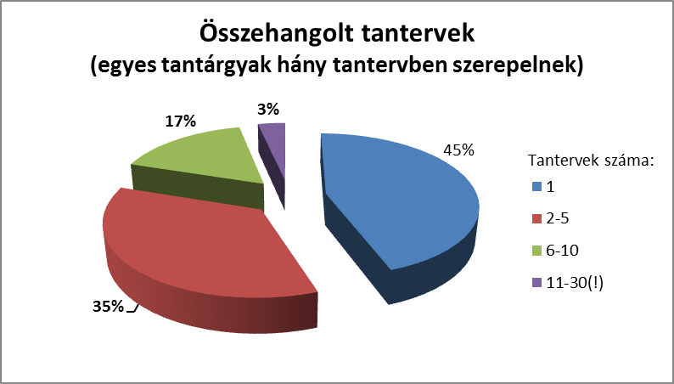
Our SSSP supporting systems
Harmonized Curricula (Bologna)
Only five credit subjects (ECTS) (sample curriculum: 6 subjects X 5 credits/semester)
Reduction of the number of subjects (same content, different name)
Reduction of the number of timetable hours per semester: student workload
Optimization of specializations (shared specializations, minimum number of students to start it)
Harmonised curriculum
(appearance of single courses in how many curriculum)
Number of curriculum:

Slide 10
SSSP project:
1st phase /2014-2015/
Sub-projects (min. 60 participants):
1. Sub-project:
The development of a student dropout monitoring system
2. Sub-project:
What makes a good mentor? The development of a professional mentoring system
3. Sub-project:
The screening (auditing) of curricula and courses
4. Sub-project:
The development of learning-centered and outcome-based methodologies and training
5. Sub-project:
Project communication

Slide 11
SSSP Project – 2nd Phase /2016/:
${SSSP}^{UoD}$ – FSA National Pilot project
7. Sub-project:
SSSP^{UoD} KIT
The synthesis of sub-projects
2. Sub-project:
The development of a mentoring model
6. Sub-project:
The development of a Student counseling – Support Center (with the involvement of HÖOK and FETA)
5. Sub-project:
Research, measurement, assessment
4. Sub-project: Strengthening student motivation
3. Sub-project:
The training of faculty
1. Sub-projectt:
Monitoring system
(Development of SSSP^{UoD}-AVATAR)

Slide 12
SSSP Sub-project 1. – The Development of a Monitoring System
SSSP Sub-project 1. – Objectives:
Studying the reasons for student dropout
The development of the monitoring (controling) system of student dropout
Tasks:
1.1. The development of the theoretical and methodological bases of information technology
1.2. The definition of entitlements, the clarification of data protection issues
1.3. The information technology development of the SSSP^{DUE}-AVATAR program
1.4. Ensuring the possibility of data conversion into systems as applied in higher education
1.5. The definition of the success criteria and indicators of the efficient operation of the monitoring system; the testing of the system
Planned outcomes and results:
Program development (intellectual property)
Handbook
The overall identification of dropout factors

Slide 13
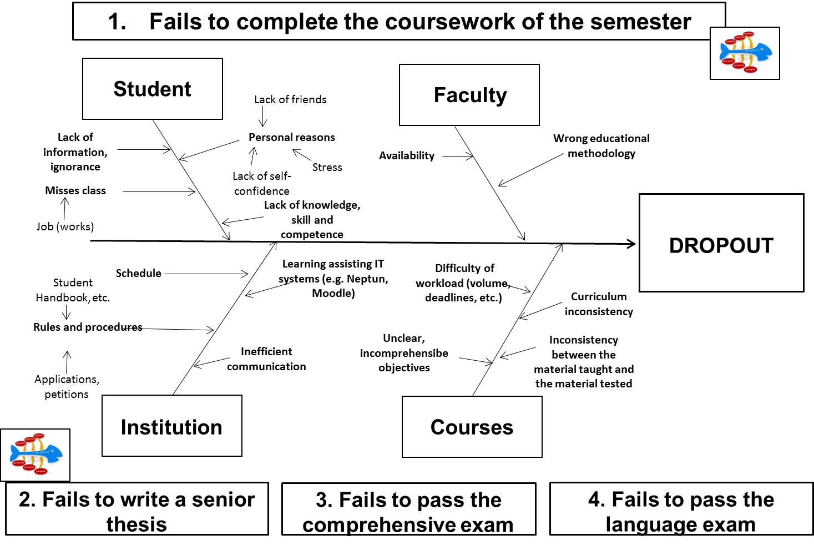
SSSP 1. sub-project – Factors of dropout, cause and effect relationships

Slide 14
SSSP 1. sub-project – Student dropout monitoring system: The structure of the system

Slide 15
SSSP 1. sub-project – Student dropout monitoring system: Selected data
Selected and identifiable data/information in the monitoring system (https://hasit.duf.hu) for each student:
Basic information (name and Neptun code of student, educational program, full time or part time, beginning of student status, minimum credit requirements, length of program, program template code)
Previous studies (e.g. high school certificate)
General state, progress (active/passive status, number of active semesters, cumulative completed credits)
Performance by template (courses, credits)
Students` semester grades, semester performance (registered/completed courses, codes, course identifiers, professor`s name, number of credit registrations, registered/completed credits, final grade of the course, cumulative grade point average)
Inter-semester progress: missed classes by course, list and results of course requirements (results of continuous evaluation)
Physical education credit completion
Data of internship (start and finish dates, length, date of certification, name of certifier)
Senior thesis information (serial number, address, date of registration, date of submission) and its completion
Language certificate information (language, level, type, completion of language certificate requirements)
∑ “Avatar” state (18 level: -9 – +9)

Slide 16
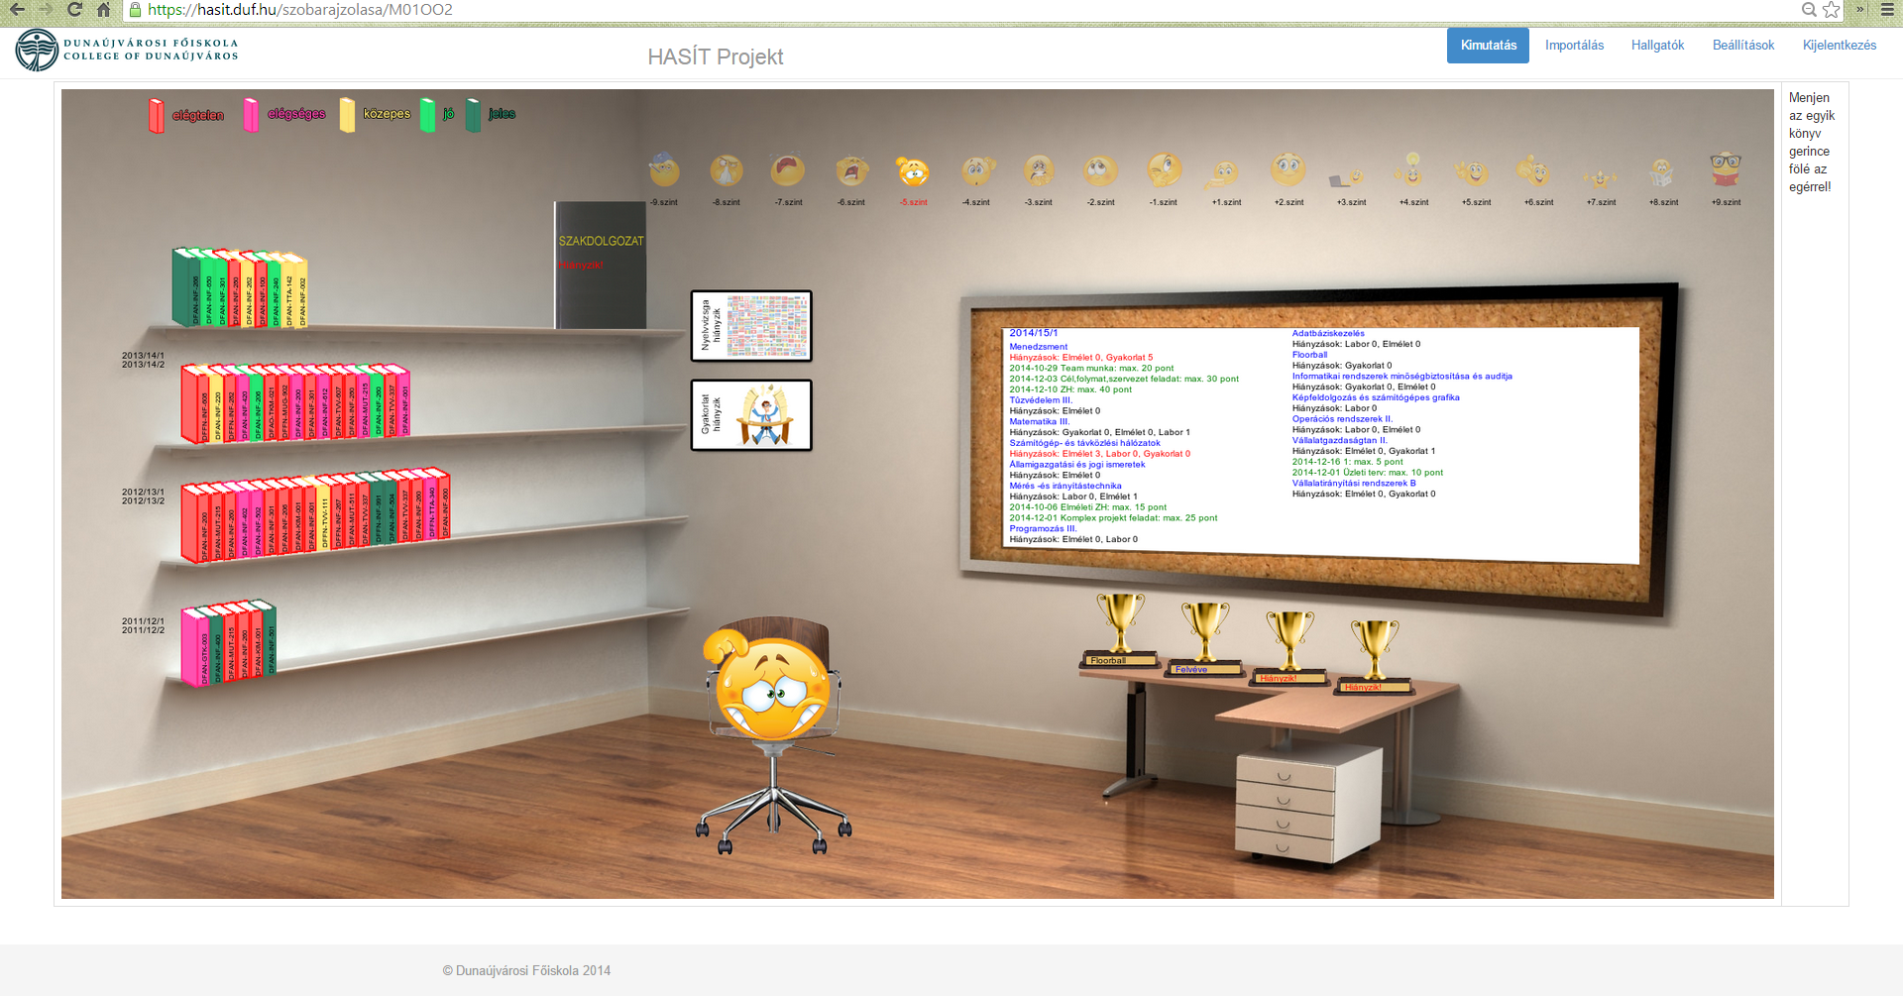
SSSP^{OuD} 1.0

Slide 17
SSSP^{UoD} 2.0
New Generation of the Student Success Support Program (SSSP)
SSSP^{UoD} 2.0

Slide 18
SSSP^{UoD} 2.0
The system is based on the hierarchy of interconnected modules:
Basic System
Modules related to Avatar
Communication modules
Modules related to data processing
Filter, Data export
Diagram, account
Bulletin board
Notification
Carrier
Calendar

Slide 19
SSSP Project – 2nd Phase /2016/:
${SSSP}^{UoD}$ – FSA National Pilot project
7. Sub-project:
SSSP^{UoD} KIT
The synthesis of sub-projects
2. Sub-project:
The development of a mentoring model
6. Sub-project:
The development of a Student counseling – Support Center (with the involvement of HÖOK and FETA)
5. Sub-project:
Research, measurement, assessment
4. Sub-project: Strengthening student motivation
3. Sub-project:
The training of faculty
1. Sub-projectt:
Monitoring system
(Development of SSSP^{UoD}-AVATAR)

Slide 20
SSSP – Results
The successful operation of the Mentoring system – Mentor Oscar Special Award (Hungarian Coaching Conference)
Decrease of dropout (e.g. students who didn`t finish a course, by 20% on average, and even 40% in certain critical subjects)
Overview of curricula and courses
Faculty-level participation
Inclusion of students!
European Committee: higher education „best practice”
EMMI: FSA support

Slide 21
SSSP - Results: Increasing Successful Course Completion
Successful course completion (without „did not complete” the course rates)
Successful course completion (overall rates)

Slide 22
Thank You for Your Kind Attention!

Slide 23
STUDENT DROPOUT…
WHY do we need to / „have to” deal with student dropout?
WHAT is the definition of dropout? WHO can be considered a dropout student?
WHERE, at which levels/degrees, fields of study, etc. can dropout be detected more strongly? (Are there any such differences?)
WHAT ARE THE main CAUSES of dropout?
WHAT KIND OF INSTITUTIONAL ANSWERS, SOLUTIONS can be given to reduce student dropout? (Best practices)

