Slide 1

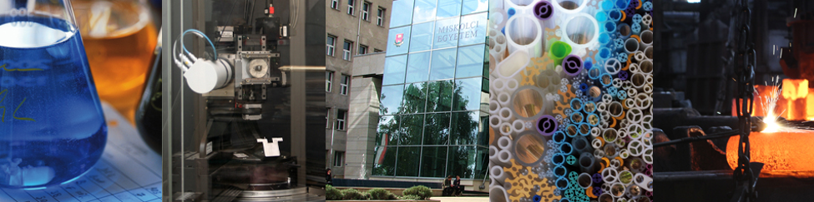

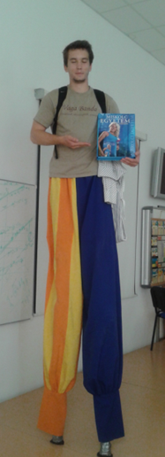
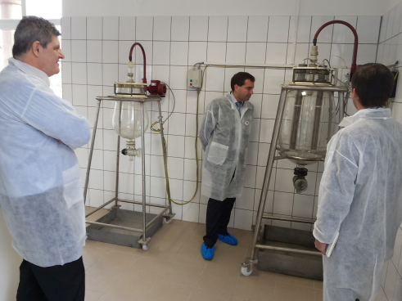
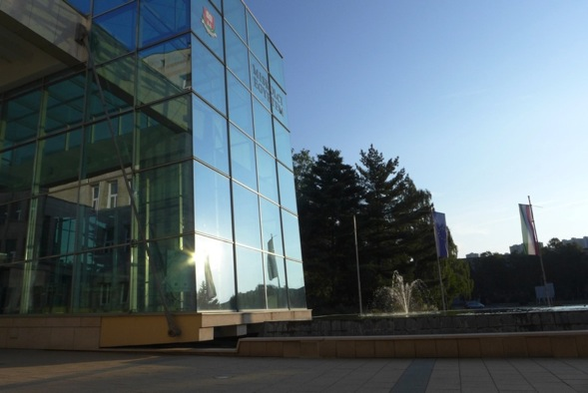
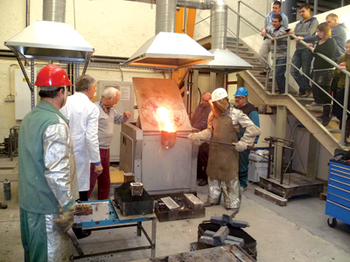
Evolving Dual Education at the University of Miskolc (UoM)
Prof. Dr. Tamás Kékesi
Vice-rector for Sci. & Intern’l Aff., UoM
Prof. Dr. Zoltán Gácsi
Head of Dual Edu. Committee, UoM

Slide 2
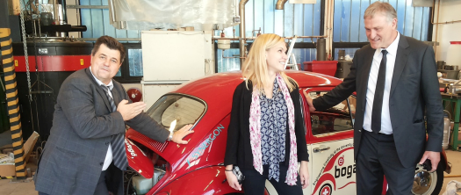
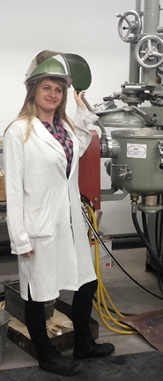
1. The major incentives
Historical roots:
Practice oriented training traditions (revolution in HE – 18th c.),
Classical R&D relations
Sponsored departments
External departments at industrial partners,
Scholarship from the industry.
Aspirations for pioneering in new methods of education/training.
A chance to strengthen the social & economical links/roles of the university.
Projects → technological innovation is emphasized (Funding will promote the joining of expertise in science to opportunities in technology and business.

Slide 3
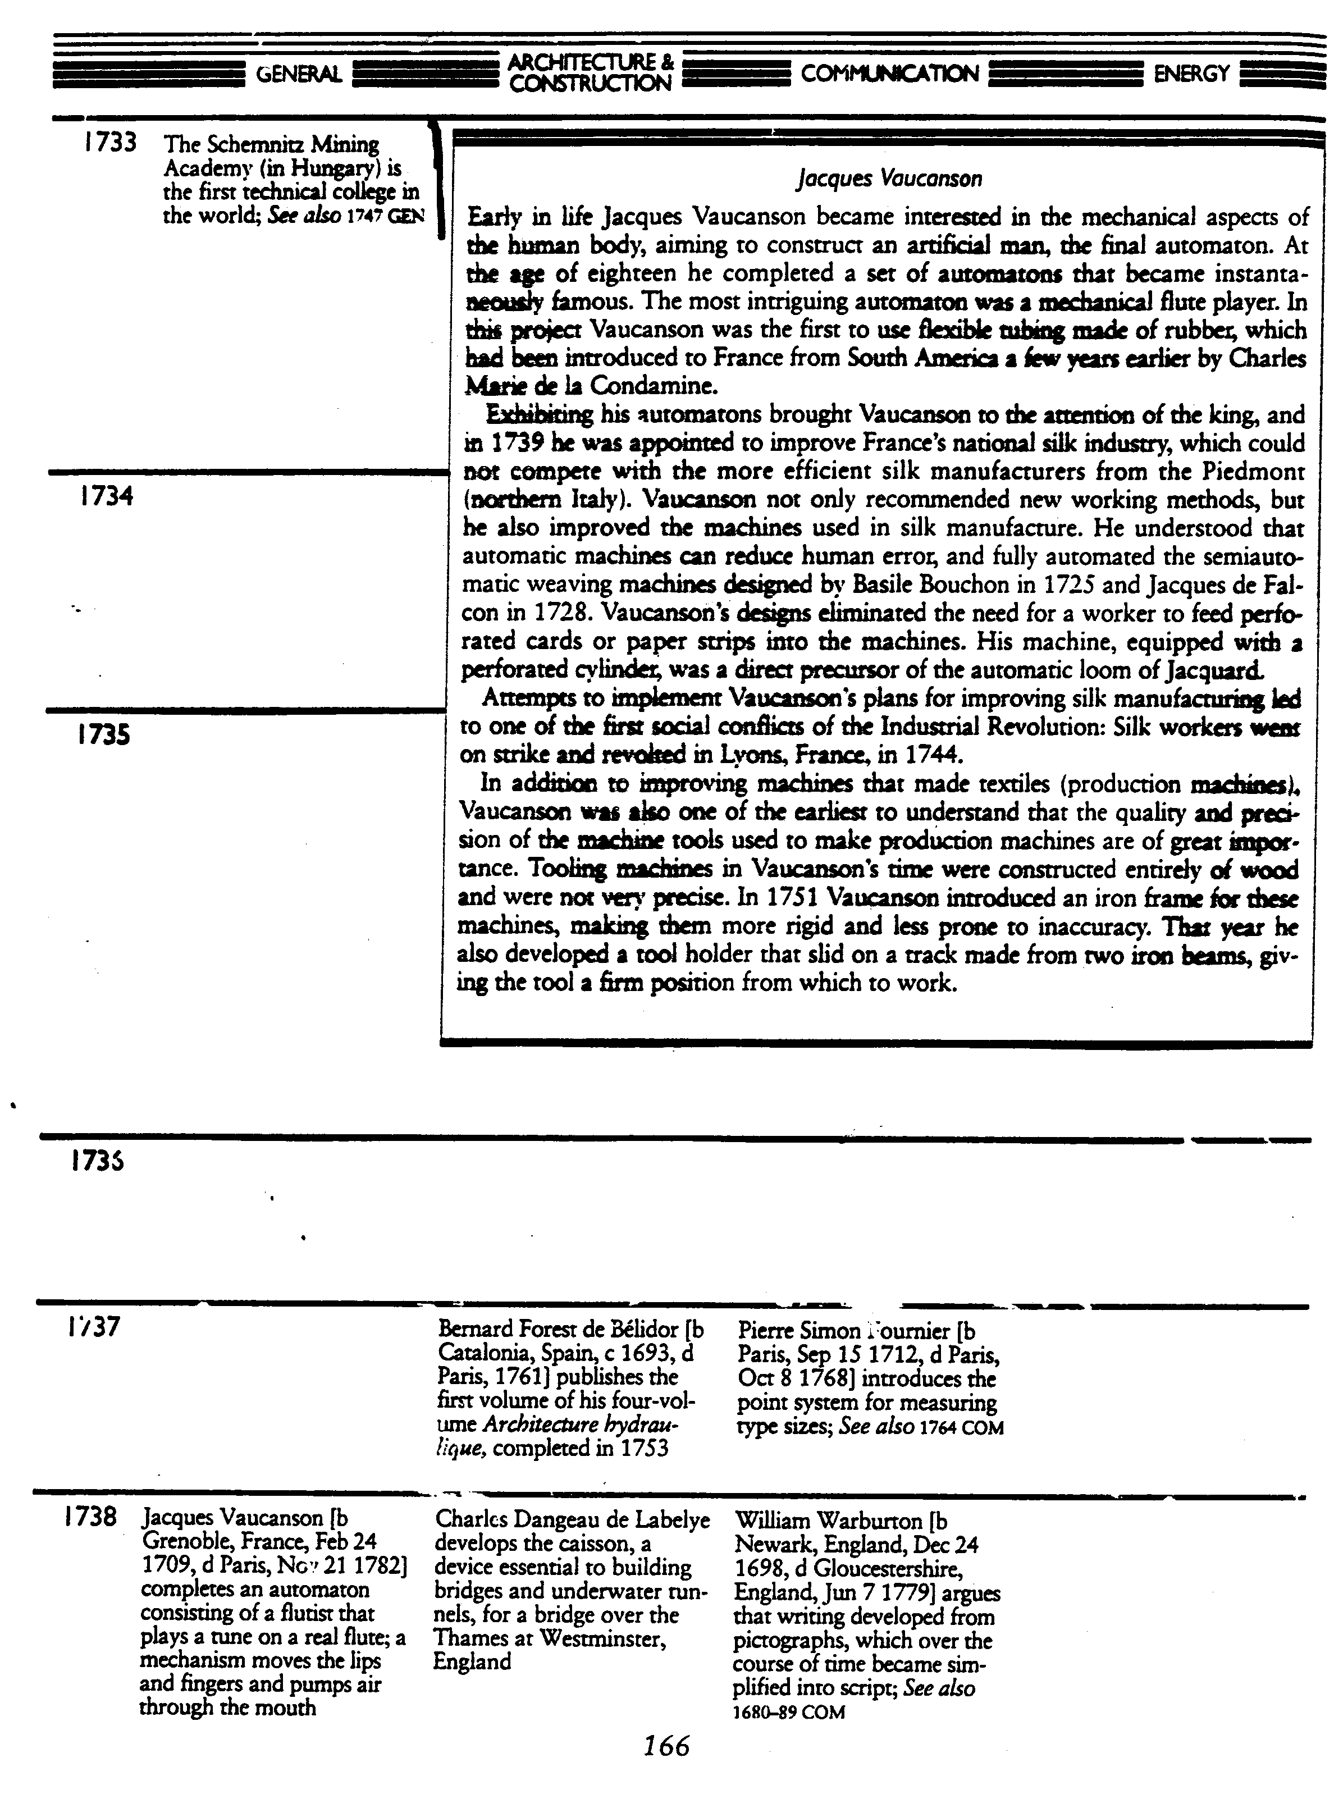
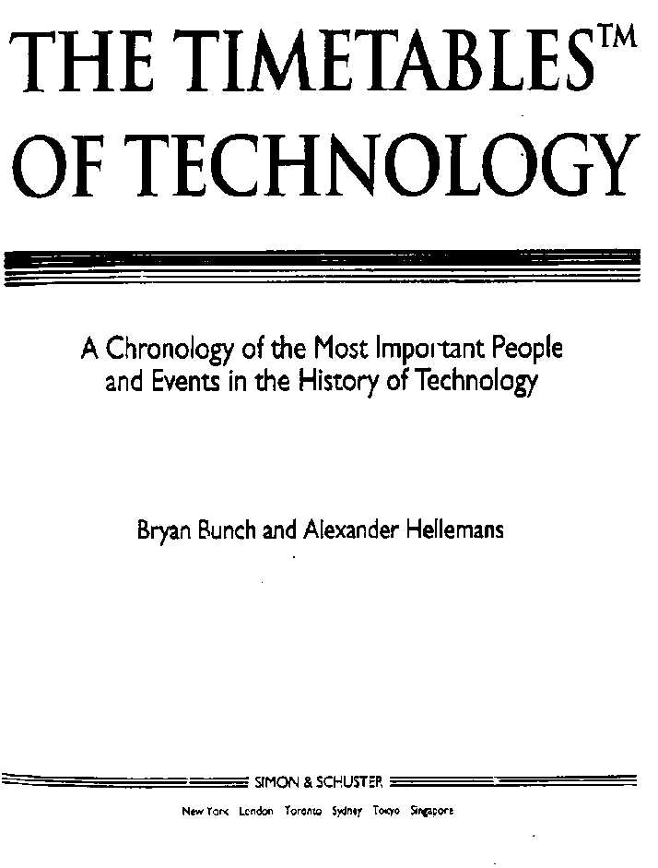
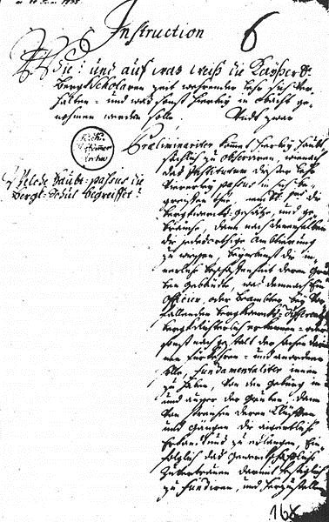
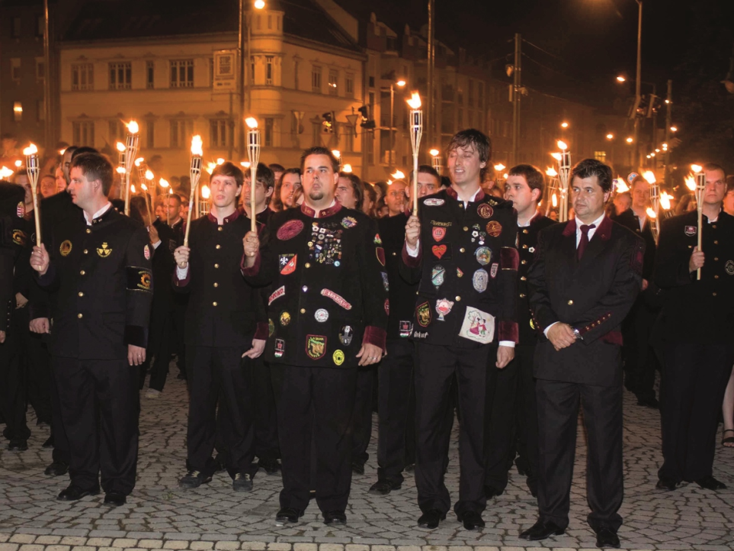
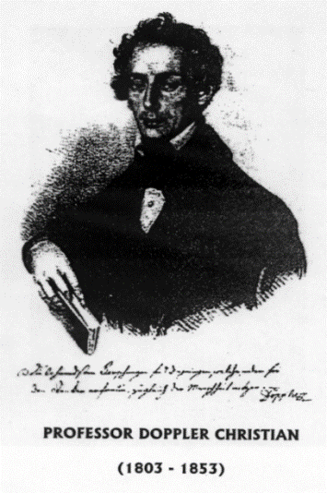
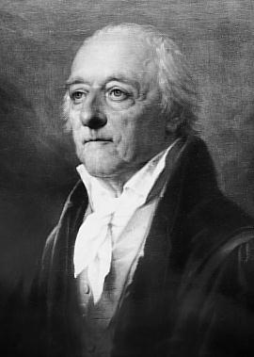
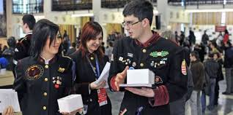
Traditions
Bergschule (School of Mining and Metallurgy)
Promotion to the rank of „Academie” in 1762 by Maria Theresia
First full professor:
Nikolaus Jacquin 1763 - 1769
Living traditions on campus – (declared as part of Hungarian Spiritual Heritage and considered for the UNESCO World Heritage List).
1848 - 1850

Slide 4
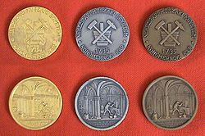
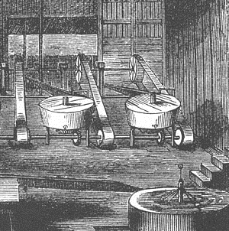
In the 18th century:
The predecessor of the UoM, the Schemnitz Mining Academy introduced the practice based teaching method to higher education.
→ became world famous
→ model for l’École Polytechnique Paris (1794), etc.
Traditional study awards
In 1786 (27th September): the first technical-scientific conference was organised
Participants from many countries (also from Mexico) arrived with their own samples.
The process of amalgamation was further developed by I. Born (coupling it with chlorinating roasting).
The "Societat der Bergbaukunde", the first international scientific union was founded there.
(154 members from 15 European and Latin-American countries, incl. Watt, Lavoisier, Goethe…)
Many former Hungarian students of the Berg Acadmie became important persons also abroad:
F. Fischer: Chief engineer of Mexican Copper Works,
I. Lindner: Professor of mining and metallurgy in Mexico,
R. Knechtel: Manager of mining in the Turkish Empire,
F. Müller: discoverer of Tellurium.

Slide 5
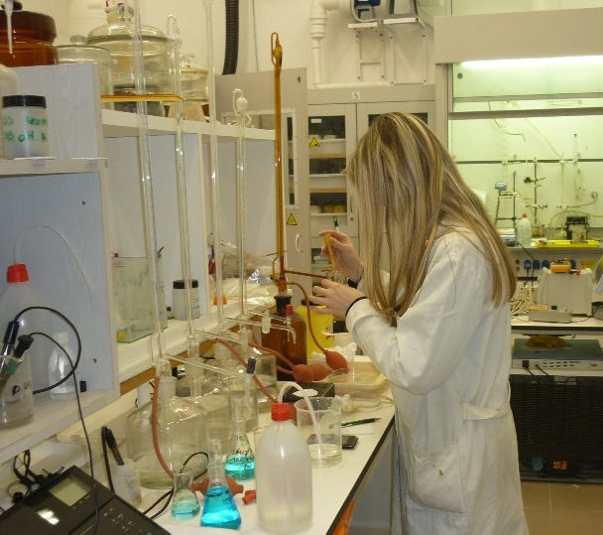
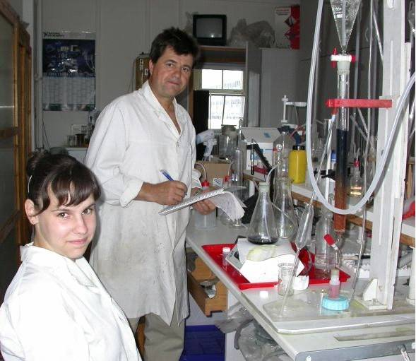
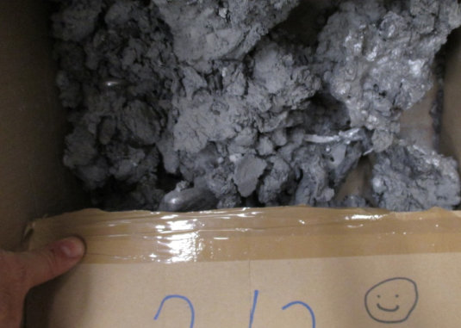
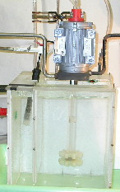
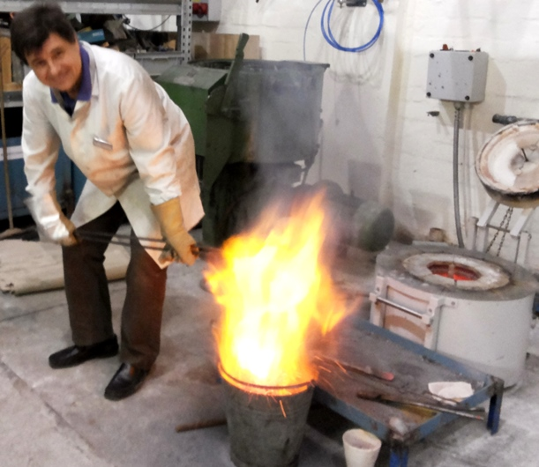
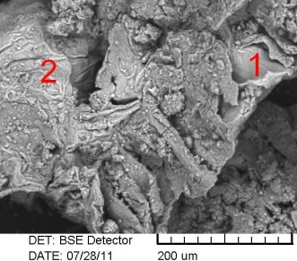
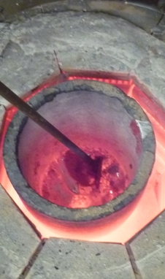
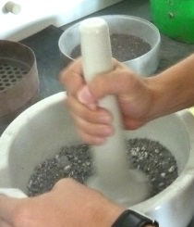
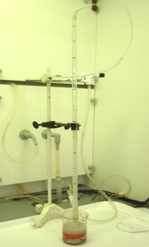
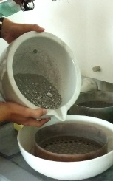
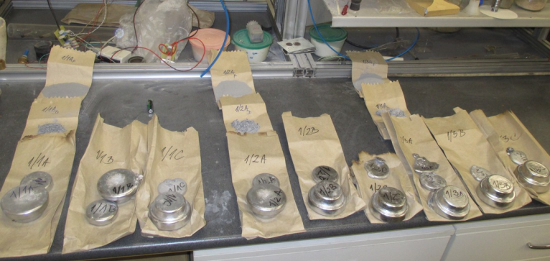
Thematic work based on specific contracts (problem solving or innovation)
Conventional R&D relationships:
Waste liquor treatment
The practical return from university research:
Updated and developed curricula
Innovation in technology
Filling the financial gaps of the university
(only 1/3 – ½ of the total expenditure is covered
by state budget…)
Some examples (from my field…)
Al dross treatment
(Metal recovery)
Water model of Al melt refining

Slide 6
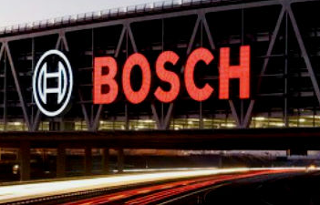
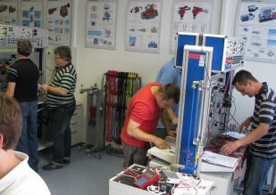
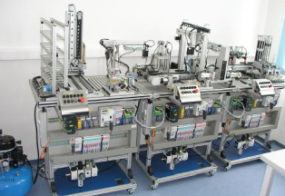
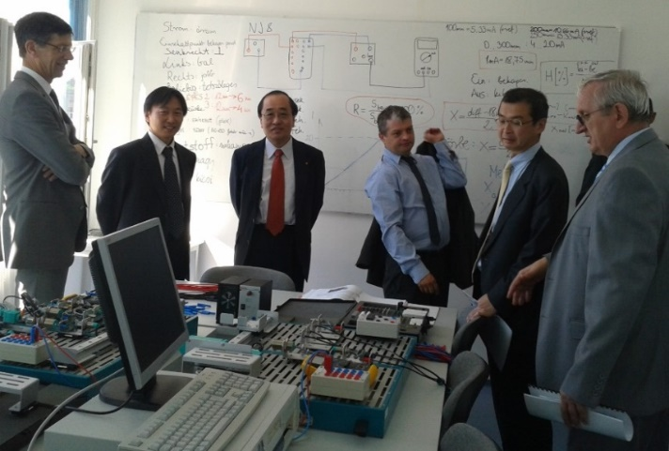

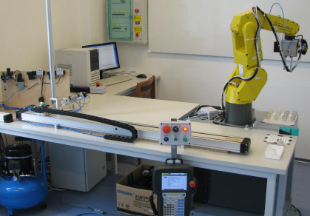
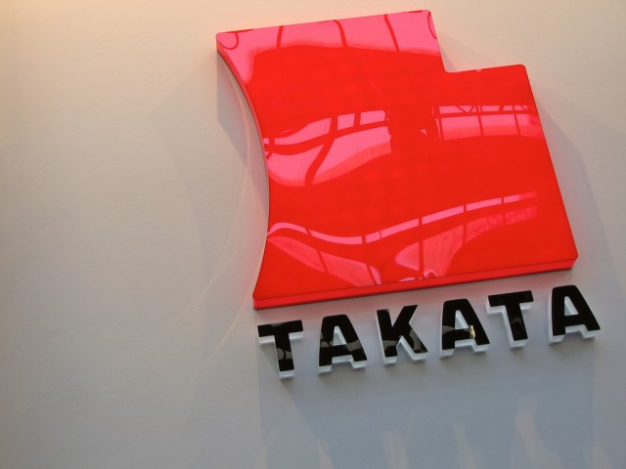

Sponsored departments (at the university):
Cooperation both in training and in research of corporate interest.
The first university department run by an international company was founded in 2005: Robert Bosch Department of Mechatronics.
Pneumatics & Hydraulics Laboratory
Benefits:
Specialized training by practical requirements
Great improvement in technical background
Fundamental costs covered by company funds
Better trained graduates
Shaping the curriculum
Practice program for junior staff
Special R&D projects
PLC & Mechatronics Systems Lab.
Robot Programming Lab.
However, funding may run out…

Slide 7

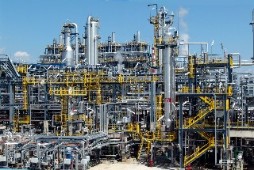


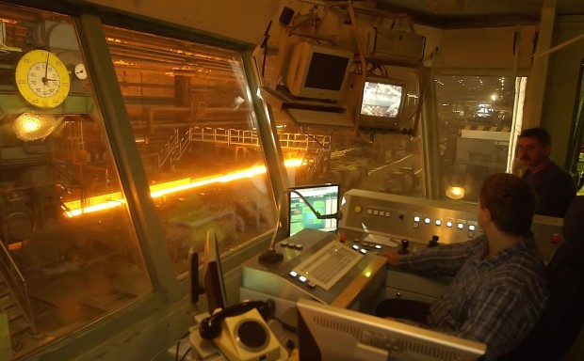
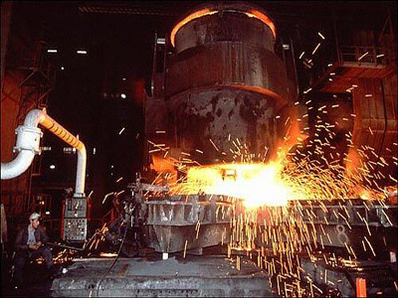
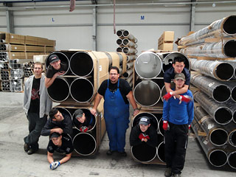

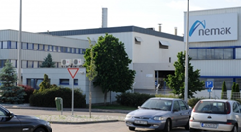
External departments (at the partners)
Establishing „external departments” located in partner companies and involving their staff in practical education.
As the Faculty of Materials Science & Engineering of UM is doing:
External Department of Chemical Technology (Wanhua-BorsodChem),
External Department of Petrochemical Technology (TVK Co. Ltd),
Exteranal Department of Metallurgy (ISD Dunaferr Co.Ltd.)
External Department for Quality Control (Metalcontrol Co. Ltd)
Sponsoring university specialized education and participating as an external department
The combined form:

Slide 8
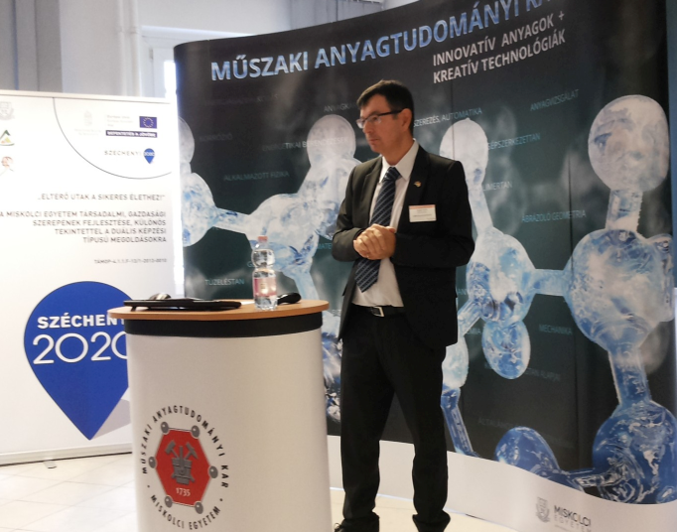
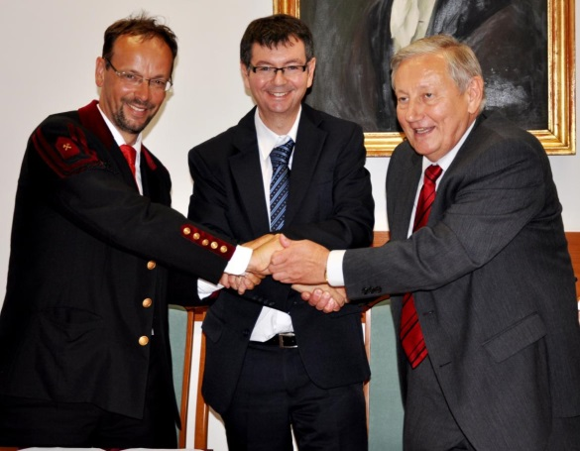
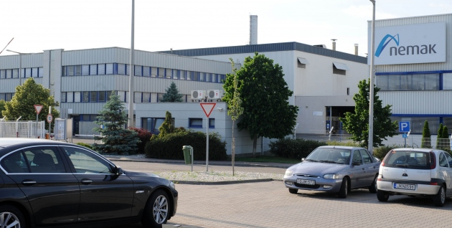
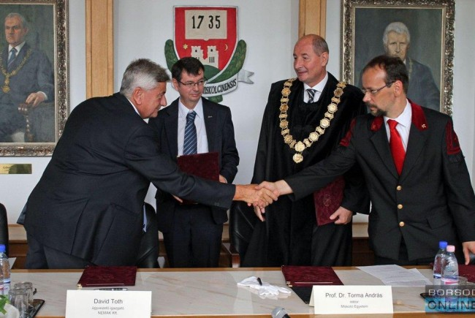
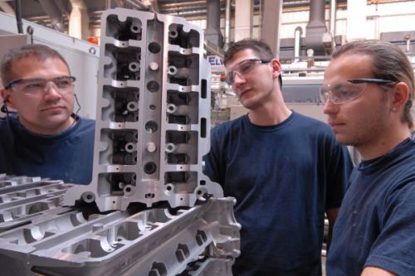
A completely new model of cooperation: „Dual educaion” program.
The curriculum is divided almost equally between the university and the partner company;
Theory is studied at the university and practice is instructed at the company;
The company provides training facilities and expert staff;
Students can be admitted only by application and competition;
Special remuneration is offered by the company for the work done at the company (and for the loss of the long Summer vacation…);
Company costs can be partly deducted from taxation;
Selected students may be directly employed by the company after graduation.

Slide 9
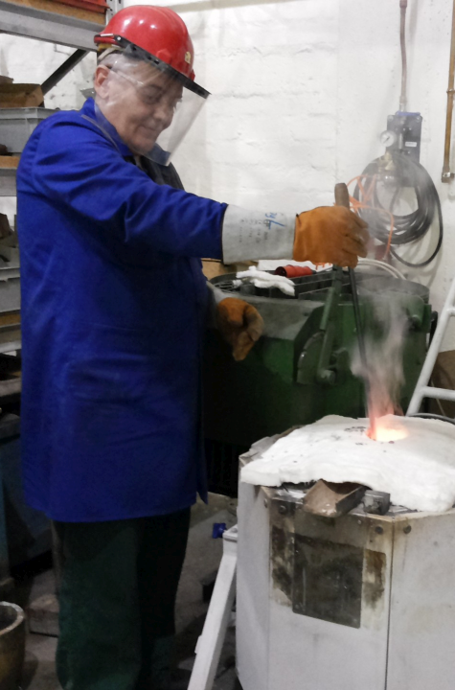
2. The major principles of dual education
„Dual students” study together with the regular ones during 13 weeks of the core period in a semester
The theoretical background of the curriculum is equivalent, which is complemented by special practical skills
The university is responsible for the content of the accredited curriculum
The period spent at the company must reach at least 80 % of the duration spent at the university.
Participating companies are continuously audited for quality in education and training
The contract between the student and the company can be cancelled by legal measures
There is a long-term cooperation agreement between the university and the partner company

Slide 10
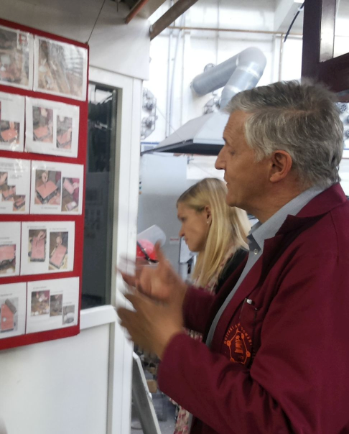
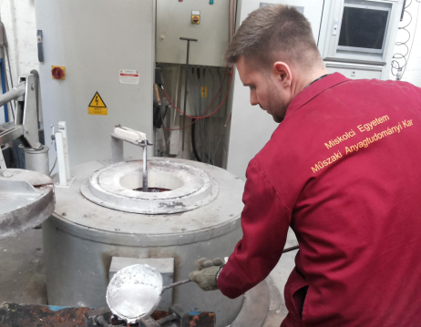
3. The major objectives
Providing well trained, directly employable young experts for companies for team and individual work;
Assuring excellent carrier potentials besides a competitive degree for the worthy students;
Developing education and training by the regular contribution of experts from the companies, providing special practical and soft skills;
Increasing attractivity of featured specialisations;
Strengthening the recognition and the recruiting potential of the university;
Fostering R&D ties and university-business relations;
Assisting the operational and human background of certain specialisations and departments.

Slide 11

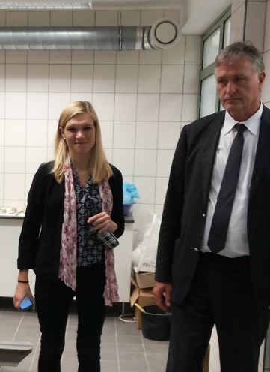
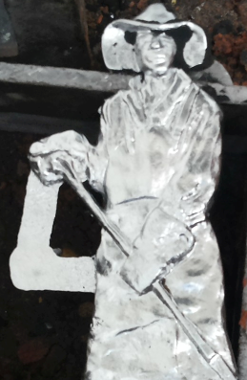
The pioneering method of higher education with increasing involvement of the business environment
Dual education

Slide 12
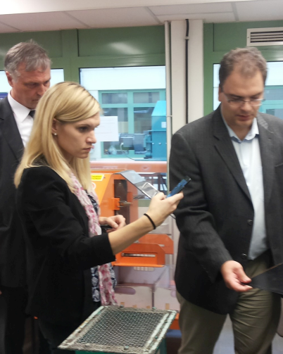
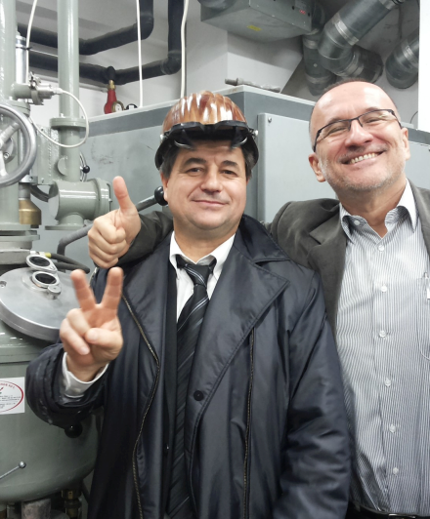
4. Dual education programs launched in 2015 by the UoM
Faculty | Specialisation | Partner companies
Economics | Business & management International business Accounting Trade & marketing Tourism & catering | 7 2 10 9 10
Mechanical Engineering | Logistics IT Software engineering | 2 14 10
Materials Sci. & Engg. | Materials Engineering w/specialisations: - Foundry Engineering, - Chemical and Physical Metallurgy, - Heat treatment | 20

Slide 13

Call released on popular social networks for dual study applications to the
Fac. Materials Sc.&Engg.
Currently available specializations
Vehicle foundry technology
Heat Treatment & Plastic Deformation
Metals Technology (Chemical met. & Surface tech.)
Polymer and Chemical Techn.

Slide 14



The promotion of one specialisation offered by the Materials Engg. BSc programme
Faculty of Materials Sci. & Engg., UoM

Slide 15








Theory and Practice in Cooperation…
„Engineering creativity” at the UoM
Internationalization is a novel resource!
Thank You for the attention

