Slide 1

The digital student impact on university governance
CC-BY-SA
Isabelle TURMAINE
INTERNATIONAL ASSOCIATION OF UNIVERSITIES

Slide 2
Outline
Today’s student
  Digital natives
  Lifelong learners
Latest developments in technology
  Bring your own device
  Learning analytics
Some issues for HEI’s governance
  Access and Accessibility
  Digital literacy
Questions for discussion

Slide 3
Today’s student
Digital native, Generation Z, iGen (following Generation Y and the Millennials):
  Definition: Born from the mid-90s. Widespread usage of the internet from a young age and interacting on social media websites for a significant portion of their socializing (source: Wikipedia)
  Impact: Cultural rather than technological shift
  Requirements:
    Students bring their own digital world expectations to HEIs
    One size fits one

Slide 4
Today’s student
Lifelong learning/learners, adult education, continuing education, knowledge work, personal learning environments:
  Definition: ongoing, voluntary, and self-motivated" pursuit of knowledge for either personal or professional reasons (source: Wikipedia)
  Impact: Changes in student cohorts
  Requirements:
    Flexible/ Short courses that respond to the needs of the labour market
    One size fits one

Slide 5

Latest developments in technology

Slide 6
Latest developments in technology
New Media Consortium Horizons Report: 2016 Higher Education Edition
  Identifies and describes developments in technology likely to have a large impact over the coming 5 years in education around the globe
  Research conducted by international (16 countries from all continents, Europe: Germany; Greece; Spain; UK) expert panel
  Highlights 6 key trends, 6 challenges, 6 developments
    Choice of 2 developments linked to students with time to adoption of one year or less

Slide 7
Latest developments in technology
Bring your own device
  Advantages:
    Reflects the contemporary lifestyle
    Reduces overall technology spending
  Issues to be addressed:
    Multi-support content (all devices including mobile phones)
    Security risks
    Equity issue

Slide 8
Latest developments in technology
Learning analytics
  Advantages:
    Improved pedagogies
    Personalized learning experience
    Student success
  Issues to be addressed:
    Security risks
    Ethical and privacy issues

Slide 9

Issues for HEI’s governance
By Calixtocapi (Own work) CC BY-SA 4.0

Slide 10
Issues for HEI’s governance
Access and Equity/Accessibility
  IAU Statement on Equitable Access, Success and Quality
    While universities should « Mainstream the assessment of prior and experimential learning as well as blended, distance and e-learning into the admission and credit accumulation processes »
    They should at the same time « Facilitate access to learning, respond to diverse learning needs and increase outreach by the appropriate and effective use of a variety of delivery modes »
    http://www.iau-aiu.net/sites/all/files/IAU%20Policy%20statement%20on%20Equitable%20access%20Final%20version%20August%202008%20Eng_0.pdf

Slide 11
Issues for HEI’s governance
Access and Accessibility
  Guidelines for Accessible Information (IAU and partners)
    With all documents for learning being firstly produced in electronic format and with an increasing number of information producers (including students);
    With an estimation from the WHO that 15% of the world’s population is having some sort of disability;
    Need for an easy to implement tool for practitionners to produce accessible information for learning from inception: The Guidelines. http://www.ict4ial.eu/

Slide 12
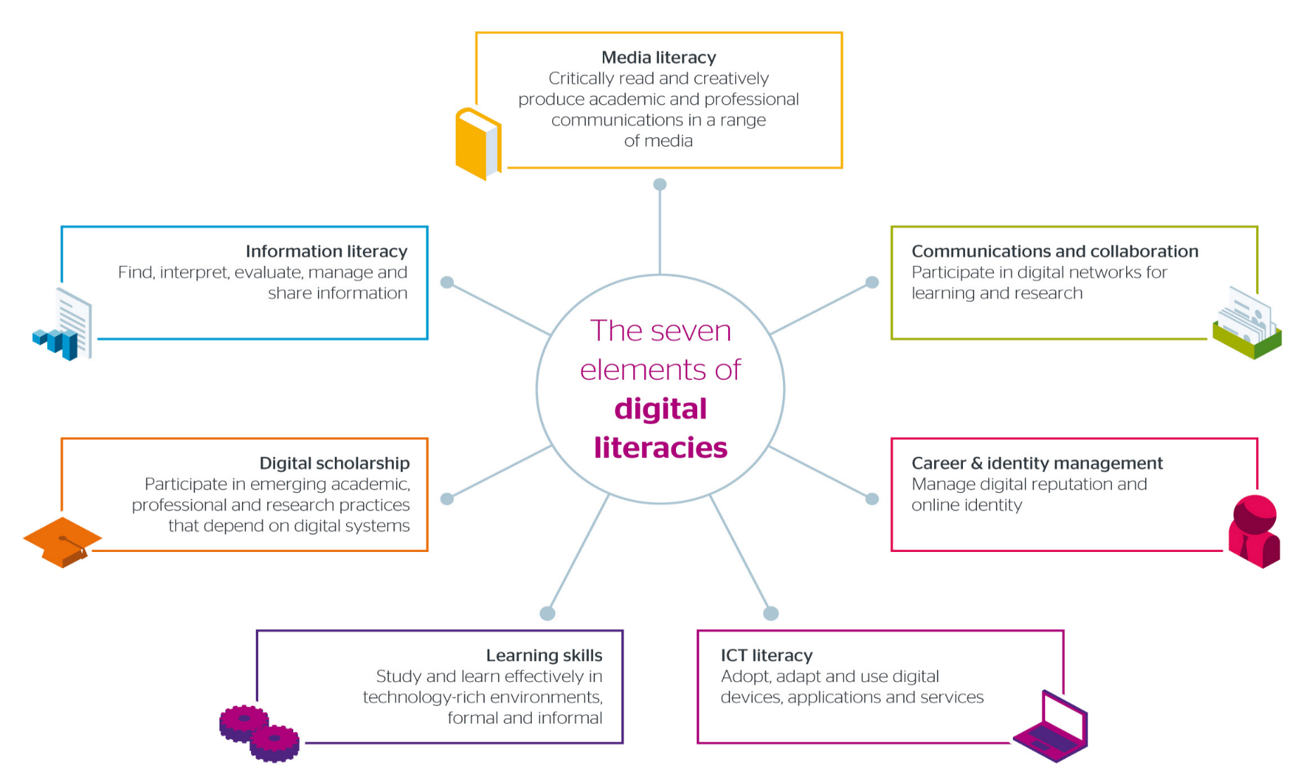
Issues for HEI’s governance
By Jisc CC BY-NC-ND

Slide 13
Issues for HEI’s governance
Digital Literacy
  Short definition: The knowledge, skills and confidence to use the available technology and devices to deliver the outcomes wanted.
  Today’s students know how to use their own device and social media for socializing well but seldom possess the skills to use ICT in a learning context in the most effective manner.
  Need to invest in training.

Slide 14

Questions for discussion
By Nevit Dilmen CC BY-SA 3.0

Slide 15
Questions for discussion
Have you adopted an ICT strategy with the aim to improve the student’s experience and learning outcomes?
  What is in your opinion the main improvement that can be brought by ICTs to your students?
  Do you measure it? What has worked well/ failed?
How does your institution engage with students in ICT matters?
  Are they given a role or a remit in the discussions on your institution’s ICT strategy?
  How does communication with students on ICT developments at your university work?

