Slide 1
On-line education
Carpathian Basin ~ Óbuda University

Slide 2
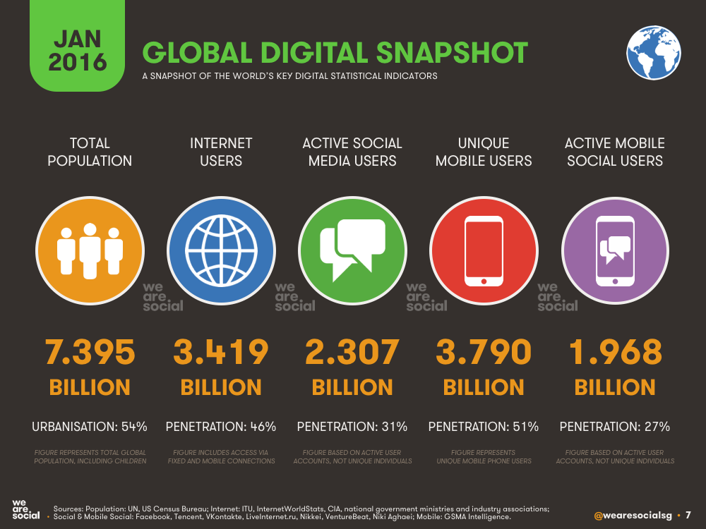
Introduction
MOOC
On-line education
K-MOOC

Slide 3
What is MOOC
?

Slide 4
MOOC
Massive
Mass education, more and more information
Open
All educational materials are available, free and without entrance requirements
Online
Computer or mobile access
Courses
Undergraduate and free courses

Slide 5
Educational technology revolution of the century

Slide 6
Why on-line
Learning hours : 0.5-1.5 h/d
University website/network: 0.5 h/d
  Social media 1-1.5 h/d
  University webpages 0.2-0.5 h/d
Information related to the curriculum:
  23.8% faculty / institute website
  15.9% of the Moodle system
87% search their classroom materials on electronic platforms

Slide 7
Cross-border activity
Make a carreer in homeland = EDUCATION
Help scientific carreer = CONFERENCIES, PUBLICATIONS
Connection to the motherland = JOINT EVENTS
Community and study possibillities for digital generation = K-MOOC

Slide 8
Óbuda University
K-MOOC
established a new center as a part of University Research and Innovation Center
Kárpát-Medencei On-line Oktatási Centrum
Center for On-line Education in Carpathian Basin
01. 09. 2014

Slide 9
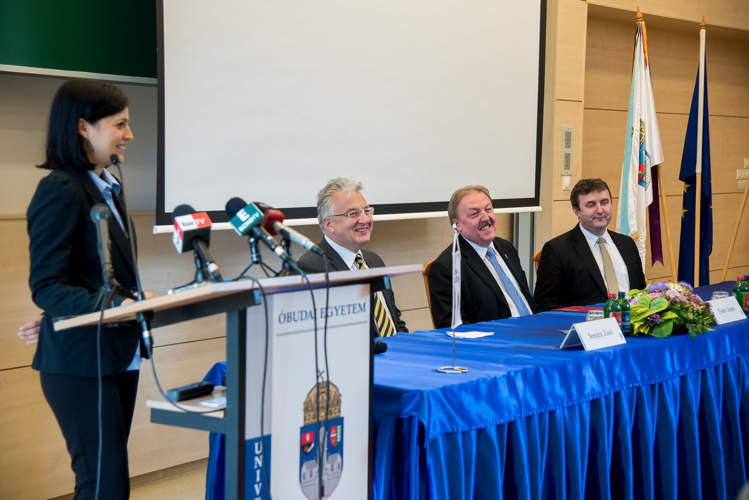
Start….

Slide 10
Mission
… offers Hungarian on-line courses – mainly for Hungarians in Carpathian Basin, and for the Hunagrian speaking people all over the world.
… supports a credit recognized educational system for all the higher education institutons who offer their courses in Hungarian
… provides a new form of Life Long Learning education
K-MOOC…

Slide 11
Goal
Serving all the Hungarian-language higher education institutes - particularly the cross-border institutes.
Institutions connected to the network can create and publish their own courses in all disciplines.
Students living outside the borders can feel being part of Hungarian Higher Education system.

Slide 12
K-MOOC without borders
Outside
Connections become alive.
Opportunities expand for the students.
Inside
Possible joint tender activities
Professional skills and experience exchange
Opportunities for cross-border community connection
A new dimension to the transformation of higher education

Slide 13
Joint universities and organizations
13 universities abroad, 16 Hungarian universities / colleges
11 supporting organizations
ienta Erdélyi M
Kecskeméti Egyetem
Gábor Dénes Főiskola
Szolnoki Főiskola
Miskolci Egyetem
Budapesti Műszaki Egyetem - megfigyelői státuszban
Budapesti Corvinus Egyetem
Szegedi Tudományegyetem
Nyíregyházi Főiskola
Apor Vilmos Katolikus Főiskola,
Szent István Egyetem,
Dunaújvárosi Egyetem,
Pécsi Tudományegyetem, Sárospataki Református Teológiai Akadémia,
Eszterházy Károly Főiskola, Eger,
Kodolányi János Főiskola, Fehérvár
Bhaktivedanta Hittudományi Főiskola
Sapienta Erdélyi egyetem dományegyetem
Újvidéki Egyetem, Magyar Tannyelvű Tanítóképző Kar, Szabadka
Babes-Bolyai Tudományegyetem, Kolozsvár
Marosvásárhelyi Művészeti Egyetem
Nyitrai Konstantin Filozófus Egyetem, Közép-Európai Tanulmányok Kara
Comenius Tudományegyetem, magyar tanszék, Pozsony
Selye János Egyetem, Révkomárom
Szabadkai Műszaki Főiskola
Vajdasági Magyar Tudományos Társaság
Strossmayer Egyetem, Eszék
Danubius Univerzity, Szlovákia
MÜFT Oktatási Központ, Székelyudvarhely
II. Rákóczi F. Kárpátaljai Magyar Főiskola, Beregszász

Slide 14
The beginning:
2014/2015/1 four pilot courses
Jazz cultural History I. 65 students
Introduction to Ergonomy 38 students
Basics of Pedagogy 71 students
Problem solving technics 97 students
Total : 271 students 113 non-OU 152 graduated

Slide 15
Development
Semester | Courses | Total registered | OU students | Graduated
2014/15/1 | 4 | 271 | 170 | 152
2014/15/2 | 9 | 551 | 374 | 228
2015/16/1 | 20 | 1346 | 764 | 479
2015/16/2 | 23 | 1524 | 958
Partners:
Dennis Gabor College
Eszterhazy Karoly University of Applied Sciences

Slide 16
Future
OU launched and operates the system.
The initial goal is only possible with collaboration of the institutions.
Encourage joint universities to make high-quality teaching materials.
Manage the Hungarian language speaking community cohesion.
Transfer knowledge - adapted to needs of digital generation.

Slide 17
Thank you for your attention!
osz@uni-obuda.hu

