Slide 1
EUROPEAN ASSOCIATION OF INSTITUTIONS IN HIGHER EDUCATION
EURASHE:
Role, Priorities & Opportunities
Hungarian UAS workshop
Budapest, November 23, 2016
Michal Karpíšek, Secretary General

Slide 2
MISSION & OBJECTIVES

Slide 3
EURASHE
EURASHE is the European Association of Institutions in Higher Education that offer professionally orientated programmes and are engaged in applied research within the Bologna cycles
EURASHE represents universities of applied sciences and university colleges; other members of EURASHE are national and sectorial associations of higher education institutions, and other individual institutions, such as universities
www.eurashe.eu

Slide 4
Mission
EURASHE’s mission is to promote, within the European Higher Education Area (EHEA), the interests of professional higher education and of relevant higher education institutions that are recognised or financed by the public authorities of a EHEA member country

Slide 5
Foundation & organisation
Founded in 1990 in Patras (Greece)
Secretariat located in Brussels (Belgium)
International not-for profit association under Belgian law (aisbl)
General Assembly (policy, strategy) > Board (executive) > Committee for Strategic Advice (advisory)
Working groups (development)

Slide 6
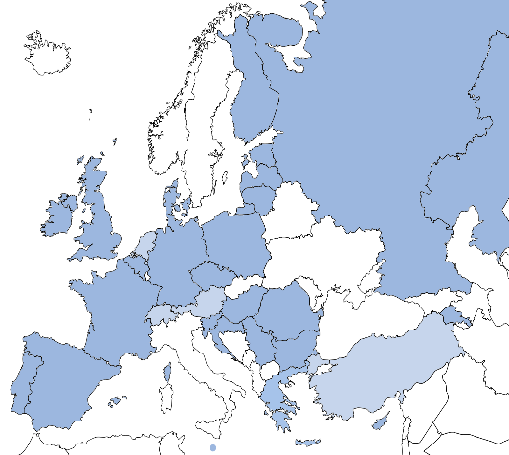
Membership
EURASHE represents universities of applied sciences and university colleges; other members of EURASHE are national and sectorial associations of higher education institutions, and other individual institutions, such as universities

Slide 7
Membership
Full membership: open to national associations of higher education institutions in the EHEA and higher education institution within the EHEA;
  49 full members: 14 national associations, 35 individual institutions
  Ex: Portuguese Polytechnics Coordinating Council (CCISP)
  Ex: Baden-Wuerttemberg Cooperative State University (DHBW)

Slide 8
PROFESSIONAL HIGHER EDUCATION

Slide 9
Professional higher education
Professional higher education is a form of higher education that offers a particularly intense integration with the world of work in all its aspects, including teaching, learning, research and governance, and at all levels of the overarching qualifications framework of the EHEA.
Its function is to diversify learning opportunities, enhance the employability of graduates, offer qualifications and stimulate innovation for the benefit of learners and society.
The world of work includes all enterprises, civil society organisations and the public sector. The intensity of integration with the world of work is manifested by a strong focus on the application of learning achievements. This approach involves combining phases of work and study, a concern for employability, cooperation with employers, the use of practice-relevant knowledge and use-inspired research.

Slide 10
Features of professional higher education
A strong link with the world of work & with enterprises
Close involvement of all stakeholders (including students)
Regional embedding of education& research
Practice-orientated & competence-based
Accessible and labour market-orientated
Flexible schemes and study programmes for new groups of learners, following new requirements of the labour market

Slide 11
Differences between PHEI & AHEI

Slide 12
Characteristics & Criteria
POLICY & STRATEGY | Policy and Strategy Integration
 | Objectives and Outcomes of PHE
 | Regional Integration
TEACHING & LEARNING | Methods of Curriculum Development
 | Learning Outcomes - WHY
 | Content for Teaching and Learning – WHAT
 | Learning Methodology - HOW
 | Learning Environment - WHERE
 | Programme Team –WHO
RESEARCH, DEVELOPMENT & INNOVATION (RDI) | RDI Agenda
 | RDI Process
 | RDI Outputs and Outcomes

Slide 13
Characteristics & criteria:
POLICY & STRATEGY
CHARACTERISTICS | DESCRIPTION | CORE CRITERIA
POLICY AND STRATEGY How is PHE embedded and represented in the overall strategic policies and framework of higher education institutions.
Policy and Strategy Integration | Integration of the world of work into policies and strategic framework | Institutional policies and strategies are defined in collaboration with the world of work.
Objectives and Outcomes | Main objectives in relation to the outcome of PHE | PHE specifically focuses on enhancing job related skills and competencies with a view to raising the employability of students. The emphasis is on learning outcomes and use-inspired research.
Regional Integration | Engagement with its regions and contribution to their development | PHE is strongly embedded in regional partnerships with the world of work.

Slide 14
Characteristics & criteria:
TEACHING & LEARNING I
CHARACTERISTICS | DESCRIPTION | CORE CRITERIA
TEACHING AND LEARNING How is teaching and learning influenced through the specific characteristics of PHE
Methods of Curriculum Development | Curriculum development refers to methods of learning design and development of curricula learning objectives and outcomes. | Curricula are developed by academia in collaboration with stakeholders, in particular from the world of work, taking into account the future needs of the practice and context of employment.
Learning Outcomes The Why | The learning outcomes refer to what a learner is expected to know, understand and be able to do as the result of a process of learning. | The learning outcomes reflect essential knowledge, skills and attitudes related to the specific professional requirements, but should not be limited to this. In addition, students acquire professional and life skills which enable them to act successfully, in an innovative and self-organised way in a changing work environment. The involvement of students in research, development and innovation activities leads them to better professional practice.

Slide 15
Characteristics & criteria:
TEACHING & LEARNING II
CHARACTERISTICS | DESCRIPTION | CORE CRITERIA
TEACHING AND LEARNING How is teaching and learning influenced through the specific characteristics of PHE
Content for Teaching and Learning The What | The content comprises working methods, practice examples, a syllabus and other materials. | The learning content is productively integrating theory and practice as the basis for complex problem-solving in real work situations. The content is informed by the latest research, trends and references from both the world of work and academia.
Learning Methodology The How | The learning methodology comprises: the learning design, the assessments needed to achieve the learning outcomes. | The learning methodology comprises methods of active, collaborative and self-organised learning and while focusing on experience based learning methods including but not limited to simulation based learning (SBL), scenario based learning (SceBL), problem based learning (PBL), or any other authentic learning situations. Both formative and summative assessments should reflect the nature and methodology of the specific PHE learning environment..

Slide 16
Characteristics & criteria:
TEACHING & LEARNING III
CHARACTERISTICS | DESCRIPTION | CORE CRITERIA
TEACHING AND LEARNING How is teaching and learning influenced through the specific characteristics of PHE
Learning Environment The Where | The learning environment refers to the surroundings and conditions in which learning takes place | The learning environment includes experience within Institutions as well as outside, in the world of work. Significant practice phases and/or job experiences serve to reflect theory in a practical context.
Programme Team The Who | The programme team refers to all persons involved in the design, delivery and assessment of learning, including visiting lecturers, professionals and support staff | At the programme level, the team shows a combination of academic background and relevant experience from the world of work.

Slide 17
Characteristics & criteria:
RESEARCH, DEVELOPMENT & INNOVATION
CHARACTERISTICS | DESCRIPTION | CORE CRITERIA
RESEARCH, DEVELOPMENT & INNOVATION (RDI) How are RDI integrated as part of a sustainable PHE, recognising that they might differ from level to level
RDI Agenda | The scope of the RDI activity | The RDI agenda is informed by the world of work in order to meet the needs of society and of the world of work.
RDI Process | The way RDI meets the needs of society and the world of work | Researchers seek and provide input from and to the world of work and value stakeholders’ requests and contributions. The RDI process respects the nature of the inputs and can include various types of research activities and scholarship.
RDI Outputs and Outcomes | The expected result of RDI | RDI outcomes aim to be relevant to the world of work, and society. In addition to traditional outputs, such as licenses, patents and publications, RDI outcomes are solution-oriented with tangible benefits for the world of work and society.

Slide 18
ROLE & PRIORITIES

Slide 19
EURASHE in the EHEA
Representation of professional higher education
Contribute towards policy formulation and development processes within EU (ET2020)
Consultative member of the Bologna Follow-up Group (BFUG) since 2001
  Engagement in BFUG working groups
Member of the ‘E4-Group’ (ENQA, ESU, EUA and EURASHE)
Founding member of EQAR
Key partner in UAS4EUROPE initiative
Close consultation with EQF, ESCO

Slide 20
EURASHE policy documents
Making European Professional Higher Education a Key Player in the Development of a Fastly and Unpredictably Changing Society
    EURASHE policy paper, 2015, EHEA Ministerial Conference
    http://www.eurashe.eu/library/eurashe_making-european-phe-a-key-player_apr2015-pdf/
Modernisation of Higher Education as part of the ET 2020 Agenda of the European Commission – EURASHE position paper
    EURASHE position paper, 2016
    http://www.eurashe.eu/library/eurashe_position_modernisation_agenda_et2020-pdf/
UAS4EUROPE: Smart Partnerships for Regional Impact
    UAS4EUROPE position paper, 2016
    http://www.eurashe.eu/library/uas4europe_paper_smart-partnerships-for-regional-impact_may2016-pdf/

Slide 21
EURASHE policy framework
Mission of PHE
Role & Position
Characteristics
Social Dimension
Modernising PHE
Employability
Lifelong Learning
Qualification Frameworks
Recognition of Prior Learning
Student Centred Learning
Methods & Student Assessment
Mobility
Research, Development and Innovation
Applied Research Promotion & Specifics including
Innovation of Professions
Innovation of Teaching/Learning
Regional Development
Quality of HE
Accreditation & Evaluation
Quality Management & Enhancement
Transparency Tools

Slide 22
EURASHE actions themes & working groups
Mission of Professional Higher Education
  Working group on the Mission of Professional Higher Education
Quality of Higher Education
  Working group on Quality of Higher Education
Modernising Professional Higher Education
within diversified Higher Education
  Working group on Employability & Lifelong Learning
Research, Development and Innovation
  Working group on Research, Development and Innovation
  +

Slide 23
Projects’ themes
ESG promotion and implementation (EQUIP)
PHE policy development in Central and South-Eastern Europe (PROCSEE)
a self-reflection tool for professional HEIs (BuildPHE)
models of strategic alliances with world of work (BEEHiVES)
teaching excellence (TEACHEX)
integrating entrepreneurship and work experience (IEWEXHE)
supporting apprenticeships in higher education (SAPS)
cooperation for innovative capacity in South-East Asia (TACTIC)

Slide 24
Emerging themes
Identity of PHE, concept of UAS
Excellence in teaching & learning
Flexibility and permeability of HE (and VET) including WBL, RPL
Mapping short cycle HE integration
Supporting research capacity at UASs
Impact of UAS/PHE on knowledge exchange & regional development

Slide 25
MEMBERSHIP

Slide 26
Members’ added-value
Lobby and advocacy towards European and national authorities
Contributing to, endorsing and sharing European policy
Forming own future by strengthening of members’ voice
Information on latest trends and evolutions within EHEA and ERA
Networking: innovative projects, international events, round tables, finding experts, debating on our social media, participating or hosting international events
Capacity building and support for the implementation of PHE – profile characteristics and policies
Peer learning: workshops and seminars
Offering expertise and promotion of own experience and institution

Slide 27
Membership
Associate membership: open to international sectorial associations of higher education institutions within the EHEA;
  1 associate member
Affiliate membership: open to recognised individual higher education institution and associations of higher education institutions outside the EHEA; institutions of higher education or national associations of higher education institutions within the EHEA that do not meet all full membership criteria; as well as any other bona fide organisation active in the field of higher education worldwide.
  8 affiliate members: 5 individual institutions outside the EHEA, 3 bona fide organisations

Slide 28
EURASHE outside the EHEA
EURASHE believes partnership and cooperation with other regions in the world are important
Relationships with countries outside the EHEA through associate membership, partnership agreements, and cooperation with other countries in the world such as Canada, the United States of America, China (Macau) and regions such as Central Asia, South-East Asia, Northern Africa and the Middle-East

Slide 29
ACTIVITIES

Slide 30
Activities
Primary focus on policy development
Commitment to higher education research with emphasis on professionally-oriented segments
Involvement in innovative & interesting projects
Organisation of annual conferences, thematic seminars & tailor-made events for members

Slide 31
EURASHE as policy-maker
Contribute to further elaboration of professional higher education adopting common policy statements (press releases, communications, position papers…) on
  Mission of professional higher education: mission and role of professional higher education, entrepreneurship, university-business cooperation
  Quality of higher education: quality assurance, accreditation, transparency tools, evaluation, rankings, labels, European Standards and Guidelines (ESG)
  Modernising professional higher education: lifelong learning (LLL), mobility, employability, qualifications frameworks, recognition of prior learning (RPL), learning outcomes (LO)
  Research, development and innovation: universities of applied sciences (UAS), innovation, regional development, knowledge transfer

Slide 32
EURASHE working groups
Working groups engaged in the development of policies
EURASHE working groups
  systematically lead research on our priority topics,
  analyse the current situation of higher education,
  actively develop and formulate policy positions on their area of expertise
  represent and further promote policy on behalf of professional higher education

Slide 33
EURASHE events
Annual Conferences (Le Havre 2017, Belgrade 2016)
Tailor-made events for members, Hands-on QA seminars, Annual LLL seminars, Seminars on ‘Bologna’ topics (Brussels 2017, Bratislava 2016, Seville 2016)
Statutory bodies and internal working groups’ meetings (3-4 times per year)

Slide 34
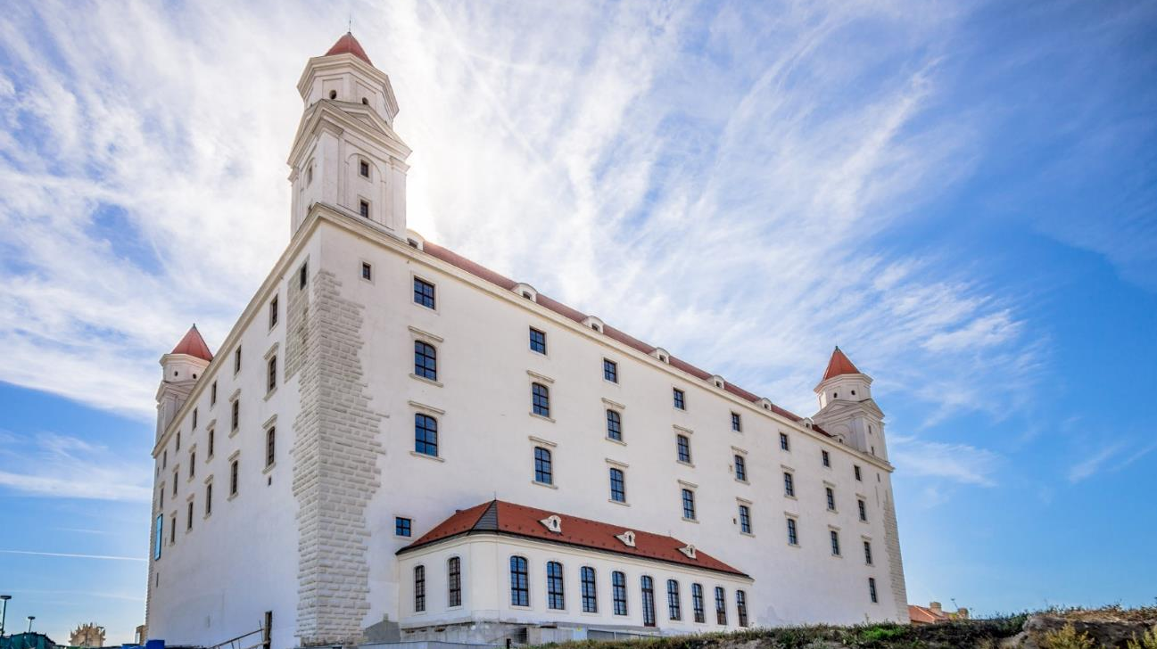
Higher Education as a Driver of Regional Development
6-7 December 2016, Bratislava, Slovakia
www.eurashe.eu/bratislava-regional

Slide 35

EURASHE 27th Annual Conference
PHE 4.0: A Change for UAS
30-31 March 2017, Le Havre, France
www.eurashe.eu/lehavre

Slide 36
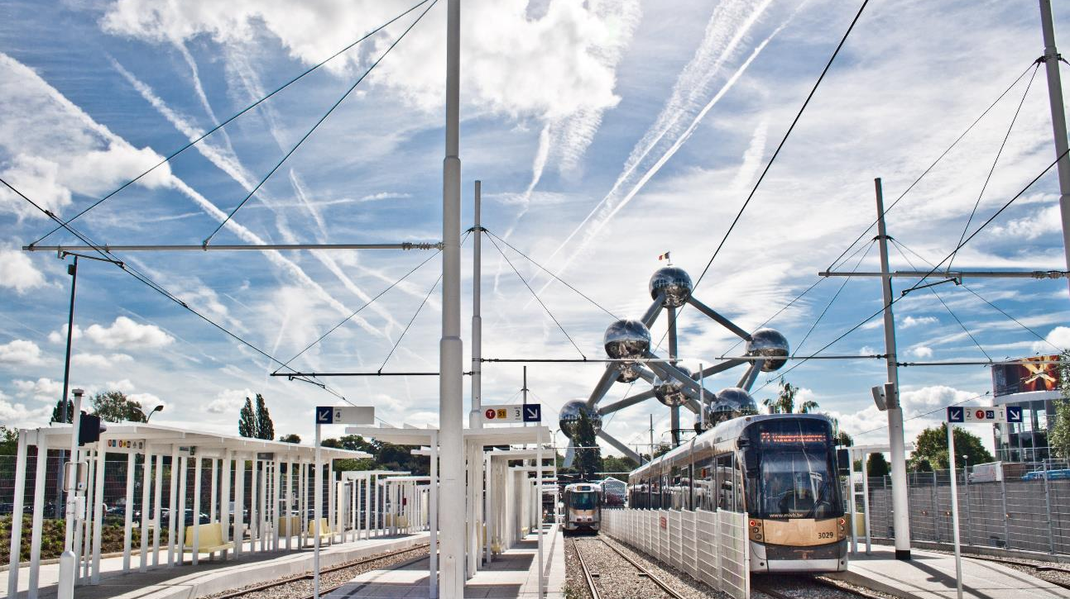
Managing your institution’s quality with the latest practices and policies 6-7 February 2017, Brussels, Belgium
www.eurashe.eu/brussels-qa

Slide 37

Conference ‘UAS4EUROPE’
15 March 2017, Brussels, Belgium
www.eurashe.eu/brussels-uas4europe

Slide 38
Thank you for your attention!
Michal Karpíšek
Secretary General
michal.karpisek@eurashe.eu
www.eurashe.eu

