Slide 1
(1) Alignment of PHE/HVET with regional/local development strategies
PROCSEE
NATIONAL PRIORITY STATEMENT
regarding the
Hungarian Professional Higher Education (PHE)
Prof. Dr. László Dinya

Slide 2
MAIN ISSUES
Global – national – regional context
Challenges of Hungarian PHE
Conclusions

Slide 3
1. Global – national – regional context
Hungary is facing the serious multiple challenges of the so called “innovation economy” (the 4-th industrial revolution) and its regions are affected by these challenges in a different way depending on their recent positions. There is an ongoing demand for local (regional) innovative answers to these challenges based on local (regional) knowledge centres, because regions have to find their relevant “good practices” instead of the universal (and locally not relevant) “best practice”. It means a new mission for HEI-s in their regions and they have to rethink their former portfolio of knowledge services, regional networking practice, participating in building up regional “triple – quadruple - quintuple helix” type collaboration in the interest of developing the regional competitiveness.

Slide 4
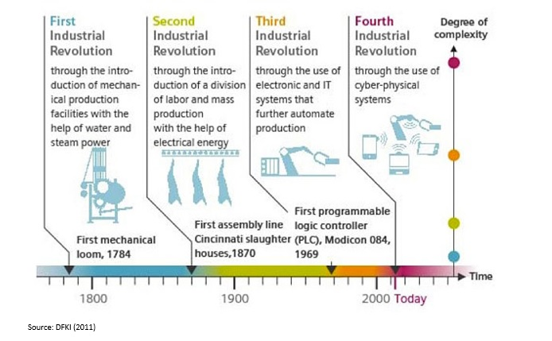
Continuosly changing demand for knowledge services!
= Innovation economy
= Digital economy
= Knowledge economy
= Network economy

Slide 5
2. Challenges of Hungarian PHE
Establishment of institutional and operational regional relationships with stake-holders
Coordinated cooperation among competing HEIs
Participation of HEIs as knowledge-centres in managing regional development strategies
Involvement of HEIs in socialization of regional development strategies
Harmonizing dual education and regional development strategies
Involving stake-holders in the elaboration of institutional development strategies of HEIs
Social responsibility of HEIs in the regional sustainability paradigm exchange
Participation of HEIs at establishing and operating regional knowledge and innovation networks

Slide 6
3. Conclusions
The thematic field is in "developing" phase generally having significant internal differences recently.
Evaluating the 8 challenges:
- Developing stages: at the 1 – 2 – 4 – 7 – 8 challenges
- Early stages: at the 3 – 5 – 6 challenges
Possible strategic tasks:
Development of institutional culture / organization / knowledge services / knowledge management practice
Stimulating the changes of institutional environment (legal / financial / economical / cultural)
Redefining regional mission of HEIs

