Slide 1

UP Cooperation in Mathematics with Hungarian Universities
Univerza na Primorskem
Fakulteta za matematiko,naravoslovje
in informacijske tehnologije
Glagoljaška 8
SI-6000 Koper
Slovenija
+386 (5) 611 75 70 (tajništvo)
+386 (5) 611 75 75 (referat za študente)
info@famnit.upr.si
referat@famnit.upr.si
www.famnit.upr.si

Slide 2
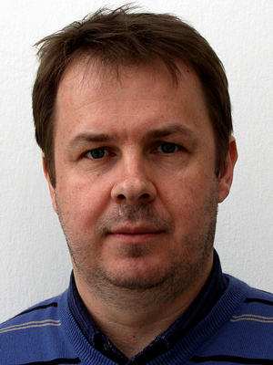
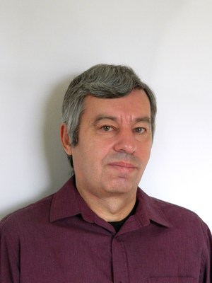
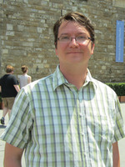
HU Mathematicians working at UP:
István Kovács (2004 – )
Associate Professor
György Kiss (2015 – )
part time
János Ruff (2015)
postdoc position

Slide 3
The cooperation of this research group with our Hungarian colleagues has started in the end of 1990s.
Since then several visits have taken place in both directions in the framework of Slovenian-Hungarian Intergovernmental Scientific and Technological Projects.
The focus was always on algebraic methods applied to graph theory and (finite) geometry.
This collaboration led to several joint papers and we had fruitful discussions about many other papers.

Slide 4
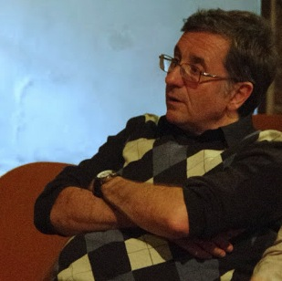
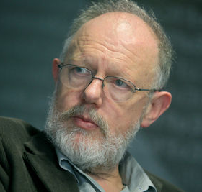


Joint Research Project:
Graphs, Groups, Configurations and Geometries
2015 – 2018
Leaders:
Tamás Szőnyi (ELTE)
Tomaž Pisanski (UP)
Financed by ARRS and “OTKA”.
Project members from University of Szeged, University of Pécs and Eötvös Loránd University via MTA-ELTE Geometric and Algebraic Combinatorics Research Group supported by the Hungarian Academy of Sciences.

Slide 5
Several Slovenian-Hungarian collaborative events
– in 2017 for the third time, with a broader international spectrum –
The list of the last three events:
Finite Geometry Workshop 2017, Szeged, April 28 – May 1, 2017
Geometric and Algebraic Combinatorics Workshop in Pécs, Pécs, May 5-9, 2016
Workshop on Galois Geometries and their Applications, Pécs April 16 - 19, 2014

Slide 6

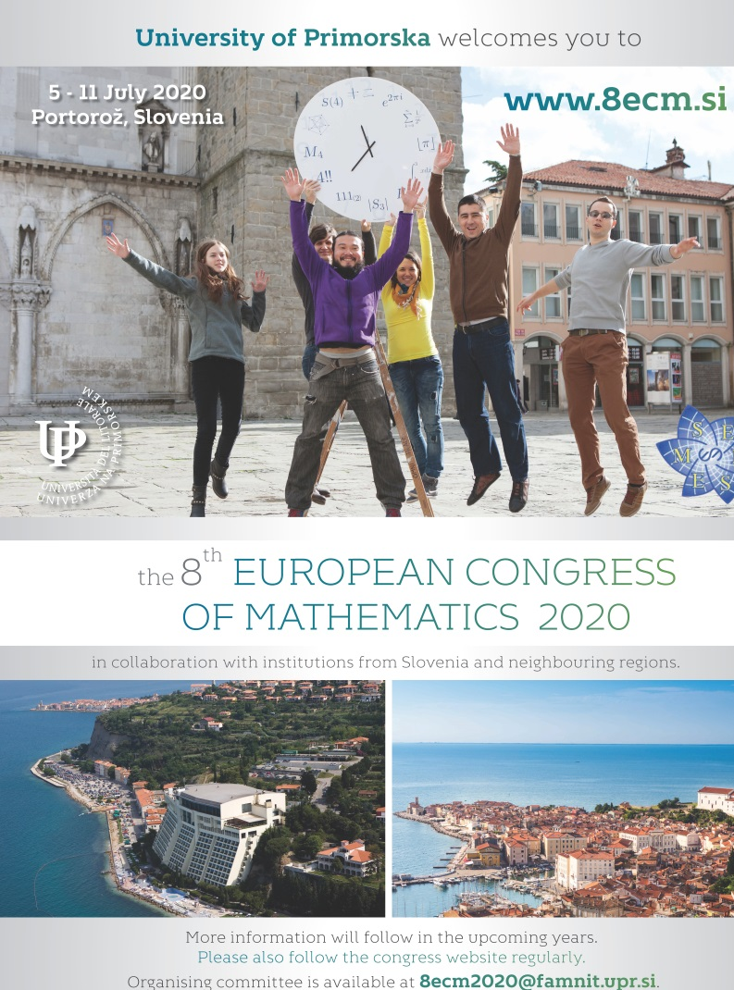
8th European Congress of Mathematics 2020
Between 5th and 11th July 2020, we will host the 8th European Congress of Mathematics.
More than 1,000 mathematicians are expected to participate.
Tomaž Pisanski (Organizing Com. Chair)
Dragan Marušič (Local Program Com. Chair)
ORGANISING COMMITTEE EXTENDED BY:
Tamás Szőnyi, Eötvös Loránd University

Slide 7
A D A M
Collaboration in Editorial Board of a new, purely electronic journal The Art of Discrete and Applied Mathematics (ADAM). First volume will appear in 2018.
Editors In Chief:
Dragan Marušič and Tomaž Pisanski
An offspring journal to SCI journal
Ars Mathematica Contemporanea.

Slide 8

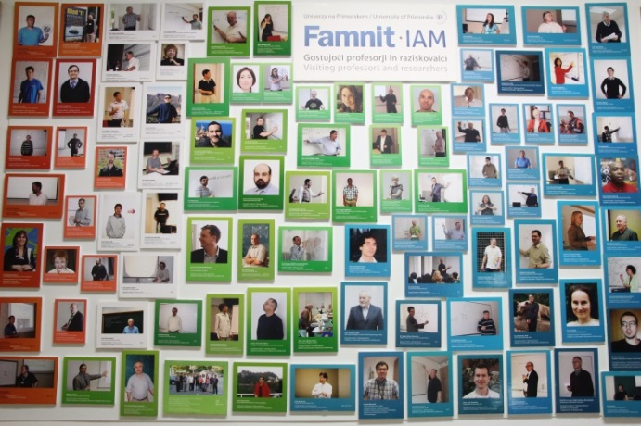
MATH Cooperation in teaching
Active Erasmus+ agreements with
University of Szeged
University of Pécs
Eötvös Loránd University
Mobility of students and staff.

Slide 9
Thank you!

