Slide 1

A Higher Education Model
Prof. Dr. András Patyi
Rector
National University of Public Service
„University of co-operation”

Slide 2
Special Higher Education (HE) Model
Reflect special policy expectations:
Government supervision | Extra-obligations | Institutional decision-making
Certain extent of autonomy | State funding | Special student status
What are the general policy expectations in HE?

Slide 3
General policy expectations in HE
Reflect social and economic sector requirements;
Develop learning skills, open-mindedness;
Motivate students towards specific professional career;
Train future leaders;
Prepare student for mobility challenges.

Slide 4
Special expectations in public service I.
In broad sense
Any profession
Emphasis on
public interest
public values
professional rules
ethical objectives
In narrow sense
Executive branches of public governance
military service
police and law enforcement
public administration
public diplomacy
Target area for all students and for all universities

Slide 5
Special expectations in public service II.
Common features:
executive power;
enforcement of government policy;
use of legitimate force.
Do they need special knowledge?

Slide 6
National HE models for Public Service
Military academies
Police colleges
Public administration faculties
National institutes
Agencies or gov. units for further education and training
Why was it necessary to change the model?

Slide 7
Post 2000 We live in a VUCA world…
                Volatile
                Uncertain
                Complex
                Ambiguous
Governments face new challenges and growing expectations

Slide 8
Security challenges
Top global risks: /WEF GRR 2017/
    (1) extreme weather events; (2) large scale immigration;
    (3) major natural disasters; (4) large scale terrorist attacks;
    (5) massive incident of data fraud; (6) water crisis
Increasing responsibility of governments for:
  external security; counter terrorism;
  climate and water policy; disaster prevention;
  fighting corruption; improve competitiveness
  How do national HE institutions react to these changes?

Slide 9

Our response: the NUPS model
2010 – new Government
First proposal: the idea of NUPS.
2011 – Reform Plans: for public administration, law enforcement & police and military

Slide 10

Foundation
2012 – New University was founded with the integration of
  Military Higher Education since 1808
  Policing and Law Enforcement HE since 1971
  Public Administration HE since 1977
  Continuing Education of Public Servants since 1990
  What were the reasons and objectives to establish the NUPS model?

Slide 11
NUPS model: Guidelines and objectives I.
1) Integrated concept of capacity building and development for government executive branches
Strategic governance of 4+1 ministers at NUPS
Strategic and direct linkage to the needs of public service
Exclusive BA and MA programs
Special Funding system
2) Comprehensive Approach
Learning common areas together! common curricula (one semester) and joint special exercise for all students
Interdisciplinary view: Science of public governance: trans-disciplinary approach
Good Governance Report since 2015
Cross-cutting R& D topics: from the modern state-building to digital agenda

Slide 12
NUPS model: Guidelines and objectives II.
3) Better alignment with public service carrier paths
Compulsory Further Training System for all public servants
Re-training for military and police HR cross mobility in public service
4) Efficient management of public resources
Integration of resources > one capacity for nation-level services
Exploiting synergies - more efficiency
Melting academic and non-academic potentials
Cutting public finances

Slide 13
NUPS model: Guidelines and objectives III.
5) To be the best in cooperation – “Win-Win together”

Slide 14
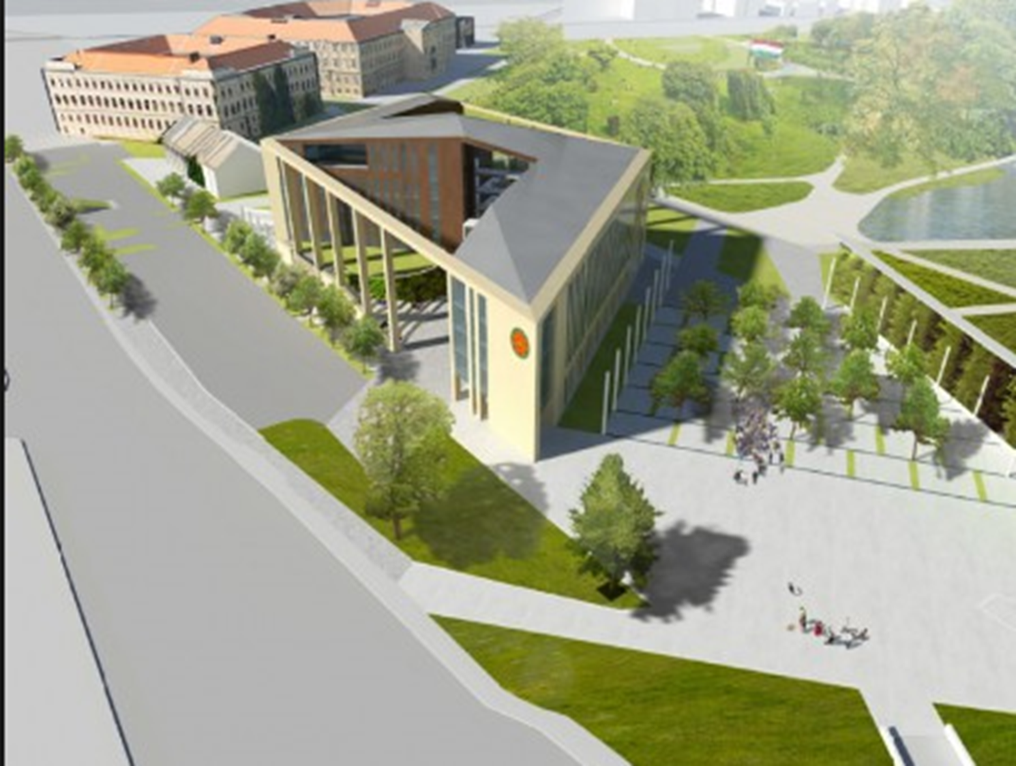
THANK YOU FOR YOUR ATTENTION!

