Slide 1
Riding on the Wind -
A Study of the Impact of Governmental and Environmental Factors on the Organizational Culture of a Hungarian Business School
Prof. Balázs HEIDRICH
Rector

Slide 2
Central-European Perspective
Standardized Soviet system can be considered an extreme version of the Napoleonic model (Charle 2003, Karády 2005)
Reforms started simultaneously after the change of the regime (within considerably unstable legal and normative frameworks)
Consonance of post-socialist countries gradually disappeared- different historical traditions (Leisyte, 2014)
Humboldtian roots, such as the Czech Republic,Poland and Hungary, then diverged…

Slide 3
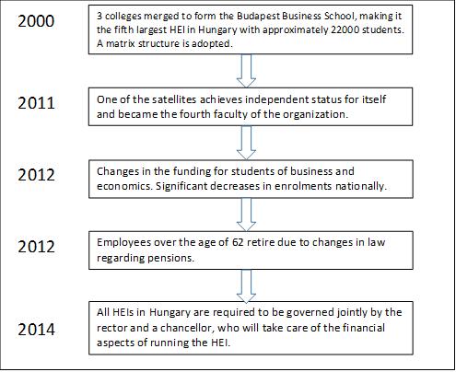
Key changes in Hungarian higher education
(BBS perspective)

Slide 4
Profile: The Budapest Business School
Formed by the merging of three Colleges in 2000
Current structure: matrix format
The sixth largest Higher Education Institution in Hungary- Largest business school
2016- University of Applied Sciences

Slide 5
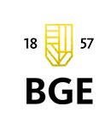

UNIVERSITY OF APPLIED SCIENCES
New era – double loop learning (how?- WHAT!)
”Most organizations die not because they do the wrong things, but because they keep doing what used to be the right things for too long…” (Doz- Kosonen: Fast Strategies)

Slide 6
BUDAPEST BUSINESS SCHOOL STRATEGIC GOALS (2016-2020)
Entrepreneurial University
Internationally acknowledged University (CEE)
Experience based learning environment
Socially responsible University

Slide 7
Longitudinal research (2011-16) with
Organisational culture assessment instrument (OCAI) – Competing values framework
Cameron and Quinn (1999)

Slide 8
Decomposition of organizational culture

Slide 9
BBS Sample
Occupation | 2011 |  | 2016
 | n | n % | n | n %
lecturer, teacher, researcher | 138 | 41.57% | 149 | 37.25%
support staff, administration | 152 | 45.78% | 186 | 46.50%
lower / middle management | 33 | 9.94% | 17 | 4.25%
top management | 9 | 2.71% | 48 | 12.00%
Total | 332 | 100% | 400 | 100%

Slide 10
Cultural values in 2011
(Subcultural clusters by OCAI means)
The way as members would see the organization (values)
5 subcultures by clustering (Ward’s method)
2011 |  | As it is currently seen |  |  |  | n
 |  | Clan | Adhocracy | Market | Hierarchy
As it should be (preferred values) | Market | 21,83 | 20,63 | 26,04 | 31,5 | 140
 | Clan | 24,86 | 23,96 | 24,32 | 26,87 | 84
 | Hierarchy | 26 | 15,57 | 22,91 | 35,51 | 34
 | Hierarchy (dom) | 24,89 | 10,78 | 21,66 | 42,67 | 30
 | Clan (dom) | 37,94 | 17,76 | 18,62 | 25,69 | 44

Slide 11
Cultural values in 2016
(Subcultural clusters by OCAI means)
The way as members would see the organization (values)
6 subcultures by clustering (Ward’s method)
2016 |  | As it is currently seen |  |  |  | n
 |  | Clan | Adhocracy | Market | Hierarchy
As it should be (preferred values) | Hierarchy (slight) | 21,46 | 18,09 | 24,38 | 36,07 | 61
 | Clan (dom) | 38,88 | 14,35 | 18 | 28,78 | 24
 | Market (slight) | 21,12 | 19,52 | 25,64 | 33,12 | 144
 | Clan (slight) | 26,83 | 19,7 | 23,56 | 29,91 | 62
 | Market-hierarchy | 17,42 | 15,16 | 30,95 | 36,47 | 21
 | Adhocracy (dom) | 23,55 | 20,7 | 22,88 | 32,87 | 36

Slide 12
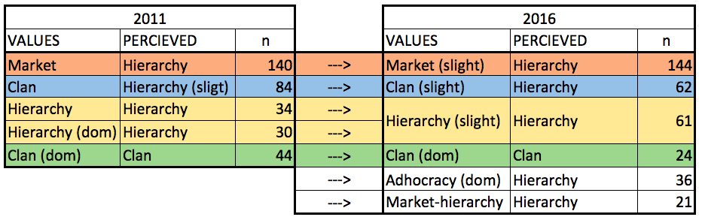
Values and perceptions

Slide 13
Conclusions
Hard as a rock- hardly changing on the organizational level
Subcultures: We are family! - no Welcome to the machine…
Even though the staff has changed significantly!!
”Culture eats strategy for breakfast” (P. Drucker) ☺
Passing of values to newcomers?

Slide 14
Thank you for your attention!

