Slide 1
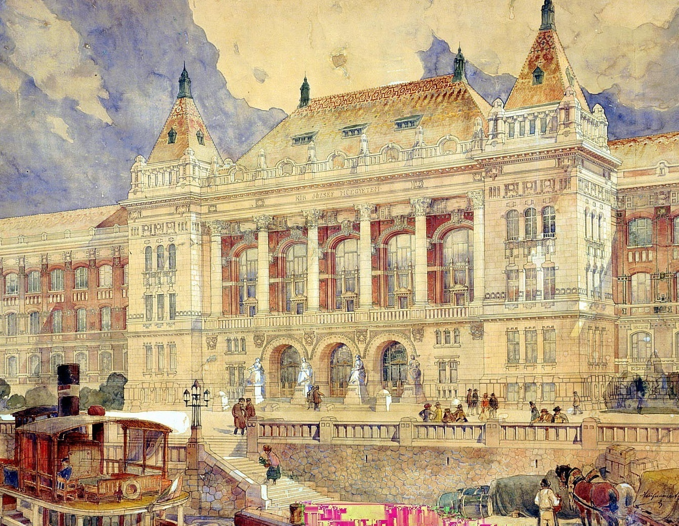
Combining Education and Research in Engineering -
the Budapest experience
Prof. János Józsa, rector (rektor@mail.bme.hu)
Budapest University of Technology and Economics (BME)

Slide 2
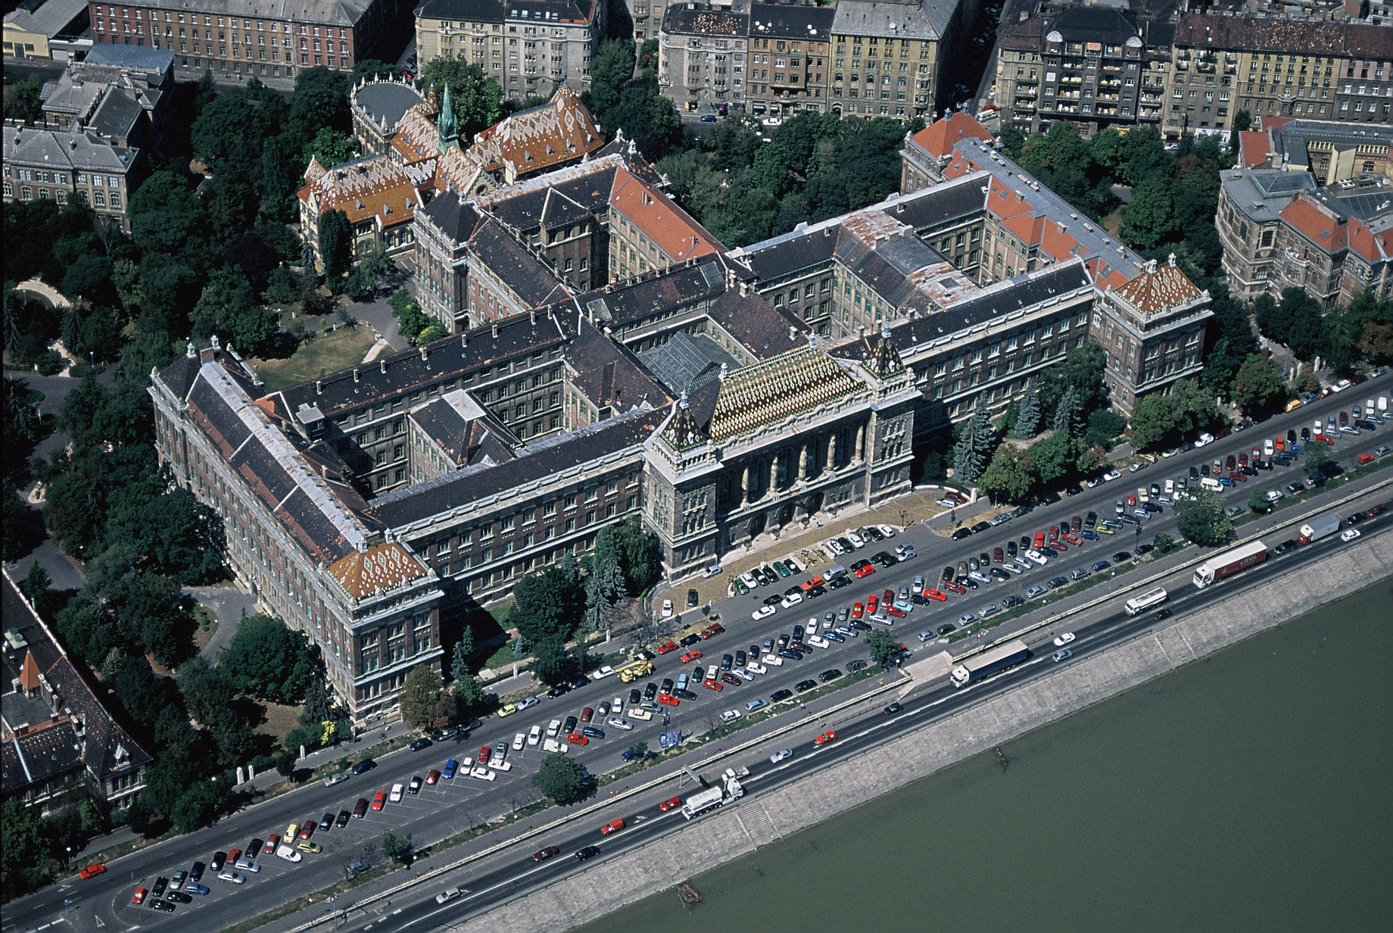
2
Notes:
Central Building of the University (designed by A. Hauszmann, 1909)

Slide 3
Main university features
Center of excellence type of education, but mass education is not avoidable, either
Research University, country leading in engineering science
International rankings: falling in the uppermost 2-5%

Slide 4
BME in Figures
Institutum Geometricum-Hydrotechnicum
. . . . .
1949 - 2000 Technical University of Budapest
2000 - Budapest University of Technology and Economics
8 Faculties 78 Departments
24,000 Students (BSc, MSc, PhD)
1,500 Academic staff members
Faculties:
Civil Engineering (1782)
Mechanical Engineering (1871)
Architecture (1873)
Chemical and Biotechnology (1873)
Electrical Engineering and Informatics (1949)
Transportation Engineering (1951)
Natural Sciences (1998)
Economic and Social Sciences (1998)
4

Slide 5
International Students at BME

Slide 6
Education and Research in Engineering
A university of technology and economics
Education and lab-, field and computer-intensive research have to go in general hand in hand
In-house research and industry-based R&D&I
Exploratory research
Applied research and innovation

Slide 7
Education and Research In what age to start?
A new initiation in 2015: Children University
Summer school for 7-10 and 11-14 years old primary school children
Week-long education, including lectures, lab and project work in teams, with final presentation
In 2015 2x300 children, in 2016 2x400 children
Own website, 2017 is already fully booked up

Slide 8
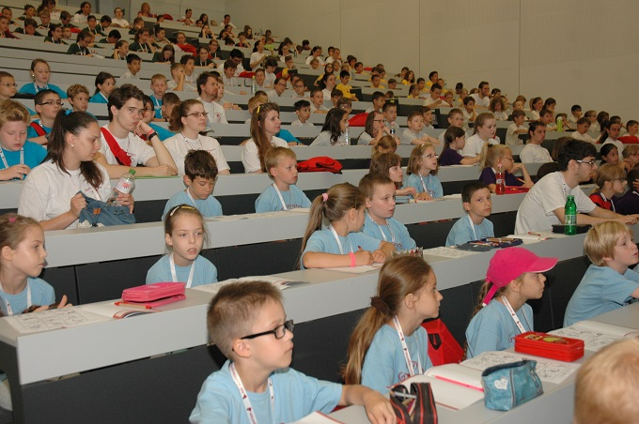
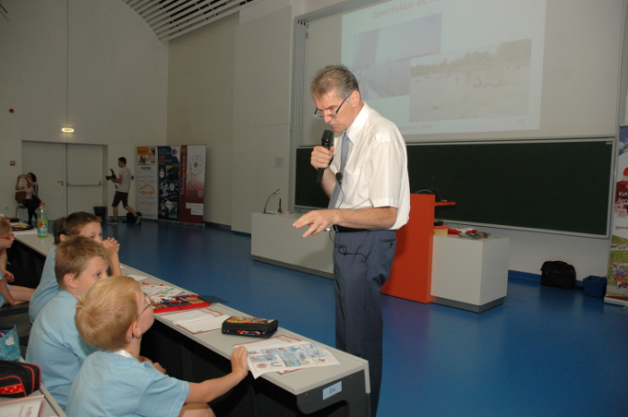
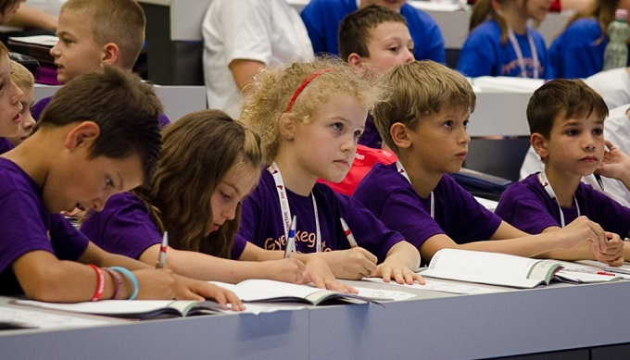
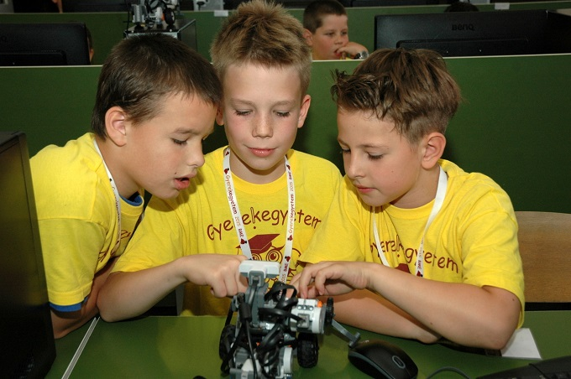
Look at those open minded faces!

Slide 9
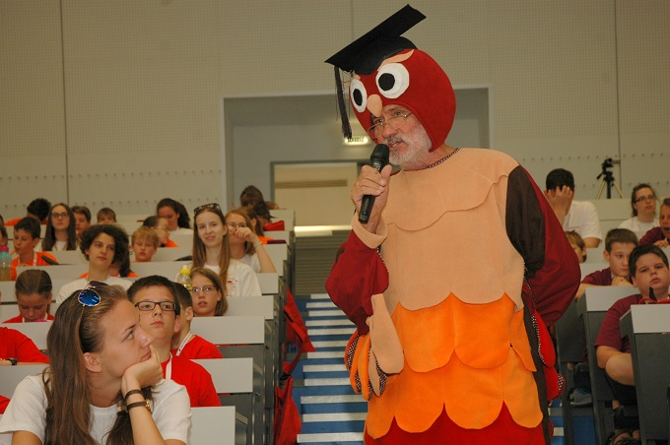
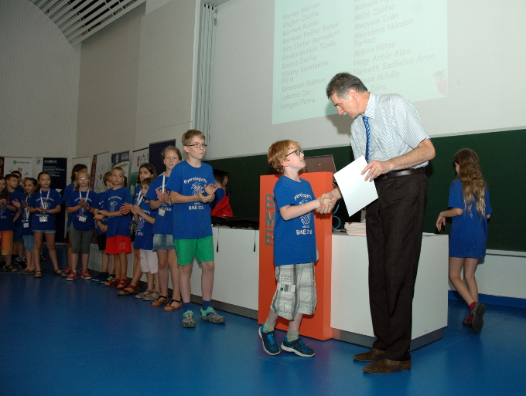
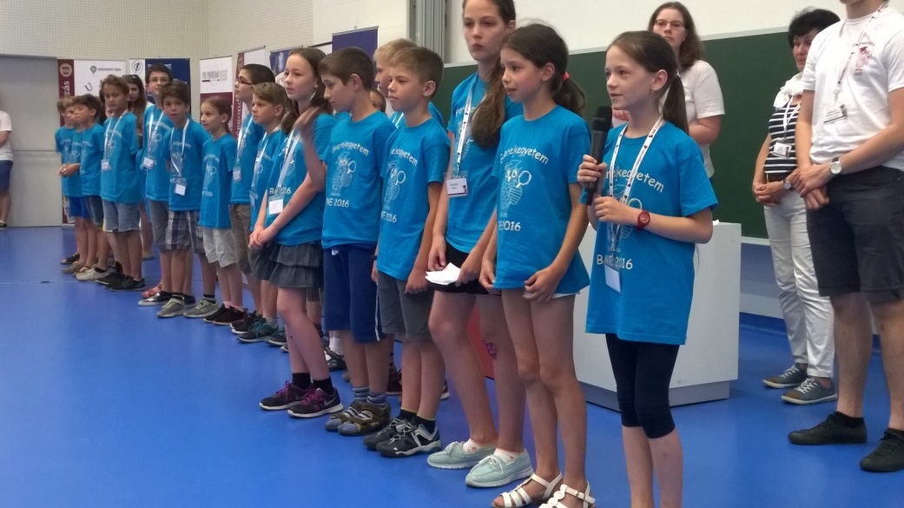
The wise owl Final presentation Graduation ceremony

Slide 10
Next level: Secondary school age
Looking for future students talented to research
University Talency Council in key role
Cooperation with nearly thirty secondary schools
Introductory lectures to natural science, lab visits
Recruiting people for engineering, talented to do research in engineering science

Slide 11
When at University: the offered framework is the „Scientific Student Circle”
SSCs with nearly 60 years history in the Hungarian Higher Education
Talency management
Fitting to the Bologna system
Do we need SSCs at BSc level? Yes, we do!
Can we handle BSc and MSc jointly in that? Yes we can!

Slide 12
Scientific Student Circles at MSc level
Enhanced involvement in ongoing research projects
More and more individual research tasks
Supervision with more and more freedom
Scientific Student Conference once a year in a great number of sessions, with nearly thousand students and 600 presentations a day
The best ones go to national level and publish paper

Slide 13
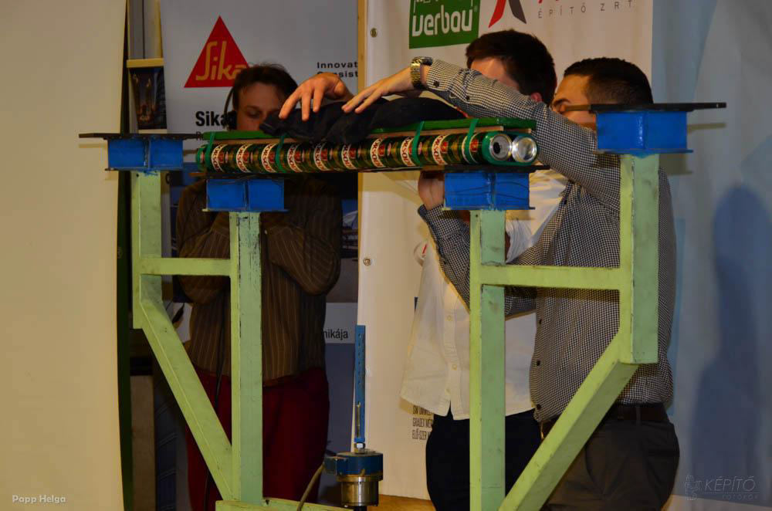
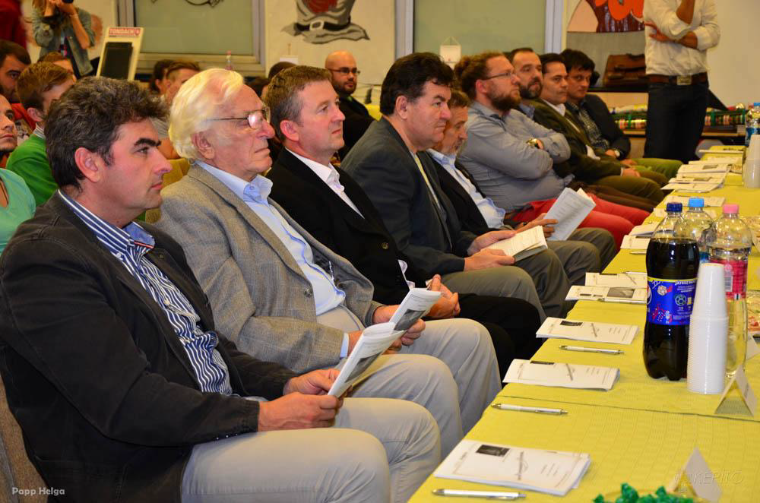
Special event: bridge design and construction competition

Slide 14
From Scientific Student Circles to PhD studies
SSCs are the primary pool to recruit PhD students
Capacity building for academic staff (both teaching and research) and for R&D&I companies
Research achievements converted to teaching material (both classical and e-learning type)
That’s how all this works, hoping that one day the kids of our doctoral students come also to our Children University, making all the process cyclic

Slide 15
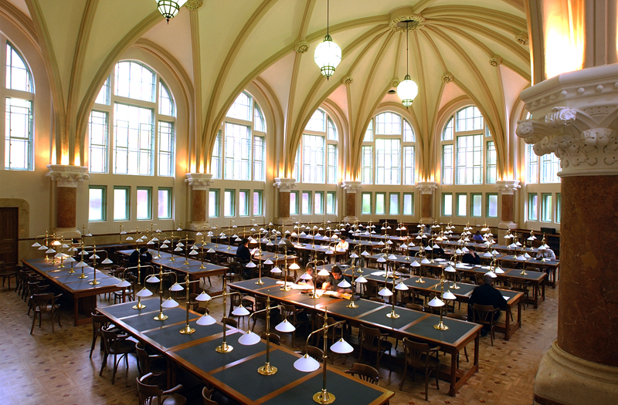

Slide 16
Budapest University of Technology and Economics (BME)
www.bme.hu

