Slide 1
Hungarian Tertiary Education – Vision, Strategy and Realization
Dr. László Palkovics State Secretary responsible for Higher Education

Slide 2
Hungarian Tertiary Education at a Glance
Some important data

Slide 3
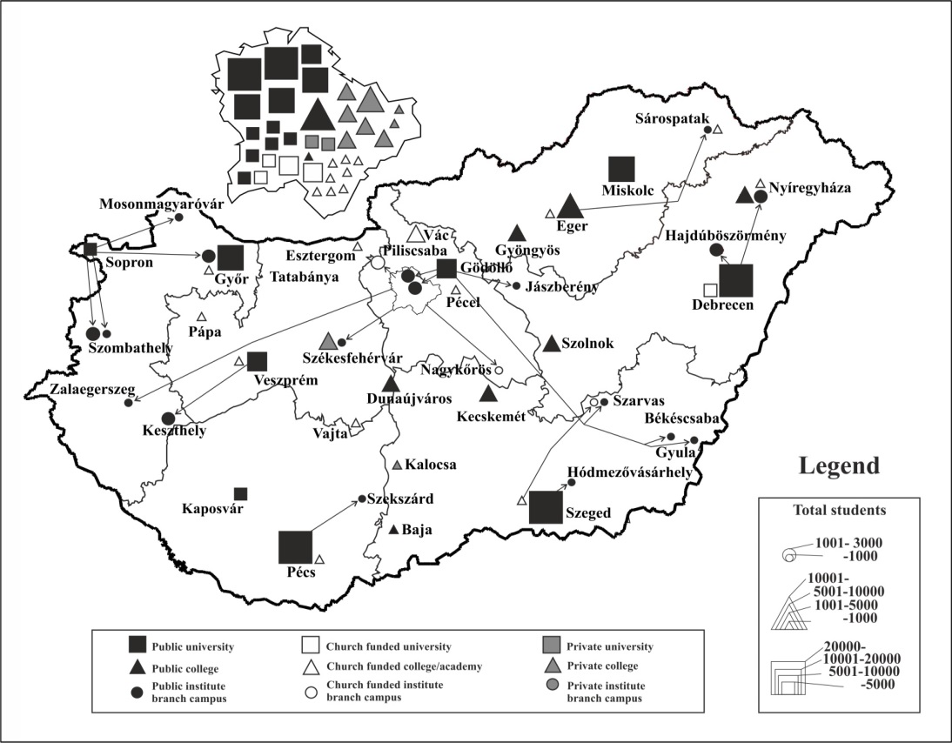
General Facts on Hungarian Higher Education
Institutional Capacities
State and non-state institutions recognised by the state
74 institutions out of which:
26 state subsidized universities and universities of applied sciences
2 state subsidized colleges
non-state subsidized universites (mostly church subsidized insitutions, and the international universities: the Andrássy University and the Central European University)
non-state subsidized colleges (church subsidized and private insitutions)
3

Slide 4
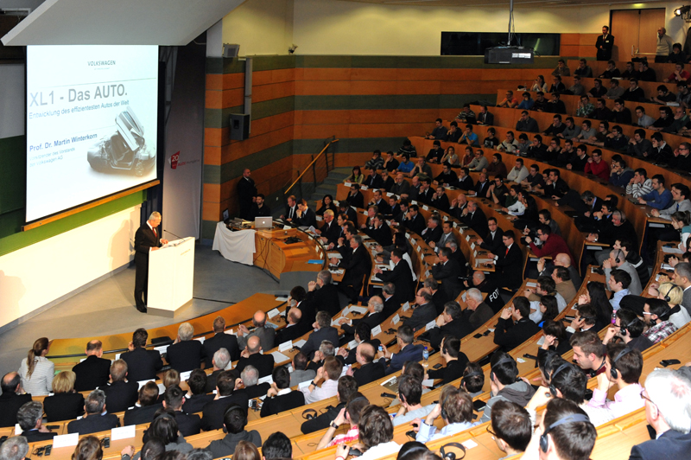
General Facts
Students and academic staff
290.000 students (2016)
201.000 students are attending BA/BSc courses
37.000 students are participating in MA/MSc courses
7.350 in postgraduate studies (PhD/DLA).
The percentage of female students is more than 54%
20.200 professors, teachers and researchers
17.050 are working in state subsidized institutions
4

Slide 5
Diagnosis
Using data form OECD sources

Slide 6
25 years of continuous development
In the last 25 years Hungary has paid its long standing debt to the society regarding tertiary education.
Higher education became more accessible, groups that had been denied access to education could get the desired degrees
Freedom of teaching was realized
The institutional system and structure of the unified Hungarian tertiary education was created
The unity of education and research was re-established
Demand for the quality development of higher education appeared.
In short: the change of the regime was finished in tertiary education.

Slide 7
Broad access to higher education

Slide 8
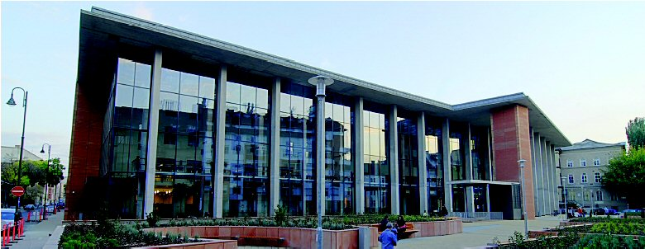
Internationally recognized quality
Hungarian diplomas (especially medical schools) have a high prestige throughout the world. The foreign language programs are of high standard with tuition fees quite favorable in the international comparison. These combined with reasonably low living costs provide optimal conditions for students wishing to come to Hungary.

Slide 9
Gearshift – a new vision
After 25 years, by 2014, we have reached a point where tertiary education is one of the most successful and competitive branches of the Hungarian economy, and every possibility is given to create the best tertiary education system of Central Europe.
Reforms have been implemented, now a gearshift is needed. We have to adapt to the speed of the global world by creating a system that delivers better quality, that is performance oriented and serves the needs of the economy, through using the capabilities of the system to a full extent by focusing the efforts, concentrating on value preservation and creation and using the resources effectively.

Slide 10
Education at a Glance - OECD
In the “Hungary Country Note” OECD outlined five key topics concerning higher education:
Educational attainment matters greatly in Hungary’s labor market.
Obtaining a diploma on higher grade is a “good investment”
Bridging the gap in between secondary and tertiary attainment remains the main challenge.
Public expenditure on education is low in general respective to the GDP
The transition from school to work in Hungary is challenging.
Educational equity remains a major challenge.

Slide 11
Those with tertiary qualifications earn on average 55% more than those with upper secondary level attainment
Relative earnings of adults working full-time, by educational attainment (2014). Upper secondary education = 100

Slide 12
The public benefits for a man attaining a tertiary education are on average nearly 4 times greater than the public costs
Public costs and benefits for a man attaining tertiary education (2012)

Slide 13
High unemployment among adults with low levels of educational attainment
Unemployment rates of 25-64 year-olds, by educational attainment (2015)

Slide 14
Strategy
Guidelines for Performance Oriented Tertiary Education Development in Hungary

Slide 15
Challenge - example most of the jobs in 10-20 years do not exist today

Slide 16
Challenge - Technologies in the pipeline

Slide 17
What shall we do?
Megatrends
Technology development
Challenges
Focusing activities
Solutions
Effective governance and new business models
Globalization
Demography and longevity
Transformation of society
Limited resources
Efficiency, effectiveness, generating new resources
Mapping the external needs into the internal structure
Competition, performance, quality and success
Restructuring the network
Innovation in education
Collaborations within the institution, between institutions, and with external partners
Re-interpretation of value-creating processes
Profiling and specialization
Notes:
Higher education institutions accomplish their mission if the knowledge passed onto the students is relevant on the labor market, if research results are beneficial for the society and national economy, and if the institutions act as regional catalysts.
However, higher education is a robust system with long lead times: approximately one decade has to pass until the students currently enrolled in higher education demonstrate a significant factor in the labor market. Similarly, at least ten to fifteen years will until research results become products and basic research contributes to raising the living standards in a way that is noticed by the society.
Thus, the real question lies not in what the current labor market expectations are, but what they will be like in ten years. It is not the current social challenges that need to be analyzed, but the challenges that will arise in a decade. The world around us is constantly changing, the challenges become bigger, and the current higher education concept must be drafted with a view to the socio-economic megatrends that can be expected in the next ten to fifteen years.
The future that lies ahead of us differs very much from what we know about our world today in at least five aspects:
The technological progress occurring at an incredible speed pushes the biological boundaries of humankind;
The aging populations which at the same time remain active for a longer time challenge our old notion about age groups;
Globalization expands and socio-economic boundaries disappear;
Members of the society voice their needs more and more actively and they participate individually in the shaping of the future via social media networks;
The realization of the finite nature of resources incites humankind to seek sustainable forms of development.

Slide 18
Building blocks of the strategy
VISION
KPI and targets
STRATEGIC GOALS
ENABLERS
< . . . . . . . . . . . . . . . . . . . . . . Profiling and specialization . . . . . . . . . . . . . . . . . . . . . >
< . . . . . . . . . . . . . . . . . . . . . . Restructuring the network . . . . . . . . . . . . . . . . . . . . . . >
< . . . . . . . . . . . . . . . . . . . . . . . . Innovation in education . . . . . . . . . . . . . . . . . . . . . . . . >
< . . . . . . . . . . . . . . . . . . Governance and business models . . . . . . . . . . . . . . . . . . >
TARGET AREAS – FOR NOW
Excellence in education | Excellence in research | Third mission
Teachers’ education | Medical schools | STEM education | Business schools | Agriculture education
Notes:
Following the definition of all these challenges and trends, the focal points of the strategic agenda aimed at creating competitive and high quality higher education can be clearly set.
In the future all higher education actors, students, teachers and institutions will be motivated by competition, perform high and be successful.
Hungarian higher education offers European quality services in the field of education, research, as well as third mission for both the society and the economy.
The modernized institutional system adapted to the regional structure of the country and the Carpathian Basin – in which all actors know their role perfectly – allows for and supports the accomplishment of the mission. The education system adapts to demographic trends; the institutions operate effectively and efficiently.
Besides all these, in certain subfields the strategy should be supplemented and fine-tuned annually in accordance with the priority sectors of the country.

Slide 19
Excellence in education
The doctoral education returns to its roots and will again be based on the master-disciple relationship, aiming at new scientific results achieved through original research, which is supported by financial incentives as well. The doctoral training will be a two-tier system: only those students can enter the second phase and receive priority assistance, who scored adequately based on scientific evidence.
The opportunities for gathering international experience will be increased both for students and faculty. The ratio of students who participate part-time foreign programs will be increased from 10.41% to 20% until 2023.
The number of foreign students in Hungary will significantly be increased, for the internationalization of the Hungarian institutions, for the better utilization of the infrastructure, and for generating extra revenue.

Slide 20
Open, excellent research system
Each institution will focus its research and development activities, and R&D networks will be formed between institutions.
The system of research funding will be transformed so that it will support the internationally competitive quality and resource concentration.
From 2016 we created and give extra funding to the so-called „national centers of excellence”, that will replace the so-called „research university” system.
We will create an excellence based research grant system for the most talented young professionals (the financing will go to persons instead of institutions, of course institutional overheads will be deductible) that will add an extra 10% resource to the whole budget of the higher education.

Slide 21
Third mission
Higher education plays an active role in the development of innovation competencies of domestic-owned, technology-intensive companies (especially SMEs), in order to better utilize the available resources.
We will create a system called „Centers for Cooperation between Higher Education and Industry” in order to standardize and foster the cooperation between industry and universities.
We will support by EU and local grants the incubation services of higher education institutions, as well as the foundation of spin-off companies, in order to convert the results of scientific discoveries into innovation.
Higher education institutions can serve as a knowledge-hub in the underdeveloped regions.

Slide 22
Profiling and specialization
We differentiate the profile of institutions, and operate and finance them according to the primary functions of the various types.
Knowledge generation: university
Knowledge application: university of applied sciences
We create new types (at least in Hungary) of higher education institutions concerning the ownership, financing and operating conditions (e.g. community colleges).
The traditionally established major/minor structure will be remodeled taking into account efficiency aspects and labor market requirements.
We provide smooth transition from vocational training into higher education, and a new training type will be introduced (B.Eng.).

Slide 23
Restructuring the network
We rationalize the higher educational institution network, establishing a hierarchic system, which is adapted to the spatial structure of Hungary, intended for improving efficiency and generating competition.
Functional urban regions should be considered as the basic units of the spatial structure without settlements.
The presence of tertiary education should be ensured according to the regional function.
The fact that almost everything is concentrated in Budapest is due to Hungary's spatial structure, which should be handled as a feature instead of problem.
Qualitative and quantitative development of the Hungarian education beyond the borders.

Slide 24
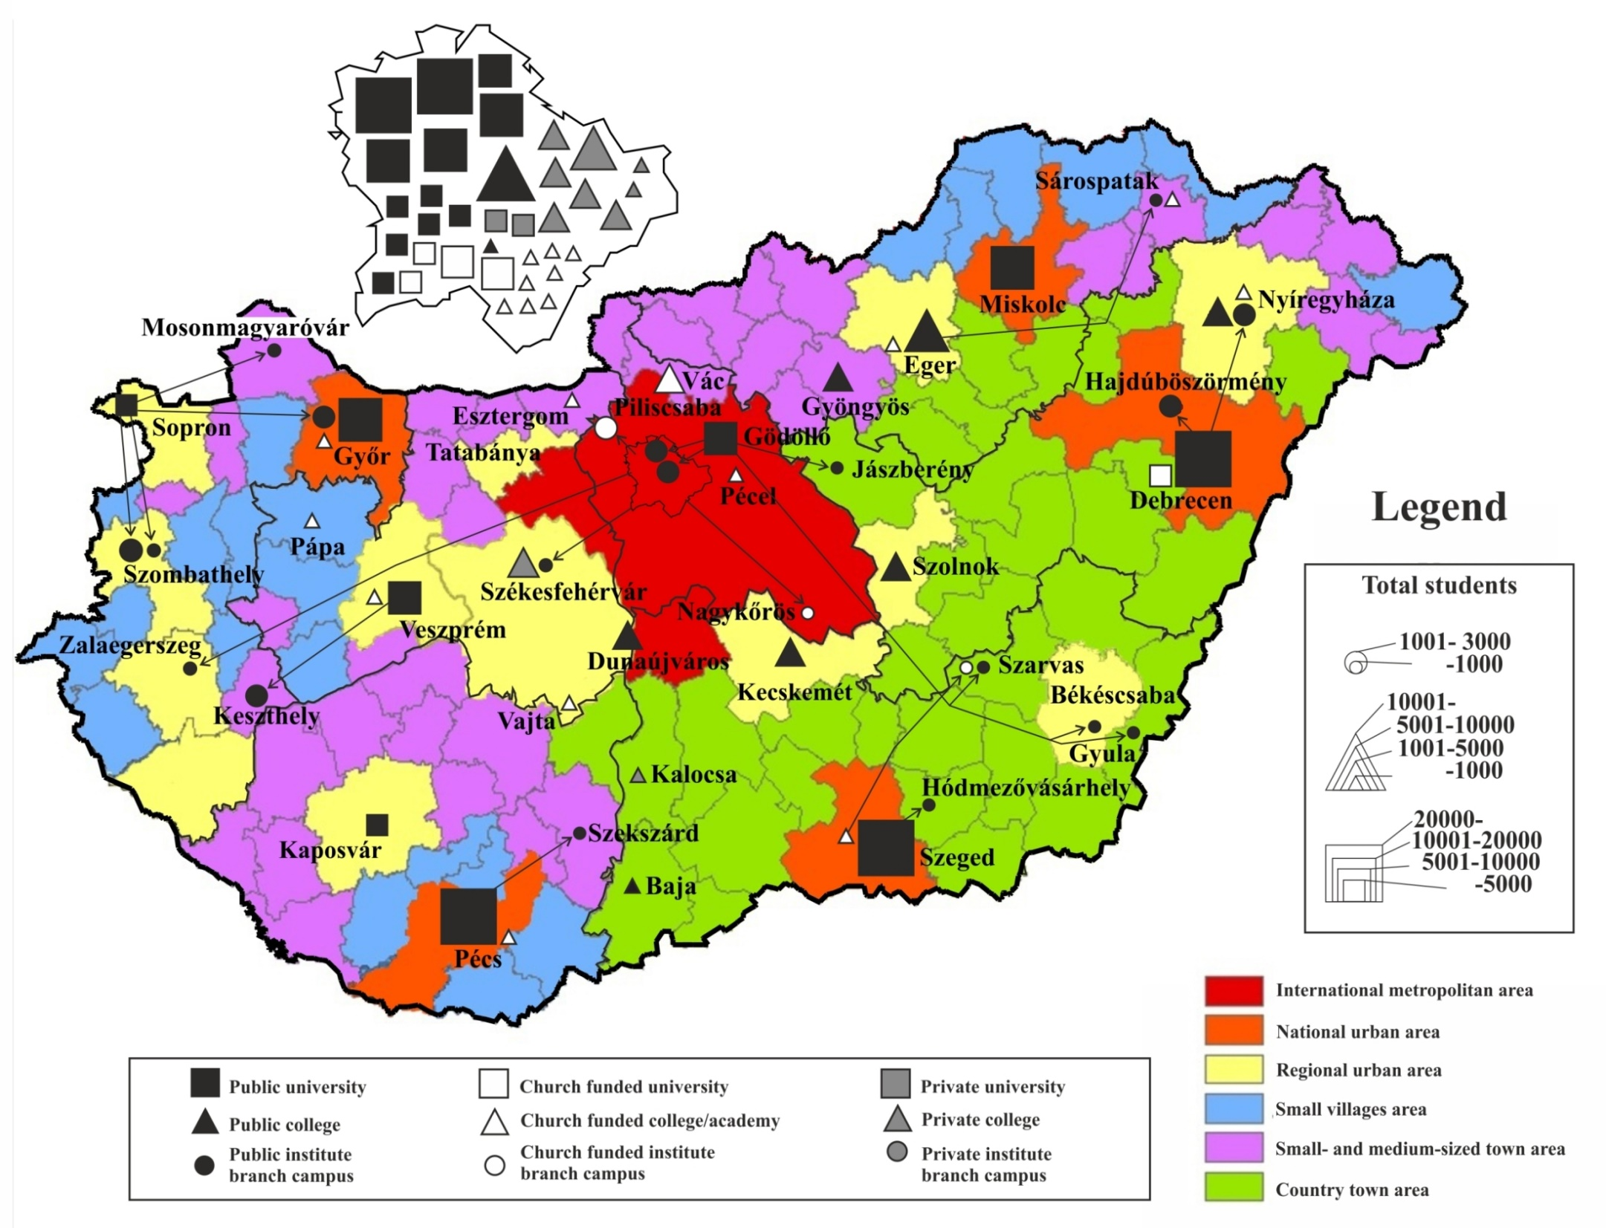
Notes:
Currently, headquarters, sites and outsourced trainings of the domestic tertiary educational institutions indicate the spatial structure as follows (figure was generated based on the maps of the National Development and Regional Development Concept).

Slide 25
Innovation in education
Relations between contact hours and students' working hours, term-time and examination period as well as “theoretical subject” and “practical subject” should be reconsidered.
The more intensive learning experience, the practical mastering of skills and the project- and result-oriented approach expected from the labor market requires the review of “subject-” and “course-centric” teaching arrangement.
We modify the education methodology used in tertiary education focusing on practice and student’s work. Where it is appropriate, we introduce and implement the dual form of higher education. By 2020, 8% of undergraduate students – in the relevant educational fields – will start the training in dual education.

Slide 26
Effective governance
We separated the professional-academic governance and strategic-economic management of universities (rector vs. chancellor).
We incorporate external stakeholders (maintainer, local economy, society) into the management of the institution (Board of Trustees).
The management should support the internationally competitive quality and resource concentration by increasingly building on resources other that direct state funds, obtained from the “market” by institutions, which is promoted also by amendment of the Act on public finances (business activity).
We create the rector's and chancellor's management, assessment and motivation system.
The students’ union system was restructured

Slide 27
New business models – vision
Notes:
Taking into consideration that direct state support cannot be increased significantly in the coming years and such an exposure to a single channel of income is not desirable given the robustness of the system; as well as that EU community resources will be available only in the coming 5-6 years; it is particularly important to address the increasing of direct R&D and other incomes resulting from the activities of institutions, as well as sponsorship-type incomes.
Although direct state support will continue to play a dominant role, and its amount will stay the same – despite the decrease in the number of students, – the sources being freed on account of decreasing of tasks and optimizing the system will be used for the quality development of tertiary education. In the next 5 years the EU community funding shall be used to create the structures and business models which will represent the funding corresponding to the scales of this source, which then will come from direct activities; largely due to the students' individual engagement and the sale of R&D&I activities.
The generation of financial resources in the form of donations in the institutions is not typical in Hungary, and also not supported by the existing legislation - especially tax legislation - however, in many countries (USA, Germany, England), these incomes represent an important funding element for tertiary educational institutions.

Slide 28
Budget structure of universities Steadily increasing financial support since 2013
Own revenues [Billion HUF]
Central budget support [Billion HUF]
The evolution of the number of students [headcount]

Slide 29
Summary - Reflections in the strategy
Key topics in the Hungary Country Note | Relevant goals in the strategic agenda
Educational attainment matters greatly in Hungary’s labor market | Smooth transition from vocational training, new type of diploma (B.Eng)
Bridging the gap in between secondary and tertiary attainment remains the main challenge | Profiling institutions, decreasing drop-out rate, correcting student/staff ratio, master-disciple relation
Public expenditure on education is low and has been decreasing | Slight increase in direct state funding, plus 10% excellence based grants for young researchers, significant direct (EFOP) and indirect (GINOP) EU funds
The transition from school to work in Hungary is challenging | Project-based education, soft-skills in curricula, dual education, future reform of vocational education, university-industry cooperation
Educational equity remains a major challenge | Restructuring the institutional network, community colleges in disadvantaged regions

Slide 30
Strategy Deployment – Selected Actions
Innovation in Education – “Dual” or Cooperative Education

Slide 31
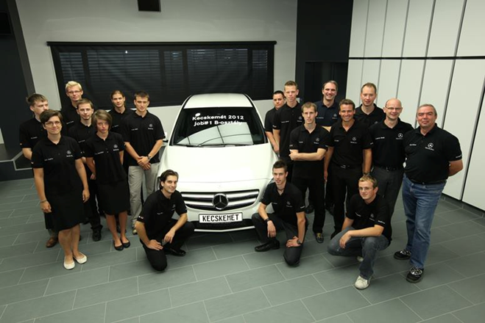
Dual Education – Preliminary Examples
Right from the starting of vehicle engineer education (academic year 2012-2013), Kecskemét College offered for vehicle engineer students a cooperative (dual) type education as well.
Recently the number of dual-type vehicle engineer students has become 60 with 4 participating companies altogether.
These companies are: Mercedes-Benz Manufacturing Hungary Kft. (31 students), Knorr-Bremse Fékrendszerek Kft. (26 students)
The students in the dual training system were more successful and enrolled more credits than their peers.
Practically there were no drop-outs during the dual trainings, all of the students were educated according to the model curriculum and the students were able to complete the basic course within 7 semesters.

Slide 32
Dual Education – Practice Oriented Training
The actors of the Hungarian industry, especially the automotive companies, expressly require professionals with practical training background.
The modification of the Act On National Tertiary Education in July 2014 created an opportunity for introducing the “dual” form in the Tertiary Education.
Dual training can be introduced only on existing basic training courses that are already accredited
The Act created the Dual Training Council the task of which is to determine the quality and development directions of the dual training education
In the Tertiary Education Strategy the government has defined as an objective that in dual Bachelor programs in the relevant fields of study the proportion of the first-year students has to reach 8% of the total number of students in the dual Bachelor programs till 2020.

Slide 33
Dual Education – Practice Oriented Training
First year experiences are very positive
In September 2016, 24 higher education institutes launch 92 Bsc programs in dual form
30 various types of Bsc programs
The institutes have signed cooperation agreements for dual training with more than 600 cooperation firms
Over 1500 new students could start their studies in dual form in September

Slide 34
Strategy Deployment – Selected Actions
Stronger positon in RDI

Slide 35
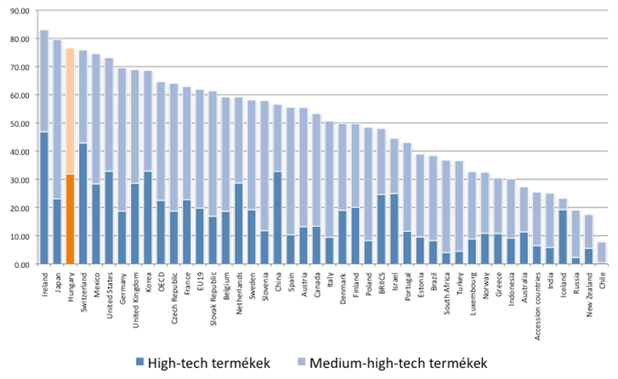
Opportunities – High Tech Production
High Tech Products
Medium Tech Products

Slide 36
Value added for knowledge intensive services High-tech and medium-high-tech industries as % of total value added

Slide 37
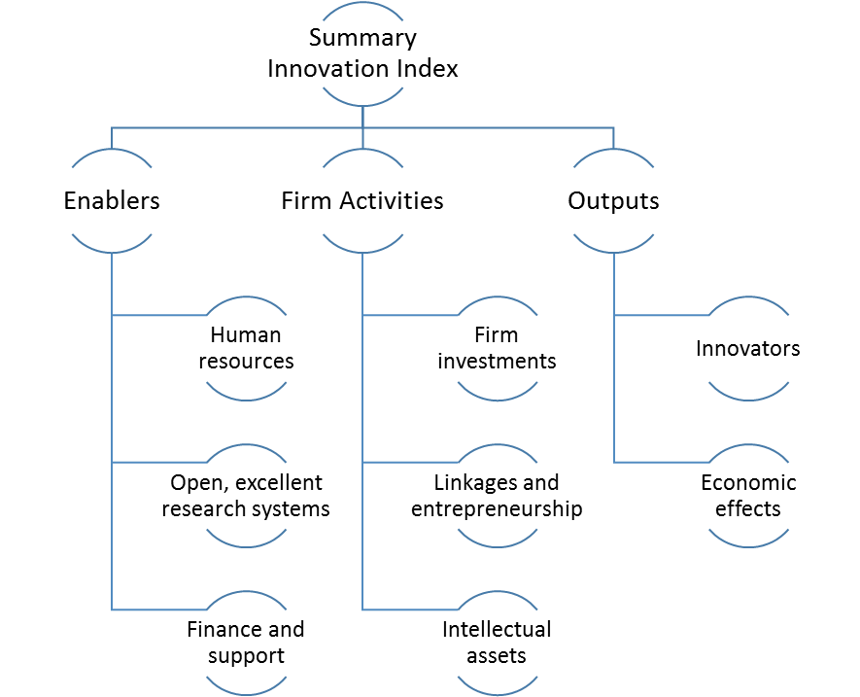
Where are We Standing? Innovation Union Scoreboard 2013

Slide 38
What is in the Background?

Slide 39
Linkages & Entrepreneurship
We will create a system called „Centers for Cooperation between Higher Education and Industry” in order to standardize and foster the cooperation between industry and universities.
We will support by EFOP grants the incubation services of higher education institutions, as well as the foundation of spin-off companies, in order to convert the results of scientific discoveries into innovation.
Higher education institutions can serve as a knowledge-hub in the underdeveloped regions, a new type of higher education access, the so called community “college” will be introduced
Modification of the house-hold financial rules for universities when they co-operate with companies in RDI projects
Modification in tax system for motivation companies to support universities

Slide 40
Intellectual Assets
Higher education institutions are important players in the field of intellectual property applications: 15% of the domestic patents have been produced here.
Unfortunately, the promotion system for faculty that is based almost exclusively on bibliometric indicators has a strong „novelty-destroying effect”, therefore the indicators need to be reconciled with the measurement of economic and social innovation.
Higher education institutions should protect their own intellectual capital, so we introduce a complex, performance-based promotion system for faculty, that is corresponding to a competitive wage package.

Slide 41
Innovators
Higher education plays an active role in the development of innovation competence of domestic-owned, technology-intensive companies (especially SMEs), in order to better utilize GINOP resources. We want to double the revenues generated by selling R&D products and services of institutions.
We want to transform teaching methodology used in higher education more practice and student-centered, and where it is possible, we will introduce the dual form of training (8% of freshmen will begin their studies in dual form in 2020).
Re-definition of the PhD system – 2+2 years instead of 3, 40 resp. 80% increase of remuneration of students
Special grants for research students already from their year 1

Slide 42
Strategy Deployment – Selected Actions
Changes in Governance

Slide 43
Management model – rector and chancellor
Maintainer
cooperation
Rector
Chancellor
Educational, research, artistical organisational units
Faculties
Institutions
Departments
Functional organisational units
Management
Law, administration
Opearations etc.
Units of organisational service
Dormitories
Library
Applications etc.
Strategic control
Operational control

Slide 44
The most important expectations towards the chancellor
The subservience of the authonomy of the education-research, the operative guidance – according to the existing rules.
The insurance of the criterias – actions which are affected in the education-research
Organisational transformation and operation according to the effectiveness and expediency
Ensure the budgetary balance (budgetary planning, implementation, hazard management)
Evolving of institutional processes , implementation and operation of the needed tools
Functional transparency towards state-owner and consistorium
Comprehensive responsibility for the decisions and its implementation

Slide 45
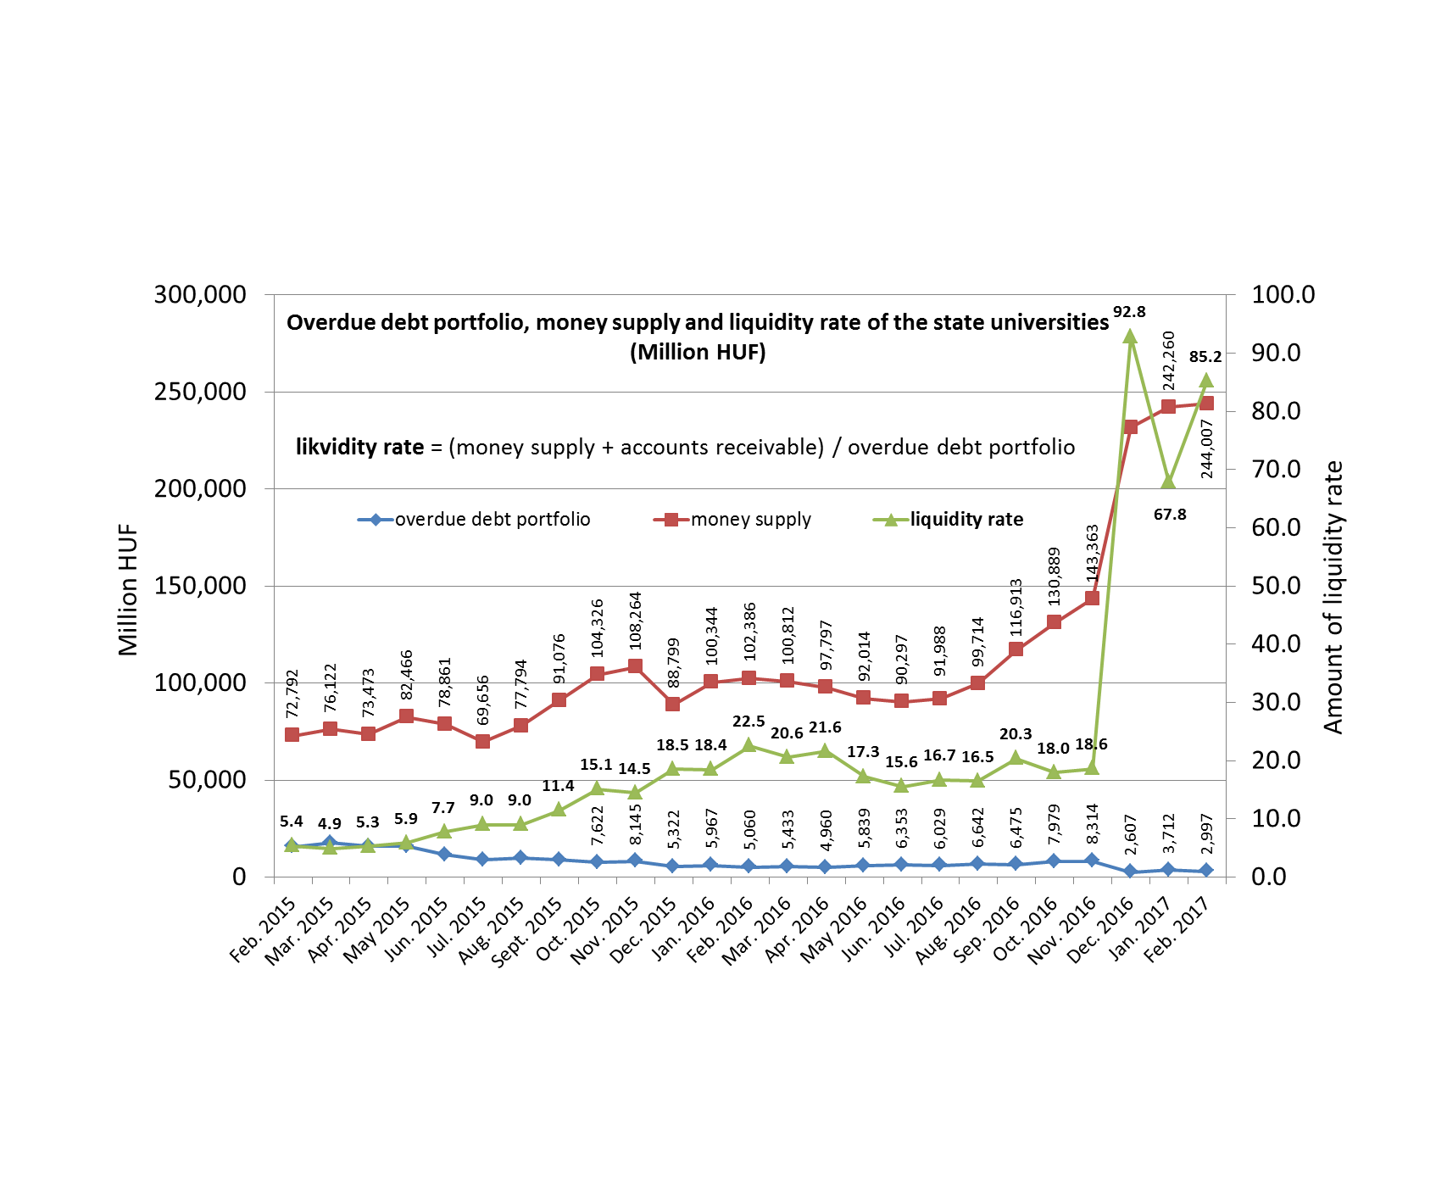
Improvement of the financial situation of universities
With the entry of the chancellors the debt portfolio less than halved, the liquidity rate increases
Source: Hungarian Treasury

Slide 46
Tipical actions
Responsible management with the property asset – utilization of not used asset units targeting not education function (typical PPP buildings)
Action plans targeting cost reduction, its affect prevail in short time
Overview of the external contracts : respeaking contracts, dismission of bad conditioning contracts etc.
Strenghtening sources of application targeting institutional utilization: stopping external and internal , contentless payments , ignoring companies responsible for wrinting applications for new contracts, loading of institutional costs belonging to the subject of the application
Overview of income structure: reduction of payments without performance, reduction of income inequalities , wage ceiling.
Reduction of not efficient activities : not allow little groups, etc.
Coopeartion between the institutions , some cost items holding inside the institutional system : using properties of each other instead of renting etc.
Run rationalisation and cost reduction projects

Slide 47
Some elements of the new financing rules Expected after 2018
The new funding is output-based, in which will appear the labour market on the basis of objective metrics, so it is quality and performance-based.
The core budget component of the system is based on completed student performance afterward. Both the student and the institution is interested in output performance.
The research component of the system, independent of the students’ number
The third element of the system, the special tasks are to ensure the funding of the national or domestic policy priority training tasks.
… and new model for university operation is being elaborated

Slide 48
Thank you for attention!

