Slide 1
The HRC’s Committee of Cross-Border Higher Education Institutions and the Makovecz Program
Dr. Márta Takács,
President of the of the Hungarian Rectors’ Conference Committee of
Cross - Border HEI
University of Novi Sad, Subotica

Slide 2
Goals and tasks of the Committee of Cross-Border Higher Education Institutions
Consultative Board
Cross-Border Hungarian minorities and the theirs HE institutions
Collaboration on HE programs and R
As the bridge
Common Hungarian language HE sphere in the Carpathian region
Similarities and differences
Common study programs
Outplaced SP
To maintain actual tasks (exchange programs, work with joung talents…)

Slide 3
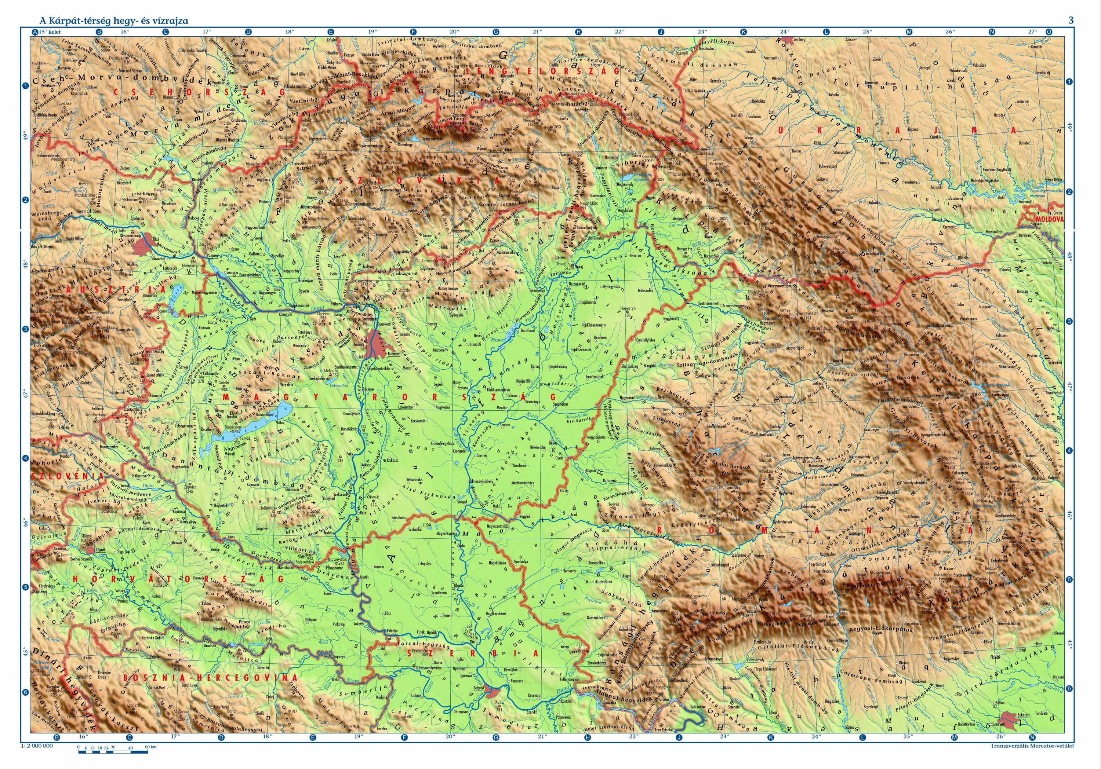
HRC’s Committee of Cross-Border Higher Education Institutions INVITED PARTICIPIENS
University of Maribor, Faculty of Arts , Department of Hungarian Language and Literature
Rudas Jutka

Slide 4
Partner-president: Dr. Mezey Barna Eötvös Loránd University
Vice-presidents:
Dr. Liszka József Selye János University, Komarno
Dr. Soós Anna Babes-Bolyai University, Cluj
Dr. Dávid László Sapientia Hungarian University of Transylvania
Dr. Orosz Ildikó Ferenc Rákóczi II. Transcarpathian Hungarian Institute
Dr. Jávor András University of Debrecen
University of Pécs (Project Charta)
Óbuda University (K-MOOC)

Slide 5
The Makovecz Program
Permanent scholarships and grants
Supported by the Ministry of Human Capacities of Hungary
Teacher exchange
Student exchange

Slide 6
At the moment active Institutions
Sapientia Erdélyi Magyar Tudományegyetem;
Partiumi Keresztény Egyetem;
Babes-Bolyai Tudományegyetem;
Egyetemi Fokú Protestáns Teológiai Intézet;
Marosvásárhelyi Művészeti Egyetem Magyar Nyelvű Művészeti Kara.
Selye János Egyetem;
Nyitrai Konstantin Filozófus Egyetem Közép-európai Tanulmányok Kara.
II. Rákóczi Ferenc Kárpátaljai Magyar Főiskola.
Újvidéki Egyetem, elsősorban annak szabadkai Magyar Tannyelvű Tanítóképző Kara;
Szabadkai Műszaki Szakfőiskola - Szabadka
We are waiting for the active participation of the faculties from Slovenia

Slide 7
Thank you!
takacs.marta@magister.uns.ac.rs

