Slide 1

Slovenian HE Challenges – Systemic Perspective
Stojan Sorčan, Director General for Higher Education
Republic of Slovenia, Ministry of Education, Science and Sport
24th March 2017

Slide 2
Content
Facts about the HE system in Slovenia
  Students and graduates
  Public and private HE institutions
  Public expenditure for HE and funding structure of HE institutions
  Governmental funding of study activities of HE institutions
Key challenges of HE in Slovenia
  National HE Programme 2011-2020
Funding system of HE in Slovenia
  (Pre)reform model (december 2016)
  Systemic and institutional perspectives
Autonomy of public HEI‘s in Slovenia
  Reform step 2: New systemic HE Act (december 2017)

Slide 3
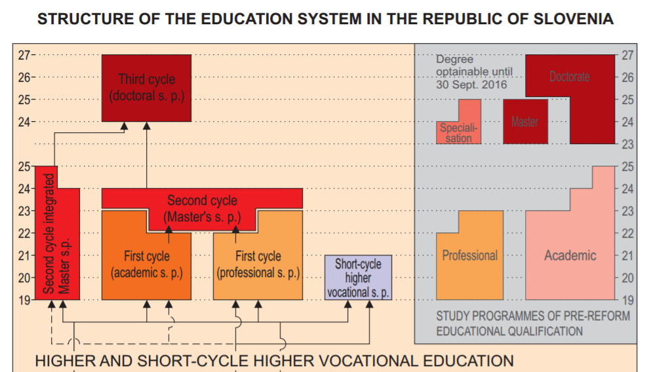
Structure of the HE System in Slovenia

Slide 4






Public HE Institutions
87% of all students
96% of state funding for HEI

Slide 5
Total number of students, 2011 – 2016
Newly enrolled: 26.000

Slide 6
Students (%) by level of study, 2016/17

Slide 7
Number of graduates by HEI, 2015

Slide 8
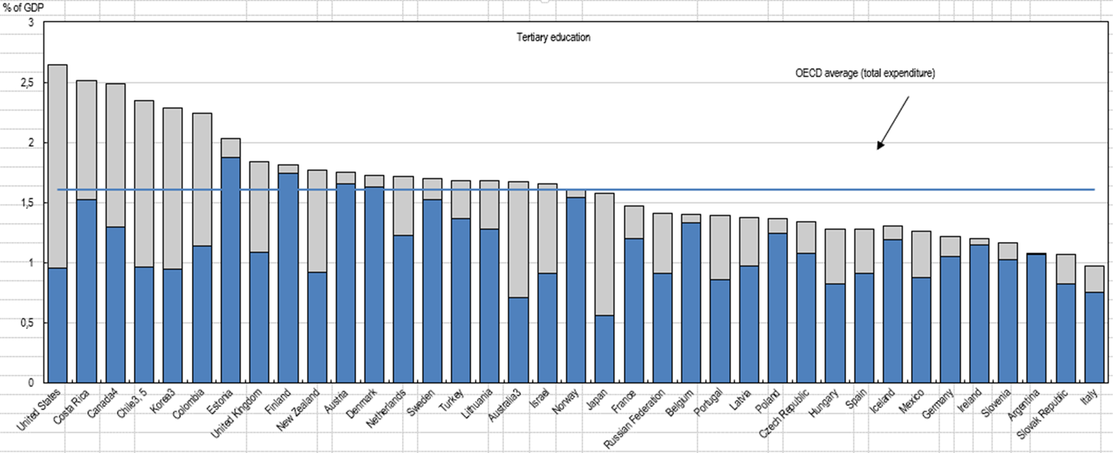
Public and private expenditure on tertiary education institutions as a percentage of GDP (2013)
What proportion of national wealth is spent for tertiary education?

Slide 9
Total public expenditure on education as % of GDP

Slide 10
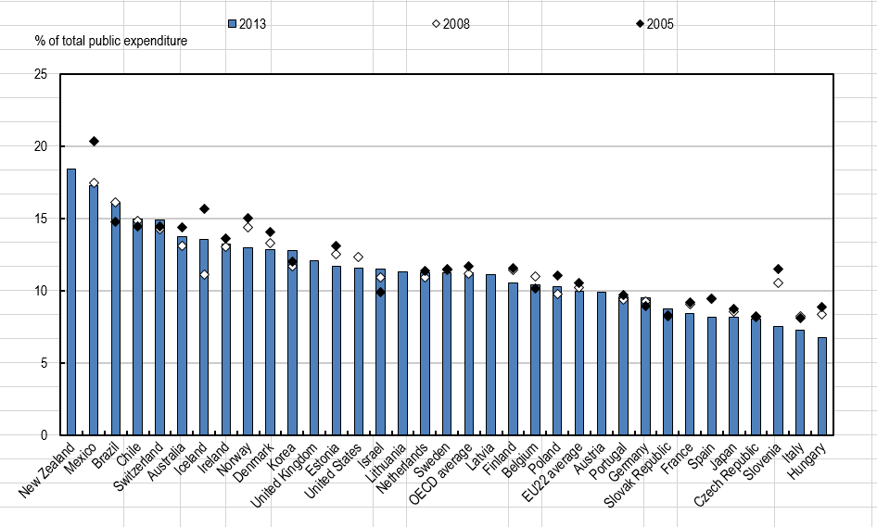
Total public expenditure on education as a percentage of total public expenditure

Slide 11
Public expenditure for HE, Slovenia

Slide 12
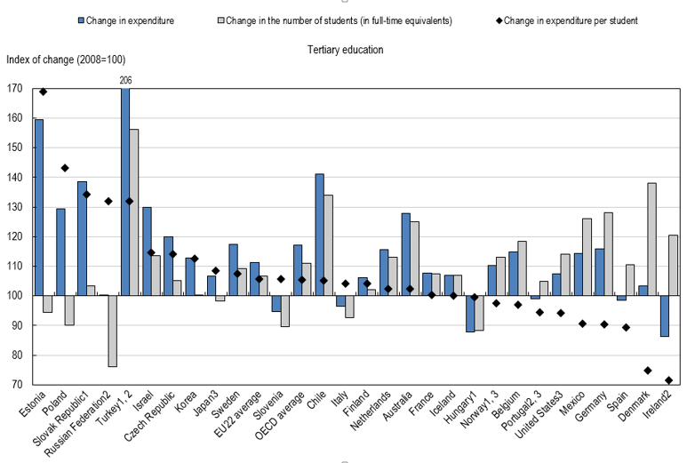
Changes in the number of students, expenditure on educational institutions and expenditure per student in tertiary education (2008, 2013)

Slide 13
How much public and private investment in tertiary education is there?
Distribution of public and private source of funds for tertiary educational institutions after transfer from public sources

Slide 14
Sources of funding of HEI, Slovenia

Slide 15
Sources of funding of universities, 2015

Slide 16
Budget items of the Ministry of education, science and sport for HE, 2015-2017

Slide 17
Governmental (ministry) funding of HEI for study activities, 2010-2016

Slide 18

Key Features of HEI Funding in Slovenia
Governmental funding of HEI comprises of :
  Funding of study activities – Ministry of education, science and sport (MESS)
  Funding of investment - MESS
  Funding of research – Slovenian Research Agency
  The funds for study activities are allocated through „lump sum“ system annualy by contract.
Undergraduate study activities are publicly financed for all full-time students in the public HEI.
Private HEI may be granted a concession for a certain study programme on the basis of public tenders.
Part-time students pay tuition fees.
Postgraduate students pay tuition fees, but the government is co-financing tuition fees through different instruments.

Slide 19
Content
Facts about the HE system in Slovenia
  Students and graduates
  Public and private HE institutions
  Public expenditure for HE and funding structure of HE institutions
  Governmental funding of study activities of HE institutions
Key challenges of HE in Slovenia
  National HE Programme 2011-2020
Funding system of HE in Slovenia
  (Pre)reform model (december 2016)
  Systemic and institutional perspectives
Autonomy of public HEI‘s in Slovenia
  Reform step 2: New systemic HE Act (december 2017)

Slide 20

Key Challenges of HE in Slovenia
Funding system of HE and R&D
Public service in HE
Institutional autonomy
Cooperation of HEI
Quality assurance system
Internationalisation
Social dimension

Slide 21
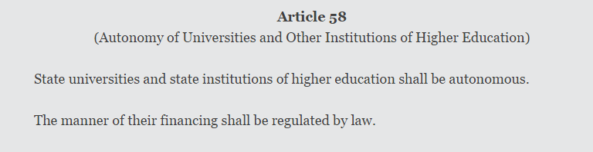
Policy background
The Constitution of the Republic of Slovenia

Slide 22
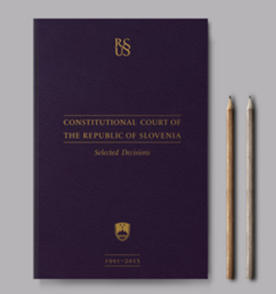
Discrepancies between the Constitution and the Higher Education Act
The Act shall define funding of public service in HE
  definition of public service
  relation between public service and market activities
  relation between public and private sources
  public funding of private HEI holding concessions
2. The Act shall define the system of public funding of HEI
- level of funding
- long-term stability of public funding
- transparent mechanism of allocation

Slide 23
Content
Facts about the HE system in Slovenia
  Students and graduates
  Public and private HE institutions
  Public expenditure for HE and funding structure of HE institutions
  Governmental funding of study activities of HE institutions
Key challenges of HE in Slovenia
  National HE Programme 2011-2020
Funding system of HE in Slovenia
  (Pre)reform model (december 2016)
  Systemic and institutional perspectives
Autonomy of public HEI‘s in Slovenia
  Reform step 2: New systemic HE Act (december 2017)

Slide 24
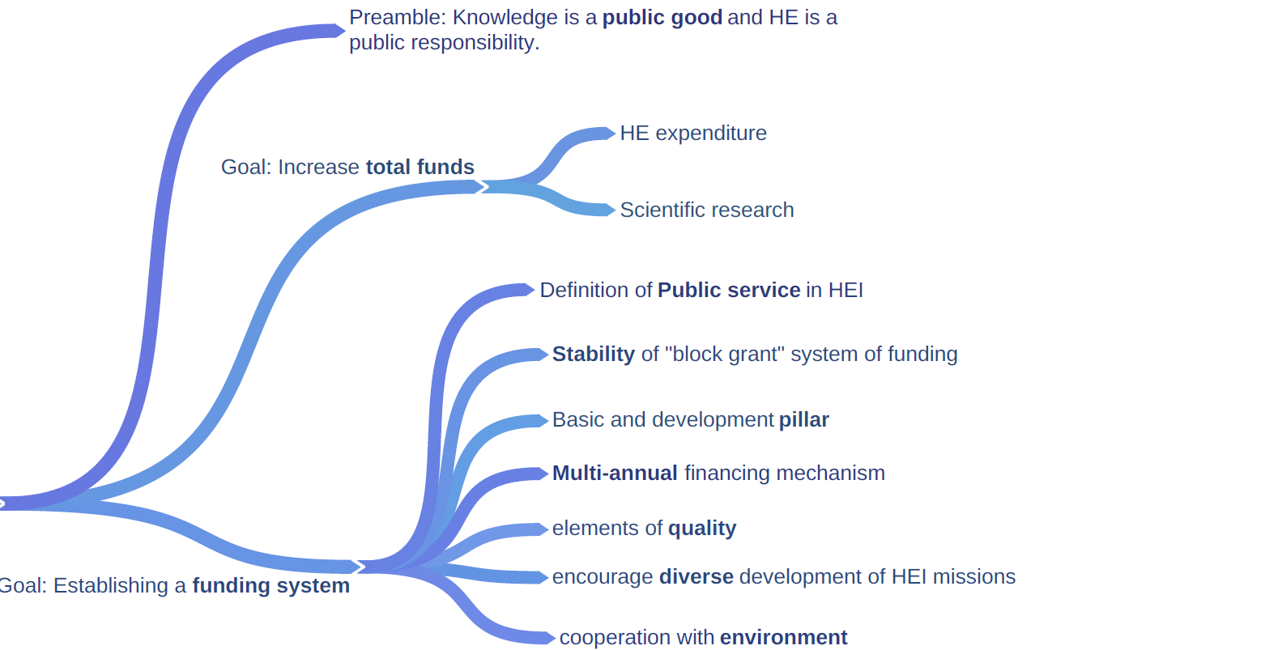
National HE Programme
2011-2020
Public funds should be granted to HEI in such a way that quality, autonomy, diversification, effectiveness and efficiency are promoted.
Funding mechanisms should provide incentives for change and innovation.

Slide 25
Pre-reform Model of HE Funding
Lump sum was introduced in 2003*.
It was chosen to replace direct payments for individual HEI activities/costs.
Lump sum instrument define the allocation of public funds among HEI in relation to their outcome.
Long term objectives were:
  to increase the autonomy, flexibility and responsiveness of HEI,
  to maintain a diverse HE system,
  to promote the more efficient use of funds and transparency.
*Borut Kodrič, Nada Trunk Širca, Rok Strašek: Funding higher education in Slovenia, the introduction of a lump-sum instrument, UMAR, IB revija, 1/2008

Slide 26
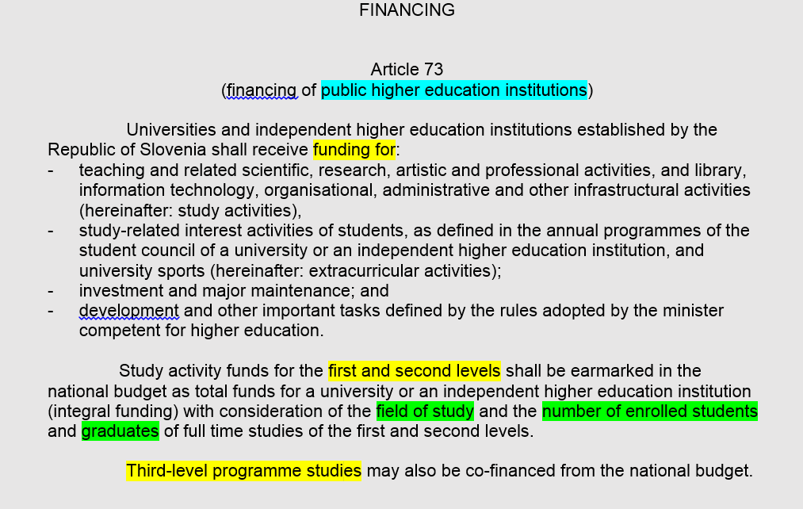
Higher Education Act (changed in December 2016)

Slide 27
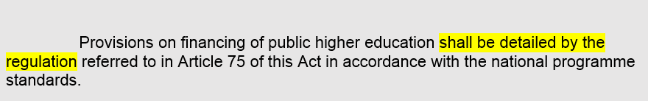
Decree on budgetary funding of HEI
The funding structure is based on two pillars:
Basic pillar: stable funding. Variability of the basic pillar was limited (+/-3%) and it was dependent on output criterias:
  number of enrolled first year students and students of the second year of study,
  ratio first year enrolled/graduated students,
  international mobility flow of students.
2. Development pillar: additional funding to support HEI development and competitiveness in the fields of diversification, internationalisation, quality and social dimensions.

Slide 28

Decree: planing the budget at the governmental level
The budget is planned so that the annual budgetary funds for study activities from the previous fiscal year are increased each year in real terms by at least the growth of GDP, but by not less than 2,5% with regard to the realisation for the previous year for study activities.
The additional funds are delivered through public tenders for specific development activities – development pillar.

Slide 29
Some Drawbacks of the Former Funding Model
The distribution of funds for study activities among HEI was mainly the responsibility of the ministry and depends mostly on the level of funds from the previous fiscal year.
Definition of outcome indicators:
  The formula includes only the number of students and graduates, which does not give strong incentives to improve educational quality.
  There is a need to establish a quality evaluation system based on performance indicators and clearly set targets; otherwise there is a risk of grade inflation*.
Financial monitoring was mainly focused on the cash flow rather than on the realisation of the set long-term goals and performance and quality indicators of HEIs.
*Borut Kodrič, Nada Trunk Širca, Rok Strašek: Funding higher education in Slovenia, the introduction of a lump-sum instrument, UMAR, IB revija, 1/2008

Slide 30
Key challanges from institutional perspective:
Stable financing of public service
Public service: education and research.
Evaluation indicators that will foster quality instead of quantity
Mechanisms that will allow efficient internationalization in education and research
Search for solutions that will increase attractiveness of education and competitiveness in research

Slide 31
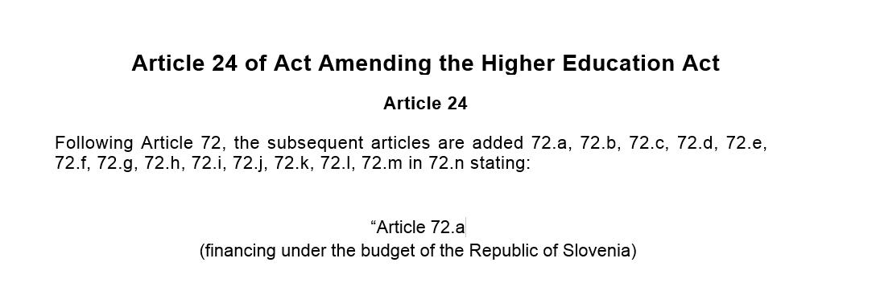
Reform step 1: Act Amending the HE Act,
December 2016

Slide 32
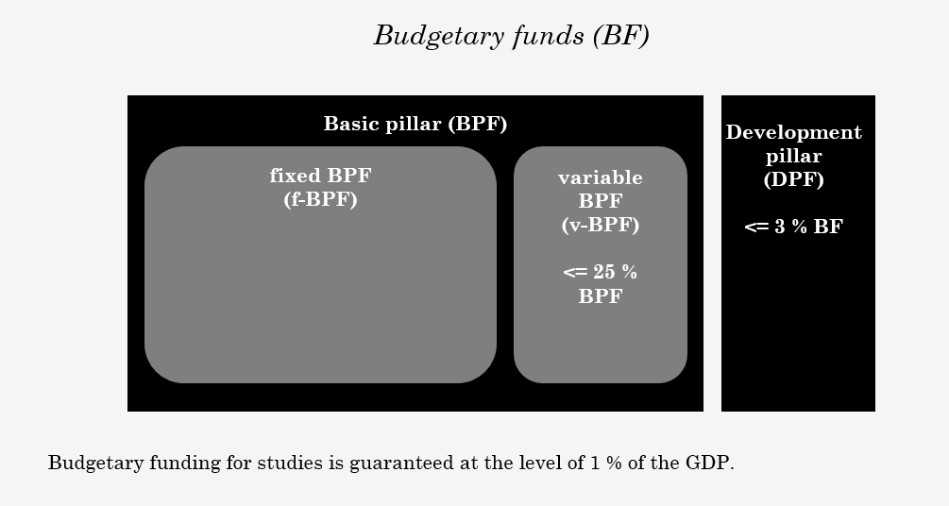
Reform step 1: Act Amending the HE Act,
December 2016

Slide 33
Budgetary funds distribution within contract period
Year 1
Year 2
Year 3
Year 4
DPF(year 1)
DPF(year 2) = DPF(year 1)
DPF(year 3) = DPF(year 1)
DPF(year 4) = DPF(year 1)
f-BPF (year 1)
f-BPF(year 2)
=
f-BPF (leto 1)
+
I(year 2)
f-BPF(year 3)
=
f-BPF (year 2)
+
I(year 3)
f-BPF(year 4)
=
f-BPF(year 3)
+
I(year 4)
Performance?
Performance?
v-BPF(year 1)
v-BPF(year 2)=
v-BPF(year 1) + additional unall. funds
v-BPF(leto 3)
= v-BPF(leto 2)
+ additional unall. funds
V-BPF(year 4)
=v-BPF(year 3)
+ additional unall. funds

Slide 34
Indicators
the number of first-time enrolled students to regular studies in first,second and third cycle study programmes, without the number of weighted students enrolled in the first year of the study programmes of the first cycle, weighted according to the corresponding factor of study groups of the study programmes,
the number of weighted graduates of regular studies of first and second cycle, multiplied by the number of years of the study programme, without the graduates of the study programmes accepted before the 11 June 2004,
level of graduates employment
the number of scientific publications,
relative share of the research, development and market funding,
the number of all habilitated teachers / researchers in line with the arts criteria, employed at the university or independent higher educational institution.
The indicators, weights of specific indicators and the study groups of the study programmes are specifically defined in the regulation prepared in line with Article 75 of this act.

Slide 35
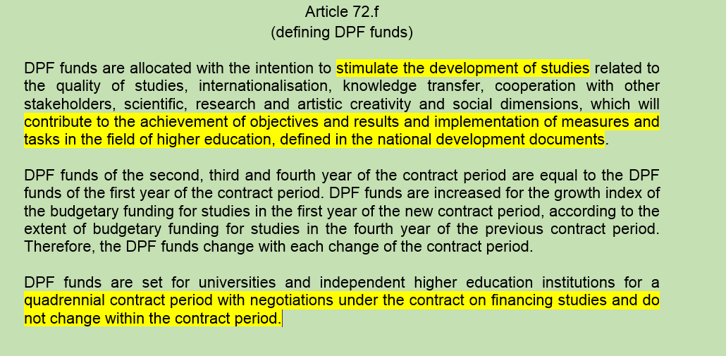
Development Pillar of Financing – Performance Agreements

Slide 36
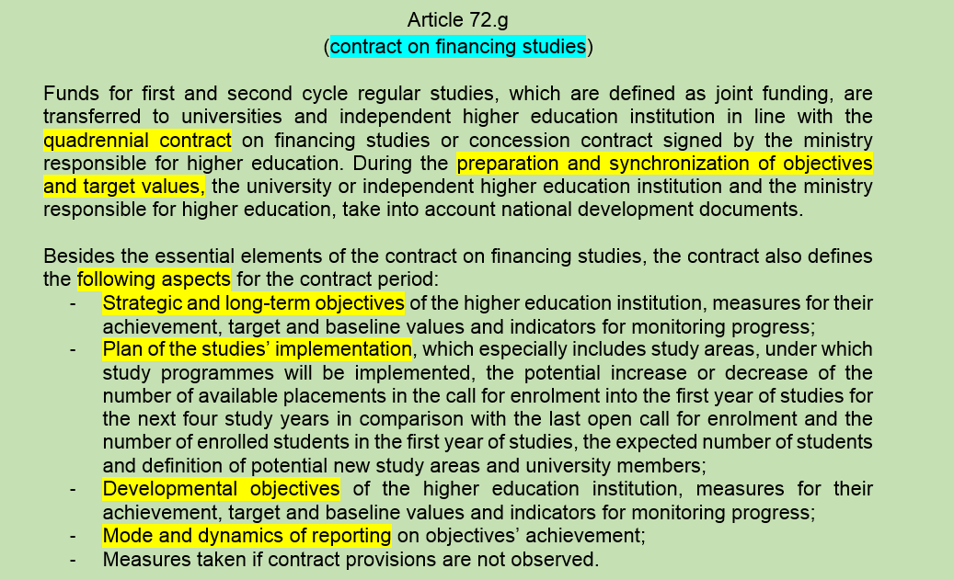
New Funding Agreements – Contracts

Slide 37
Challenge:
Funding agreement
Transformation from 1 to 4-year financing contracts
To conceptualize the process and instrument!
Importance of the national strategic objectives and long-term goals of HEI
How to regulate the process of negotiations between the ministry and HEI?
How could the system be developed and implemented in a participatory process with the stakeholders?

Slide 38
Content
Facts about the HE system in Slovenia
  Students and graduates
  Public and private HE institutions
  Public expenditure for HE and funding structure of HE institutions
  Governmental funding of study activities of HE institutions
Key challenges of HE in Slovenia
  National HE Programme 2011-2020
Funding system of HE in Slovenia
  (Pre)reform model (december 2016)
  Systemic and institutional perspectives
Autonomy of public HEI‘s in Slovenia
  Reform step 2: New systemic HE Act (december 2017)

Slide 39

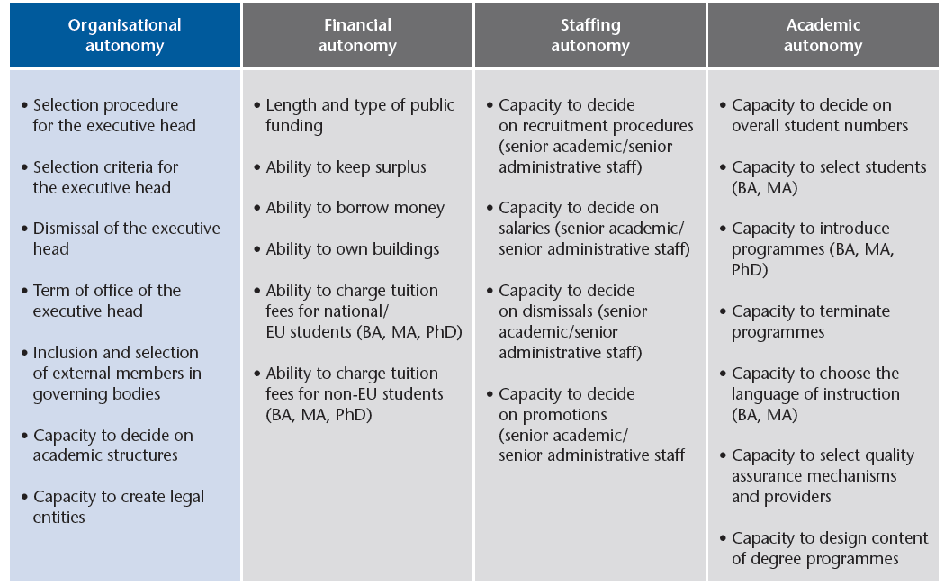

Slide 40
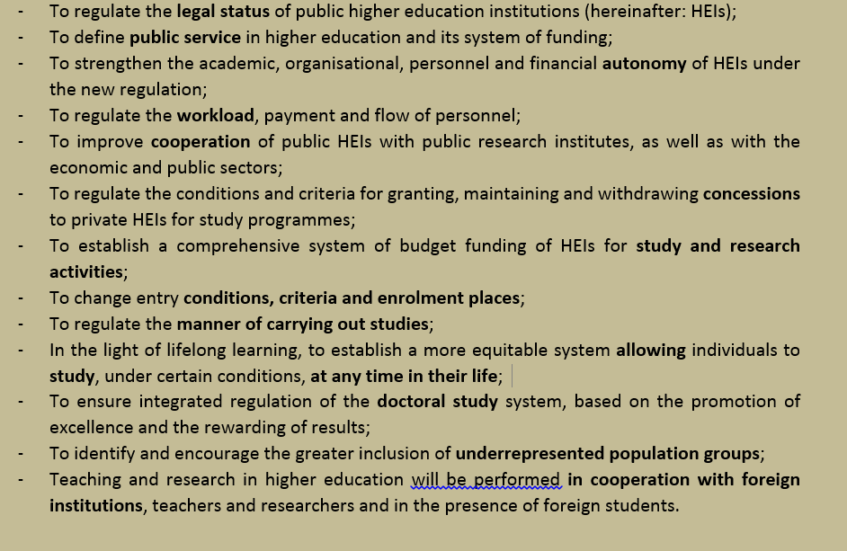
The objective of the new HEA shall be:

Slide 41
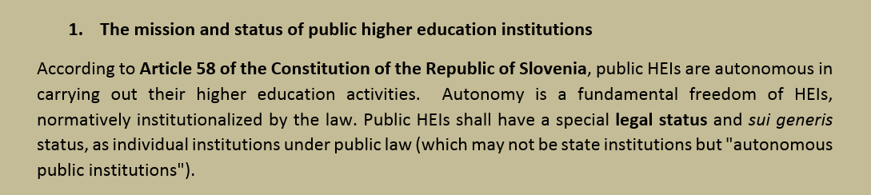
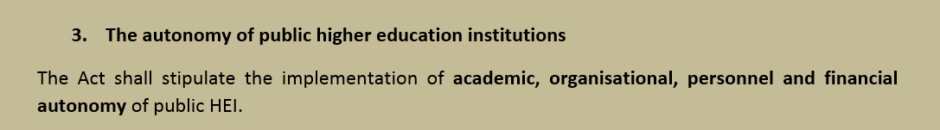
Legal Status of public HE institutions

Slide 42
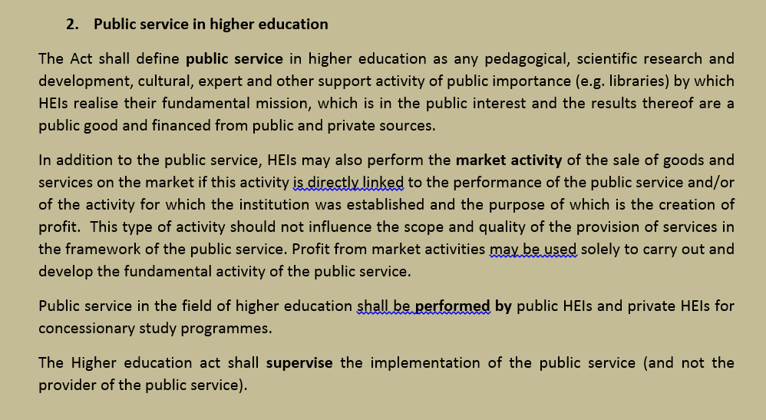
Public Service in HE:

Slide 43
Challenge:
Public Service in HE
Defining the general framework of HE funding in HEI!
Public service: education, research, transfer of knowledge, public vs private sources.
Responsibility and autonomy of HE in providing high quality HEI.
Public funding of private HEI: which HEI are needed and on which criteria should it be based?
Diversification of funding sources: HE as a public good vs commercialization.
Flexibility of HEI regarding to public and private funding sources!
Separate or integrated funding schemes for teaching and research?
Teaching, research and transfers tasks should be fulfilled by university staff in a flexible way….how to regulate it?

Slide 44
THANK YOU!

