Slide 1
The Slovenian Rectors′ Conference (SRC)
The Voice of Slovenian Universities
Prof. Dragan Marušič
SRC President

Slide 2
Who we are
Formed in 2005, the Slovenian Rectors' Conference (SRC) is a collective association representing Slovenian universities.
It aims to support continued development of HE and R&D in Slovenia and internationally.
Our vision of Slovenian HE development is a system of academic institutions with highly diversified profiles, providing a wide spectrum of graduate qualifications and facilitating mobility of staff and students.

Slide 3
Members of SRC
The University of Ljubljana
Kongresni trg 12 • 1000 Ljubljana • Slovenia
www.uni-lj.si
The University of Maribor
Slomškov trg 15 • 2000 Maribor • Slovenia
www.uni-mb.si
The University of Primorska
Titov trg 4 • 6000 Koper • Slovenia
www.upr.si
The University of Nova Gorica
Vipavska 13 • 5000 Nova Gorica • Slovenia
www.ung.si

Slide 4
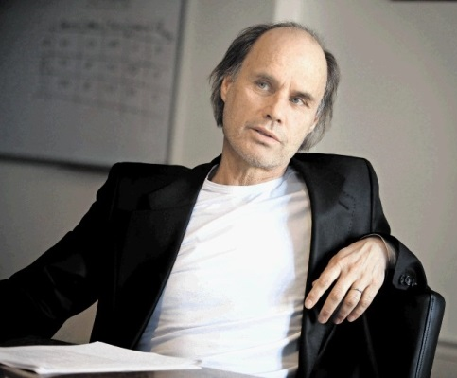
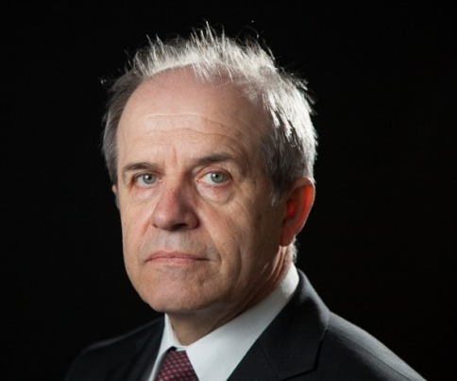
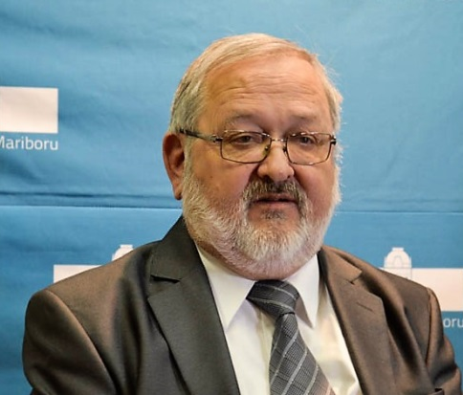
Rectors Members of SRC 2016-2017
Prof. Dragan Marušič
Rector of the University of Primorska, President of SRC
Prof. Danilo Zavrtanik
Rector of the University of Nova Gorica
Vice-President of SRC
Prof. Ivan Svetlik
Rector of the University of Ljubljana
Prof. Igor Tičar
Rector of the University of Maribor

Slide 5
Organization
SRC is comprised of the Rectors of Slovenia’s four universities. The members have a status of full membership.
Rotating presidency: The Presidency and the Secretariat rotate among the members for a 2-year term. During this 2-year period the presidency chairs meetings to ensure the continuity of the SRC's work.
SRC is governed and represented by the President and the Vice-President. The President is the Rector of the university that presides over the SRC, the Vice-President is the Rector of the university that will hold the next presidency.
SRC Presidency & Secretariat 2016-2017:
University of Primorska • Titov trg 4 • 6000 Koper • Slovenia • www.upr.si

Slide 6
What we do
SRC addresses all issues related to the activities of Slovenian universities.
SRC supports its members by:
Promoting policies that will strengthen the Slovenian universities' role in the development of a knowledge-based society;
Promoting networking opportunities by enhancing the international dimension of universities through improved cooperation among its members;
Influencing key decision makers at national and international levels;
Informing members on policy debates impacting their development;
Strengthening the governance, leadership and management of its members through mutual learning, exchange of experiences and best practices.

Slide 7
SRC Activities & Services
To coordinate the ideas and actions of its members;
To promote cooperation on issues of common interest by contributing to the stability and the development of an open and democratic national HE system;
To act as a consultant, by presenting its views and by making appropriate recommendations to the government, national and international organizations.

Slide 8
SRC Working Groups (WG)
At the moment, there are 14 active SRC WGs covering different academic issues:
WG on Copyright Issues in Universities
WG on Modernization of the Enrolment system in Slovenian universities
WG on Classification of Study Programmes
WG on Smart Specialization, Innovative Business Support Environment and Talents
WG on Law on Research and Innovation Activities
WG on Initiative for Opening Up Slovenia
WG on Use of Language and the Development of a Strategy for the Use of Language
WG on Health Sciences
WG on Preparation of the New Legislation
WG on Student Athletes and University sport
WG on Informatics
WG on Habilitation Procedures
WG on Management of Genetically modified Organisms
Commission on Development of Quality Culture in Slovenian universities
University Art Observatory

Slide 9
Policy
University autonomy is at the heart of every university system.
The university as an academic community of students, teachers and researchers is the highest form of (collective) human creativity and expression that contributes to the greatest achievements of humankind.
Universities are autonomous institutions, which means they have to be able to independently pursue their mission and goals and to use human and financial recourses in order to achieve the best optimal functioning of the institution and to ensure that each individual academic member performs optimally.

Slide 10
Contact:
SRC Secretariat
University of Primorska
Titov trg 4 • 6000 Koper • Slovenia
Tel: +386 56 11 75 50 E-mail: frenk.mavric@upr.si
www.rkrs.si/en

Slide 11
Najlepša hvala. Thank you.

