Slide 1
UNiversity of NovA GoricA

Slide 2
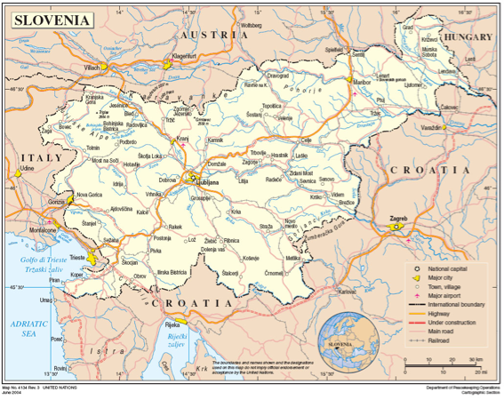

Slide 3
Foundation
1995 School of Environmental Science
1999 Nova Gorica Polytechnic
2006 University of Nova Gorica
Founders
Nova Gorica Municipality
Ajdovščina Municipality
Institute Jožef Stefan, Ljubljana

Slide 4
Internal strucure
Senate
Management Board
Rector
International council
Student council
Vice rector for science and arts
Vice rector for education
Library, Student office, Career center, International office, Industrial liaison office
Foundation UNG
Primorska Technology park
Research
Education

Slide 5
education
School of Environmental Sciences
School of Engineering and Management
School of Science
School of Humanities
School of Viticulture and Enology
School of Arts

Slide 6
graduate School
Environmental Sciences
Humanities
Molecular genetics and Biotechnology
Cognitive Science of Language
Physics
Economics and Techniques for the Concervation of the Architecutral and Environmental Heritage
Karstology

Slide 7
Research
Laboratory for Environmental and Life Sciences
Center for Systems and Information Technologies
Laboratory for Astroparticle Physics
Center for Atmospheric Research
Laboratory for Organic Matter Physics
Wine Research Center
Laboratory for Quantum Optics
Research Center for Humanities
Laboratory for Multiphase Processes
Center for Cognitive Science of Language
Materials Research Laboratory

Slide 8
INternational Relations
UNG is a member of:
EUA - European University Association
Alps - Adriatic Rectors’ Conference
DRC - Danube Rectors’ Conference
Slovenian Rector’s Conference
UNG signed
Magna Charta Universitatum
ERASMUS charter
Numerous international inter-institutional agreements

Slide 9
Recent rankings
President of the Republic:
The Order for Merits 2015
U-Multirank
2017
Report of the European Commission: Scientific Output and Collaboration of European Universities.
First in average SCI
Second in impact factor
Rank for 2016: 203 overall, 87 teaching

Slide 10
cooperation with Hungarian universites
Double-degree study programs
Physics
Environmental science
Computer science
Joint research programs
Materials science
Solid state physics
Atmospheric research
History (1st World war, Soča front)
Enology and viticulture

Slide 11
University of nova Gorica / Budapest metropolitan UNiversity
Joint study programs in the area of animation and film making

