Slide 1
Introduction of The Hungarian Rectors’ Conference 24 march 2016
Dr. Zoltán Dubéczi, Secretary General

Slide 2
INTRODUCTION OF HRC
The Hungarian Rectors’ Conference (HRC) has been operating now for 29 years.
The primary task of HRC is to represent higher education institutions and to protect their interests in both national and international level.
The HRC is the only organization in Hungary which represents higher education institutions and protects their interests; accordingly all the 66 Hungarian higher education institutions (universities and colleges included) are members of the HRC.

Slide 3
MEMBERS OF THE DELEGATION

Slide 4
MEMBERS OF THE DELEGATION
Ministry of Human Capacities:
Dr. László Palkovics
Minister of State for Education

Slide 5
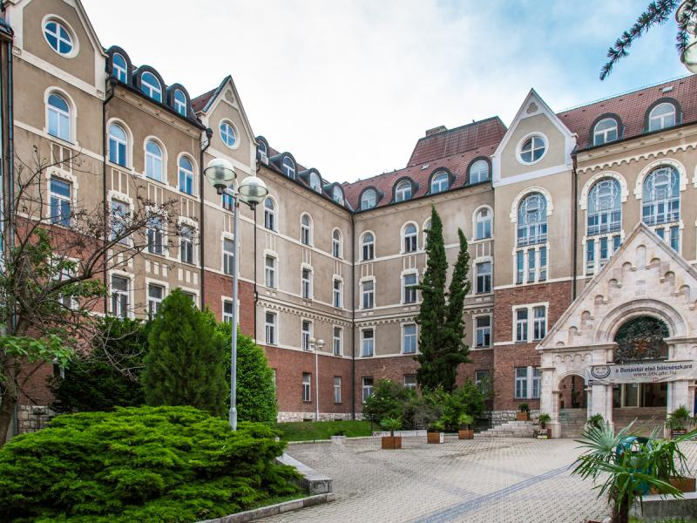
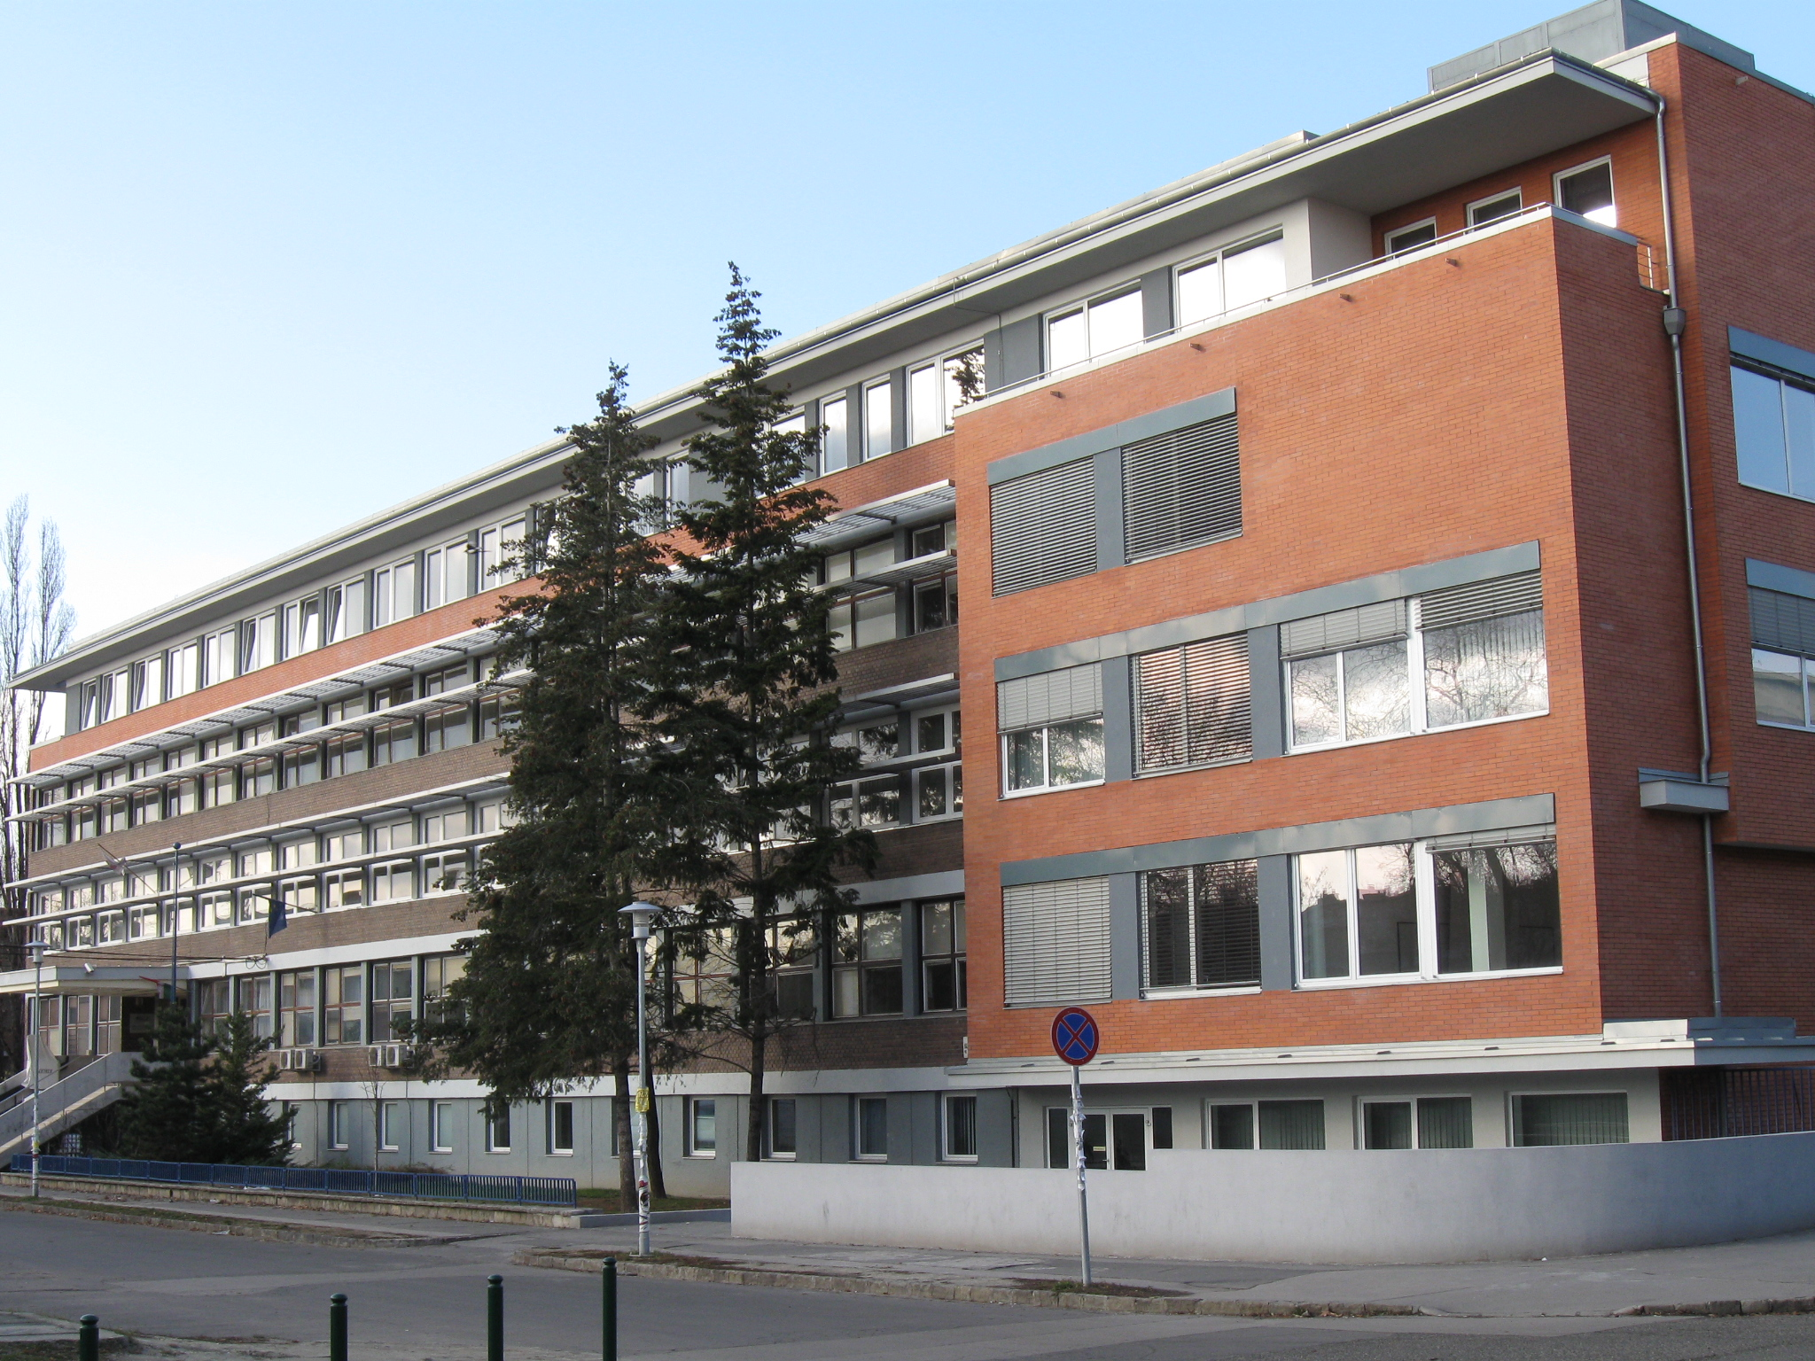
MEMBERS OF THE DELEGATION
Dr. József Bódis - president of HRC, rector of University of Pécs
Almost 20,000 students study at the Faculty of Law, Medical School, Faculty of Humanities, Faculty of Health Sciences, Faculty of Business and Economics, Faculty of Music and Visual Arts, Faculty of Engineering and Information Technology , Faculty of Sciences
Dr. Balázs Heidrich - rector of Budapest Business School
15,000 students study at the College of Commerce, Catering and Tourism , College of International Management and Business College of Finance and Accountancy and Zalaegerszeg College of Business Administration

Slide 6
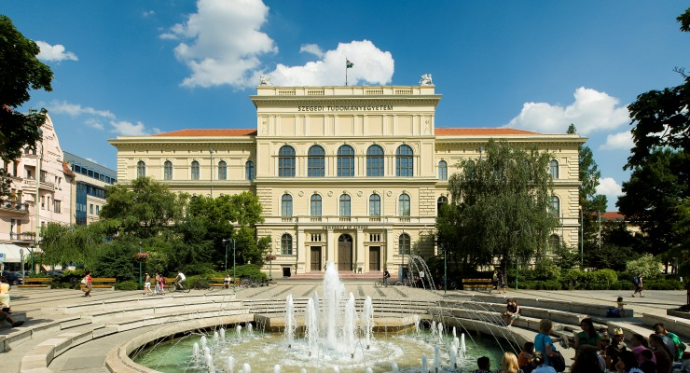
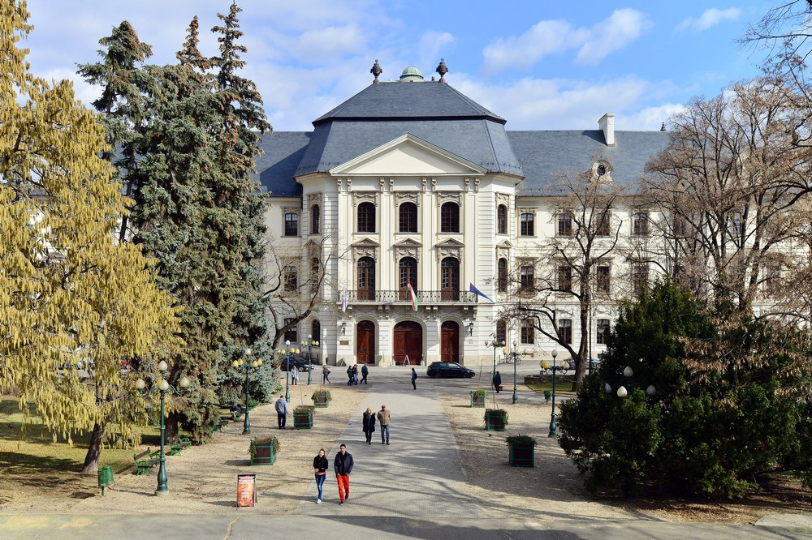
MEMBERS OF THE DELEGATION
Dr. Gábor Szabó - vice-president of HRC, rector of University of Szeged
Dr. Katalin Nagy – President of the HRC International Affairs Committee, vice-rector of University of Szeged
More than 22,000 students study at the Faculty of Agriculture, Faculty of Law and Political Sciences, Faculty of Arts, Faculty of Medicine, Faculty of Dentistry, Faculty of Music, Faculty of Economics and Business Administration, Faculty of Pharmacy, Faculty of Engineering, Faculty of Science and Informatics, Faculty of Health Sciences and Social Studies, Juhász Gyula Teacher Training Faculty
Dr. Kálmán Liptai - vice-president of HRC, rector of Eszterházy Károly University of Applied Sciences
More than 6,000 students study at the Faculty of the Humanities, Comenius Faculty, Faculty of Economics and Social Sciences, Faculty of Teacher Training and Knowledge Technology, Faculty of Natural Sciences

Slide 7
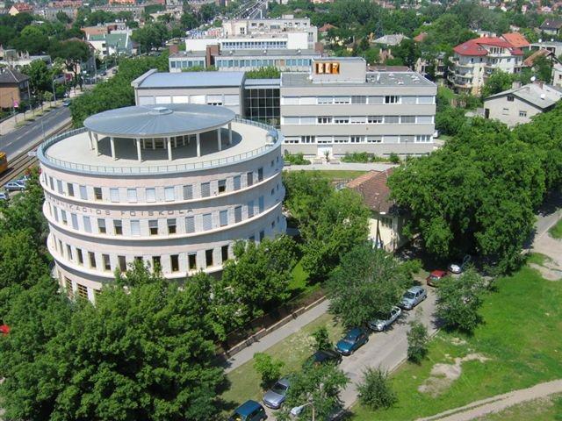
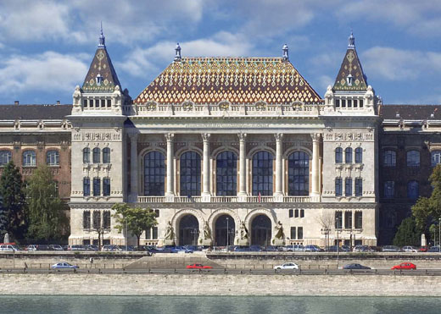
MEMBERS OF THE DELEGATION
Dr. László Vass - presidency member of HRC, rector of Budapest Metropolitan University
Almost 6,000 students study in the Institute of Economics and Business Sciences Institute of Marketing Institute of Methodology School of Tourism, Leisure and Hospitality Institute of Foreign Languages Institute of Social Sciences and International Studies Institute of Communication studies
Dr. János Józsa – rector of Budapest University of Technology and Economics
Faculties of Civil Engineering, Mechanical Engineering, Architecture, Chemical Technology and Biotechnology, Electrical Engineering and Informatics, Transportation Engineering and Vehicle Engineering, Natural Sciences, Economic and Social Sciences.

Slide 8
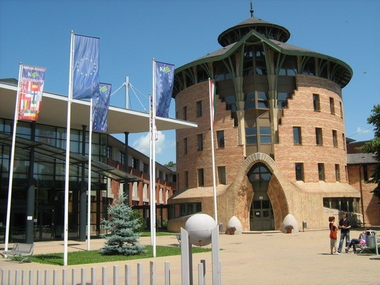
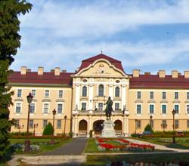
MEMBERS OF THE DELEGATION
Dr. Ferenc Szávai - presidency member of HRC, rector of Kaposvár University
Almost 3,000 students study at the Faculty of Agricultural and Environmental Sciences, Faculty of Arts, Faculty of Economic Science, Faculty of Pedagogy
Dr. Tőzsér János - rector of Szent István University
Dr. Molnár József - president of the supervisory board of the HRC, pro- rector of the Szent István University
Almost 15,000 students study at the Faculty Of Applied Arts, Faculty Of Agricultural And Environmental Sciences, Faculty Of Economics, Agriculture And Health Studies, Faculty Of Economics And Social Sciences , Faculty Of Food Science, Faculty Of Landscape Architecture , Faculty Of Mechanical Engineering , Faculty Of Veterinary Science, Ybl Miklós Faculty Of Architecture And Civil Engineering

Slide 9
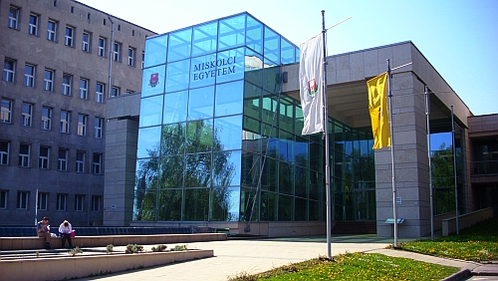
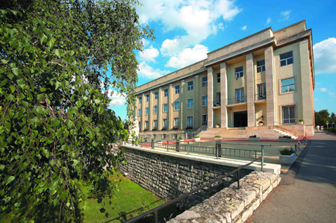
MEMBERS OF THE DELEGATION
Dr. András Torma - rector of University of Miskolc
Almost 10, 000 students study at the Faculty of Earth Science and Engineering, Faculty of Materials Science and Engineering, Faculty of Mechanical Engineering and Informatics Faculty of Law, Faculty of Economics, Faculty of Arts, Faculty of Healthcare, Bartók Béla Music Institute
Dr. András Gelencsér - rector of University of Pannonia
More than 6,000 students study at the Faculty of Business and Economics, Faculty of Engineering, Faculty of Information Technology, Faculty of Modern Philology and Social Sciences, Georgikon Faculty, Nagykanizsa Campus, Kőszeg Campus, Pápa Campus, Zalaegerszeg Campus, Centre for Agricultural Sciences

Slide 10
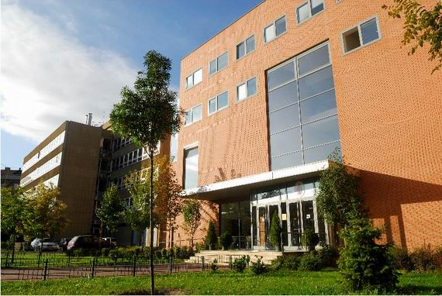
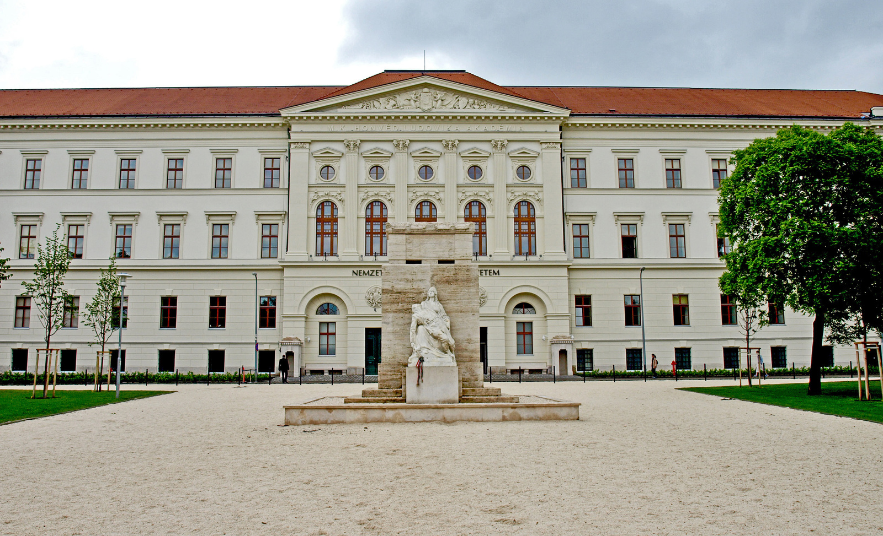
MEMBERS OF THE DELEGATION
Dr. Mihály Réger – rector of Óbuda University
Dr. József Gáti – vice-rector of Óbuda University
More than 12,000 students study at the Alba Regia Technical Faculty – Székesfehérvár, Donát Bánki Faculty of Mechanical and Safety Engineering, Kálmán Kandó Faculty of Electrical Engineering, Keleti Faculty of Business and Management, John von Neumann Faculty of Informatics, Sándor Rejtő Faculty of Light Industry and Environmental Protection Engineering, Ágoston Trefort Centre for Engineering Education
Dr. András Patyi – rector of the National University of Public Service
More than 6,000 students on the faculties of International and European Studies, Political Sciences and Public Administration, Law Enforcement, Military Sciences and Officer Training

Slide 11
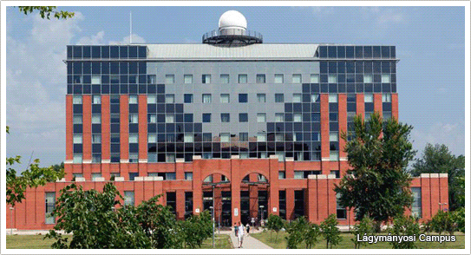
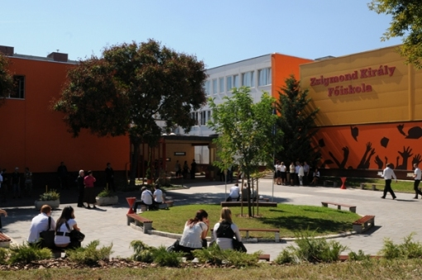
MEMBERS OF THE DELEGATION
Dr. András Kisfaludi - vice-rector for general affairs, Eötvös Loránd University
Almost 28,000 students study at the following faculties: Faculty of Education and Psychology, Faculty of Humanities, Faculty of Informatics, Faculty of Law, Faculty of Primary and Pre-School Education, Faculty of Science, Faculty of Social Sciences Bárczi Gusztáv Faculty of Special Education
Dr. Péter Szatmári - member of HRC, rector of King Sigismund Business School
Over 1,500 students study at the Institute of International and Political Studies, Institute of Business and Management, Institute of Communication and Media Studies, Institute of Foreign Languages

Slide 12
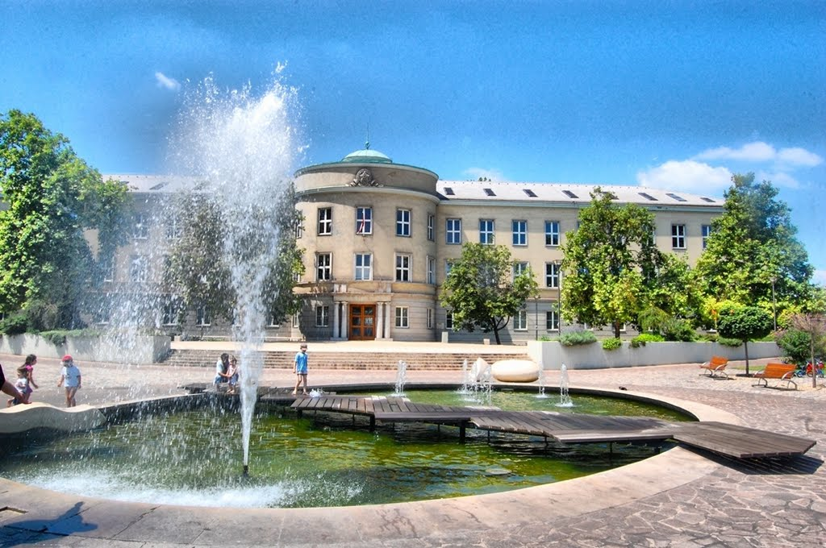
MEMBERS OF THE DELEGATION
Dr István András – presidency member of HRC,rector of the University of Dunaújváros
The university offers bachelor courses in Computer Engineering, Engineering Business Management, Communication and Media, Business Administration, Material Engineering, Mechanical Engineer and master course in Teacher of Engineering.

Slide 13
MEMBERS OF THE DELEGATION
Dr Márta Takács – President of the HRC Committee of Cross-Border Higher Educational Institutions
Dr Orsolya Heuer – legal advisor, HRC Secretariat
Fanni Komlós – Secretary of International Affairs, HRC Secretariat

Slide 14
Structure of membership
Number of HEI’s
66 Institutions
State institutions |  |  |  | Church and Private institutions
29 |  |  |  | 37 (9 Universities, 28 Colleges)
 |  |  |  | Church Institutions |  |  |  | Private Institutions
 |  |  |  | 26 |  |  |  | 11
Universities |  | Colleges |  | Universities |  | Colleges |  | Universities |  | Colleges
27 |  | 2 |  | 5 |  | 21 |  | 4 |  | 7
Budapest | Other Cities | Budapest | Other Cities | Budapest | Other Cities | Budapest | Other cities | Budapest | Other cities | Budapest | Other cities
14 | 13 | 1 | 1 | 4 | 1 | 8 | 13 | 4 | 0 | 5 | 2
Structure of HRC’s membership

Slide 15
ORGANIZATIONAL STRUCTURE
Plenary Session: comprising 65 rectors (1 church institution’s the operation is temporarily suspended)
Main decision making body, holds meetings 4 times a year
Presidency: 12 members
Delegates from each smaller sector of the system, 2 years long mandates, meetings held on a monthly basis
19 committee (13 academic, 5 functional)

Slide 16
ORGANIZATION
President – elected every 2 years
Co-president – elected every 2 years
2 Vice-presidents
3 Presidents of the Sections
Honorary president
Secretary General

Slide 17
REPRESENTATION OF INTEREST
Participation, representation of interests in drafting legislative provisions.
Per annum, the HRC opines on about 30-40 statutory proposals, in this manner participating in the legislation procedures related to higher education.
Presentation of proposals, opinion or initiation in any issue with relevance to higher education.
The HRC presents a dozen of initiatives on various fields of higher education every year.

Slide 18
International ROLE of the HRC

Slide 19
COOPERATION AND MEMBERSHIPS
European University Association, EUA (Belgium, Brussels)
an umbrella organization of European universities and national rectors’ conferences (The Council of the EUA involves the presidents of all the European rectors conference’s )
Academic Links and Strategies for the Internationalization of the HE Sector, ALISIOS
International Association of Universities, IAU (France, Paris)
organization comprising the worlds’ institutions of higher education belonging to the UNESCO family
European Association for International Education, EAIE
European Association of Institutions in Higher Education, EURASHE
Organization for Economic Co-operation and Development, OECD
Science without Borders (Brazil)
Horizon2020 (European Union)

Slide 20
ROLE IN THE INTERNATIONALIZATION
Constant and effective dialogue with international partners:
Embassies
Hungarian and foreign ministries
Foreign agencies
Scholarship management
Science without Borders
Summer universities
Organizing international programs:
Incoming and outgoing delegation visits
Joint conferences
Workshops

Slide 21
Thank you for your attention!
dubeczi@mrk.hu

