Slide 1
THE COIMBRA GROUP OF BRAZILIAN UNIVERSITIES

Slide 2
SUMMARY
THE CGBU
PARTNERS AND SUPPORTERS
EVENTS IN 2017
PROJECTS AND PROGRAMS

Slide 3
      THE COIMBRA GROUP OF BRAZILIAN UNIVERSITIES
  Mission and objectives
  Associated Universities
  Organizational Structure

Slide 4

THE COIMBRA GROUP OF BRAZILIAN UNIVERSITIES
  Network comprising 77 Brazilian Higher Education Institutions.
  Founded in 2008 , in Brasilia, Brazil.
  Institutional mission:
  To develop academic, scientific and cultural relations between among its associated institutions and to foster university internationalization, through international cooperation programs, projects and actions.

Slide 5
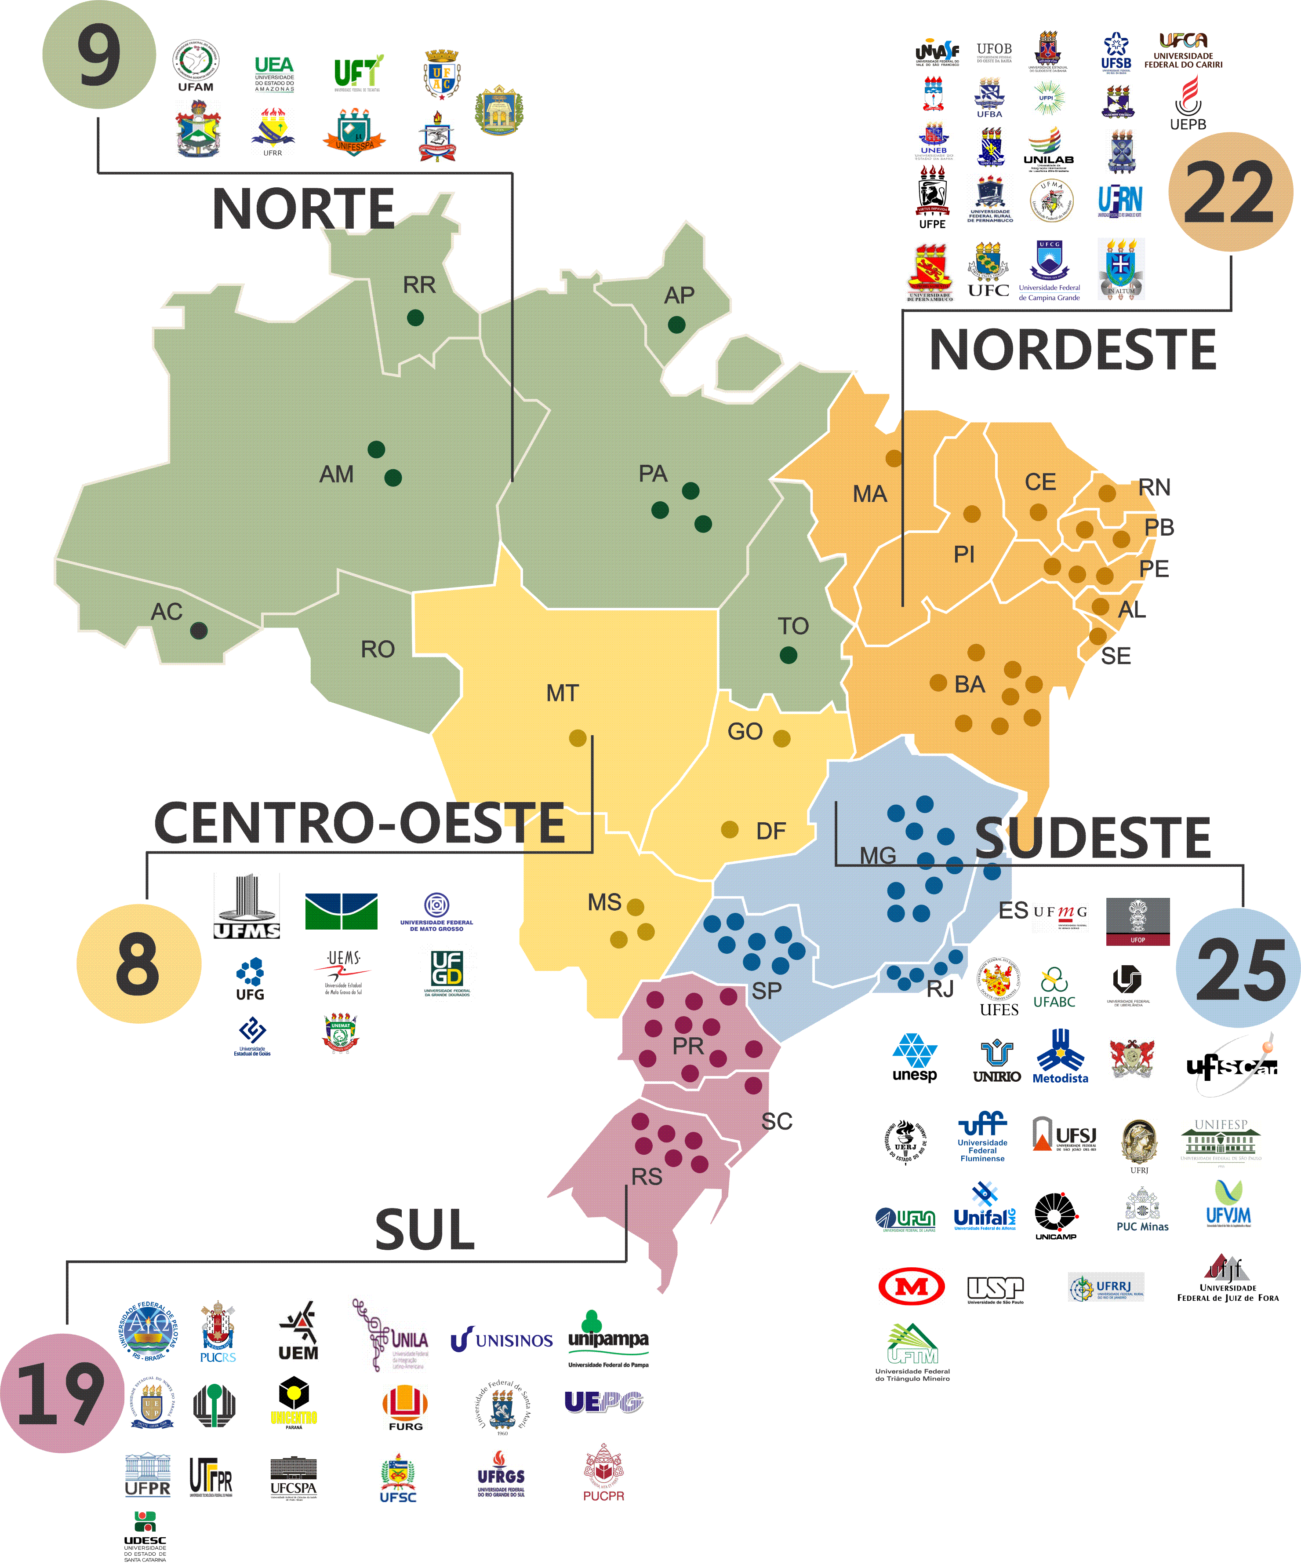
ASSOCIATED UNIVERSITIES
83
    ASSOCIATED UNIVERSITIES
    57
    20
    6
    Federal
  State
Community
25
5
  Brazilian Federal States + Federal District
    Regions in Brazil

Slide 6


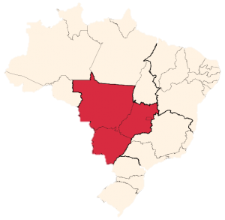





ASSOCIATED UNIVERSITIES
        MIDWESTERN
  Universidade Estadual de Goiás
  Universidade Federal da Grande Dourados
Rector Haroldo Reimer
Rector Liane Maria Calarge
  Universidade do Estado de Mato Grosso
  Universidade Federal de Goiás
Rector Ana Maria Di Renzo
Rector Orlando Afonso Valle do Amaral
  Universidade de Brasília
  Universidade Federal de Mato Grosso
Rector Márcia Abrahão
Rector Myrian de Moura Serra
  Universidade Estadual de Mato Grosso do Sul
  Universidade Federal de Mato Grosso do Sul
      8
Rector Fábio Edir dos Santos Costa
Rector Marcelo Augusto Santos Turine

Slide 7


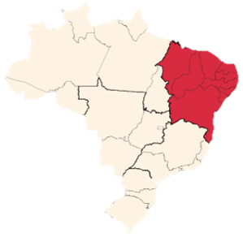






UNIVERSIDADES ASSOCIADAS
        NORTHWEST
  Universidade de Pernambuco
  Universidade Estadual do Sudoeste da Bahia
Reitor Pedro Henrique de Barros Falcão
Reitor Paulo Roberto Pinto Santos
  Universidade do Estado da Bahia
  Universidade Federal da Bahia
Reitor José Bites de Carvalho
Reitor João Carlos Salles Pires da Silva
  Universidade Estadual de Feira de Santana
  Universidade Federal da Integração Luso-Afro-Brasileira
Reitor Evandro do Nascimento Silva
Reitor Tomaz Aroldo da Mota Santos
  Universidade Estadual de Santa Cruz
  Universidade Federal da Paraíba
      22
Reitora Adélia Maria Carvalho de Melo Pinheiro
Reitora Margareth de Fátima Formiga Melo Diniz

Slide 8








UNIVERSIDADES ASSOCIADAS
        NORTHWEST
  Universidade Federal de Alagoas
  Universidade Federal do Ceará
Reitora Maria Valéria Costa Correia
Reitor Henry de Olanda Campos
  Universidade Federal de Campina Grande
  Universidade Federal do Maranhão
Reitor José Edilson de Amorim
Reitora Nair Portela
  Universidade Federal de Pernambuco
  Universidade Federal do Oeste da Bahia
Reitor Anísio Brasileiro de Freitas Dourado
Reitora Iracema Santos Veloso
  Universidade Federal de Sergipe
  Universidade Federal do Piauí
      22
Reitor Angelo Roberto Antoniolli
Reitor José Arimatéia Dantas Lopes

Slide 9






UNIVERSIDADES ASSOCIADAS
        NORTHWEST
  Universidade Federal do Cariri
  Universidade Estadual da Paraíba
Rector Ricardo Luiz Lange Ness
Reitora Ângela Maria Paiva Cruz
  Universidade Federal do Rio Grande do Norte
  Universidade Federal do Vale do São Francisco
Reitora Ângela Maria Paiva Cruz
Reitor Julianeli Tolentino de Lima
  Universidade Federal do Sul da Bahia
  Universidade Federal Rural de Pernambuco
      22
Reitor Naomar Monteiro de Almeida Filho
Reitora Maria José de Sena

Slide 10

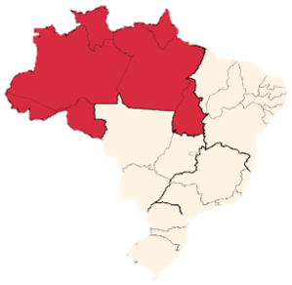





UNIVERSIDADES ASSOCIADAS
        NORTH
  Universidade Federal do Acre
Reitor Minoru Kinpara
  Universidade do Estado do Amazonas
  Universidade Federal do Amapá
Reitor Cleinaldo de Almeida Costa
Reitora Eliane Superti
  Universidade Federal de Roraima
  Universidade Federal do Amazonas
Reitor Jefferson Fernandes do Nascimento
Reitora Márcia Perales Mendes Silva
  Universidade Federal do Oeste do Pará
      9
Reitora Raimunda Nonata Monteiro

Slide 11



UNIVERSIDADES ASSOCIADAS
        NORTH
  Universidade Federal do Sul e Sudeste do Pará
Reitor Maurílio de Abreu Monteiro
  Universidade Federal do Pará
  Universidade Federal do Tocantins
Reitor Emmanuel Zagury Tourinho
Reitora Isabel Cristina Auler Pereira
      9

Slide 12


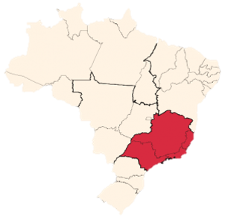






UNIVERSIDADES ASSOCIADAS
        SOUTHWEST
  Pontifícia Universidade Católica de Minas Gerais
  Universidade Estadual Paulista « Júlio de Mesquita Filho »
Reitor Joaquim Giovani Mol Guimarães
Reitor Sandro Roberto Valentini
  Universidade de São Paulo
  Universidade Federal de Alfenas
Reitor Marco Antonio Zago
Reitor Paulo Márcio de Farias e Silva
  Universidade do Estado do Rio de Janeiro
  Universidade Federal de Juiz de Fora
Reitor Ruy Garcia Marques
Reitor Marcos Vinício Chein Feres
  Universidade Estadual de Campinas
  Universidade Federal de Lavras
      25
Reitor José Tadeu Jorge
Reitor José Roberto Soares Scolforo

Slide 13








UNIVERSIDADES ASSOCIADAS
        SOUTHWEST
  Universidade Federal de Minas Gerais
  Universidade Federal de São Paulo
Reitor Jaime Arturo Ramírez
Reitora Soraya Soubhi Smaili
  Universidade Federal de Ouro Preto
  Universidade Federal de Uberlândia
Reitor Cláudia Aparecida Marliére de Lima
Reitor Valder Steffen Júnior
  Universidade Federal de São Carlos
  Universidade Federal de Viçosa
Reitora Wanda Aparecida Machado Hoffmann
Reitora Nilda de Fátima Ferreira Soares
  Universidade Federal de São João Del Rei
  Universidade Federal do ABC
      25
Reitor Sérgio Augusto Araújo da Gama Cerqueira
Reitor Klaus Capelle

Slide 14








UNIVERSIDADES ASSOCIADAS
        SOUTHWEST
  Universidade Federal do Espírito Santo
  Universidade Federal Fluminense
Reitor Reinaldo Centoducatte
Reitor Sidney Luiz de Matos Mello
  Universidade Federal do Estado do Rio de Janeiro
  Universidade Federal Rural do Rio de Janeiro
Reitor Luiz Pedro San Gil Jutuca
Reitora Ana Maria Dantas Soares
  Universidade Federal do Rio de Janeiro
  Universidade Metodista de São Paulo
Reitor Roberto Leher
Reitor Márcio de Moraes
  Universidade Federal dos Vales do Jequitinhonha e Mucuri
  Universidade Presbiteriana Mackenzie
      25
Reitor Gilciano Saraiva Nogueira
Reitor Benedito Guimarães Aguiar Neto

Slide 15

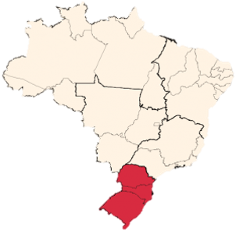






UNIVERSIDADES ASSOCIADAS
        SOUTH
  Universidade do Vale do Rio dos Sinos
Reitor Marcelo Fernandes de Aquino
  Universidade do Estado de Santa Catarina
  Universidade Estadual de Londrina
Reitor Marcus Tomasi
Reitora Berenice Quinzani Jordão
  Pontifícia Universidade Católica do Paraná
  Universidade Estadual de Maringá
Reitor Waldemiro Gremski
Reitor Mauro Luciano Baesso
  Pontifícia Universidade Católica do Rio Grande do Sul
  Universidade Estadual de Ponta Grossa
      19
Reitor Evilázio Francisco Borges Teixeira
Reitor Carlos Luciano Santa'Ana Vargas

Slide 16






UNIVERSIDADES ASSOCIADAS
        SOUTH
  Universidade Federal da Integração Latino-Americana
Reitor Josué Modesto dos Passos Subrinho
  Universidade Estadual do Centro-Oeste do Paraná
  Universidade Federal de Ciências da Saúde de Porto Alegre
Reitor Aldo Nelson Bona
Reitora Lucia Campos Pellanda
  Universidade Estadual do Norte do Paraná
  Universidade Federal de Pelotas
Reitora Fátima Aparecida Cruz Padoan
Reitor Pedro Rodrigues Curi Hallal
  Universidade Federal de Santa Catarina
      19
Reitor Luis Carlos Cancellier de Olivo

Slide 17






UNIVERSIDADES ASSOCIADAS
        SOUTH
  Universidade Federal do Paraná
Reitor Ricardo Marcelo Fonseca
  Universidade Federal de Santa Maria
  Universidade Federal do Rio Grande
Reitor Paulo Afonso Burmann
Reitora Cleuza Maria Sobral Dias
  Universidade Federal do Pampa
  Universidade Federal do Rio Grande do Sul
Reitor Marco Antonio Fontoura Hansen
Reitor Rui Vicente Oppermann
  Universidade Tecnológica Federal do Paraná
      19
Reitor Luiz Alberto Pilatti

Slide 18
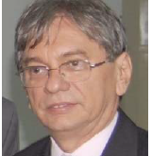
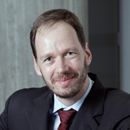
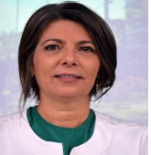
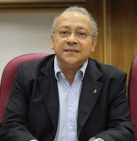
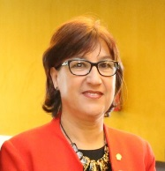
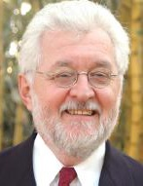
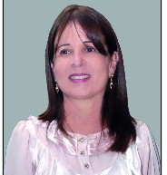
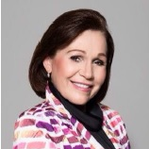
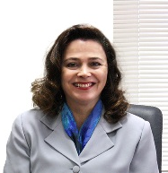
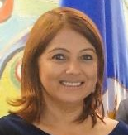
ORGANIZATIONAL STRUCTURE
  Rector José Arimatéia Dantas Lopes (UFPI)
  Rector Klaus Werner Capelle (UFABC)
  Rector Adélia Maria Carvalho Pinheiro (UESC)
  Rector Cleuza Maria Sobral Dias (FURG)
  Rector Luiz Pedro San Gil Jutuca (UNIRIO)
  Prof. Carlos Alberto Kamienski (UFABC)
  Prof. Márcio Venício Barbosa (UFRN)
  Rector Marcelo Fernandes de Aquino (UNISINOS)
  Prof. César Finger
  (UFSM)
  Prof. Naziano Pantoja
  (UFAM)
  Prof. Harold M. Butch Wright (UEA)
  Prof. Ofir Bergemann
  (UFG)
  Rector Margareth de Fátima Diniz (UFPB)
  Rector Maria José de Sena (UFRPE)
  Prof. Jardelina Bispo do Nascimento (UNEB)
  Prof. Rita Louback
  (PUC-MG)
  Prof. José Antônio Rodrigues da Silva (UFPB)
  Prof. Sabine Gorovitz
  (UnB)
  Professor Rossana Valéria de Souza e Silva (UnB – GCUB)
  Prof. Lincoln Paulo Fernandes (UFSC)
  Rector Soraya Soubhi Smaili (UNIFESP)
  Prof. Silvana Lucato Moretti (UEMS)

Slide 19
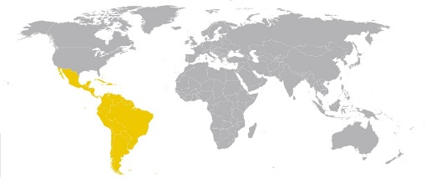
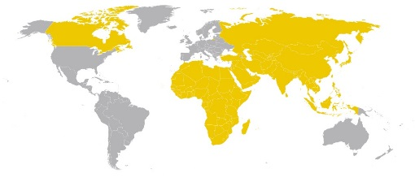
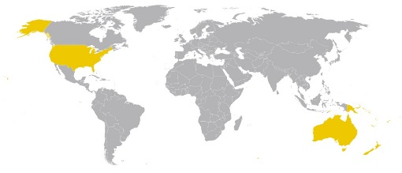
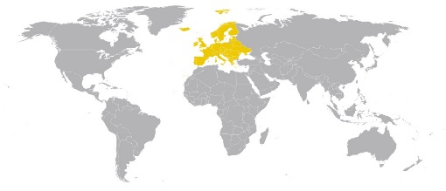
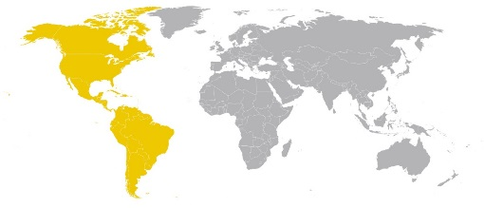
ORGANIZATIONAL STRUCTURE
EXECUTIVE DIRECTOR
GENERAL COORDINATION
General Coordination of Projects and Programmes
Events’ Coordination
Administrative Manager
COORDINATORS PER AREA
South America, Mexico and the Caribbean
Asia, Africa and Canada
United States and Oceania
Brazil Scholarships
PAEC OAS-CGBU
Europe

Slide 20
      PARTNERS AND
      SUPPORTERS
  Brazilian partners and supporters
  Partners and Supporters: categories
  Brazilian partners and supporters
  International partners and supporters

Slide 21
PARTNERS AND SUPPORTERS: CATHEGORIES
UNIVERSITY
NETWORKS
ASSOCIATIONS
INTERNATIONAL
ORGANIZATIONS
TECHNOLOGY
INSTITUTES
  The CGBU develops its programs and activities with the support of several
  Partners
CULTURAL
CENTERS
GOVERNMENTAL
BODIES
RECTORS´
COUNCILS
UNIVERSITIES

Slide 22
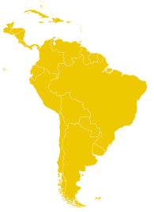













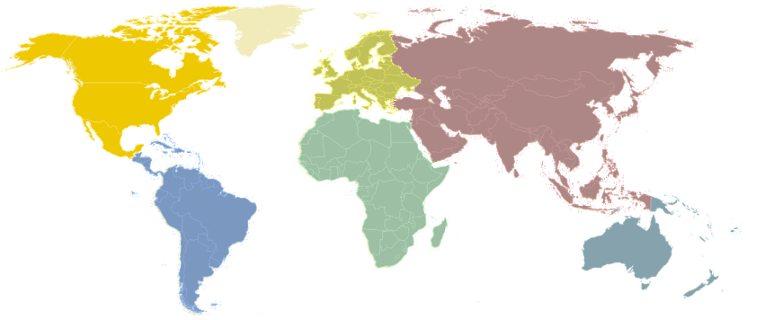
BRAZILIAN PARTNERS AND SUPPORTERS
          BRAZIL
(Ministry of Education)
(Ministry of Science, Technology, Innovation and Communications)

Slide 23
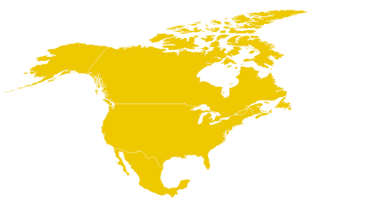
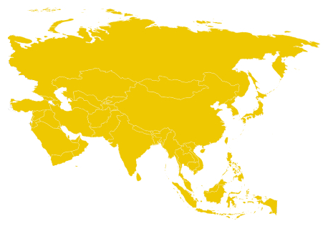

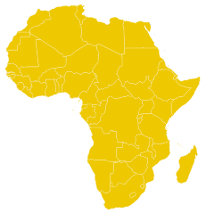

INTERNATIONAL PARTNERS AND SUPPORTERS

Slide 24


















NORTH AMERICA
          UNITED STATES
          MEXICO
          CANADA
Instituto Politécnico Nacional

Slide 25











SOUTH AMERICA, CENTRAL AMERICA AND THE CARIBBEAN
          BOLIVIA
          COLOMBIA
Association of Universities from the Amazon Region
          ARGENTINA
          CHILE
          CUBA
(Cuban Ministry of Higher Education)

Slide 26








SOUTH AMERICA, CENTRAL AMERICA AND THE CARIBBEAN
          ECUADOR
          JAMAICA
          NICARAGUA
          PANAMA
Universidad Técnica de Ambato
          DOMINICAN REPUBLIC
          SURINAME
          URUGUAY
          VENEZUELA

Slide 27















EUROPE
          BELGIUM
          SPAIN
          ESTONIA
          ITALY

Slide 28










EUROPE
          HUNGARY
          PORTUGAL
          UNITED KINGDOM
          ROMANIA
          FRANCE
          SWEDEN
          SWITZERLAND

Slide 29





AFRICA
          ANGOLA
          GHANA
          MOROCCO
          MOZAMBIQUE

Slide 30











ASIA
          CHINA
          BRUNEI
Universiti Brunei Darussalam

Slide 31









ASIA
          SOUTH KOREA
          JORDAN
          TURKEY
Association of Arab Universities

Slide 32
      PROGRAMS AND PROJECTS
  Undergraduate Mobility
  Graduate Mobility
  Thematic Seminars
  Short-term courses
  International missions
  Funding mechanisms

Slide 33
PROGRAMS AND PROJECTS
VALOFRAM
Engineering
Formation Course
Biodiversity
Be_A_Doc
CAMINOS
Intercultural Competencies
China
PAEC
OEA-GCUB
PROPE
OVERWORLD
Nanotechnology
Tropical Diseases
PROPAT
BRAMEX
Spanish Courses
BRACOL
UBD
GDP
Peru

Slide 34

UNDERGRADUATE MOBILITY PROGRAMS
GENERAL STRUCTURE:
Pro-Rector for Undergraduate Studies
PARTNER
Rector
Program Coordinator
International Relations Advisor
Program Vice-Coordinator

Slide 35





BRAZIL – COLOMBIA STUDENT EXANGE PROGRAM
BRACOL
BRAMEX
BRAZIL – MEXICO STUDENT EXANGE PROGRAM
  Partner:
  Undergraduate student exchange between ASSOCIATED UNIVERSITIES of GCUB and ASSOCIATED UNIVERSITIES of the PARTNERS
  Partner:
Institutional Coordinators
Institutional Coordinators
2014
  Benefits:
  Academic fees exemption
  Meals and accomodation
  Offered by the host university
  Optional aids
  Offered by sending university
2011
RELEASE YEAR
RELEASE YEAR
5
5
EDITIONS
EDITIONS
46
35
HEI ASSOCIATED TO GCUB HAVE ADHERED TO THE PROGRAM
HEI ASSOCIATED TO GCUB HAVE ADHERED TO THE PROGRAM
  Characteristics:
  One semestre exchange
  All knowledge domains
210 BRAZILIAN AND COLOMBIAN STUDENTS HAVE PARTICIPATED SINCE 2014
119 BRAZILIAN AND MEXICAN STUDENTS HAVE PARTICIPANTED SINCE 2011

Slide 36


OVERWORLD
ITALY-BRAZIL MOBILITY PROGRAM
  Partner:
  Undergraduate and graduate mobility program from UNIVERSITY OF PARMA to the ASSOCIATED UNIVERSITIES of GCUB
2017
RELEASE YEAR
1
FIRST EDITION IN THE 2ND SEMESTER 2017
43
  Benefits:
  Academic fees exemption
  Offered by the host university
  2400 EUR Scholarship
  Offered by the University of Parma
  Knowledge domains:
  Medecine and Nursing;
  Economy and Business Administration
  Humanities: Languages, Philosophy and Education
HEI ASSOCIATED TO GCUB HAVE ADHERED TO THE PROGRAM
12 ITALIAN STUDENTS ARE EXPECTED TO PARTICIPATE IN THE FIRST EDITION.
Institutional Coordinators
  One semester exchange

Slide 37


UBD - GCUB
ACADEMIC EXCHANGE PROGRAM AT BRUNEI DARUSSALAM UNIVERSITY
  Partner:
  Undergraduate exchange program between UBD and the ASSOCIATED UNIVERSITIES of GCUB
2017
RELEASE YEAR
1
FIRST EDITION IN THE 2ND SEMESTER 2017
  Characteristics:
  One semestre exchange
  All knowledge domains
STUDENTS FROM ALL UNIVERSITIES ASSOCIATED TO THE CGBU CAN APPLY.
4 BRAZILIAN STUDENTS ARE EXPECTED TO PARTICIPATE IN THE FIRST EDITION.
Universiti Brunei Darussalam (UBD)
  Benefits:
  Academic fees exemption
  Volunteer internship
  Offered by the host university

Slide 38
GRADUATE MOBILITY PROGRAMS
GENERAL STRUCTURE:
Pro-Rector for Undergraduate Studies
PARTNER
Rector
Program Coordinator
International Relations Advisor
Program Vice-Coordinator

Slide 39


BRAZIL SCHOLARSHIPS - PAEC OAS-CGBU
PARTNERSHIPS PROGRAM FOR EDUCATION AND TRAINING
2011
RELEASE YEAR
  Brazilian Universities associated to CGBU provide scholarships for master and doctoral studies to students from the 34 OAS member countries
  Partners:
7
EDITIONS
65
HEI ASSOCIATED TO GCUB HAVE ADHERED TO THE PROGRAM
(Organization of American States - OAS)
  Characteristics:
  Full master or PhD
  All knowledge domains
2.865 SCHOLARSHIPS OFFERED FROM 2011 TO 2017
  Benefits:
  Arrival Subsidy U$1200 (150 grants)
  Offered by OAS
  Monthly stipend (from R$1500,00 to R$2200,00).
  Portuguese course
  Subsidized meals, access to University facilities
  Offered by the host University
(Brazilian Ministry of Foreign Affairs)
Institutional Coordinators

Slide 40
Bolsas Brasil - PAEC OAS-CGBU
OBJECTIVES
TO CONTRIBUTE TO THE DEVELOPMENT OF BRIGHT INDIVIDUALS IN THE AMERICAS.
TO FAVOR INTEGRATION AND REGIONAL DEVELOPMENT THROUGH TRAINING AND FORMATION OF LEADERS WITH MASTER AND PhD DEGREES ABLE TO ACT IN DIFFERENT SECTORS SUCH AS:
UNIVERSITIES AND RESEARCH INSTITUTIONS
GOVERNMENTAL AGENCIES
COMPANIES
OTHERS

Slide 41
Bolsas Brasil - PAEC OAS-CGBU
ORGANIZATIONAL CHART
UNIVERSITIES
OAS - CGBU
RECTOR
INSTITUTIONAL COORDINATOR
COURSE DIRECTORS
STUDENTS
VICE-INSTITUTIONAL COORDINATOR
ORIENTADOR
GENERAL COORDINATION
OAS
EMPLOYEE 1
OAS
EMPLOYEE 2
OAS
GENERAL COORDINATION
BRAZIL
EMPLOYEE 1
CGBU
EMPLOYEE 2
CGBU
UNIVERSITIES + STUDENTS
STUDENTS

Slide 42
Bolsas Brasil - PAEC OAS-CGBU
CRONOLOGY
2011
BEGINNING OF THE PROGRAM – MASTER LEVEL ONLY
2012
EXPANSION: PhD Courses included
2013
PORTUGUESE LANGUAGE CERTIFICATE – WAIVER → PARTICIPATION OF ENGLISH-SPEAKING COUNTRIES
2014
PAHO/WHO AGREEMENT
INCLUSION OF HEALTH SCIENCES
2015
RECORD IN NUMBER OF APPLICATIONS, NUMBER OF SCHOLARSHIPS AND UNIVERSITIES
2016
INCREASE RATIO
CANDIDATE / VACANCIES

Slide 43
Bolsas Brasil - PAEC OAS-CGBU
BENEFITS
OFFERED BY BRAZILIAN UNIVERSITIES
MONTHLY STIPENDS
R$ 1.500,00 MASTER (2 YEARS)
R$ 2.200,00 PhD (4 YEARS)
FREE PORTUGUESE COURSE THROUGHOUT THE WHOLE PERIOD OF STUDIES
ACCESS TO UNIVERSITY RESTAURANTS, LABORATORIES, LIBRARIES
OFFERED BY OAS
ONE-TIME GRANT – ARRIVAL SUBSIDY:
US$ 1,200 – 150 GRANTS

Slide 44
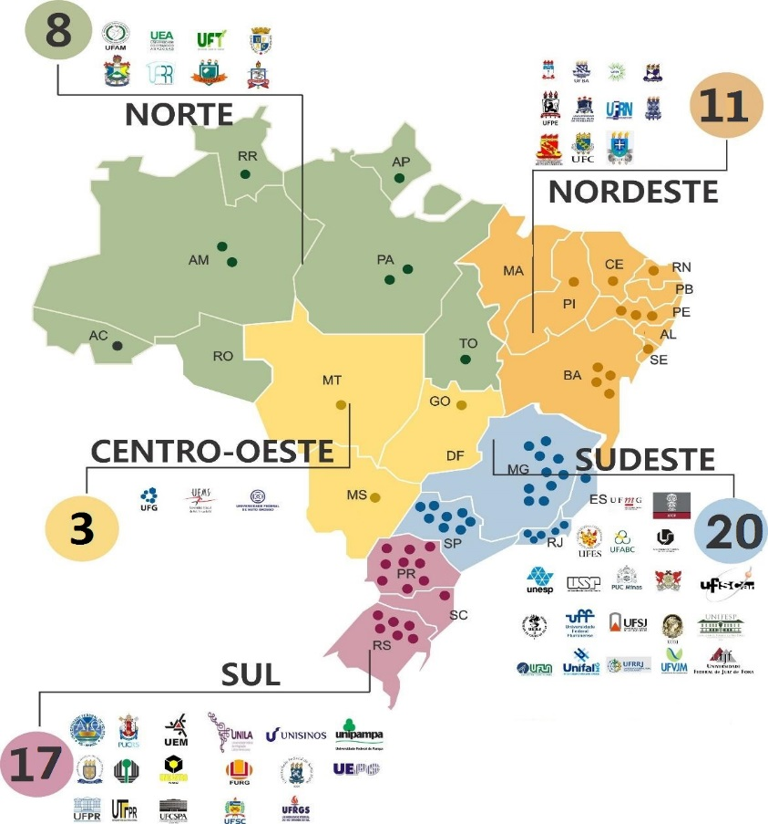





BRAZIL SCHOLARSHIP PAEC OAS – CGBU
UNIVERSIDADES BRASILEÑAS DISTRIBUIDAS POR REGIÓN
9
2017
13
2017
WHERE ARE THE PAEC OAS-CGBU
STUDENTS ?
70
4
22
2017
2017
UNIVERSITIES

Slide 45
BRAZIL SCHOLARSHIP PAEC OAS – CGBU
IMPACT ON
Training and Education of leaders in the Americas in
MASTER’S and DOCTORATE
2011 - 2017
2078
MASTER’S SCHOLARSHIPS
787
DOCTORATE SCHOLARSHIPS
TOTAL
2865 SCHOLARSHIPS

Slide 46
BRAZIL SCHOLARSHIP PAEC OAS – CGBU
EVOLUTION IN THE TOTAL NUMBER OF APPLICATIONS RECEIVED
2011 - 2017
+ 30.000
TOTAL APPLICATIONS
2011 - 2017

Slide 47
Bolsas Brasil - PAEC OAS-CGBU
GROWTH IN THE NUMBER OF SCHOLARSHIPS OFFERED BY BRAZILIAN UNIVERSITIES
2011 - 2016
59
UNIVERSITIES
(Participated in the Program)
737
PARTICIPATING BRAZILIAN UNIVERSITIES
2.195
STIPENDS
403
Source: CGBU-OAS

Slide 48
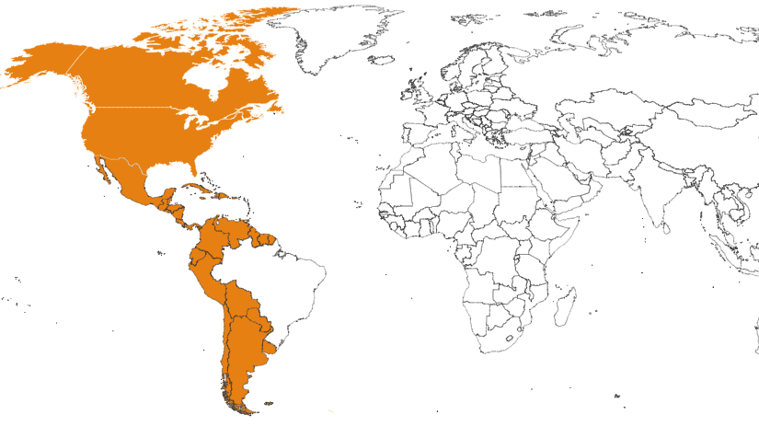





























29
STUDENTS FROM THE OAS MEMBER STATES
Argentina
Guyana
Belize
Haiti
Bolivia
Saint Vincent and
the Grenadines
Honduras
Canada
Jamaica
Suriname
Chile
Mexico
The Bahamas
Colombia
Nicaragua
Trinidad and Tobago
Costa Rica
Panama
United States
Dominica
Paraguay
Uruguay
Dominican Republic
Peru
Venezuela
Ecuador
Saint Lucia
El Salvador
Guatemala

Slide 49








Bolsas Brasil - PAEC OAS-CGBU
TOP 10 COUNTRIES WITH HIGHEST NUMBER OF STUDENTS IN THE PROGRAM
2011 - 2016
Colombia
565
Peru
242
Venezuela
179
Mexico
139
Ecuador
117
Bolivia
108
Honduras
97
Argentina
81
Costa Rica
69
Chile
68

Slide 50
BRAZIL SCHOLARSHIP PAEC OAS – CGBU
NEW UNIVERSITIES THAT HAVE JOINED IN
2017
38 NEW SCHOLARSHIPS
6 NEW UNIVERSITIES
UFOPA
UFSB
UPM
→ 4 Master’s scholarships
Federal/ North
→ 2 Master’s scholarships
→ 1 PhD scholarship
Federal/ Northeast
→ 2 Master’s scholarships
Community/ Southeast
UNB
UFMA
UNIRIO
→ 2 PhD scholarships
Federal/ Midwest
→ 19 Master’s scholarships
→ 7 PhD scholarships
Federal/ Northeast
→ 1 Master’s scholarships
Federal/ Southeast

Slide 51
BRAZIL SCHOLARSHIP PAEC OAS – CGBU
DISTRIBUTION OF STUDENTS BY KNOWLEDGE AREA* OF INCOMING STUDENTS IN 2017
*Areas classified by the
Coordination of Improvement of Personnel of Higher Education (CAPES)

Slide 52
BRAZIL SCHOLARSHIP PAEC OAS – CGBU
IN ADDITION TO THE STUDENTS,
BRAZIL SCHOLARSHIP PAEC OEA – GCUB,
INCLUDES A LARGE NUMBER OF PEOPLE.
General Coordinator and OAS team
Coordinator and PAHO team
Division of Educational Themes – DCE/MRE
Permanent Mission of Brazil - OAS
Representatives of the Permanent Commissions (31 countries) – OAS
31
Embassies

Slide 53
BRAZIL SCHOLARSHIP PAEC OAS – CGBU
ATORES ENVUELTOS EN EL PROGRAMA – BRASIL
38 INSTITUTIONAL COORDINATORS – PAEC
65 RECTORS
65 GRADUATE STUDIES PRO-RECTORS
38 VICE COORDINATORS
65 INTERNATIONAL RELATIONS ADVISORS
XX MASTER AND DOCTORATE COORDINATORS
XX ADVISORS OF DISSERTATIONS AND THESES

Slide 54
Bolsas Brasil - PAEC OAS-CGBU
SELECTED STUDENTS, BY COUNTRY - 2011 - 2016
COUNTRIES | 2011 | 2012 | 2013 | 2014 | 2015 | 2016 | TOTAL PER COUNTRY
Colombia | 5 | 79 | 115 | 157 | 155 | 54 | 565
Peru | 5 | 31 | 33 | 64 | 69 | 51 | 253
Venezuela | 3 | 4 | 20 | 34 | 61 | 45 | 167
Mexico | 4 | 14 | 29 | 26 | 41 | 32 | 146
Ecuador | 4 | 2 | 12 | 31 | 36 | 32 | 117
Bolivia | 5 | 6 | 13 | 27 | 36 | 15 | 102
Honduras | 4 | 3 | 12 | 33 | 27 | 21 | 100
Argentina | 4 | 4 | 17 | 20 | 21 | 15 | 81
Chile | 4 | 0 | 9 | 17 | 27 | 11 | 68
Costa Rica | 4 | 9 | 11 | 20 | 13 | 10 | 67
Haiti | 0 | 1 | 9 | 14 | 19 | 21 | 64
Nicaragua | 2 | 7 | 5 | 20 | 14 | 11 | 59
Paraguay | 4 | 1 | 9 | 11 | 19 | 11 | 55
El Salvador | 2 | 2 | 10 | 14 | 10 | 10 | 48
Guatemala | 3 | 1 | 6 | 13 | 17 | 4 | 44
Uruguay | 3 | 3 | 2 | 5 | 9 | 5 | 27
SELECTED STUDENTS, BY COUNTRY - 2011 - 2016
COUNTRIES | 2011 | 2012 | 2013 | 2014 | 2015 | 2016 | TOTAL PER COUNTRY
Dominican Republic | 2 | 2 | 5 | 7 | 9 | 2 | 27
Panama | 1 | 2 | 4 | 6 | 3 | 3 | 19
Jamaica | 0 | 1 | 3 | 3 | 1 | 0 | 8
United States | 0 | 0 | 3 | 3 | 0 | 0 | 6
Belize | 1 | 0 | 1 | 0 | 2 | 0 | 4
Suriname | 0 | 0 | 0 | 1 | 1 | 1 | 3
Guyana | 0 | 0 | 0 | 1 | 1 | 1 | 3
Dominica | 0 | 0 | 1 | 1 | 0 | 0 | 2
San Vicent and Granadines | 0 | 0 | 1 | 1 | 0 | 0 | 2
Trinidad and Tobago | 0 | 0 | 0 | 0 | 1 | 1 | 2
Bahamas | 0 | 0 | 1 | 0 | 0 | 0 | 1
Canada | 0 | 0 | 0 | 1 | 0 | 0 | 1
Santa Lucia | 0 | 0 | 0 | 1 | 0 | 0 | 1
TOTAL PER EDITION | 60 | 172 | 331 | 531 | 592 | 356 | 2042
77
2.195
BECAS
403
Fonte: GCUB-OEA

Slide 55



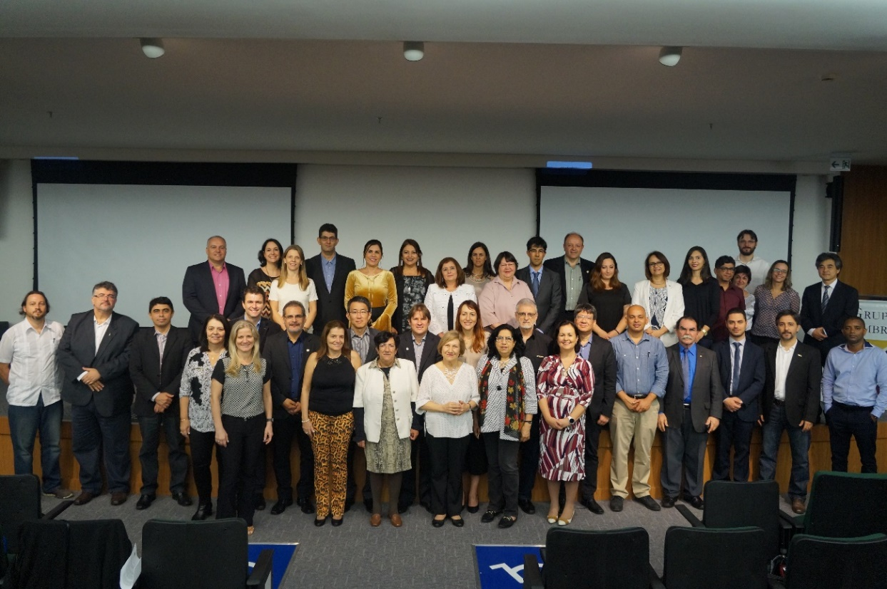

5th University Internationalization Seminar and 6th Workshop of the Partnerships Program for Education and Training (PAEC OAS-CGBU)
DATES
March, 17-19, 2017
PARTNER INSTITUTIONS
2017
BRASILIA, BRAZIL
GOAL
To discuss issues pertaining to University Internationalization in the Americas
Gather the PAEC-OAS-CGBU Institutional Coordinators in order to approve the Call for the 7th edition of the Program.
Discuss and evaluate developments and propose new actions
Organization of American States (OAS)
Pan-American Health Organization (PAHO/WHO)
Division of Educational Themes of the Brazilian Ministry of Foreign Affairs (DCE/MRE)

Slide 56

BRAZIL-MEXICO SCHOLARSHIPS PROGRAM FOR GRADUATE STUDIES IN ENERGY
PROPE BR-MX
PROPAT BRAZIL-MEXICO
BRAZIL- MEXICO SCHOLARSHIPS PROGRAM FOR GRADUATE STUDIES IN TROPICAL AGRICULTURE AND LIVESTOCK
Partners:
2016
Institutional Coordinators
RELEASE YEAR
EDITIONS
1
RELEASE YEAR
  Both programs promote the professional qualification of Mexican students by offering scholarships for pursuing a master degree in Brazilian universities.
2014
16
5
EDITIONS
HEI ASSOCIATED
TO GCUB HAVE JOINED THE PROGRAM
  Benefits:
  Monthly stipend, flight tickets, insurance and Portuguese course.
  Offered by the Mexican Government
  Subsidized meals, access to University facilities
  Offered by the host Universities
HEI ASSOCIATED TO GCUB HAVE ADHERED TO THE PROGRAM
35
Institutional Coordinators
69 MEXICAN STUDENTS PARTICIPANTED SINCE 2014

Slide 57



BE_A_DOC
BRAZIL – EUROPE DOCTORAL AND RESEARCH PROGRAMME
  Online platform to facilitate the international research mobility of students and researchers between ASSOCIATED UNIVERSITIES of GCUB and MEMBER UNIVERSITIES of the COIMBRA GROUP.
27 BRAZILIAN STUDENTS in Europe
  Partner:
2
EDITIONS
2016
3 EUROPEAN STUDENTS in Brazil
  Target audience:
  PhD Students
  Researchers
1st Edition
2017
38
2nd Edition
UNIVERSITIES ASSOCIATED TO GCUB HAVE CONFIRMED PARTICIPATION IN 2017
  Duration of the mobility:
  Up to 12 months
Institutional Coordinators

Slide 58
INTERNATIONAL THEMATIC SEMINARS
GENERAL STRUCTURE:
PARTNER
  A main theme is defined conjointly
  Seminars take place alternately in Brazil and in our partner’s country
  Expert researchers are the target audience
  The objective is to gather experts to discuss joint projects and promote research collaboration in cutting-edge areas.
UNIVERSITY ASSOCIATED TO THE CGBU

Slide 59



NANOTECHNOLOGY
INTERNATIONAL SEMINAR ON NANOTECHNOLOGY
2nd Edition:
December 1-3, 2015
at
Universidade Federal do ABC (Brazil)
  Partners:
22
UNIVERSITIES FROM BRAZIL AND TURKEY
31 RESEARCHERS
1st Edition:
December 15-17, 2014
at
Fatih Üniversitesi (Turkey)
2014
RELEASE YEAR
10
UNIVERSITIES FROM BRAZIL AND TURKEY
2
18 RESEARCHERS
EDITIONS

Slide 60




ECOLOGY AND BIODIVERSITY
INTERNATIONAL SEMINAR ON ECOLOGY, EVOLUTION AND CONSERVATION OF DIVERSE AND THREATENED ECOSYSTEMS IN THE NEOTROPICS
  Partners:
1st Edition:
September 12-15, 2016
at
Universidade Federal do Rio Grande do Norte (Brazil)
2016
RELEASE YEAR
1
EDITION HAVE ALREADY OCCURED
7
UNIVERSITIES FROM BELGIUM AND BRAZIL
2nd Edition:
2017/2018 (date to be defined)
at
Vrije Universiteit Brussel (Belgium)
18 BELGIAN AND BRAZILIAN RESEARCHERS HAVE PARTICIPATED

Slide 61




ENGINEERING
DEVELOPMENT CHALLENGES: TECHNOLOGY AND INNOVATION IN A LIMITED WORLD.
  Partners:
1st Edition:
2018 (date to be defined)
at
Universidade Federal do Paraná (Brazil)
2nd Edition:
2019 (date to be defined)
at
Lund University (Sweden)
PROBABLE RELEASE YEAR
2018

Slide 62
SPECIAL COURSES
GENERAL STRUCTURE:
PARTNER
  Each special course has its own characteristics according to its duration, target audience and methodology

Slide 63


GCUB-ICC
FORMATION PROGRAM FOR BRAZILIAN TEACHERS OF SPANISH LANGUAGE
PRESENCIAL MODALITY
(AT ICC - COLOMBIA)
  PARTNERS:
ONLINE MODALITY
  Benefits:
  Fees exemption
  Financial aid of USD 750
  International insurance
  Flight tickets ( for the 10 better scored candidates)
  Characteristics:
  120 hours
  1 month
  Benefits:
  Fees exemption (2015)
  40% fee reduction (2016)
  Characteristics:
  120 hours
  5 modules
  3 months
2015
RELEASE YEAR
2
EDITIONS
35
2
RELEASE YEAR
2014
EDITIONS
HEI ASSOCIATED TO GCUB REPRESENTED
  Target audience:
  Teachers of Spanish
  in all education levels.
  Students from Spanish graduating class
HEI ASSOCIATED TO GCUB REPRESENTED
27
112 PARTICIPANTS
SINCE 2015
44 PARTICIPANTS
SINCE 2014

Slide 64



1st CGBU AUTUMN COURSE
DEVELOPMENT OF INTERCULTURAL SKILLS AND INTERNATIONAL UNIVERSITY COOPERATION
  Partner:
  The aim of this course was to develop tools for the establishment of better and enhanced forms of interaction with people from different cultures, as well as sharing knowledge about institutional and personal resources in this area.
Equipe de Recherche en Dimensions Internationales de l'Education (ERDIE) from Université de Genève
Location: University of Brasilia
  Target audience
  International Relations Advisors,
  Heads of international cooperation in public and private institutions,
  Experts in mobility,
  Professors and researchers in this domain.
2017
April 24-26
34 PARTICIPANTS

Slide 65

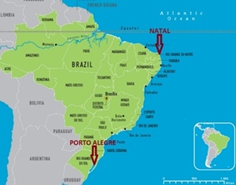
TROPICAL MEDICINE
BRAZILIAN PUBLIC HEALTH SYSTEM, TROPICAL DISEASES AND BRAZILIAN CULTURE
  Partner:
This short course was directed to Medicine and Nursing undergraduate students from the University of Istanbul (Turkey). Students took part in different activities, including field trips, bedside teaching, theoretical classes and cultural events.
This unique opportunity offered students the possibility to get to know different Brazilian regions and develop a deeper understanding of the country’s culture and health issues.
LOCATION:
  Benefits
  Accomodation
  Meals
  Local transpotation
  Offered by UFRN and UFCSPA
2016
MODULE 1: Federal University of
Health Sciences of Porto Alegre
July 18 – August 5
(3 weeks)
MODULE 2: Federal University of
Rio Grande do Norte
17 PARTICIPANTS

Slide 66



FACI
TRAINING COURSE FOR LEADERS IN INTERNATIONAL UNIVERSITY COOPERATION
  Partners:
  The course targets the developpment of the skills needed for an excellent work in the international university cooperation sector.
2017
  Methodology
  4 online modules (5 hours each)
  4 onsite modules in different countries (4 days each) - participants must choose only 2
PROBABLE
RELEASE DATE
  Characteristics
  Languages: Spanish, French and Portuguese
  Target audience: International Relations Advisors and Coordinators of international programs.
45 EXPECTED PARTICIPANTS FOR THE FIRST EDITION

Slide 67
INTERNATIONAL MISSIONS
GENERAL STRUCTURE:
INTERNATIONAL
PARTNER
UNIVERSITITES ASSOCIATED TO THE CGBU
  Organization of all logistic aspects
  Invitation
  Communication on all aspects of the Missions
  Organization of relevant information on participants

Slide 68



CHINA
BRAZIL-CHINA EDUCATORS MISSION 2017
  Partner:
  The purpose of the Mission is to present the Chinese Higher Education System and to encourage collaborative actions between Chinese and Brazilian Universities, such as mobility programs and the creation of Confucius Institutes.
VISITED CITIES:
Baoding
Shijiazhuang
Beijing
  Agenda:
  Visits to Chinese Universities
  Cultural activities
  Visit to the Chinese Scholarship Council
  Visits to Educational Institutions in China
2017
11
May 2 – 13
HEI ASSOCIATED TO THE GCUB HAVE PARTICIPATED
12 PARTICIPANTS

Slide 69





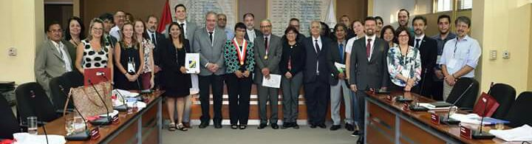
PERU
ACADEMIC EXCHANGE BRAZIL-PERU
  Organizing Institutions:
  Agenda:
  International Education Fair
  Seminar on Undergraduate and Graduate Scholarship opportunities in Brazil
  Visits to Peruvian Government Agencies
  Cultural Visits
PLACE
LIMA, PERU
2017
Embassy of Brazil in Lima (Peru)
April 19 – 20
  OBJECTIVES
  To promote greater contact between universities, institutions responsible for the promotion of scientific and technological research and development, and public institutions related to higher education in Brazil and Peru;
  To offer the opportunity to visitors to explore all the possibilities available for undergraduate and graduate studies in Brazil.
  To establish contacts for a medium-term agenda in educational cooperation, science, technology and innovation.
15
HEI ASSOCIATED TO THE GCUB HAVE PARTICIPATED
19 PARTICIPANTS

Slide 70
OTHER PROGRAMS

Slide 71





CAMINOS
EUROPEAN UNION – ERASMUS +
3
OVERALL GOAL:
To build institutional capacities of the Universities and University Networks in Latin America, so as to enhance mobility of students and staff.
MAIN GOAL
To advance in diploma and studies recognition in Latin American Universities and foster their Internationalization, as well as promoting integration of Latin America.
COORDINATORS
STEPS
TOTAL DURATION OF THE PROJECT:
36 MONTHS
KICK-OFF:
OCTOBER 2016
1st STEP: research and mapping
2nd STEP: development of the Project Handbook on Mobility
3rd STEP: implementation of the Handbook
UNIVERSITIES ASSOCIATED TO THE CGBU

Slide 72

VALOFRAM
Valuing French Language in Latin America
Audience: Master, PhD and Researchers from Universities member of AUF and the CGBU in Latin America.
Knowledge area: all, exepcet those related to French language training
International Seminar: expected to be from 1 de marzo de 2017 y 28 de febrero de 2018.
Language of the presentation: French
Release date: 2016
3 scholarships offered
Amount of each scholarship: 1300 Euros
  Partner:
  The VALOFRAM Project seeks to offer scholarships to foster the presentation in seminars and Francophone colloquiums in Latin America.

Slide 73
      EVENTS:
      2017
  X General Assembly and IX International Seminar of the CGBU

Slide 74

IX INTERNATIONAL SEMINAR AND X GENERAL ASSEMBLY OF THE CGBU
In the 2011 Edition, 38 Chinese representatives from more than 20 universities have attended the event!
Our anual Seminar takes place in Brazil or in Foreign countries, such as in Italy (Università di Parma) and in the United Kingdom (University of Manchester)

Slide 75
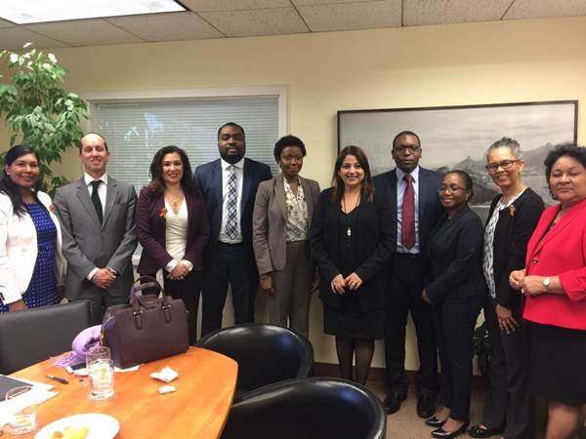
MISSION TO WASHINGTON DC – 24 - 30 March
Activities
Reunião Preparatória na Missão do Brasil junto à OEA
Reunião com a Senhora Kim Osborne (OEA)
Reunião na Comissão para o Desenvolvimento Integral (CID)
Reunião com Sra. Nelly Gochicoa (OEA)
Reunião com representantes dos países do CARICOM encarregados da cooperação educacional.
Photo: meeting with CARICOM representatives

Slide 76

CUMBRE DE LAS AMÉRICAS – 30 March

Slide 77
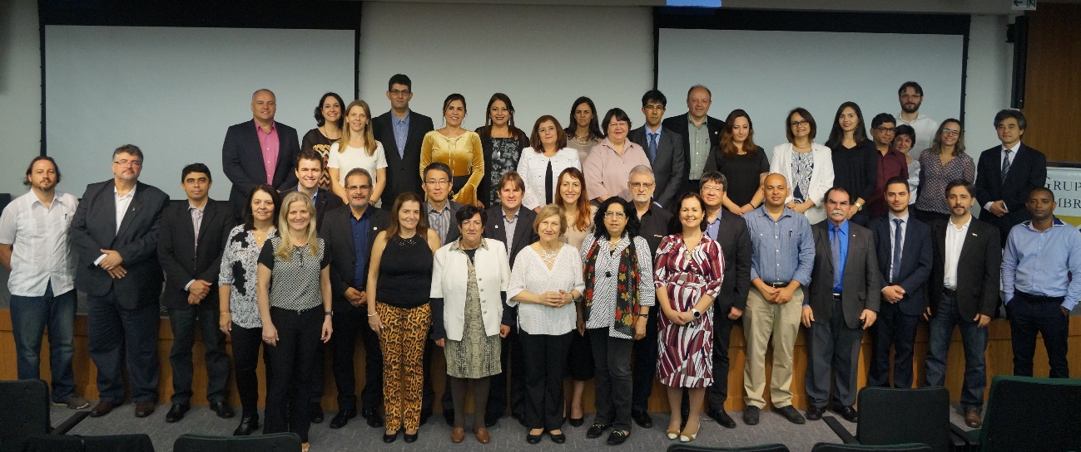
PAEC OEA-GCUB – University Internationalization Seminar
DATES
May 17,18 and 19
2017
PARTNER INSTITUTIONS
GOAL
Discutir temas relativos à Internacionalização Universitária nas Américas
Reunir Coordenadores Institucionais do Programa PAEC OEA-GCUB para aprovação do Edital para a 7ª Edição do Programa
Discutir os avanços do Programa e propor novas ações
BRASÍLIA - DF
Organização dos Estados Americanos (OEA)
Organização Pan-americana da Saúde (OPAS/OMS)
Divisão de Temas Educacionais do Ministério das Relações Exteriores (DCE/MRE)

Slide 78

ARCA (Panama) – 17 - 19 May
GCUB was represented by Rector Cleuza Maria Maria Sobral Dias (FURG), at the Rectors´ Meeting from the Caribbean and the Americas.

Slide 79

WORKSHOP UNEB – 24 - 26 May
Presentation of GCUB´s activies and programs during the IV UNEB Graduate Course Workshop

Slide 80
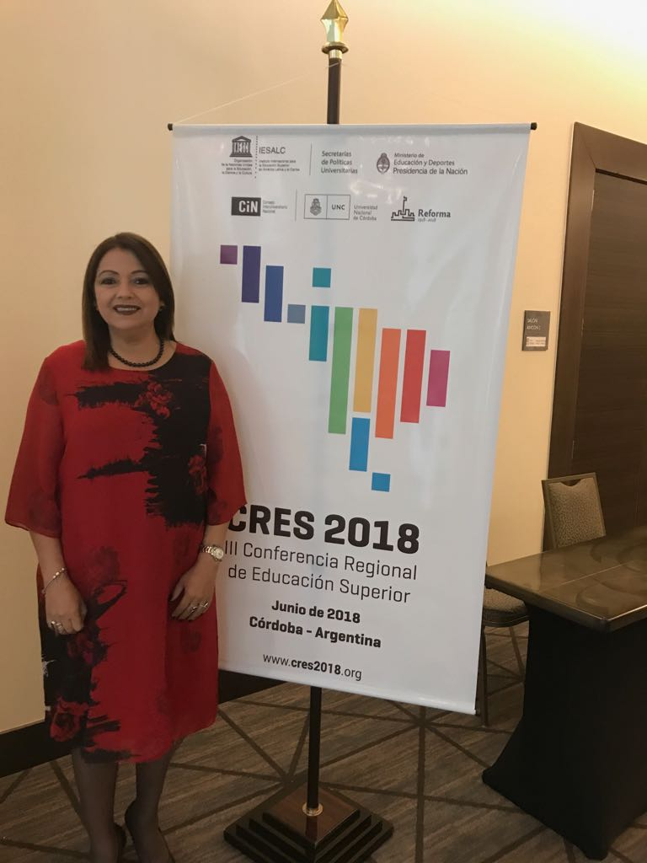
Meeting at IESALC (PANAMA) – 29 - 30 May
XI Reunión Ordinaria del Consejo de Administración del IESALC tendrá lugar en la ciudad de

Slide 81
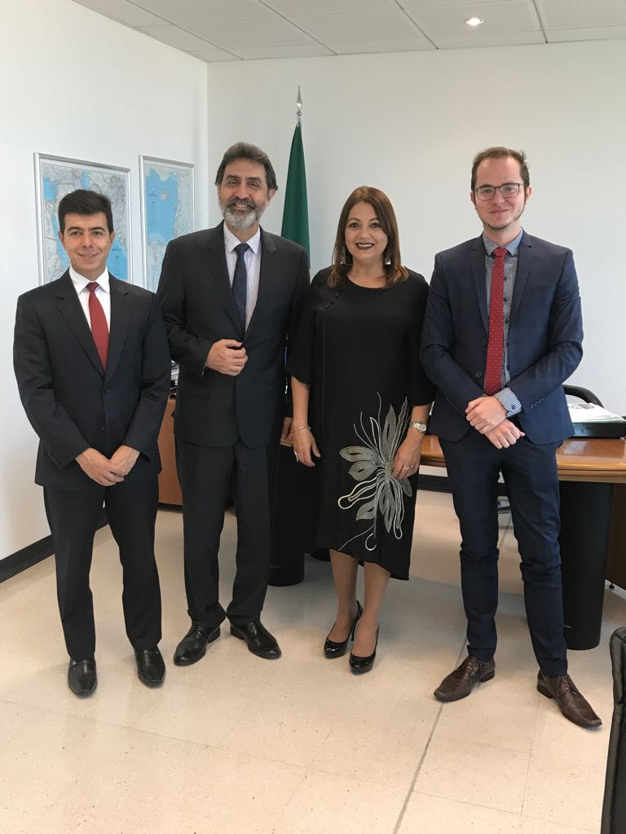
MISSION TO LEBANON – 5 - 13 May
Visits to the following Lebanese Institutions:
Embassy of Brazil in Lebanon
Lebanese Ministry of Education
Université Saint-Joseph
Brazil-Lebanon Cultural Centre
American University of Beirut
Lebanese University
Holy Spirit University of Kaslik
Lebanese American University
Lebanese International University
Beirut Arab University
Notre Dame University
Photo: Representatives from the Brazilian Embassy in Lebanon

Slide 82
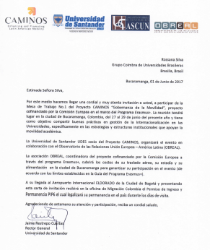
CAMINOS Project (Colombia and Chile) – 14 - 19 March, 27- 29 June
Project CAMINOS
4 a- 19 March (Chile)
27 - 29 June (Colombia)

Slide 83

CUMBRE DE LAS AMÉRICAS – 20 July

Slide 84
THANK YOU!
Professor Rossana Valéria de Souza e Silva, PhD
Executive Director
rossanavsilva@gmail.com
rossana.silva@grupocoimbra.org.br
+55 61 3321 2330

Slide 85
ANNEX 1 – Institutional Coordinators - BRACOL
RETORNAR

Slide 86
ANNEX 1 – Institutional Coordinators - BRACOL
RETORNAR

Slide 87
ANNEX 2 – Institutional Coordinator - BRAMEX
RETORNAR

Slide 88
ANNEX 3 – Institutional Coordinators - OverWorld
Acronym | University | Title | Institutional Coordinator | Position
UNESP | Universidade Estadual Paulista”Julio de Mesquita Filho” | Prof. Dr. | José Celso Freire Júnior | Assessor de Relações Internacionais
UPM | Universidade Presbiteriana Mackenzie | Profa. Dr. | Maria Campos Lage | Assessora de Relações Internacionais
UFBA | Universidade Federal da Bahia | Profa. | Mirella Márcia Longo Vieira Lima | Assessora de Relações Internacionais
UFPA | Universidade Federal do Pará | Prof. Dr. | Cláudio Fabian Szlafsztein | Pro-Reitor de Relações Internacionais
UFPI | Universidade Federal de Piaui | Prof. | Beatriz Gama Rodrigues | Assessora de Relações Internacionais
UNISINOS | Universidade do Vale do Rio Sinos | Prof. Dr. Pe. | Pedro Gilberto Gomes | Pro-Reitor acadêmico
UFMA | Universidade Federal do Maranhão | Profa. | Conceição de Maria Barbosa de Araújo | Assessora de Relações Internacionais
UNICAMP | Universidade Estadual de Campinas | Prof. Dr. | Luís Augusto Barbosa Cortez | Vice-Reitor Executivo de Relações Internacionais
UFCSPA | Universidade Federal de Ciências da Saúde de Porto Alegre | Profa. | Jenifer Saffi | Assessora de Relações Internacionais
RETORNAR

Slide 89
ANNEX 4 – Institutional Coordinators – PAEC OAS CGBU
RETORNAR

Slide 90
ANNEX 4 – Institutional Coordinators – PAEC OAS CGBU
RETORNAR

Slide 91
ANNEX 4 – Institutional Coordinators – PAEC OAS CGBU
RETORNAR

Slide 92
ANNEX 5 – Institutional Coordinators – PROPE
RETORNAR

Slide 93
ANNEX 6 – Institutional Coordinators – PROPAT
RETORNAR

Slide 94
ANNEX 6 – Institutional Coordinators – PROPAT
RETORNAR

Slide 95
ANNEX 7 – Institutional Coordinators – BE_a_DOC 2017
RETORNAR

Slide 96
ANNEX 7 – Institutional Coordinators – BE_a_DOC 2017
RETORNAR

