Slide 1
The Hungarian Rectors’ Conference
Prof. Dr. József Bódis, President of HRC

Slide 2
ABOUT HUNGARY
Language: Hungarian
Population: ~10 million
Capital:Budapest with 1.74 million inhabitants
Rich history dating back to 896.
Part of the European Union, NATO, OECD, Visegrád Group, Schengen Area
Type of government: Since 1989 democratic parliamentary republic
Currency: Hungarian Forint (HUF)

Slide 3
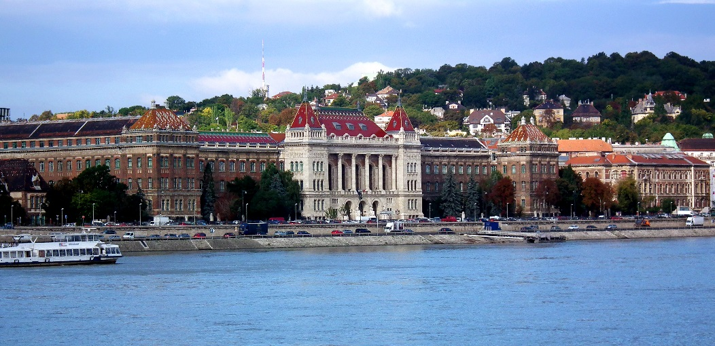
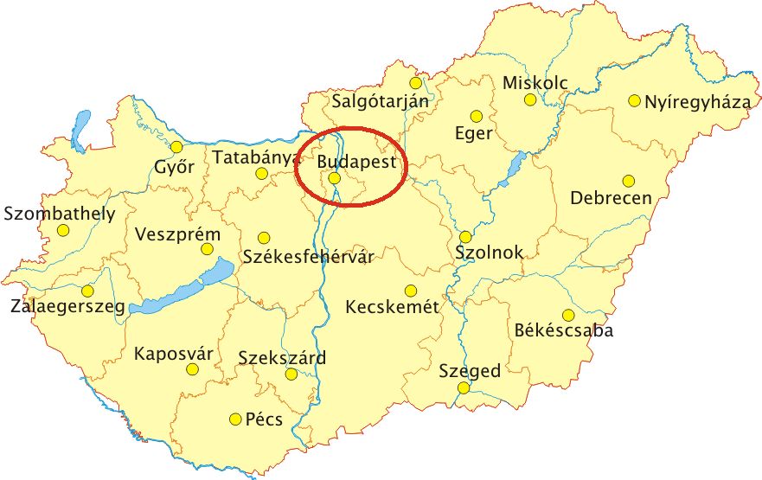
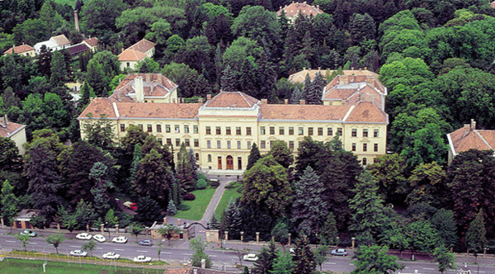
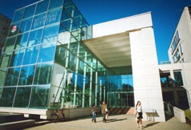
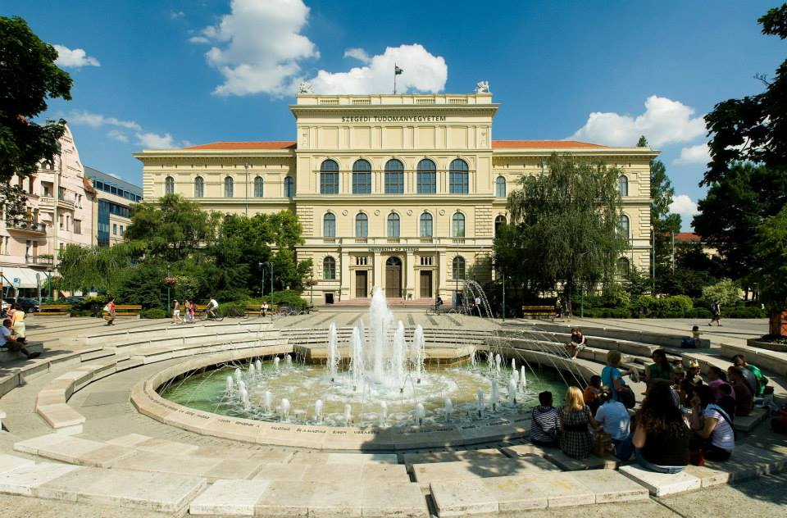
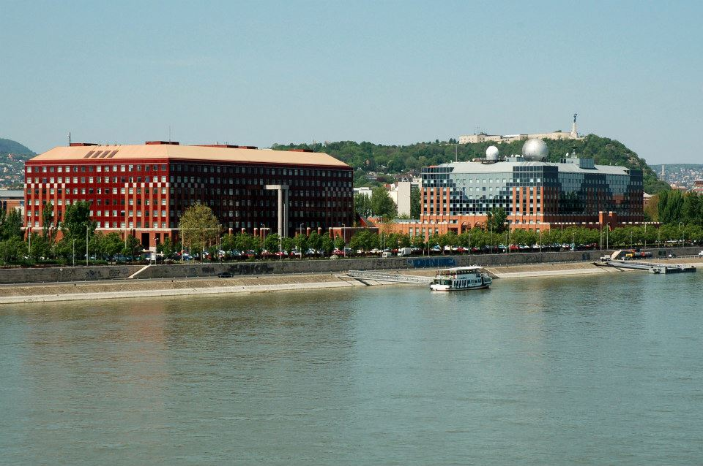
UNIVERSITY CITIES

Slide 4
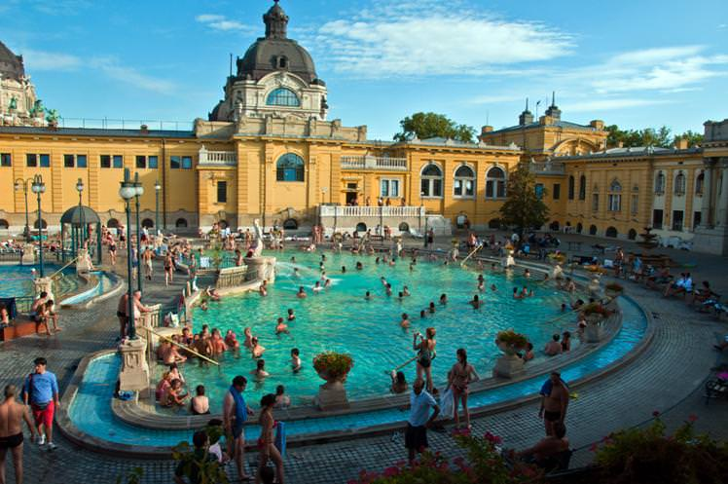
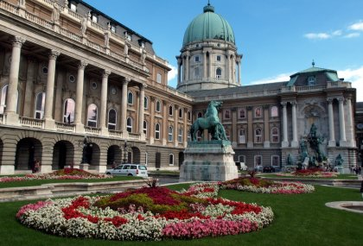
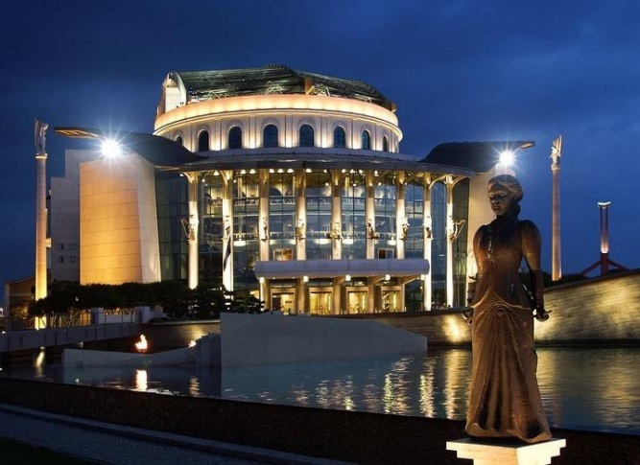
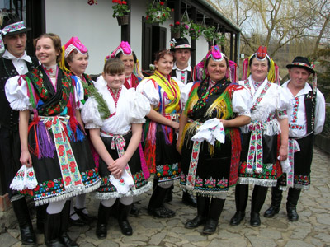
HUNGARY

Slide 5
Structure of membership
Number of HEI’s
64 Institutions
State institutions |  |  |  | Church and Private institutions
28 |  |  |  | 36 (9 Universities, 27 Colleges)
 |  |  |  | Church Institutions |  |  |  | Private Institutions
 |  |  |  | 25 |  |  |  | 11
Universities |  | Colleges |  | Universities |  | Colleges |  | Universities |  | Colleges
27 |  | 1 |  | 5 |  | 20 |  | 4 |  | 7
Budapest | Other Cities | Budapest | Other Cities | Budapest | Other Cities | Budapest | Other cities | Budapest | Other cities | Budapest | Other cities
14 | 13 | 0 | 1 | 4 | 1 | 8 | 12 | 4 | 0 | 5 | 2
Structure of HRC’s membership

Slide 6
The Hungarian HIGHER EDUCATION SYSTEM
Prof. Dr. József Bódis, President of HRC

Slide 7
History of the Hungarian higher education
Today’s universities date back to the Middle Ages: 1st September 1367 Pope Urban V approved the establishment of Studium Generale of Pécs, in line with European trends, among the first universities - beginning of the Hungarian higher education.
Throughout almost 650 years the Hungarian higher educational sector has become a determinant actor in the European Higher Educational Area (EHEA) with many acknowledged institutions.
HE courses until 2005
University: 5-6 years undivided course
College: 3-4 years undivided course
Transition to the „Bologna system”: 3 levels of HE courses; Bachelor, Master, Doctoral training
Applied since September 2006
From this year, only 108 majors are available for selection (instead of more than 400 in the previous year), out of which six are exempt from the Bachelor vs. Master division: lawyer, physician, dentist, veterinary, pharmacist and architect.

Slide 8
Hungarian HE system - Finance
Budget of higher educational institutions
STATE FINANCED HEI-s – maintainence institution is the Ministry of Human Capacities
Main part of the budget is allocated based on a normative formula; basis of calculation: number of students and PhD holding staff
Support for the maintenance costs of buildings
Challenge! Radical decrease of the state funding troughout the last years- The institutions need to use own funds and create alternative incomes, in equal (or bigger) proportion as the state funds!
PRIVATE HEI-s – private maintainence institutions
Churches (25)
Foundations (11)

Slide 9
Hungarian HE system - Main figures
Total number of students (Autumn 2017): 283 350
Total number of foreign students (Autumn 2017): 32 309 ≈ 11,5 % of the total nr. of students!
Total number of teachers in HE (Autumn 2017): 23.405
Courses:
Regular courses in the 3-level Bologna system
Preparatory year
Summer universities
Courses in Hungarian language cover all fields of studies.

Slide 10
Hallgatók megoszlása
*Based on the statistics of students admitted for programs starting in September 2017

Slide 11
Division of scientific fields

Slide 12
Institutions admitted the most students in 2017
 | Intézmény | Összes Hallgatók statisztikai száma
 | ELTE | 29082
2. | DE | 26771
3. | BME | 22155
4. | SZTE | 20706
5. | PTE | 20075
6. | BGE | 15347
7. | SZIE | 12400
8. | SZE | 12281
9. | BCE | 11818
10. | OE | 11355

Slide 13
Student Contract
Act of 2011: State-funded students are obliged to sign a contract with the state with the following conditions:
the student must obtain degree within the original length +50% of the program (eg. 3 years in 4.5 years)
in 20 years following the graduation student must work in Hungary or for Hungarian employer for the period of double length of the state funded academic studies. (eg. 3 years program for 6 years)
In case of non-fulfillment of the conditions, the student must pay back to the state betweeen 25% to total of the tuition costs (depending on the circumstances of beaching conditions).
Aim: to prevent and reduce braindrain of state funded students.
In the following years the contract has been modified in order to mitigate the rigid conditions (eg. 1.Obligation of working in Hungary only for the original length of the program, 2. depending on special cases, the student might not have to pay back the tuition costs eg: pregnancy etc.)

Slide 14
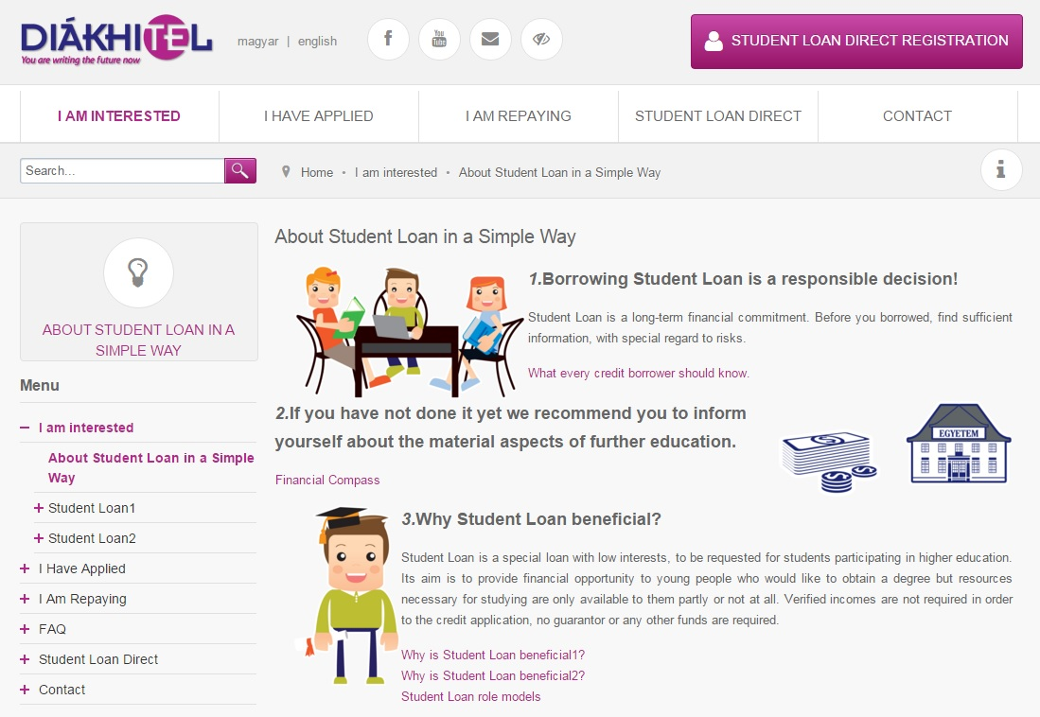
Student Loan
Student loans hold the key to equal educational opportunities.
Diákhitel Központ Zrt., Hungary’s student loan company, has been helping to enable Hungarian and foreign students to pay their expenses and continue with higher education studies since 2001.
Diákhitel 2 (tied-loan) since 2012: only for self-funded students, specifically for funding the program costs
Repayment: only after obtaining degree (latest at the age of 40) – with good conditions

Slide 15
„A change of pace in higher education” Recent reforms and present 1-2.
INITIATIVES in accordance with the strategy „A change of pace in higher education”
1. Overview and renewal of courses and qualifications New governmental regulation: Reg. Nr. 139/2015. (VI. 9.)
Result: the system of the higher educational courses has been rationalized respecting training fields, and the number of the courses has been decreased by a reasonable 14 %, and ended up by 80 course types
2. Broadening the pool of the training contents in foreign language
The tool: students can have subjects in foreign language up to 10 % of the total credit amount needed

Slide 16
„A change of pace in higher education” Recent reforms and present 3-4.
3. FINE-TUNE of the COURSE ENTRANCE AND RESULT REQUIREMENTS in accordance with the new regulation on the course structure
Result: New requirements have been elaborated in 2015, and the new governmental regulation has been approved by September 2016
4. DUAL COURSES
Higher educational courses with a strong focus on professional practice – Multinational companies are partners of HEI-s
New type of HEI emerged: University of Applied Sciences; criterium: the institution must operate Dual Course

Slide 17
Recent reforms and present - 5. Brand new management structure in HEI-s
5.1. CHANCELLOR
Instead of former Financial Council, the Chancellor is responsible for all financial issues of the HE institution. Practically there are two executive heads of the HE institution: the rector and the chancellor. Chancellors operate in HEI-s from the end of 2014.
Main changes resulting from the role of chancellor:
Chancellor took over financial responsibility from the rector
Better pursuing maintainer’s interest
The chancellor has the right of agreement in issues the Consistory does not have
Debt of HEI-s fell to about a third (!) from 2013 to 2015

Slide 18
Recent reforms and present - 5. Brand new management structure in HEI-s
5.2. CONSISTORY
The effective legislation define Consistory, a "board-type" forum responsible for
- supporting the institution’s strategic decisions
- professional support of the financial management of the HEI
The Consistory has anticipative agreement right in the following issues:
Institutional development plan
Budget
Annual report
Asset management plan
Establishment of business organisation, or buying shares in business organisation

Slide 19
Recent reforms and present – 5. Chancellor and Consistory challenges
CHALLENGES arising from the new management structure:
1. The Chancellor is assigned to approve all strategic decision of the institution, because almost every measurement has financial aspect. This regulation
slows down all the processes of the institution, institutions de facto have a „double management”
empowers chancellors to influence professional strategic questions – this a strong control, an area of particular concern
2. The operation of Consistory also implies a „double board management”: the work of the Senate - the traditional board of HEI-s -, consisting of the rector and vice-rectors is complemented by the work of Consistory.

Slide 20
Recent reforms and present – 5. Chancellor and Consistory challenges
CHALLENGES arising from the new management structure:
3. Rectors feel themselves excluded from the life of the HEI due to the strong relationship between the maintainer and the Chancellor.
Reaction on this:
Experts nominated by the Hungarian Rectors’ Conference are invited into the selection process of chancellors.
To ensure partnership between the rector and the chancellor, a single performance assessment and motivation system will be elaborated.

Slide 21
More challenges…
1. FOCUS ON NATURAL SCIENCES SUFFERS DEFICIENCIES
In accordance with EU principles Hungarian government tries to motivate students with scolarships to study natural sciences, but due to global trends it hasn’t resulted in increasing interest among the youth.
Challenge resulting from this:
Low level of interest Low entrance exam points for successfull admission
- Unprepared students decrease the professional level of the course
- Unprepared students cause a big drop-out rate
Main planned actions to solve the situation:
Raise the professional level of the courses with bigger finance independently from the students number
Promote researches as a contribution to the success of the researches.

Slide 22
More challenges…
2. DECREASING NUMBER OF STUDENTS IN HIGHER EDUCATION
Twofold cause of the decrease of the students in HE:
Demographic decline in Hungary
„Braindrain”: foreign HE-s, specifically Western-European HE-s, attract Hungarian youth
 | CHANGE from 2010 to 2017
Number of 18-year old people in Hungary | - 13 %
Number of new students in higher education | - 24 %

Slide 23
More challenges… 3. REGIONAL INEQUALITIES INSIDE HUNGARY

Slide 24
Hungarian higher education in 2030 - Vision -
Goals
Reacting with IMPROVING STUDENT PERFORMANCE to global challenges
Higher educational sector meets the emerging requirements of the labour market with HIGH-LEVEL PROFESSIONALITY
Higher educational system reflects HUNGARIAN TRADITIONS AND ACADEMIC VALUES
RESEARCHES RELEVANT to both the Hungarian and European ECONOMIC SECTOR
Higher educational institutions as the REGIONAL CENTERS FOR SOCIAL MOBILITY AND INNOVATION

Slide 25
Thank you for your attention!
mrk@mrk.hu

