Slide 1
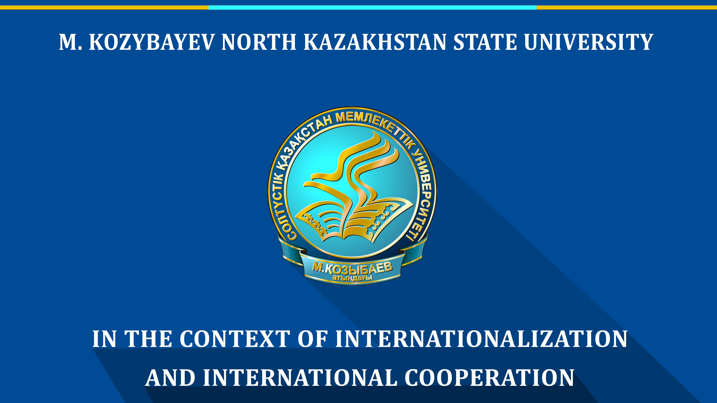

Slide 2
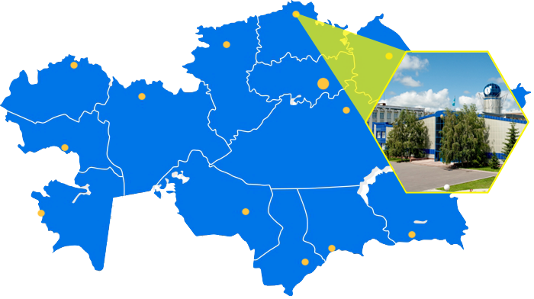
LOCATION
Petropavl
M. Kozybayev North Kazakhstan State University was established in 1937
KAZAKHSTAN

Slide 3



KAZAKHSTAN IN THE BOLOGNA PROCESS
2010
Kazakhstan signed the Bologna Declaration
2012
The Bologna Process and Academic Mobility Center was established
2014
Kazakhstan and Greece became co-chairs of the Bologna Process
2015
Kazakhstan took part in the Yerevan Conference of Ministers of Education of the EHEA countries
2011
The process of introducing the Bologna parameters into the RK higher education system was started
2016
an international conference "Kazakhstan in the Bologna Process: Achievements and Prospects" was organized
2017
The bill on expanding the autonomy of universities
Kazakhstan is the first Central Asian state recognized as a full member of the EHEA

Slide 4

THE MAIN FORMS OF INTERNATIONALIZATION OF KAZAKHSTAN HEIs
Membership in international associations
Double degree and joint programs
International cooperation with HEIs
Participation in international research projects
Academic mobility of students
Internationalization of curricula and programs
Mobility of teaching staff
Teaching of foreign students
Inviting foreign scientists
International credit mobility of students
Scientific internships of undergraduates and doctoral students

Slide 5
THE THREE-LEVEL SYSTEM OF EDUCATION
PHD
MASTER
BACHELOR
3 452 people
33 212 people
477 801 people
TOTAL ENROLLMENT in Kazakhstan: 514 465 people
PHD
4 programmes
MASTER DEGREE
23 programmes
BACHELOR DEGREE
48 programmes
25 people
Total number of HEIs in Kazakhstan: 130
236 people
5170 people
TOTAL ENROLLMENT in NKSU: 5 431 people

Slide 6

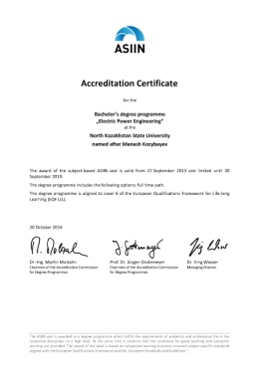

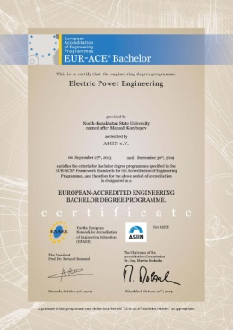

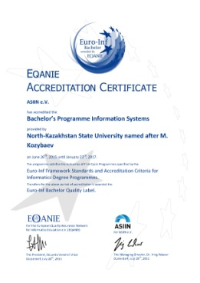
EDUCATIONAL PROGRAMS
International
accreditation of 7 EP
Educational programs in
three languages
5B011000 Physics
5B011100 Computer Science
5B011200 Chemistry
5B011300 Biology
5B050900 Finance
5B070300 Information Systems
5B071600 Instrument Engineering
Electric Power Engineering (Bachelor and Master programs)
Instrument Engineering (Bachelor program)
Radio Engineering, Electronics and Telecommunications (Bachelor and Master programs)
Information Systems (Bachelor and Master programs)
Doctorate PhD:
6D071200 Mechanical Engineering
6D071900 Radio Engineering, Electronics and Telecommunications
6D075100 Computer Science, Computer Technology and Management
6D071800 Electrical Power Engineering
PhD Dissertation Councils on group of specialties:
6D071200 Mechanical Engineering
6D071900 Radio Engineering, Electronics and Telecommunications

Slide 7
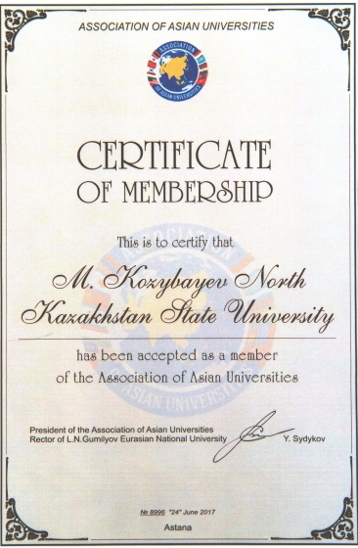
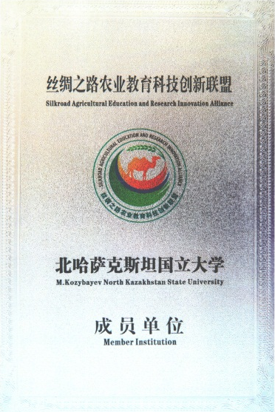





MEMBERSHIP IN INTERNATIONAL
ASSOCIATIONS
  The Magna Charta Universitatum (2010)
  European University Association (EUA, 2017)
  Euro-Asia Economic Forum (2015)
  Silk Road Alliance of Agricultural Education and Scientific Innovation (2017)
  The Association of Asian Universities (2017)
  The International Association for the Exchange of Students for Technical Experience (IAESTE, 2006)
  Caucasus University Association (2017)
7
international organizations
International activities in the M. Kozybayev NKSU are managed by
the Strategy, Quality and Internationalization Department established in 2016

Slide 8









ACADEMIC MOBILITY
Academic mobility of M. Kozybayev NKSU students – 103 people
Poland
Hungary
Lithuania
Czech Republic
Latvia
Russia
Turkey
USA
The Strategy for Academic Mobility of the Republic of Kazakhstan until 2020 has been adopted.
Total number of the students trained in HEIs of Europe, the USA and Southeast Asia – 9183 people
Since 2011, the Ministry of Education and Science of the Republic of Kazakhstan annually funds the program "Academic Mobility"

Slide 9
FOREIGN STUDENTS
Number of foreign students in Kazakhstan
Countries of origin of foreign students
Russia
China
Mongolia
Azerbaijan
Uzbekistan
Tajikistan

Slide 10
ATTRACTING FOREIGN SCIENTISTS
The dynamics of the number of invited foreign scientists at the expense of the state budget, 2009-2016.
The program to attract foreign scientists has been operating since 2009.
PURPOSE OF VISIT OF FOREIGN SCIENTISTS - lecturing, conducting information trainings, introduction of modern technologies and training programs, scientific consulting of doctoral students

Slide 11
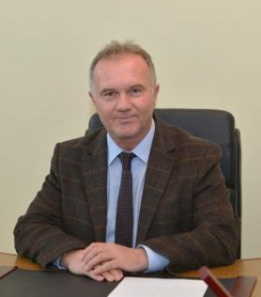
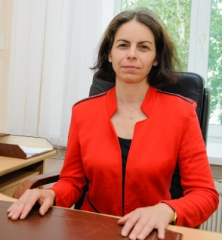
FOREIGN TOP MANAGERS
Orhan Söylemez
Professor, Doctor of Philology,
citizen of Turkey,
Vice-rector for Internationalization
ANDRIANA RISK SURLEVA
Professor, Doctor of Chemical Sciences, citizen of Bulgaria,
Director of the Department of Science

Slide 12





DOUBLE DEGREE AND JOINT EDUCATIONAL PROGRAMS
M. Kozybayev NKSU – 15 joint and double degree programs
Omsk Branch of the Financial University under the Government of the Russian Federation
Finance
Accounting and Audit
Economics
Dostoevsky Omsk State University
Chemistry
Omsk Humanitarian Academy
Pedagogy and Psychology
Jurisprudence
Accounting and Audit
Ecology
Information Systems
Finance
State and Local Management
Omsk State Pedagogical University
Information Systems
Vytautas Magnus University
The total number of joint and double degree programs in HEIs of Kazakhstan - 875
  Biology
  Biotechnology
  Ecology
Graduation of 5 masters in 2018

Slide 13























INTERNATIONAL COOPERATION OF
THE M. KOZYBAYEV NKSU
140
  with international HEIs and organizations:
  Belarus, Bulgaria, Germany, China, Korea, Latvia, Lithuania, Poland, Portugal, Russia, Slovakia, Turkey, USA, Finland,
  Czech Republic
agreements
  Number of agreements with HEIs and organizations of near and far abroad

Slide 14



The European Union's Erasmus+ programme
Number of Erasmus + projects that Kazakhstan HEIs won from 2015 to 2017 - 345
2
  «Development of two cycle innovative curricula in microelectronic engineering»
  «Transition to University Autonomy in Kazakhstan»
Erasmus+ projects
  In 2018, 8 project applications were submitted
In Kazakhstan the programme is coordinated by the National Erasmus + Office in Kazakhstan

Slide 15

POTENTIAL OF THE UNIVERSITY: international cooperation
  International accreditation of educational programs
  Inviting foreign teachers
  Creation of the literature fund in English
  Participation of staff, teaching staff and students in international programs Erasmus + (European Union), Bolashak (Kazakhstan), Horizon 2020 (European Union), Mevlana (Turkey), etc.
  Development of academic mobility of teaching staff and students
  English language courses for teaching staff and students

Slide 16

POTENTIAL OF THE UNIVERSITY: recruitment of foreign students
  Development of educational programs in English
  Introduction of medical specialties to recruit foreign students
  Opening of representative office abroad
  Creation of international clubs
  Development of a program for the adaptation of foreign students
  Resource support for students (dormitories, medical care)

Slide 17

POTENTIAL OF THE UNIVERSITY: new international projects
  Development of a joint program 6M022100 "Chemical technology of organic substances" with the University of Chemical Technology and Metallurgy (Bulgaria)
  Development of a joint program "Information Systems" with the University of Fujairah (UAE)
  Expansion of joint programs with the University of Vytautas Magnus (Lithuania)
  Scientific cooperation with the Northwest Agriculture and Forestry University, the opening of the Agrotechnical Park (China) on the basis of the M. Kozybayev NKSU
  Opening of the Turkish language learning center (Turkey)

Slide 18
THANK YOU FOR ATTENTION!

