Slide 1



Prof. Dr. Ferenc Szávai
Cooperations Between the Universities of Kazakhstan and Kaposvár University –
Present and Future

Slide 2
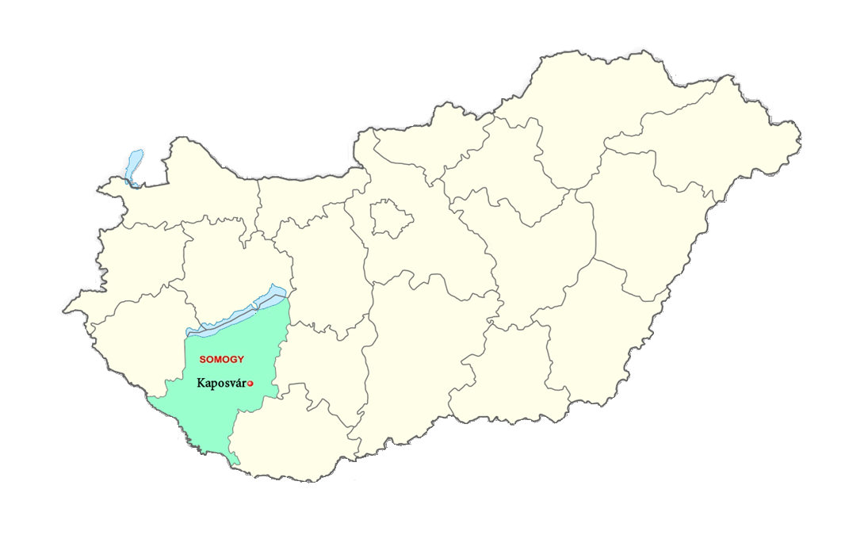
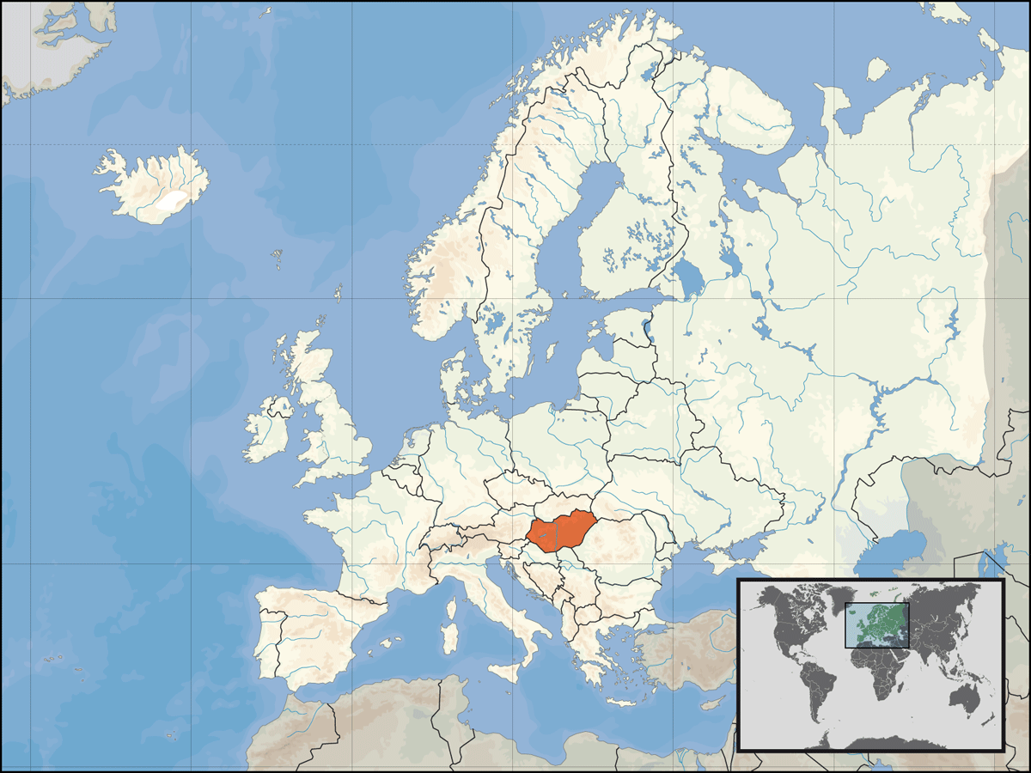

Slide 3
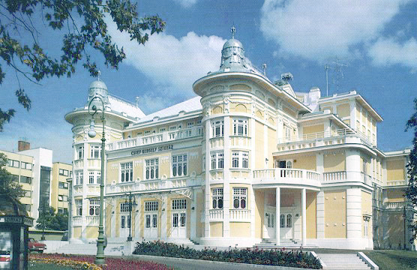
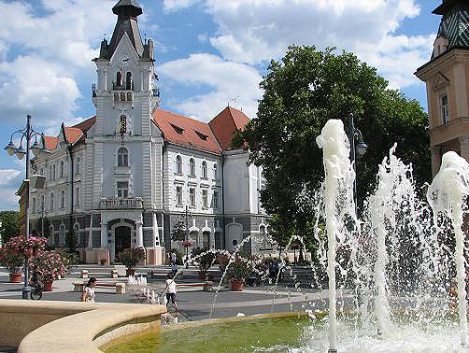

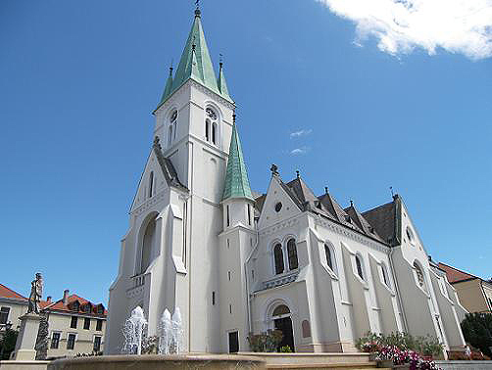
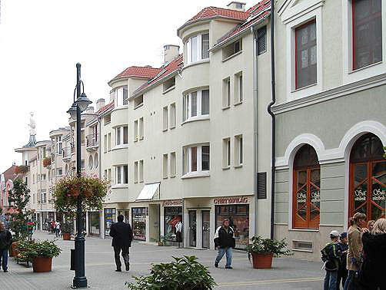
City of KAPOSVÁR

Slide 4
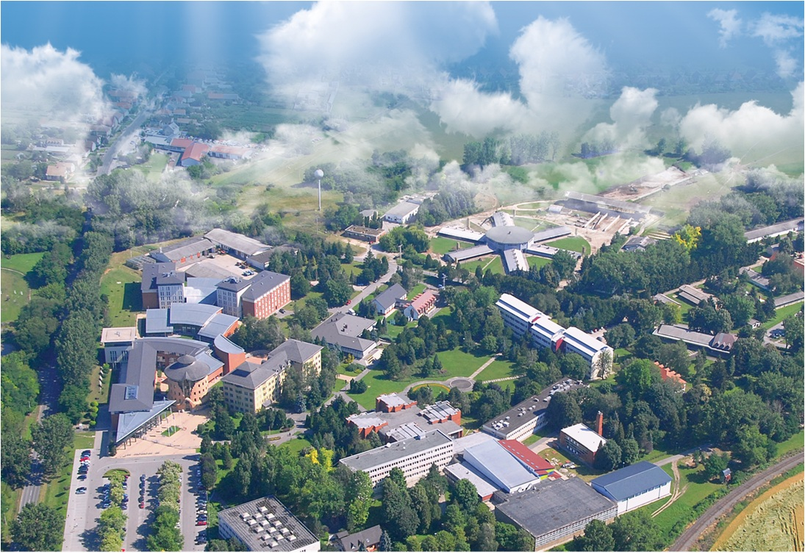
3000 students
4 Faculties
+ Pannon Equestrian Academy
+ Game Management Landscape Center
+ Feed Crops Research Institute
Notes:
Kaposvár University was founded on January 1st 2000, by integrating the Faculty of Animal Science of Pannon Agricultural University, the Teachers’ Training College of Kaposvár and the Feed Crops Research Institute of Iregszemcse.
Kaposvár University is the most important institution of higher education and innovation in the South-Transdanubian region (Baranya, Somogy and Tolna counties) and in the wider region (Zala and Fejér counties) besides the University of Pécs.
The university is situated on a tree-lined campus on the outskirts of Kaposvár. Students have the opportunity to study at one of the most beautiful landscapes in Hungary.

Slide 5
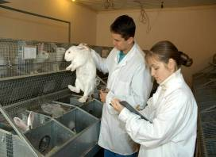

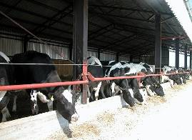
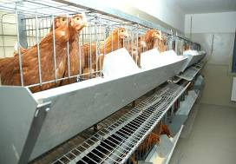
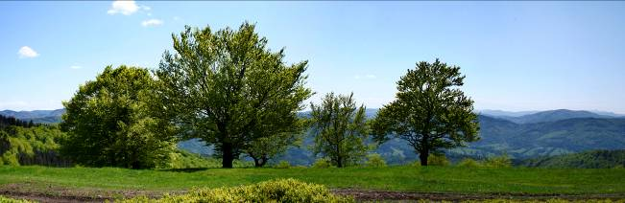
Faculty of Agricultural and Environmental Sciences
Running courses
Bachelor level:
Agricultural Engineer (BSc)
Horse Breeder, Equestrian Sports Organizer Agricultural Engineer (BSc)
Nature Protection Engineer (BSc)
Environmental Engineer (BSc)
Master level:
Animal Husbandry Engineer (MSc)
Animal Nutrition and Feed Safety Engineer (MSc) (running in English language also)
Vocational higher education:
Stud Farmer
Agriculture

Slide 6

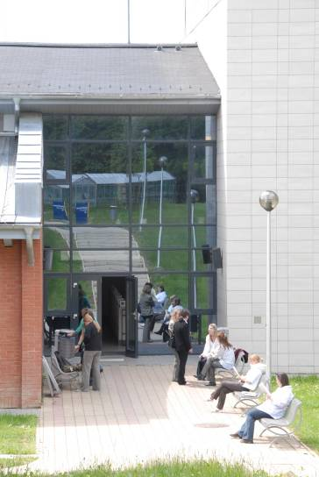
FACULTY OF ECONOMIC SCIENCE
Running courses
Bachelor level:
Finance and Accounting (BA)
Rural Development Manager (BSc)
Commerce and Marketing (BA)
International Relations (BA) (running in English language also)
Master level:
Finance (MA) (Joint degree with the Corvinus Univ., Budapest)
Regional and Environmental Economics (MA)
Rural Development Engineer (MSc)
Vocational Higher Education:
Finance and Accounting
Commerce and Marketing

Slide 7
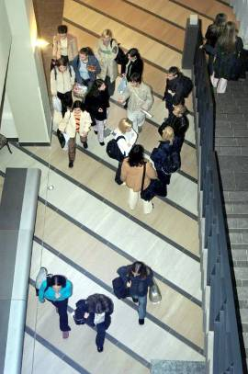
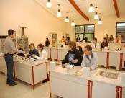
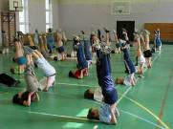

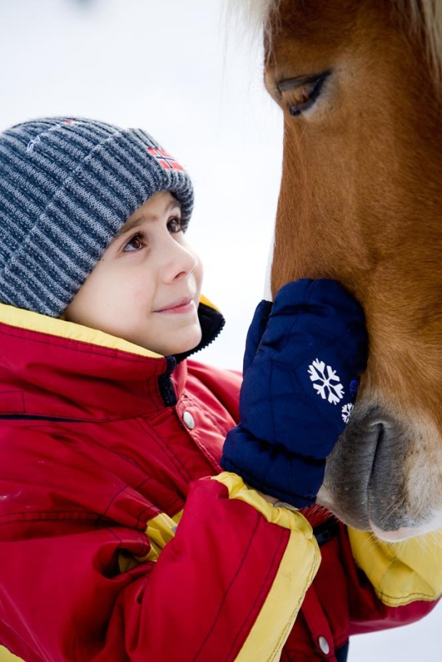
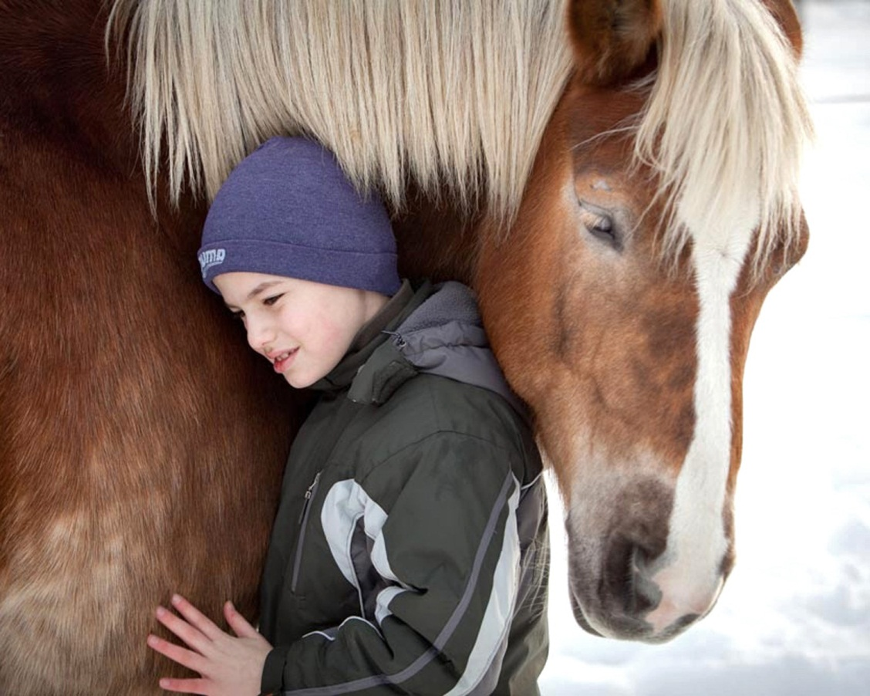
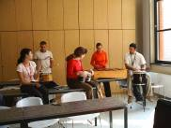
FACULTY OF PEDAGOGY
Running courses
Bachelor level:
Special Education Teacher (BA)
Primary school teacher (BA)
Kindergarten teacher (BA)
Infant and Early Childhood Education (BA)
Equestrian Therapy
Special research fields
In cooperation with:
International Children's Safety Service
Hungarian Equestrian Therapy Association

Slide 8
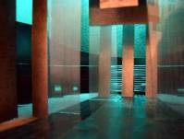
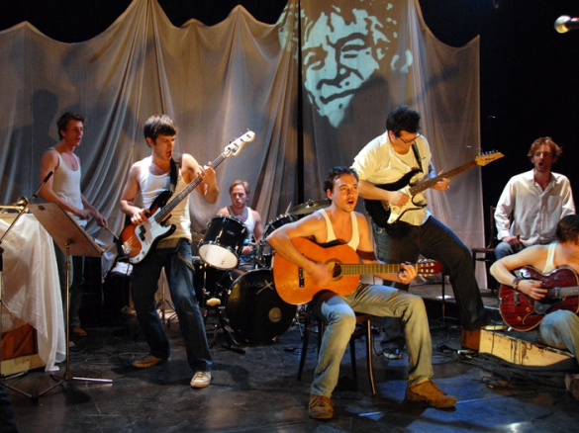
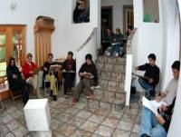
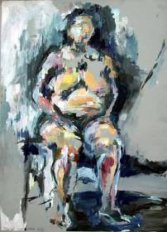



FACULTY OF FINE ARTS
Running courses
Bachelor level:
Scenery Design (BA)
Visual Design (BA)
Photography (BA)
Motion Picture and Media (BA)
In cooperation with the Hungarian National Theater
Master level:
Actor (MA)
Photography (MA)
Attila Vidnyánszky
Director of the Hungarian National Theater and
Vice Rector for Arts of the Kaposvár University

Slide 9
English Language Programmes
Faculty of Agricultural and Environmental Sciences
Animal Nutrition and Feed Safety Manager, MSc
Faculty of Economic Science
International Relations, BA
Regional and Environmental Economic Studies, MSc
DOCTORAL (PhD) SCHOOLS
Doctoral (PhD) School for Management and Organizational Science
Doctoral (PhD) School in Animal Science

Slide 10
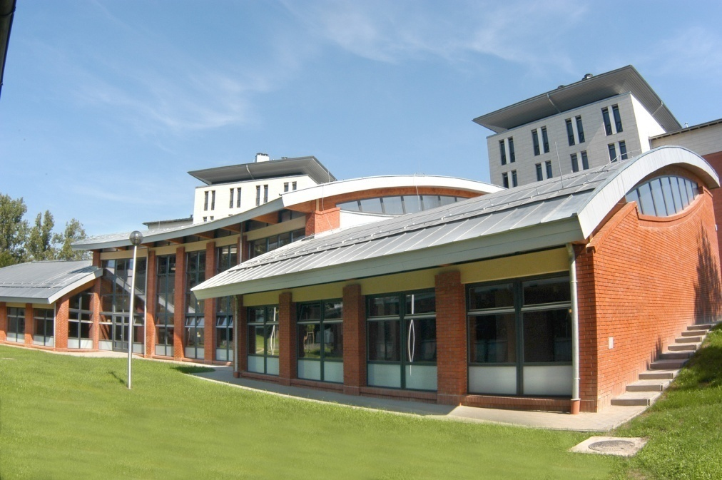
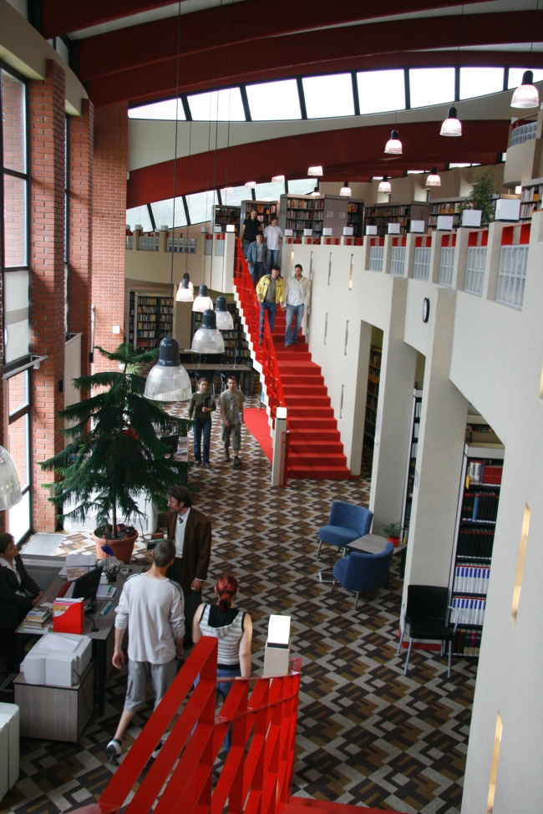
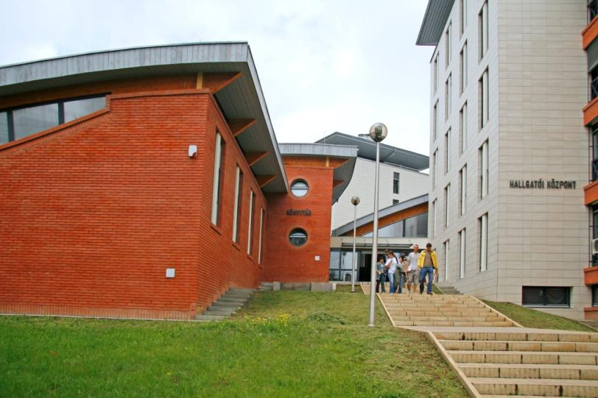
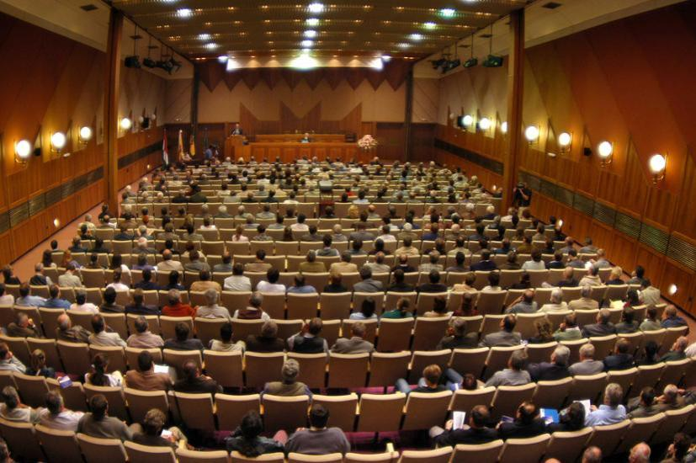
INFRASTRUCTURE
The Student Center incorporates a multi-storey University Library containing 250,000 documents and a 350-bed student residence hall with double rooms equipped with bathroom, cable television and internet access. The student residence hall provides comprehensive services for students including a grocery store and cafeteria, computer and multimedia rooms, sauna, gym, and studio.

Slide 11
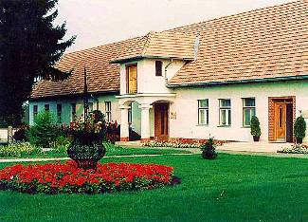
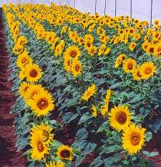
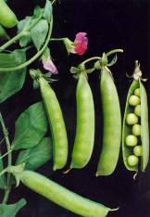
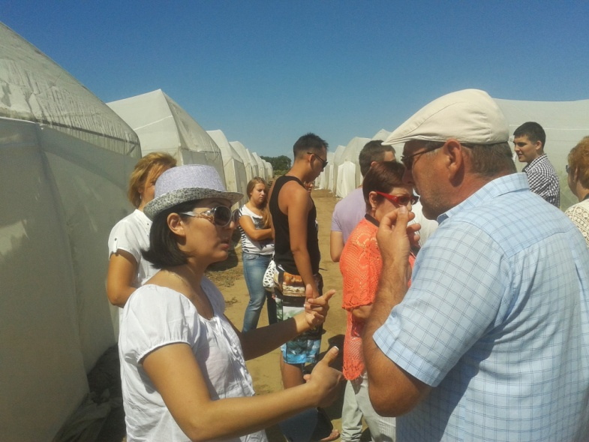
Educational and Research Facilities
THE FEED CROPS RESEARCH INSTITUTE
Notes:
The Feed Crops Research Institute pursues selective breeding and the improvement of oil-yielding crops, protein-rich crops, grains and forage crops and produces high-quality seeds.
The most important future task is the breeding of stress-resistant varieties which conform to the needs of the most up-to-date feed crops supply.

Slide 12

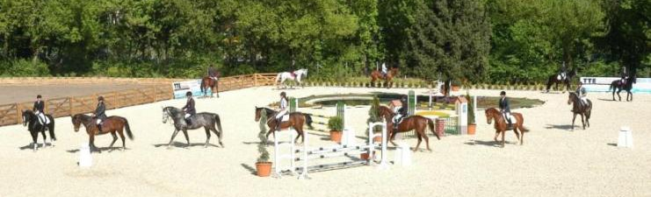
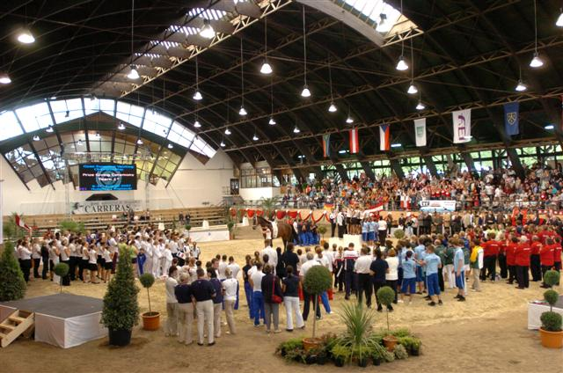
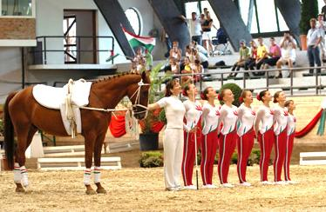

PANNON EQUESTRIAN ACADEMY
Notes:
To meet the requirements of the Health Science Center and the Equestrian Academy summarized the main areas of activities and developments as follows: education, sport, organization of national and international competitions, horse-riding of disabled childrens.

Slide 13
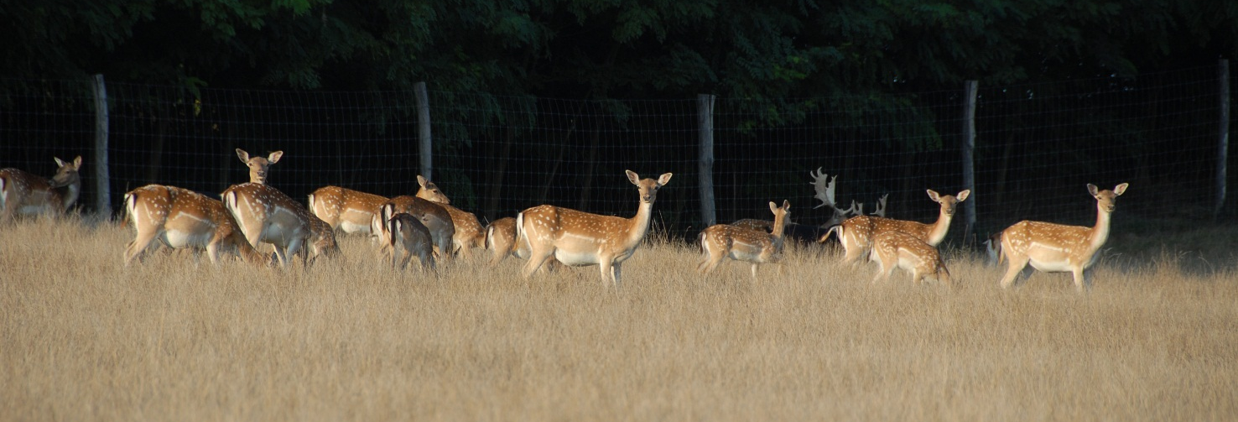
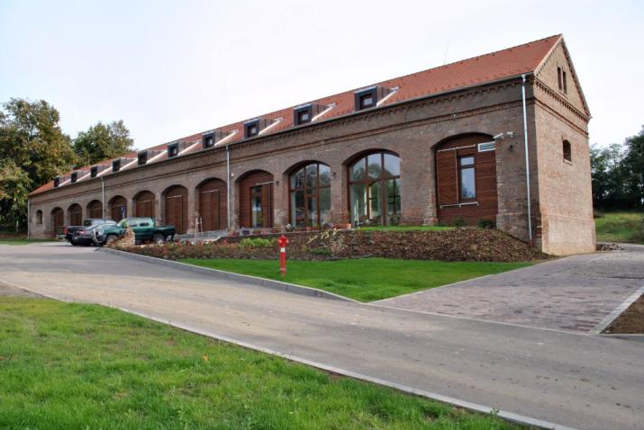
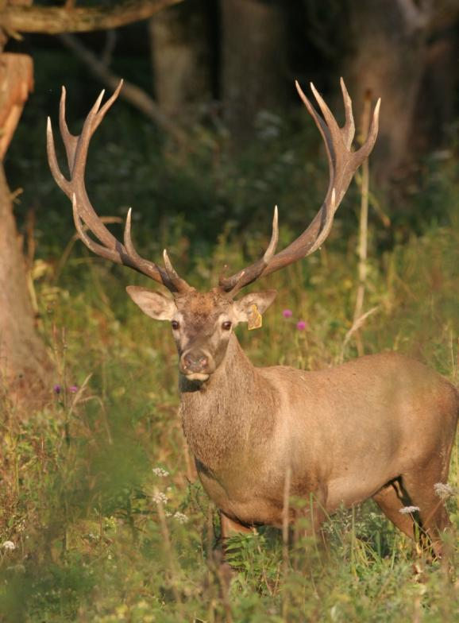

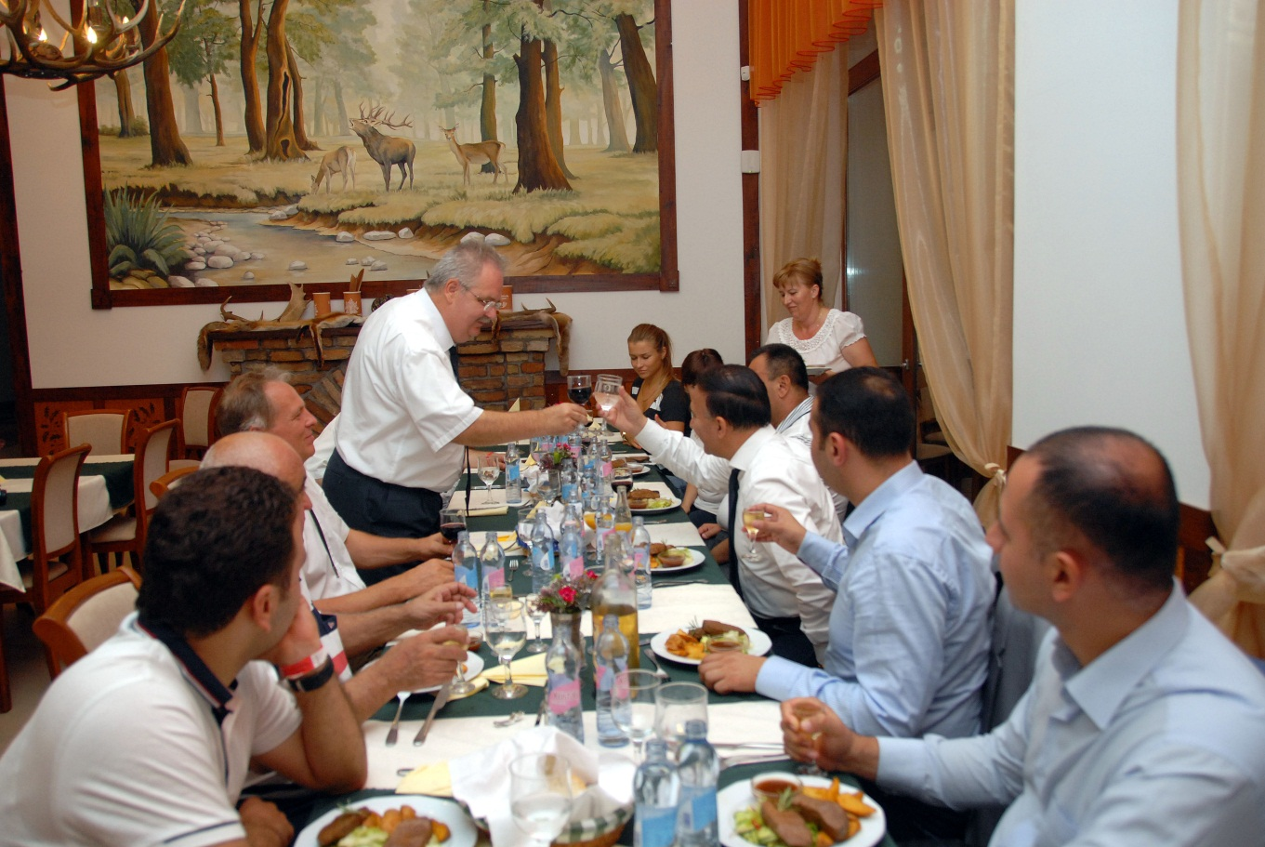
GAME MANAGEMENT LANDSCAPE CENTER
Bőszénfa
3400 hectars
1500 red deers
300 wild boars
200 fallow deers
150 moufflon
50 roe deers
Tame animals

Slide 14


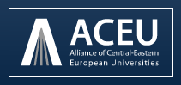
International Partner Institutes
Countries
Austria
Azerbaijan
Belgium
Croatia
Denmark
Germany
Italy
Netherlands
Norway
Poland
Romania
Slovakia
United Kingdom
New-Zealand
Australia
South African Rep.
USA
South-Korea
France
Japan
Canada
KAZAKHSTAN
China
Russia
Serbia
Switzerland
Sweden
Slovenia

Slide 15



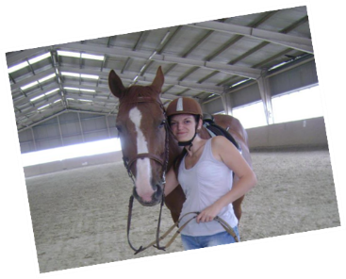
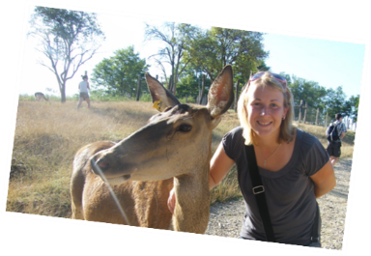
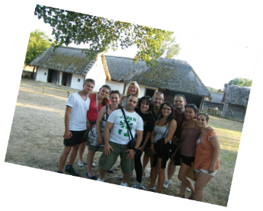
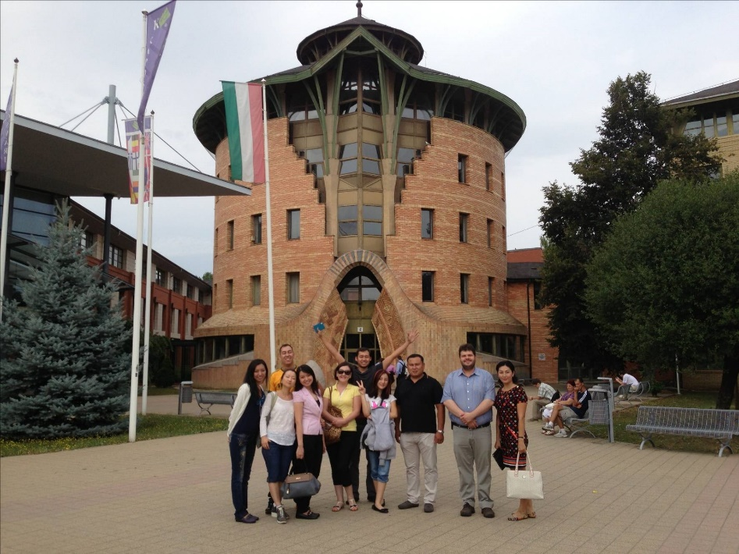


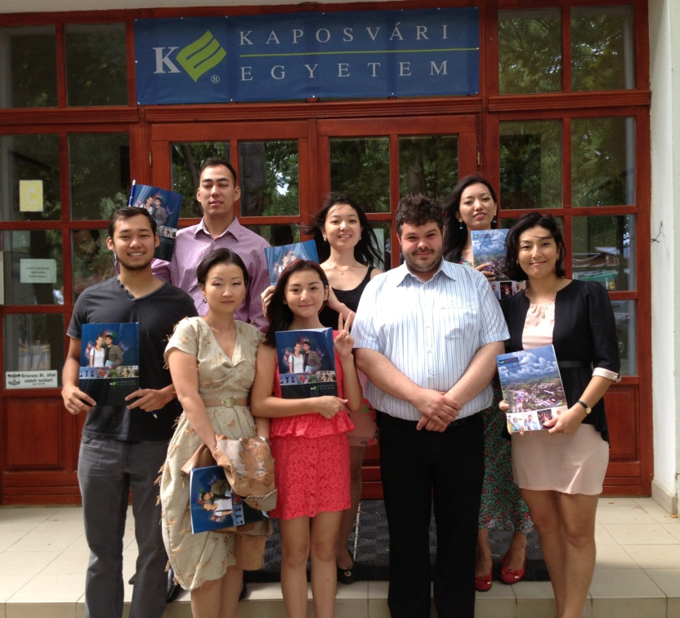
Kaposvár University and Kazakhstan
The Past
Summer school in
2013
August
Australia

Slide 16


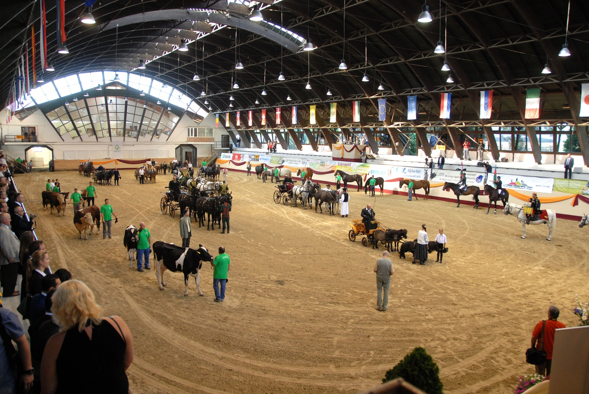
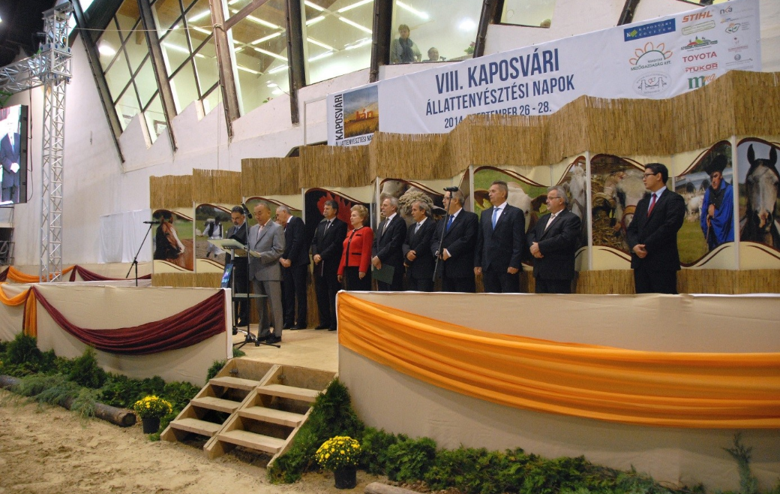
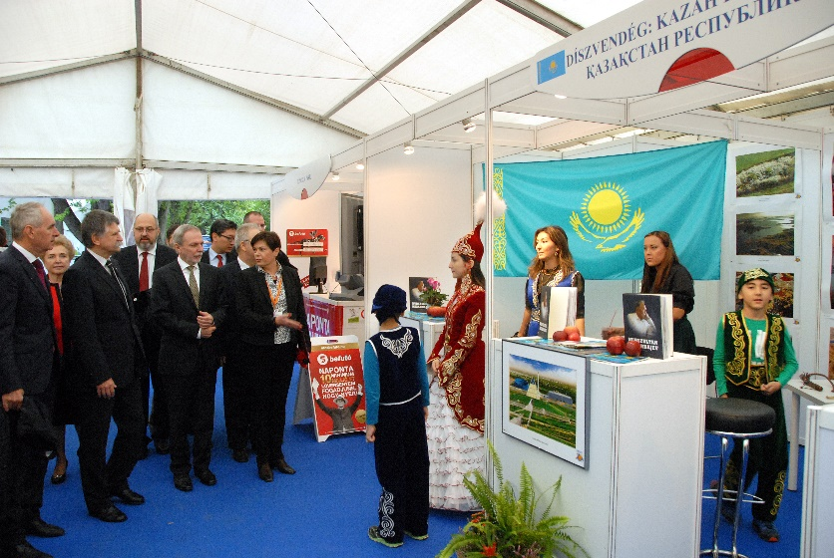
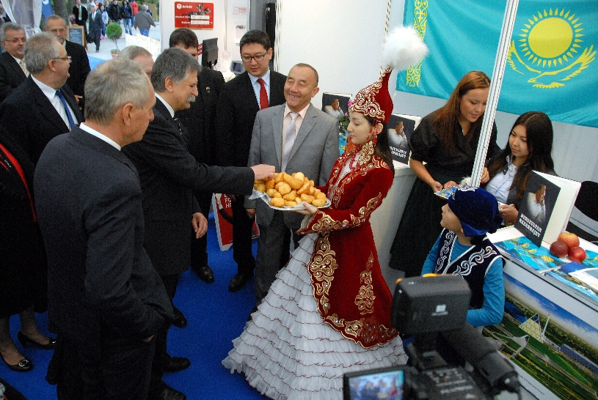
INTERNATIONAL ANIMAL BREEDING DAYS
OF KAPOSVÁR (2014)
More than 200 exhibitors
More than 1000 animals
30 000 visitors/year

Slide 17

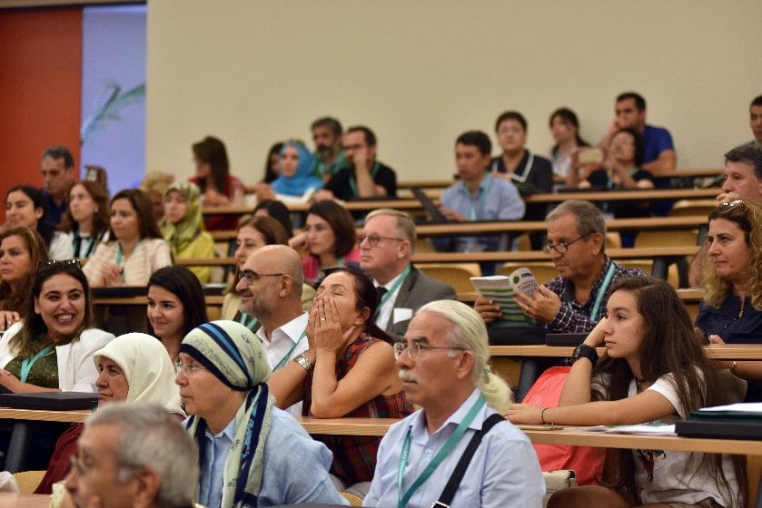
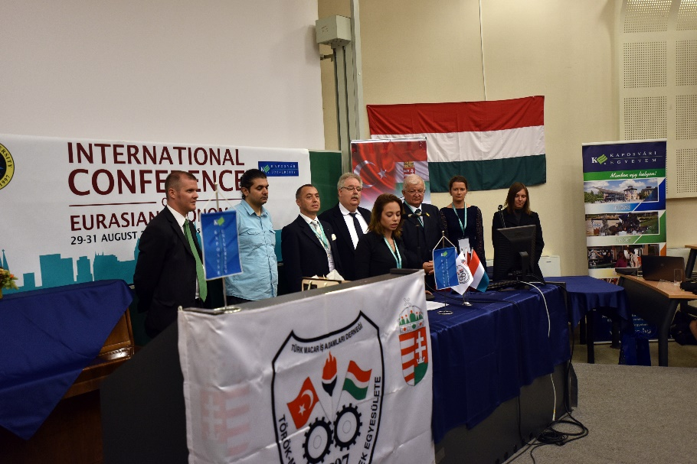
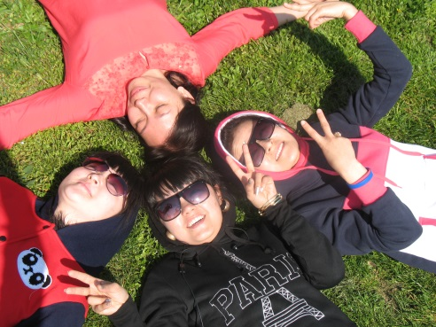





7. International Conference on Eurasian Economies
2016 August
2014
August
­6. International Conference of Economic Science
2017
May

Slide 18
Present
Institutional Cooperations with Kazakh Universities
Narxos University (Ryskolov Kazakh Economic University)
Kazakh Engineering Financial and Bank Academy
Science Research Institute Agroengeneering Problems and New Technologies
Almaty Humanitarian Technical University
Eurasian Technological University
College of the „Academy of Banking”

Slide 19
The STIPENDIUM HUNGARICUM Scholarship
MAIN INFO ABOUT THE SCHOLARSHIP
Application Requirements determined by the host university (eg Kaposvár)
Opened for English and Hungarian language courses as well
The scholarship covers the followings:
  Tuition fee for the whole studies (2-3 years, depending on the program)
  Accommodation in the university dormitories
  Monthly scholarship for living (about 200 $/month)
The details will be published soon (Responsible: Hungarian Scholarship Committee)
Kazakh students studying at Kaposvár University:
- Currently we have 9 Kazakh students
- The first Kazakh student arrived in 2014 to our university

Slide 20




International Education Fair 2017 - ASTANA

Slide 21
Future
Renewal of present cooperations
Increase the number of Kazakh students
Expansion of Stipendium Hungaricum Scholarship
Joint scientific research projects
Joint conferences and publications
Teacher and student exchange programs
Short term vocational training in Special Education

Slide 22






Snapshots of the Lives of International Students
„I am proud to study at Kaposvár”
/Dinara Aliyeva/

Slide 23


Thank you for your attention!

