Slide 1
University in the face of global challenges, the ways of development
Rector: Prof. Zh. Shaimardanov
Budapest 2018

Slide 2
INTERNATIONALIZATION OF EDUCATION
Academic related activity in EKSTU
Education of highly skilled personnel for economy 3.0
Diversification of EPs
Sectoral cluster
New EPs
Digitisation of EPs
Internationalization and export of educational services
Unified University Management System
-Metallurgy – BA, MA
Akita University, Japan, Curtin, Australia
-Materials for nuclear power engineering
-Innovative technology of uranium production,
Bauman MSTU, TPU, MIPT
-Geology and exploration of mineral deposits - MA
Politechnika Wrocławska, Акита.
-Heat power engineering - MA
Schmalkalden University, Germany
-Automation and Control - MA
-Information Systems - MA
Óbuda University, Hungary
- Precision agriculture
- Digital methods of Earth exploration
- Medical equipment
- Robotic Unmanned Systems
- Augmented and virtual reality
- Intelligent life support systems
- Additive technologies

Slide 3
INTERNATIONALIZATION OF EDUCATION
Opening ITPS ОК is to implement postgraduate training and to raise funds and practice-orientated training of Master and PhD students
Master programs
PhD programs,
Post Doctoral programs
Six EPs with English as a medium of instruction + 7 innovative Master EPs
Invited foreign scientists with high H- index
Project on Kazakh postgraduate school
Funding: Volkswagen Foundation (Germany), Techn. University of Clausthal (Lower Saxony).
Date: JANUARY 2018 - DECEMBER 2021
Amount of financing: 903.140,00 Euro

Slide 4
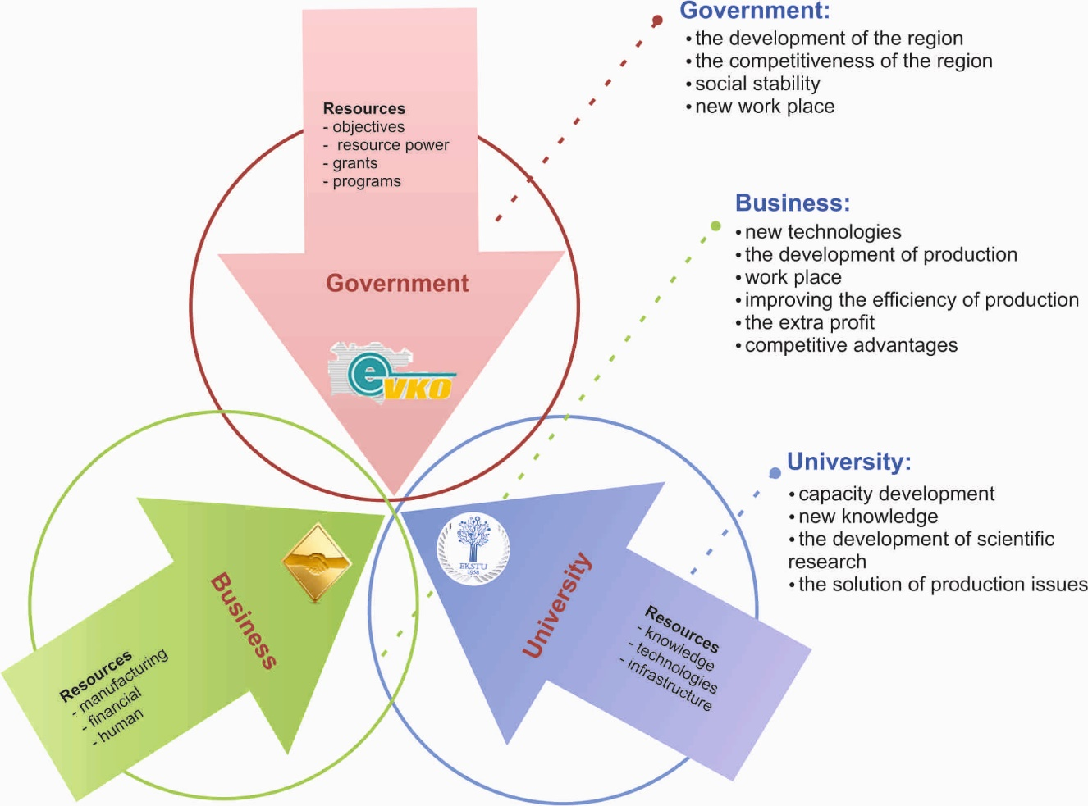
COMPETITIVE SCIENTIFIC AND INNOVATIVE ACTIVITY
7 scientific and technical projects within program-targeted financing
PROJECT PARTNERS
Total amount of investments - 7,3 billion tenge
The scientific component is financed by the Ministry of Education and Science of the Republic of Kazakhstan in the amount of 2,7 billion tenge

Slide 5
SCIENTIFIC AND TECHNICAL PROJECTS
WITHIN PROGRAM-TARGETED FINANCING
PROJECT "Development of high-tech production of medical products from refractory metals of tantalum and niobium and alloys based on them“ with JSC UMP
PROJECT "Development of technology for atmospheric leaching of low-grade concentrates using the pilot plant " Hydropolymer “ with Kazzinc LLP.
PROJECT "Titanium products in medicine and oil and gas sector" with JSC "UK TMK" and others.
FOREIGN PARTNER INSTITUTION/ ENTERPRISES – PROJECT STAKEHOLDERS
Schlumberger (France)
Company «Engineering Dobersek» (Germany)
Company Stainless (France)
Mining institute of RAS
Freiberg University of Mining and Technology(Germany)
Central South University, Beijing (China)
University of Queensland (Australia)

Slide 6
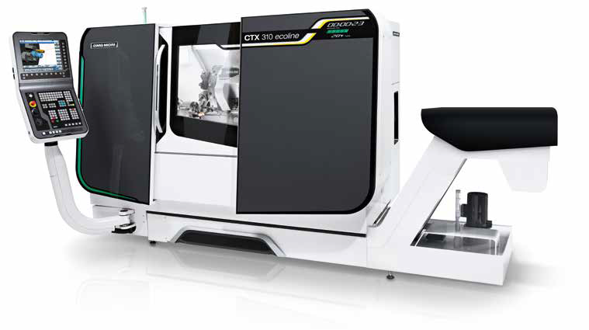
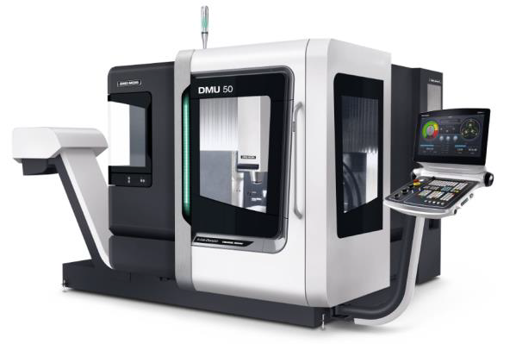
INFRASTRUCTURE OF PROJECTS
CENTER OF PROTOTYPING AND MATERIAL PROCESSING
Equipment of the leader manufacture CNC-Maсhine:
high stability
high-precision and high-performance
CTX-ecoline
Up-to-date digital machining center
DMU 50
High –tech digital milling machine

Slide 7
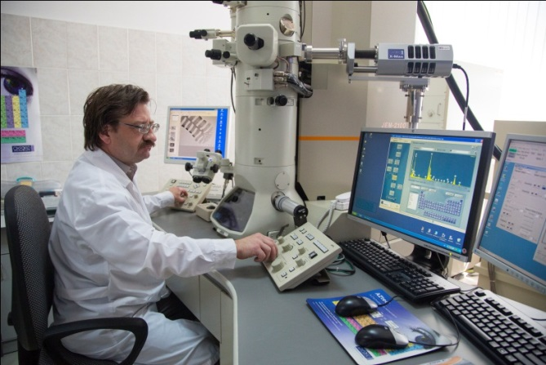
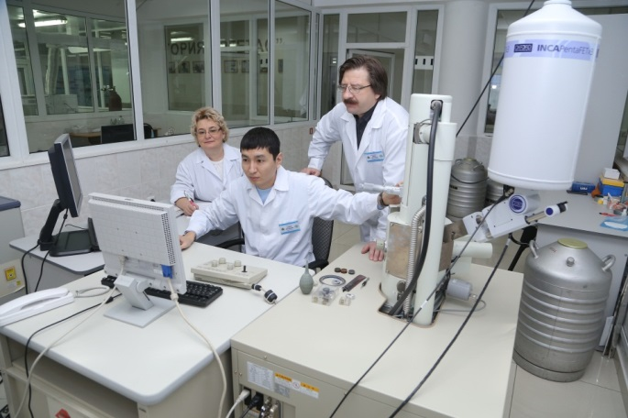
INFRASTRUCTURE OF PROJECTS
CENTER EXCELLENCE TECHNOLOGY «IRGETAS»
Equipment from the leader manufacture
UP-TO-DATE ELECTRON MICROSCOPE:
Super-resolution and accuracy
UP-TO-DATE SCANNING ELECTRON MICROSCOPE:
Observation and analysis of fine structure at high resolution level

Slide 8
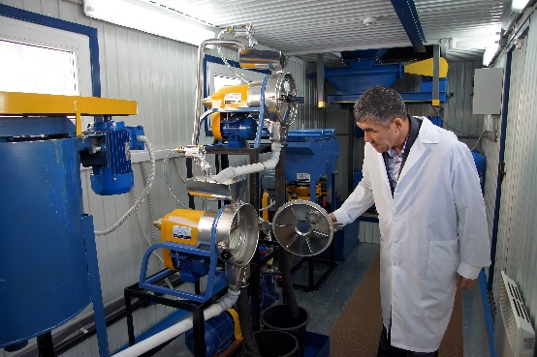
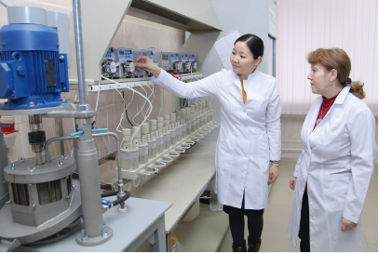
INFRASTRUCTURE OF PROJECTS
CENTER EXCELLENCE TECHNOLOGY «METALLURGY»
Modern technological and research equipment to study enrichment processes
Modern technological and research equipment to study metallurgical processes

Slide 9
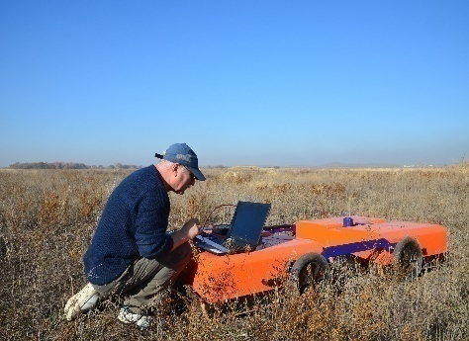
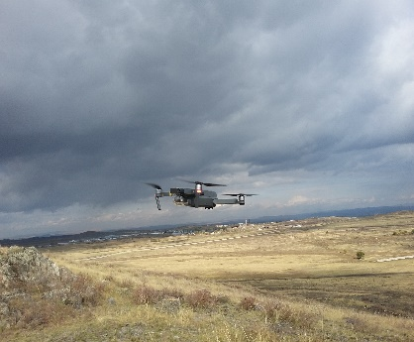
INFRASTRUCTURE OF PROJECTS
CENTER EXCELLENCE TECHNOLOGY «ENGINEERING»
Computer modeling of natural and technogenic processes using methods of remote and digital sounding of the Earth

Slide 10
INFRASTRUCTURE OF PROJECTS
CENTER EXCELLENCE TECHNOLOGY «Constructing technologies»
Additive technologies in construction
New building materials
Testing building materials
Assessment of the condition of buildings and structures by non-destructive methods

Slide 11
GLOBAL LEVEL
LOCAL LEVEL
International
Association of
Universities
European University Association
Eurasian Network
University
University
The Shanghai Cooperation Organization
Association
Of Asian Universities,
Bolshoi Altai

Slide 12
COOPERATION PROPOSAL ÓBUDA UNIVERSITY
Joint master degrees
Unmanned Robotic Systems
Development and expertise
Invite professors to give courses
Internship in partner institution
Intelligent life support systems
Other promising
«Circuitry of control and monitoring systems"»,
"Intelligent control systems and neural networks”,
"Modeling mechatronic and robotic systems”,
"Management of unmanned robotic vehicles"

Slide 13
Thank you for attention!

