Slide 1
Future(s) of Higher Education Dilemmas and Questions.
Gábor Király Ph.D.
Future of Higher Education Research Center
Scientific Director

Slide 2
Session moderators
Professor Jan Burdukiewicz: Vice Rector for International Relations and Projects at University of Wrocław, Poland.
Assoc. Prof. Jana Péliová: Vice Rector for Managing International Projects at the Economic University of Bratislava, Slovakia.

Slide 3
Aim of the workshop
Discuss dilemmas in relation to the future of Higher Education
Reflect on the arguments, expectations and values that guide our decisions
Create a space for exchanging ideas and building connections
there are no „right” answers or decisions

Slide 4
Old joke (…still works though)
What kind of romantic partner are you looking for? Somebody who (is)…
kind and empathetic.
great with kids.
sad when I’m sad, happy when I’m happy.
always happy and waits for me at the door when I get home.
can go for long walks with me and listens to me intently when I share my thoughts.

Slide 5
Your ideal partner is:
Kutyazona

Slide 6
What HEIs should contribute to…
professional formation of students
their personal growth
the development of a learning/growth/entrepreneurial/gritty/creative mindset(s)
the development of responsibility towards the future
research & development, innovation
building (inter)national networks and cooperating with social and economic partners
local/urban/regional development
economic growth
Rauchmeldershop - Rauchmelder Shop

Slide 7
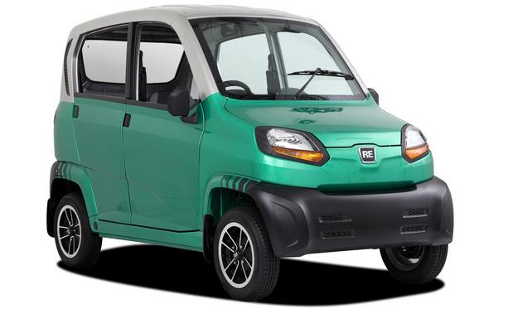
Thinking about automotive design…
Palladino Honda
Autos MaxAbout
Ersatzteile Lada Niva
toyota.com

Slide 8
Websalad

Slide 9
Education is per definitionem future-oriented
Decisions can be based on expectations about the future of…
learning
work
the HE sector (including competitors)
the labour market
the structure of the economy
society in general
MIT Sloan Management Review

Slide 10
Q1: How to teach? Where/how did you experience true learning (deep, long-lasting, transferable)?
Possibly through practice in an environment:
meaningful
feedback rich
offering expert support
involving both emotionally & intellectually
maybe embedded in a learning community
Practice Gallery

Slide 11
Discussion in small groups
Please form small groups, preferably with people who you do not know (yet)
read the dilemma first then discuss how you would decide and why
please listen intently to others & try to connect to their thoughts
collect the arguments for each side with the session moderators
Time limit: 10-15 minutes

Slide 12
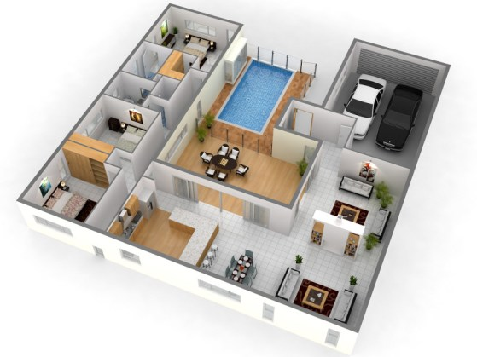
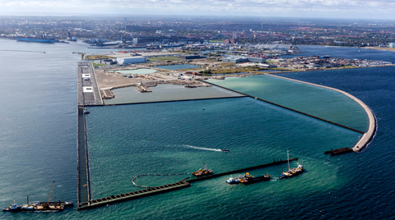
Architecture as a metaphor
Decorated Life
Designing spaces for living (or learning)
Flat, house, (maybe a school)
How will people utilise this space?
Or taking the long view:
How do you design a new part of the city for the next 30-40 years?
allowing for space-to-come
http://www.nordhavnen.dk/english/uk-nh-transformation2/uk-nh-nordhavnen.aspx

Slide 13
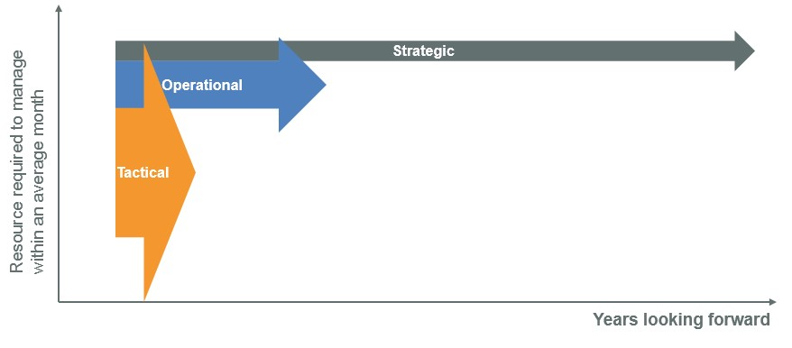
Q2: What is the ideal time horizon for HE programmes?
Should we design our courses for the next 5-10 years or for the next 40-50?
OrgVue Blog

Slide 14
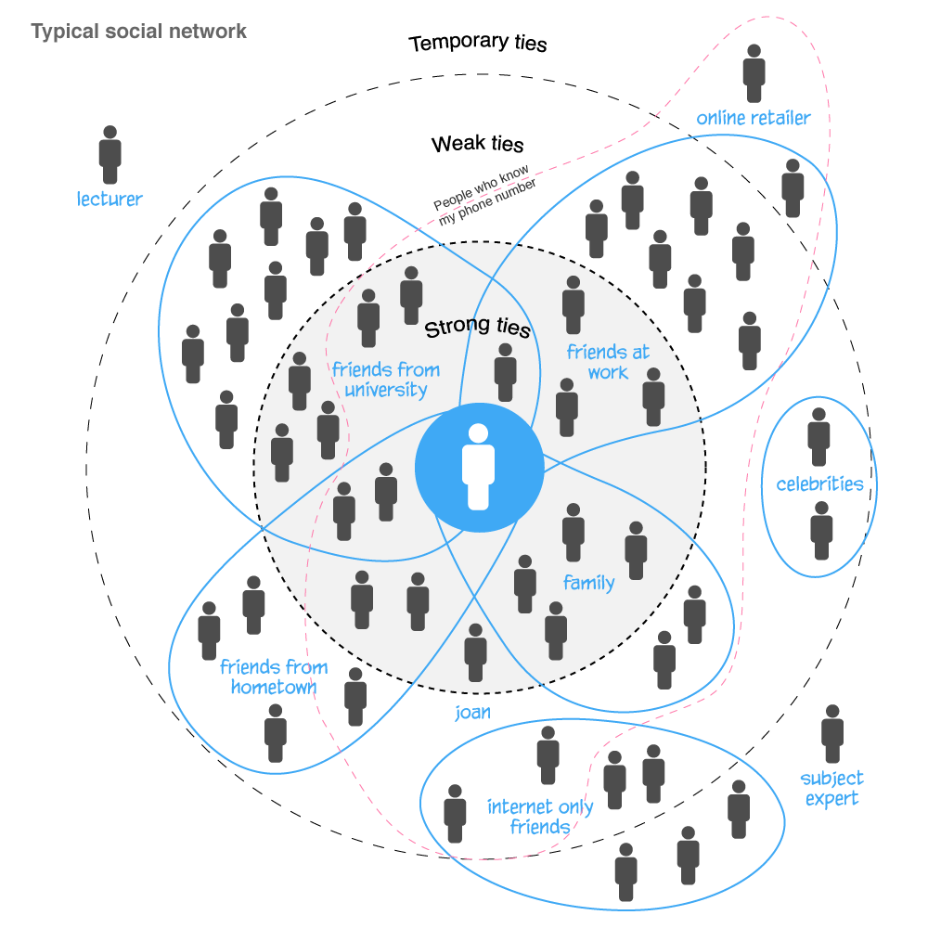
Social networks
Hyperdiadic relationships:
we not only affect our friends but our friends’ friends and…
we are not only responsible for ourselves but we affect many others around us
Circles of influence
shaping the lives of others
halfblog.net

Slide 15
Q3: What/Who HEIs (intended) circle of influence might include?
only the economic sphere
or…
also the social and environmental spheres?
http://bursa.listedcompany.com/misc/ar2015/Bursa_AR15_html/corporate-sustainability-statement.html

Slide 16
Contact
@: kiraly.gabor@uni-bge.hu
web: https://www.researchgate.net/profile/Gabor_Kiraly

