Slide 1
Corvinus Business School V4 Cooperation
Professor Zita Zoltay Paprika Ph.D.

Slide 2
The CEMS Network
CEMS:
Established in December 1988 by four leading European schools
(ESADE, HEC Paris, Bocconi University, University of Cologne)
designed the first truly European business education through one single Master's in International Management (MIM) degree
Members:
31 leading business schools worldwide
over 70 multinational companies
7 NGOs

Slide 3
RANKINGS
CBS is 2nd best CEMS School in Fall 2015
CBS is No 1 CEMS School in skill seminars in 2016 Spring
CBS is No 1 CEMS School in electives based on student evaluations in Fall 2015
CEMS
2013: 7
Corvinus Business School
2014: 79
MSc in Management and Leadership
2013: 68
2014: 70
2015: 4
2014: 5
2015: 68
2015: 79
2016: 70
2016: 82
2017: 9
2017: 76
2017: 70

Slide 4
V4 countries join the CEMS Alliance
Corvinus Business School, VSE University of Economics Prague and Warsaw School of Economics joined the CEMS Alliance together in 1996
Similar academic profiles of the V4 schools, common interests
No member school in Slovakia, so V4 is represented by 3 countries
Korea University BS
American University of Cairo
Koc, Ivey
Hong Kong University
UCD
CBS, HSG
NHH
Aalto
Keio
1988
1991
1996
2008
2011
2013
1990
1992
1998
2002
2009
2010
2012
2015
2017
CEMS was founded
(ESADE, Bocconi, HEC Paris, Uni of Cologne)
V4 countries
(Corvinus, VSE, SGH)
Tsinghua
LSE, SSE
University Adolfo Ibanez, Chile
CEMS becomes The Global Alliance

Slide 5
CEMS V4 Conference
a 2-3 day annual event in Central Europe
hosted on a rotating basis by CEMS member schools
of the Visegrad Group
VSE, SGH and Corvinus take turns to organise the conference
corporate partners are invited to give skill seminars
students from all over the world attend the conference
students earn credits on the courses
Priorities, aims:
valuable professional programs
strengthening the Central-European CEMS community
possibility for students to get to know the CEMS corporate partners
making the CEE region more popular and attractive among CEMS students

Slide 6
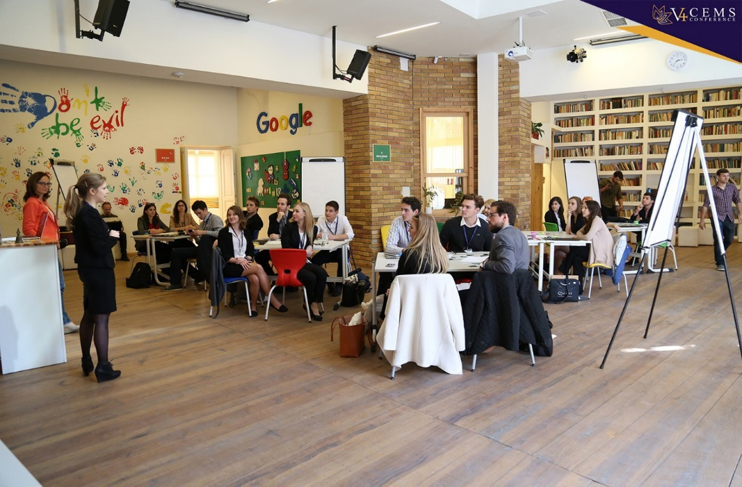
CEMS V4 Conference topics
2018: Digital Economy, Warsaw School of Economics
2017: Behavioural Economics, University of Economics Prague
2016: Disrupt Inside, Corvinus Business School, Budapest
2015: Business at the EU Eastern Frontier, Warsaw School of Economics
2014: Leadership in Dynamic Markets, Warsaw School of Economics
2013: Strategic Decisions in a Fast-changing Environment,
University of Economics Prague
2012: The Role of V4 - Regional Management Challenges,
Corvinus Business School, Budapest

Slide 7
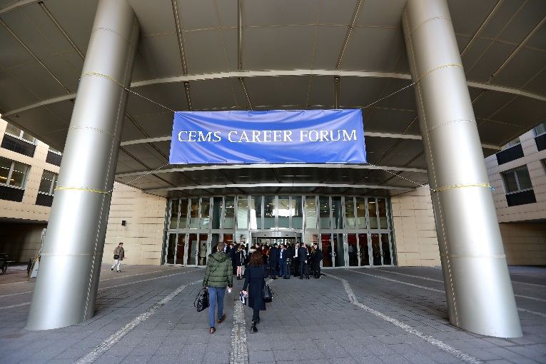
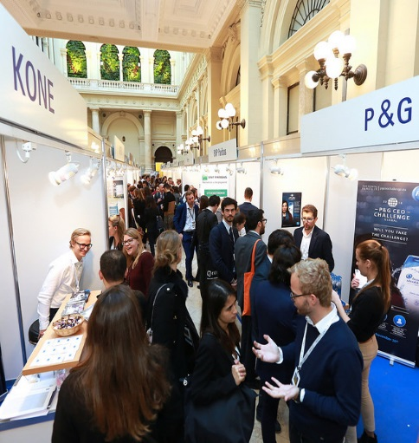
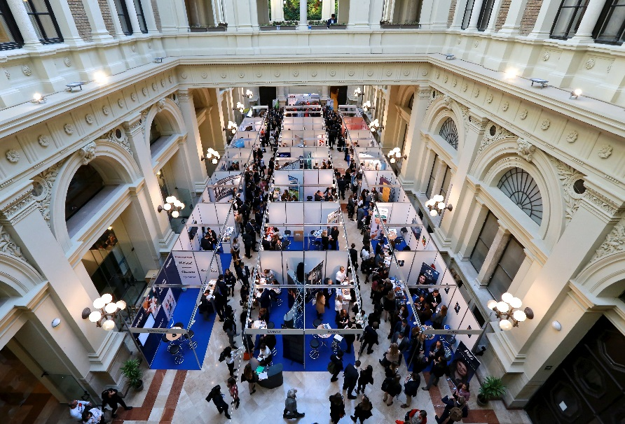
CEMS Career Forum in the V4 region
a 2-day recruitment and networking event taking place
annually in November
a platform that connects over 1000 students and alumni
with representatives from over 40 corporate partners,
including global companies
opportunities for internship and permanent employment
from 2017 Corvinus Business School hosts the event for 3 years
companies represented at CEMS Career Forum 2017:
Swiss Re, Novo Nordisk, Arla Foods, Vodafone, Gartner, Astra Zeneca, Facebook, Salesforce, Henkel, Deloitte, Société Généralé, Reckitt Benckiser, SKODA AUTO, A.T. Kearney, Whirlpool, MET Group, Siemens Management Consulting, A.P. Moller – Maersk, zeb, ABB, DHL Consulting, LVMH, UniCredit, Unibail-Rodamco, Beiersdorf, Daimler AG, GSK, L’Oréal, KONE, METRO, Bain & Company, Bayer, Groupe SEB, Barilla, Merck, P&G, BNP Paribas, Kerry, EF Education First, Statoil ASA, E.ON Inhouse Consulting, Google, McKinsey & Company, Hilti

Slide 8
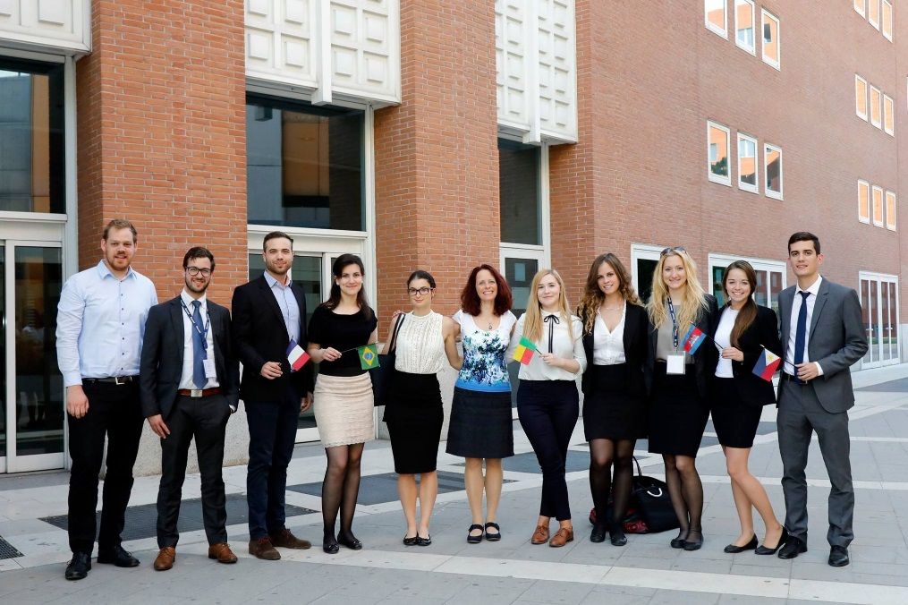
Student mobility at CBS in the V4 business schools
PRAGUE |  |  |  |  |  | WARSAW |  |  | Kozminsky (PL) | Slovakia (Selye Janos University)
 | OUT |  |  | IN |  | OUT | IN |  | OUT | IN
YEAR | ERASMUS | CEMS | CEEPUS | ERASMUS | CEMS | ERASMUS | ERASMUS | CEMS | ERASMUS | ERASMUS
2014/15 | 2 | 1 |  | 4 |  | 1 |  | 2
2015/16 | 4 | 1 | 1 | 2 |  | 3 | 1 |  |  | 2
2016/17 | 2 | 2 |  | 1 |  | 1 | 1 | 2 |  | 4
2017/18 | 5 |  |  | 4 | 2 | 2 |  | 2 |  | 5
2018/19 | 5 | 1 |  |  |  | 3 |  |  | 1

Slide 9
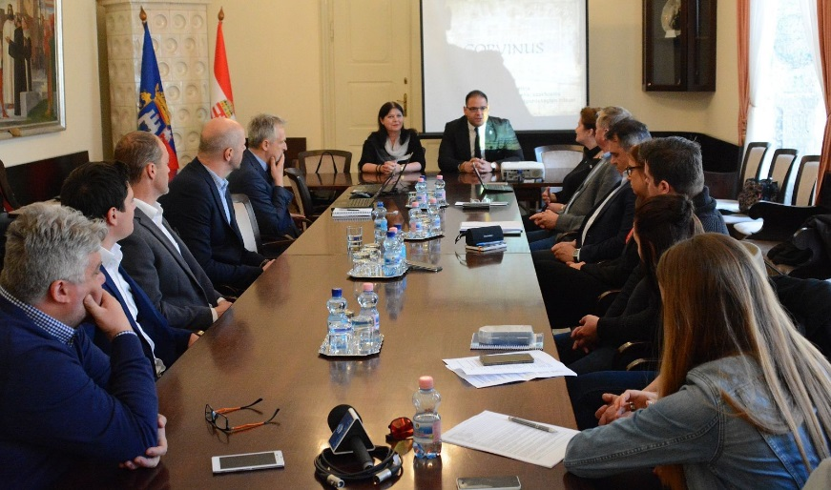
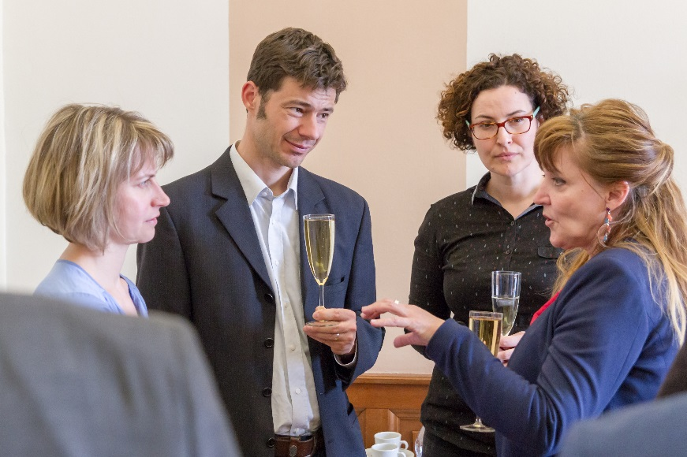
V4 Faculty mobility at CBS
 |  | Name | School | Program | Institute
2016-2017 | in | Karolina Daszyńska-Żygadło | Wroclaw University of Economics | Erasmus | Institute of Finance, Accounting and Business Law
2016-2017 | in | Rafael Sieradzki | Uniwersytet Ekonomiczny w Krakowie | ERASMUS | Institute of Finance, Accounting and Business Law
2016-2017 | in | Tomas Słoński | Wroclaw University of Economics | Erasmus | Institute of Finance, Accounting and Business Law
2015-2016 | in | Katarzyna Sum | Warsaw School of Economics | Corvinus Research Week | Institute of Finance, Accounting and Business Law
2015-2016 | in | Michal Konopczak | Warsaw School of Economics | Corvinus Research Week | Institute of Finance, Accounting and Business Law
2014-2015 | in | Pavel Turčínek | Mendel University in Brno | Erasmus + | Institute of Informatics
2016-2017 | out | Fazakas Gergely | Krakow University of Economics | CEEPUS | Institute of Finance, Accounting and Business Law
2016-2017 | out | Gáspár Judit | Institute for Sustainable Technologies - National Research Institute in Radom | The Future Engineering 2016 Technical and Organizational Innovations for Industry | Institute of Business Economics
2016-2017 | out | Gódor Zoltán | AIB-CEE | Research Conference | Institute of Management Science
2016-2017 | out | Havran Dániel | Warsaw School of Economics | Erasmus Mobility | Institute of Finance, Accounting and Business Law
2016-2017 | out | Reizingerné Dr. Ducsai Anita | Wroclaw University of Economics | XXI International Conference „Accounting and Management Control” | Institute of Finance, Accounting and Business Law
2015-2016 | out | Forgács Csaba | SGGW Warsaw | ERASMUS | Institute of Business Development
2015-2016 | out | Zsóka Ágnes | Prague | CEMS Faculty Group Meeting | Institute of Marketing and Media

Slide 10
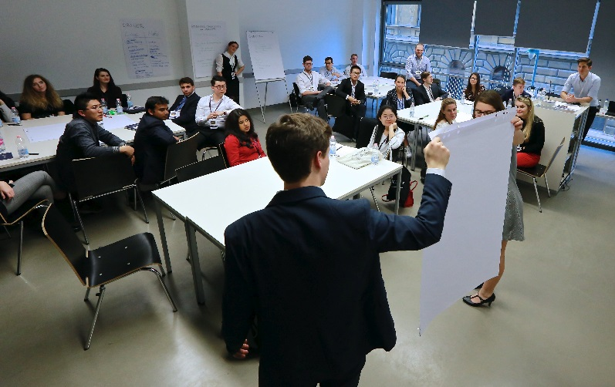
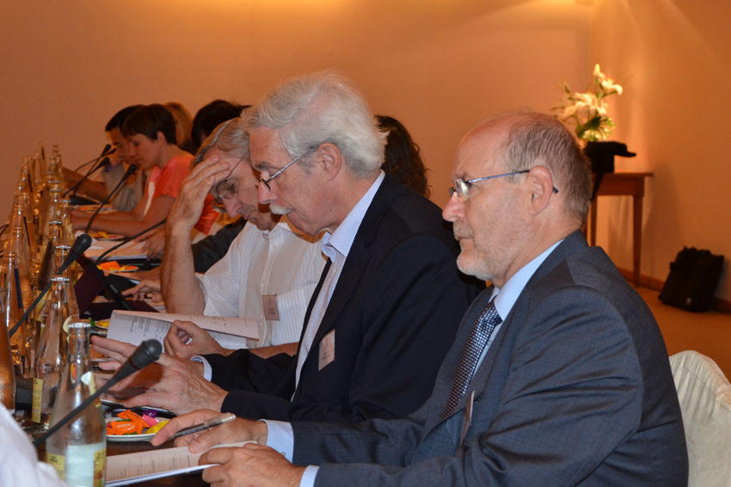
V4 Research Cooperations
Poznan University colleagues visited CBS
because of a best-practice (Corvinus Science Shop)
Publications is CEE regional journals:
Michalkó Gábor: Polish Journal of Sports and Tourism
Szalai Zsuzsanna: Horyzonty Politky
Erdős Gabriella: Financial Times East European Business Law
Primecz Henriett: Intersections, East European Journal of Society and Politics
Jámbor Attila and Török Áron usually publish articles in the
Czech Journal of Agricultural Economics
Usually there are articles from V4 countries in the English issue of Management Science Magazine

Slide 11
Future cooperation opportunities with V4 partner schools
Case study competitions
Skill seminars
Summer programmes
Publications
Joint corporate partnerships

Slide 12
THANK YOU
FOR YOUR ATTENTION!

