Slide 1
Geopolitical changes and challenges for the internationalization of universities
Professor Attila Brungs Vice-Chancellor and President

Slide 2
THE
FUTURE
IS NOW

Slide 3
DID YOU KNOW
In 2018, the education of international students in Australia generated over $30 billion and is the country’s 3rd largest export

Slide 4
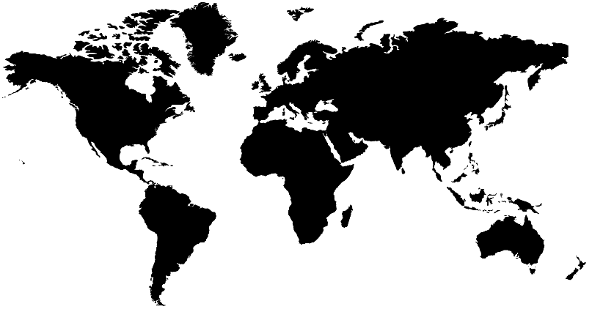
Who we are
Medium–large university
Over 40,000 students in 2017 (34,015 EFTSL)
UTS has students from almost
120 countries
International enrolments for 2017
Over 14,000 international students
Two thirds undergraduate in terms of student numbers

Slide 5
Geopolitical challenges

Slide 6
Global connectedness

Slide 7
The future of work

Slide 8
Digital disruption

Slide 9
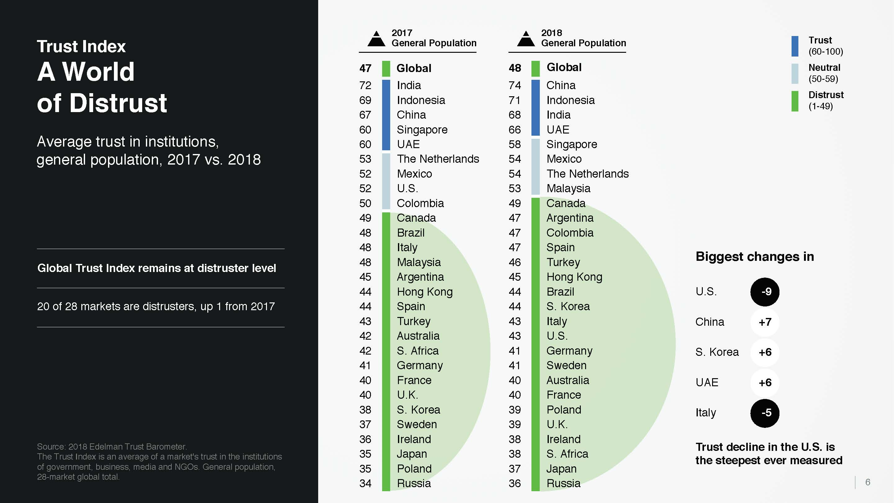
Global distrust

Slide 10
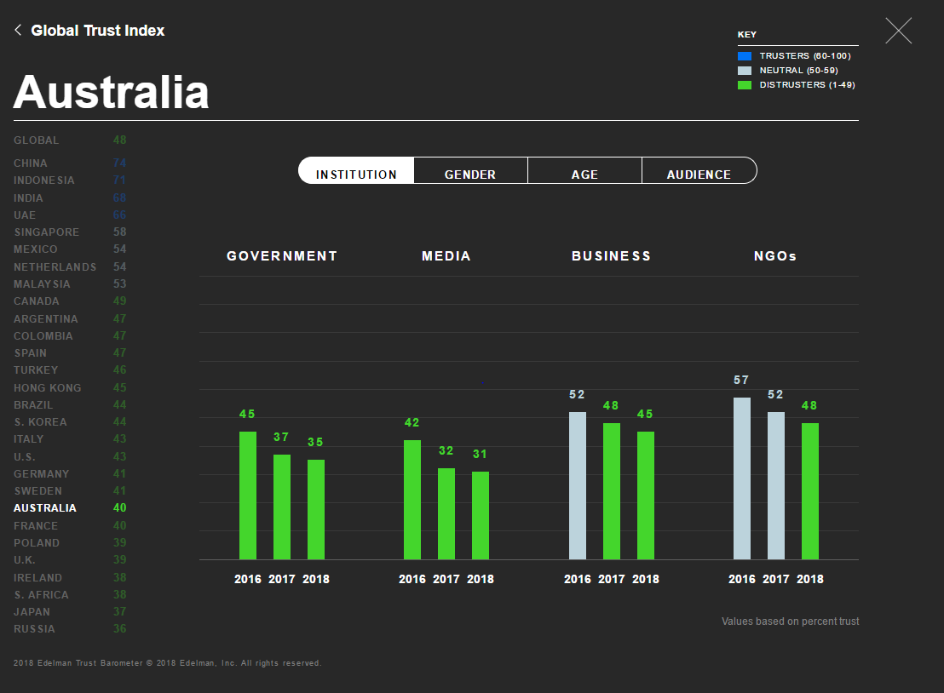
Australian trust index

Slide 11
Social upheaval / populism

Slide 12
NOW WHAT?

Slide 13
What we’re doing
Rethink our education model
Recognise our different working environment
Business model transformation
Technology transformation
International champion

Slide 14
Thank you

