Slide 1
XI General Assembly and X International Seminar of the CBGU

Slide 2
Global Universities in the 21st Century – Characteristics, Trends and Main Challenges
Budapest Hungary, 24-27 September, 2018

Slide 3
Environmental Considerations in an Urban Setting By Amb. Gauri Shankar Gupta

Slide 4
Introduction
My presentation is simple and devoid of jargons, technical details and mathematical formulae.
I consider degradation of environment as the most significant challenge facing the humanity.
Mass migration to cities has made it worse.
Environmental issues must form part of education curriculums at all levels.
This is a societal issue and must be dealt with collectively by all nations at all levels.

Slide 5
What is Environment?
Five Great Elements Constitute the Environment
Space
Air
Energy
Water
Earth with its geo-physical features and millions of life forms

Slide 6
Environment as Life Support System
Air we breathe
Water we drink
Food we eat
Clothing we wear
Habitation we live in
Energy we consume
Everything else we use
Nature is our HOME

Slide 7
Humans lived in Harmony with their Environment
for Thousands of Years

Slide 9
Nature, Pristine and Pure

Slide 10
Industrial Revolution
Mechanization and fossil fuel (1760 onwards)
Adam Smith – Wealth of Nations (1776)
Machine-led exploitation of natural resources
Massive Urbanization
Mass Production - Global GDP up from $5.31 trillion in 1950 to $79.3 trillion in 2017 ($ 127.7 trillion on PPP basis)
Emergence of Consumption Society
Technology and Globalization

Slide 11
60 Billion Tones/Year 41000 Empire Estate Building/Year

Slide 13
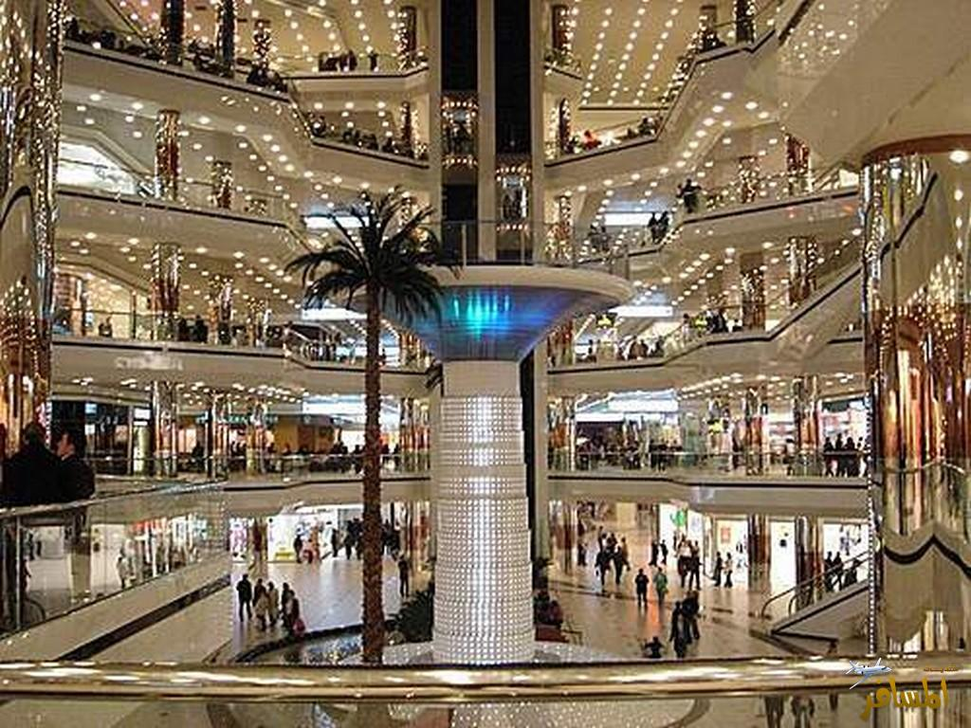
Consumption Society

Slide 14
Growth, growth and more growth
Race for higher GDP and per capita income.
How much and for how long??
Increasing global population??
We are challenging the carrying capacity of the Earth.

Slide 15
Environmental Degradation
Air pollution
Water contamination– Rivers, Lakes, Under Ground Aquifers
Contamination and Acidification of Oceans
Soil Degradation
Eco-System
Global Warming

Slide 18
Soil Erosion

Slide 19
Salinity

Slide 20
Desertification

Slide 21
Cornell Research
Over 40% of Total Deaths World-Wide Caused due to Air, Water and Soil Pollution.
Most human illnesses have their roots in air and water pollution and poor quality of food.

Slide 22
Global Warming and Climate Change

Slide 23
GHG Emissions Over 2000 Years

Slide 24
Global Trend of GHG Emissions

Slide 25
Evidence of Global Warming
Ice cores drawn from Greenland, Antarctica, and tropical mountain glaciers show that the Earth’s climate responds to changes in greenhouse gas levels.
Each of the Last Three Decades has been Successively Warmer at the Earth’s surface than any Preceding Decade Since 1850
The Rate in the Last Two Decades was Nearly Double that of the Last Century
Most of the Warming Occurred in the Past 35 years, with 16 of the 17 Warmest Years on Record Occurring since 2001, 2016 Being the Warmest

Slide 26
Evidence of Global Warming II
Global Sea Level Rose About 8 Inches in the Last Century
Earth’s Average Surface Temperature has Risen by 1.1 degrees Celsius Since the Late 19th Century
The Greenland, Arctic and Antarctic ice sheets have decreased in mass
Greenland lost 150 to 250 cubic kilometers of ice per year between 2002 and 2006, Antarctica lost about 152 cubic kilometers of ice between 2002 and 2005 while Arctic Sea Shrunk by 35% since 1979

Slide 27
Evidence of Global Warming III
Glaciers are Retreating almost Everywhere Around the World - in the Alps, Himalayas, Andes, Rockies, Alaska and Africa
Since the Beginning of the Industrial Revolution, the Acidity of Surface Ocean Waters has Increased by About 30%
Number of Extreme High Temperature Events are on Increase
CO2 Level in the Atmosphere have Increased Substantially. Even compared to 1957 they were 25% higher in 2015

Slide 29
Impact of Urbanization

Slide 30
Trends in Urbanization

Slide 31
Some Facts
In 2014, 54% population of the world lived in cities.
In 1950 only 30% world population was urban.
Today most urbanized regions include; North America 82%, South America and the Caribbean 80% and Europe 73%. Asia and Africa are catching up fast with 48% and 40% respectively.
In 2014 there were 28 megacities with a population of 10 million and more. The number will go up to 41 by 2030.
Emergence of cities as economic hubs and innovation centres.

Slide 32
Cities as Hubs of Prosperity and Poverty
Centres of Employment, Education, Innovation, Healthcare, Entertainment and Communication.
Centres of Governance and a Symbol of Civilizations.
Centres of Connectivity and Globalization.
New World Order based on Cities and Connectivity.
Centres of Economic Activities; 750 cities contribute 57% global GDP.
Crumbling Infrastructure.
Slums with sub-human living conditions.

Slide 34
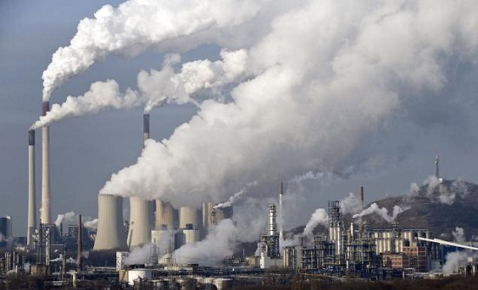

Slide 35
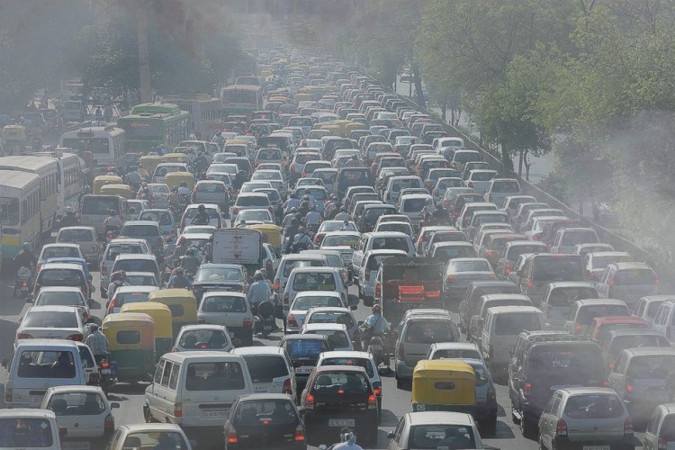

Slide 36
Slums and Garbage

Slide 38
Challenges Ahead
As the world enters the second decade in the new millennium, humanity faces a very dangerous threat. Fueled by two powerful human-induced forces that have been unleashed by development and manipulation of the environment in the industrial age, the effects of urbanization and climate change are converging in dangerous ways which threaten to have unprecedented negative impacts upon quality of life, and economic and social stability.
Cities and Climate Change Report 2011 by UN Habitat

Slide 39
Environmental Impact of Massive Urbanization 1
Deteriorating air quality: vehicles, factories, high concentrated energy consumption
Water Supply Issues: poor quality, scarcity
Excessive Waste Generation: solid waste, liquid waste, chemicals
Waste Collection and Disposal
Contamination of Rivers, Coastal Areas, Lakes and Other Water Bodies

Slide 40
Environmental Impact of Massive Urbanization 2
Concentrated Heat Zones affecting Weather Conditions: smog, trapping of pollutants, higher CO2 emissions
Deforestation and Degradation of Soil
Environment-ravaging Construction
Excessive Noise Pollution
Damage to Ecosystem due Unplanned Growth of Cities
Use of Fertile land for Urban Infrastructure
Consumerism
Economic Disparity and Urban Slums

Slide 41
Poor air and water quality, insufficient water availability, waste-disposal problems, and high energy consumption are exacerbated by the increasing population density and demands of urban environments (National Geographic)
The conversion of Earth’s land surface to urban uses is one of the most irreversible human impacts on the global biosphere. It hastens the loss of highly productive farmland, affects energy demand, alters the climate, modifies hydrologic and biogeochemical cycles, fragments habitats, and reduces biodiversity (Seto et al., 2011)
many studies have described how urbanization affects CO₂ emissions and heat budgets, effects on the circulation of water, aerosols, and nitrogen in the climate system are only beginning to be understood (Seto & Shepherd, 2009).

Slide 42
Urbanization worrying because much of the urbanization wave is happening with little to no advance planning, amplifying the environmental cost of stuffing hundreds of millions of poor people into half-built metropolitan areas that often lack basic sanitation, waste management or water services (Time Magazine).
Researchers estimate that urban expansion will encroach on or displace habitats for 139 amphibian species, 41 mammalian species and 25 bird species that are either critically endangered or endangered. And as land is cleared for those new cities — especially in the densely forested tropics — carbon will be released into the atmosphere as well. (Time Magazine)

Slide 43
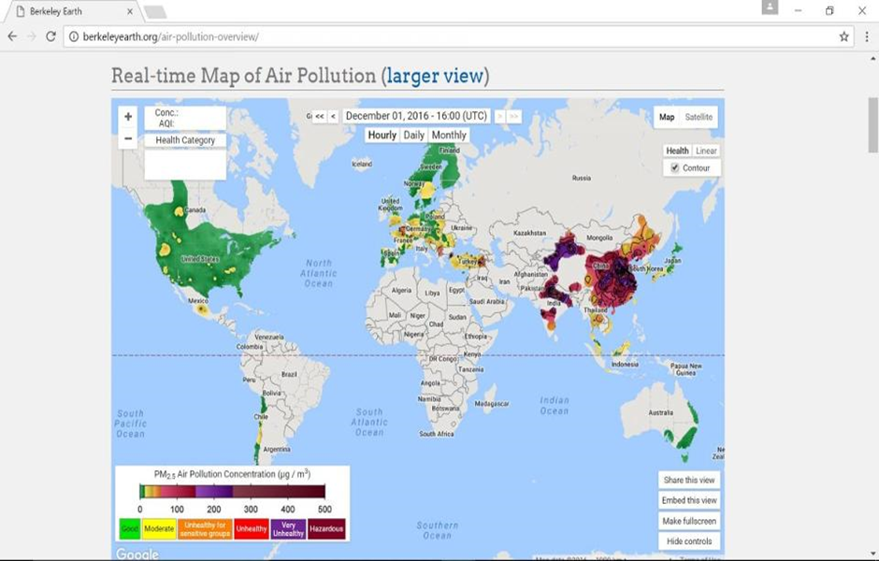
Global Air Pollution Concentration

Slide 44
Most Cities in the World are Under Heavily Polluted Category

Slide 45
Extreme Inequality
On the Other Hand Economic Inequality is on the Rise in a Manner Never Seen Before
Today 8 Individuals Own as Much Wealth as 3.6 billion people or the 50% of Humanity
Number of Billionaires is Rising Very Fast from 1226 in 2012 to 1826 in 2015
Every Year in Rich Countries People Waste as Much Food as the Total Production of Sub-Saharan Africa (230 mt)

Slide 46
Billionaires

Slide 47
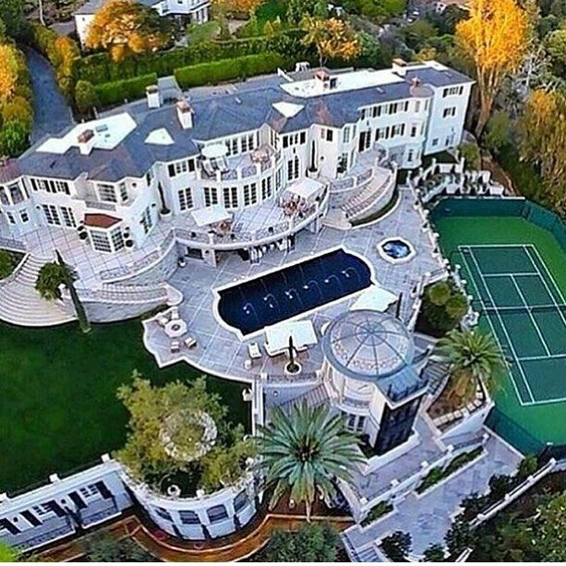
Extreme Inequality

Slide 48
Failure of Smart City Concept
Better Planning
Green Areas
Energy Efficiency
Efficient Housing
Efficient Water Supply System
Waste Collection and Reprocessing
Rapid Public Transport System
Monitoring Congestion

Slide 49
Emissions and Contaminations on the Rise
There is No Visible Progress on the Ground despite Many International Conferences, Agreements and Plethora of Declarations
5th Assessment Report of IPCC Provides a very Dismal and Alarming Picture
All Variety of Contamination is on the Increase at a Faster Pace
Solid and Municipal Waste is also on the Increase @ 800kg pp per year

Slide 50
Moderation is the Essence of Life
While Poverty is a Curse, Excessive Consumption is a Greater Evil
Middle Path Advocated By Buddha is the Best Way

Slide 51
Needs V/S Greed
Human Needs of Food, Water, Shelter, Health and Education Must be Met.
Desires are Infinite and Can Never be Satisfied. They Grow in Geometric Progression.
Consumption as Principal Goal of Life Cannot be Sustained – We Do Not Live to Eat but Eat to Live.
Needs can be satisfied but not the greed - Mahatma Gandhi

Slide 52
7000 Years Ago Vedas Said
ईशा वास्यमिदं सर्वं यत्किञ्च जगत्यां जगत्।
तेन त्यक्तेन भुञ्जीथा मा गृधः कस्य स्विद्धनम्॥
This Entire Universe-animate and inanimate-is Pervaded by The Almighty. Use only as Much as You Need. Neither be Greedy Nor Attached, as the Wealth of Nature Does Not Belong to You.
Isha Upanishad

Slide 53
Hen with Golden Egg

Slide 55
Köszönöm!
Thank You!

