Slide 1
STREET TALK on the difference between structures, validation of credits and diploma’s in Bachelor’s, Master’s and PhD’s Degrees
Prof. dr. Koen DEPRYCK
CGBU – HRC 24-27 September 2018 Boedapest, Hungary

Slide 2
Mobility of degrees for mobility of people

Slide 3
It’s all about mobility
a group of 48 countries that cooperate to achieve comparable and compatible higher education systems throughout Europe (and beyond)
3 cycles of higher education (Bachelor, Master, PhD)
European Credit Transfer System (ECTS) and EQF
1 “full” year = 60 credits
Broken down to the level of courses or smaller, and building up to the level of programmes
Country | Year joined EHEA | EU member? | EEA member?
Albania | 2003 | no | no
Andorra | 2003 | no | no
Armenia | 2005 | no | no
Azerbaijan | 2005 | no | no
Belarus | 2015 | no | no
Bosnia and Herzegovina | 2003 | no | no
Georgia | 2005 | no | no
Kazakhstan | 2010 | no | no
Macedonia (FYROM) | 2003 | no | no
Moldova | 2005 | no | no
Montenegro | 2003/2007 | no | no
Russia | 2003 | no | no
Serbia | 2003 | no | no
Turkey | 2001 | no | no
Ukraine | 2005 | no | no
Vatican / Holy See | 2003 | no | no
EHEA European Higher Education Area
Automatic transfers of secondary and higher degrees

Slide 4
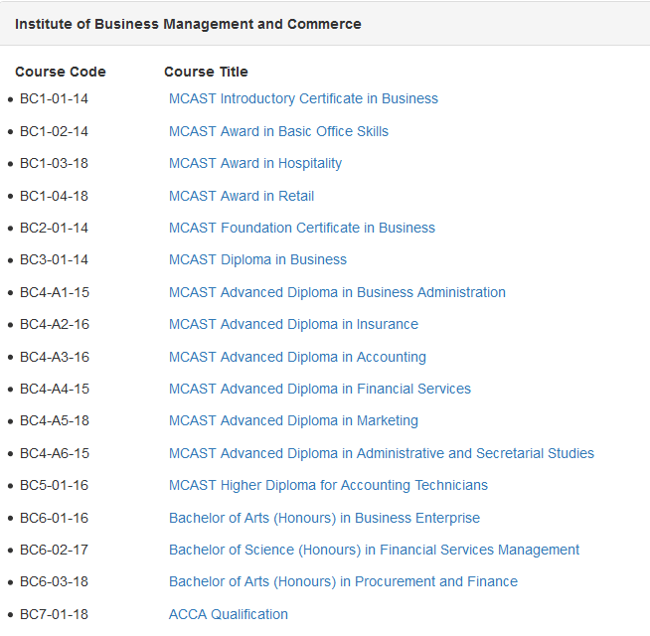

Slide 5
From 48 countries to....

Slide 6
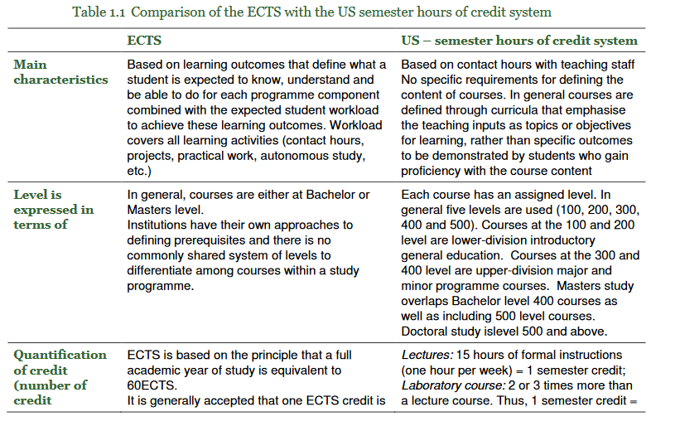
Differences between structures, validation of credits and diplomas

Slide 7
Recommendations...
If possible adopt a liberal approach to credit recognition for core, optional, elective, and general education programme components, especially in organised student mobility. If it is not possible to adopt a liberal approach compare courses
Do not consider the differences in credit points allocation or grading systems between the EU and the US as an obstacle
Develop/ maintain clear protocols around credit recognition from abroad across offices and departments in the institution, and improve the content description of courses taken by exchange students to enable better evaluation of credit
Support EU-US exchanges among faculty and staff in charge of recognition to build trust between faculty partners, to integrate study abroad components into major and minor degree programmes, and to improve consistency of the credit articulation within the institution
...

Slide 8
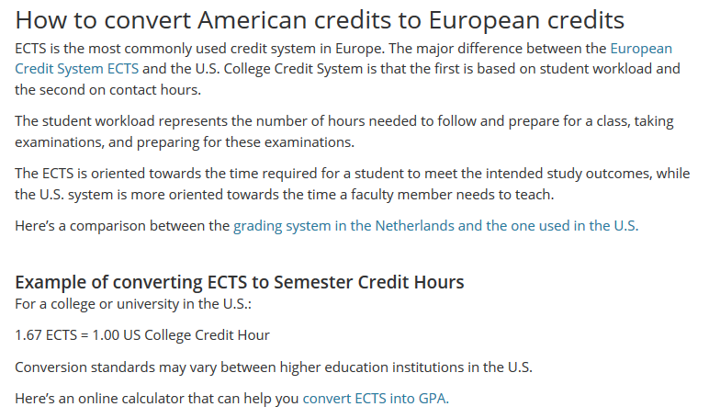
And then there is the quick and dirty approach...
“Here’s an online calculator that can help you convert ECTS into GPA”

Slide 9
Street talk...
“I want to continue my studies in the Netherlands”
“I would like to move to Miamy when I have my BA”
“Is MA better than a MSc?”
“I hear a M.Ed. is more like a bachelor...”
“Can you do a M.Ed. In education?”
“A Master’s degree is between 90 and 120 credits. Why do we need to do 120 if 90 is enough?
“Our national university is not accredited. So it is difficult to continue your studies in another country.”
“I want a bachelor’s degree because I want to apply for a management position. Which programs do you offer?”
“This is a professional master’s degree, between a bachelor and a real master’s degree.”
“When I have my master’s I will also be a professor at the university.”
“People in the inland don’t need a master’s degree.”
“The government doesn’t want to pay (salary) for your master’s degree. So i’m not doing it.
...
“Oh, we mixed grading systems.”
...
Notes:
Context: IIED (International Institute of Education for Development)
New university in Suriname, focussed on addressing development issues (Sustainable Development Goals) locally and regionally

Slide 10
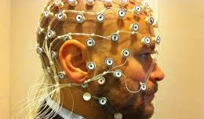
Are we measuring what we want to know?
Competences...
Knowledge
Skills
Attitudes (autonomy, leadership, entrepreneurship, responsibility... )
Formal but also non-formal and informal learning

Slide 11
If not: are we really facilitating mobility? Not only geographic mobility, but also social mobility

Slide 12
OpenBadges
Move away from “large learning patches towards micro-sized learning”

Slide 13
Microlearning, Badges, Blockchain...
“Open Badges represent skills, achievements, and accomplishments that occur in any context, whether that be formal, informal or non-formal, in and out of school learning, job training, online-learning, or self-learning. There are three essential audiences: earners (recipients), issuers and consumers.”
“The Open Badges specification describes a method for packaging information about accomplishments, embedding it into portable image files as digital badges, and establishing an infrastructure for its validation. This data makes it possible to verify the asserted achievements by identifying the issuer and recipient, explaining the criteria required along with the evidence of the achievement.”

Slide 14
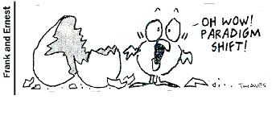
Let us challenge ourselves...
Without change, no progress is possible.
koen.depryck@outlook.com
App +32 497 447 887

