Slide 1
START-UPS, SPIN-OFFS, TECHNOLOGY TRANSFER and INCUBATION: Different Regional Approaches
SZÉCHENYI ISTVÁN UNIVERSITY
Dr Péter Földesi, Rector
27 September 2018

Slide 2
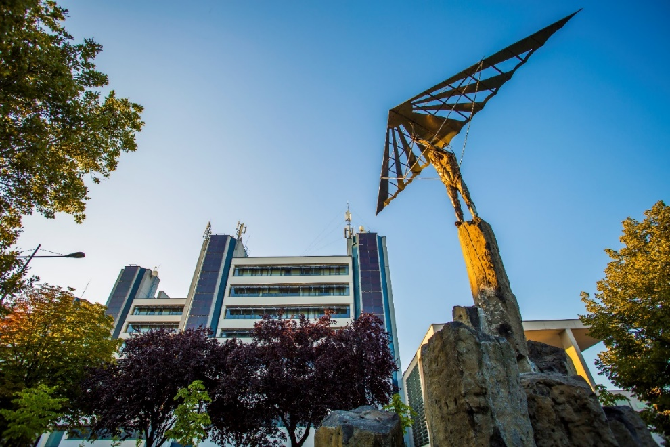
SZÉCHENYI ISTVÁN UNIVERSITY
9 Faculties + 1 R&D Centre
Audi Hungaria Faculty of Automotive Engineering **
Faculty of Mechanical and Electrical Engineering & IT
Faculty of Architecture, Building Construction and Transport
Kautz Gyula Faculty of Economics
Faculty of Law and Political Sciences
Faculty of Agricultural and Food Sciences
Faculty of Humanities, Education and Social Sciences
Faculty of Health and Sports Sciences
Faculty of Performance Arts
Research Centre of the Automotive Industry
Notes:
SLIDE 6
…….which are organized in the 9 faculties of our University….

Slide 3
Vehicle Industry Research Centre
Basic and targeted basic research
Ensuring R&D human resource and service
Improvement of R&D services
Common work in research and innovation
Establishing R&D and innovation activities with infrastructure
The Vehicle Industry Research Centre has been in operation since May 2011 and consists of the following research groups: Vehicle Dynamics, Vehicle Electronics, Electronic Vehicle Powertrain, Simulation and Optimization. These groups give an excellent background for the planned basic and targeted researches on the topics of modelling and analysing complex hybrid and electric vehicle dynamics, electronic measuring and control methods, mathematical models and optimization processes, automotive infocommunication technologies. Based on the results of the different research areas significant and continuous cooperative industrial developments of vehicle (sub)systems can be achieved.

Slide 4
In the field of innovation, that is decisive for competitiveness and economic growth, Hungary is ranked 22nd in the European Union in 2017
Cumulative innovation index, 2016 (performance in the proportion of 2010 EU average)³⁷
Sweden
Human resources
64,8
Main findings
Hungary lags far behind Europe’s best in innovation
This is primarily due to the low level of innovation activity of small and medium-sized enterprises (product, process, marketing, organizational, in-house innovation) and intellectual property (patents, trademarks)
Funding was low in 2016 due to the cyclical nature of EU funds
Denmark
Finland
Attractive research systems
55,5
Netherlands
Innovation-friendly environment
93,4
Germany
Funding and support
44,4
Austria
Israel
Corporate investments
88,9
Czech Republic
Innovator enterprises
14,4
Portugal
Relationships
60,4
Estonia
Lithuania
Intellectual assets
46,9
Slovakia
Employment effects
126,7
Hungary
Poland
Sales effects
98,0
Romania
Moderate innovators
Innovation leaders
Modest innovators
Strong innovators
The low innovation activity of domestic small and medium-sized enterprises limits their productivity. International innovation trends have shifted from the direction of industrial innovation to service innovation in recent years, which the Hungarian economic policy must also bear in mind. There is a lack of the middle sector that disappeared in the 1990s, while in the other Visegrád countries a higher proportion of them survived.
With acknowlegements to "The role of the universities in the innovation ecosystem" by László Palkovics, 2018
³⁷ European Innovation Scoreboard 2017
Notes:
Hiányzik a változásra való képesség.

Slide 5
The proportion of basic research is low within the total R&D and the proportion of experimental development is extremely high in international comparison, while the ratio of applied research is low in higher education institutions
Proportion of fundamental research, applied research and experimental development in R&D (2016, %)⁴¹
Proportion of fundamental research, applied research and experimental development in R&D in higher education institutions (2016, %)⁴²
Fundamental research
Applied research
Experimental development
Fundamental research
Applied research
Experimental development
With acknowlegements to "The role of the universities in the innovation ecosystem" by László Palkovics, 2018
^{41, 42} Eurostat
Notes:
Hiányzik a változásra való képesség.

Slide 6
The goal is to shift Hungarian economic players towards the production of higher value added and increased efficiency, which can ensure sustainable economic growth over the long term. Some intervention areas
Increasing the productivity of nationally-owned enterprises through innovation and the use of new technologies
Retaining global value chains within the country, and involving their higher value added activities – both nationally-owned enterprises and local partners
Building up nationally-owned global value chains and Hungarian brands
Increasing the competitiveness of SMEs by reducing their tax and administrative burden
Increasing the productivity and innovation capacity of SMEs through the development of a university-centered innovation ecosystem
Increasing the productivity of the workforce through the development of vocational and adult training
Critical Infrastructure (ICT, Energy, Transport, Sustainability and Environmental Protection) serves these goals
With acknowlegements to "The role of the universities in the innovation ecosystem" by László Palkovics, 2018
Notes:
Technológia és innováció előre
Bérek 2028-ig megdpulázódnak.
Hatékonyságbeli különbség 100/60-ról 100/80-ra mérséklődik
Hazai tulajdonú vállalatok exportrészesedése 30 százalékra nő.
OECD átlag alá csökkenő lemorzsolódás
Rugalmas felnőttképzés a munkaerőpiac kiszolgálása érdekében – biztos foglalkoztatás
Kkv-k adóterhei 30%-ra 2028
Kivándorlás mérséklésse technológiai fejlődés
Rezsicsökkentés a technológiával 20-25%-kal és javuló ellátásbiztonság
Stb stb.

Slide 7
Strategic objectives in the field of innovation
Strengthening co-operation between ecosystem actors
Collaboration between higher education and the research institutes of the HAS to improve the quality of research and education
Strengthening the corporate relationship of higher education, similarly to FIEK - so higher education revenues can be increased and the corporate focus of higher education R&D&I can be strengthened
Providing research infrastructures (and R&D capacities in research institutions) and making their services available to businesses - this could be an income for institutes and could lead to technological solutions for companies. It is related to mapping how well the research institute / higher education infrastructures can be used to fulfill corporate orders and, on this basis, planning their targeted development
The exploitation of open innovation, ie R&D outside the business, and the strengthening of the culture of cooperation is a prerequisite
Attracting innovation and product development enterprises to Hungary
Supporting the establishment of foreign research institutes in the Hungarian ecosystem (eg Fraunhofer, Max Planck)
2. Focusing and specialization
In higher education, more emphasis should be placed on MTMI trainings (partly involving labor market actors)
In this context, the strengthening of MTMI career guidance and MTMI research areas (eg through targeted corporate research) is an important element
R&D&I activities should, wherever possible, be brought into line with the major socio-economic challenges and with the Iriny Plan and Industry 4.0 Strategy
Combining technological and social innovation in order to tackle technological problems and challenges in a complex way (eg ethical issues in self-driving vehicles, shared economy, etc.)
Support for experimental development infrastructures in addition to basic research infrastructures
3. R&D&I policies
In addition to the current support-oriented approach, regulation, indirect incentives and tax incentives should be emphasized as they are just as important as non-refundable subsidies
In the case of investment promotion grants, R&D&I has to play a larger role - labor intensive production has reached its limits, the economy needs higher value added and innovation, in line with Industry 4.0 paradigm
The more systematic involvement of R&D&I ecosystem actors in policy making, taking into account the views of actors improves the effectiveness of the policies, and therefore the establishment of conciliatory forums is justified (eg National R&D&I Council, Startup Forum)
With acknowlegements to "The role of the universities in the innovation ecosystem" by László Palkovics, 2018
Notes:
Hiányzik a változásra való képesség.

Slide 8
Strategic objectives in the field of innovation
With innovative public procurement, the demand for domestic R&D&I products and services (not a product, but a solution)
Due to the changing EU support system after 2020 (ie, for example, the refundable resources to be reimbursed in economic development and the reduction of resources), NKFI Fund budget should be significantly increased. Specifying bilateral, targeted cooperation areas (eg vehicle industry, cyber security, biomedicine) in international co-operations, besides EU and multilateral co-operations
The difference between the competitiveness and efficiency of domestic and foreign companies has to be reduced by increasing the R&D&I capacity and abilities (human / asset) of domestic SMEs
We consider it important to continue to support startups, coupled with national R&D&I focus areas
To support scientific and innovation achievements and best practices
4. Objectives related to higher education and science policy
Settlement of teacher-researcher salaries
Establishing R&D&I profiles of higher education institutions is indispensable for the connection to the business sector
Increasing the number of researchers and PhD students
The most directly applicable research projects are displayed in doctoral schools' thesis topics
A one-stop-shop system should be set up to enable business partners to clearly understand the R&D&I services of higher education institutions
In addition to education, the R&D&I should be strengthened; besides basic research, applied research and market-oriented developments are more necessary
Higher education institutions should be able to strengthen the intellectual capacities of enterprises and improve the competitiveness of the domestic SME sector through their trainings
The third missions that are widely understood - not merely economic, but also socially - have to be developed in every institution
Enhancement of the university’s „Lendület" program (bringing Hungary recognized researchers from abroad and also young Hungarians) and creation of new programs
Creating / launching business-based universities
With acknowlegements to "The role of the universities in the innovation ecosystem" by László Palkovics, 2018
Notes:
Hiányzik a változásra való képesség.

Slide 9
The aim of developing a university-centered innovation ecosystem is to create and develop internationally competitive nationally-owned businesses
~15
Incubators
Why is the university the center of the ecosystem?
Links
With incubators, accelerators, venture capital funds, business angels, local and regional corporations, ecosystem shepherds
Provides
Research and development capacity, due diligence service, professional and business consulting
Window to the world
Has international relations
Gives new approaches
Entrepreneurial approach
~30
VCs and business angels
~10
Accelerators
1
2
3
4
Enterprise
Hotline
University
Local, regional enterprises
Growth and internationalisation
Internationally competitive nationally-owned business
The University is available 24/7 for businesses within 60 kilometers via a hotline that will ensure a response within 48 hours for the companies
Main challenges:
Universities in the current legal framework can not fulfill their central role in the ecosystem
Few (even internationally) marketable ideas and entrepreneurial young people, low productivity of working SMEs
Difficult entering into international markets
Due diligence
R&D capacities
International relations
With acknowlegements to "The role of the universities in the innovation ecosystem" by László Palkovics, 2018

Slide 10
The low number of entrepreneurial youth and marketable ideas can be managed by the attitudinal practice of public
education and higher education institutions and by the creation of an online matching platform
VCs, aquisitons, strategic alliances
Venture capital funds, incubators and accelerators created from state resources
"There is more money than marketable idea"
Business angels, FFF (family, friend and fools)
Later stage
Key Values Supporting Successful Business in Israeli Society
Risk-taking
Independence
Healthy self-confidence
Accepting failure ("OK to fail")
Goal orientation
Online matching
platform
Linking solutions to business needs and startup businesses
Connecting Startups with Incubators, Accelerators, Business Angels and Venture Capital Funds
Import data from the largest international databases
SME efficiency benchmark
Marketplace: startups are offered by business solutions in a browseable way
Event organization announced through community media
Revenue
Seed money
Early stage
IPO
(initial public offering)
Half-stage
3
Market
2
Break even
1
Valley of death
Time
1. Public education institutions and universities should focus on technological knowledge, as well as on the transfer of entrepreneurial attitudes and the necessary values.
2. An online platform is needed that connects the idea to the right (professional, business, financial) supporters and benchmarks startups and SMEs.
Few young people who want a business
Most of the ideas are not marketable
They do not know how to start a business
With acknowlegements to "The role of the universities in the innovation ecosystem" by László Palkovics, 2018
²⁹ Daniela Kandel, az izraeli Start-up Nation Central vezetőjének budapesti előadása alapján

Slide 11
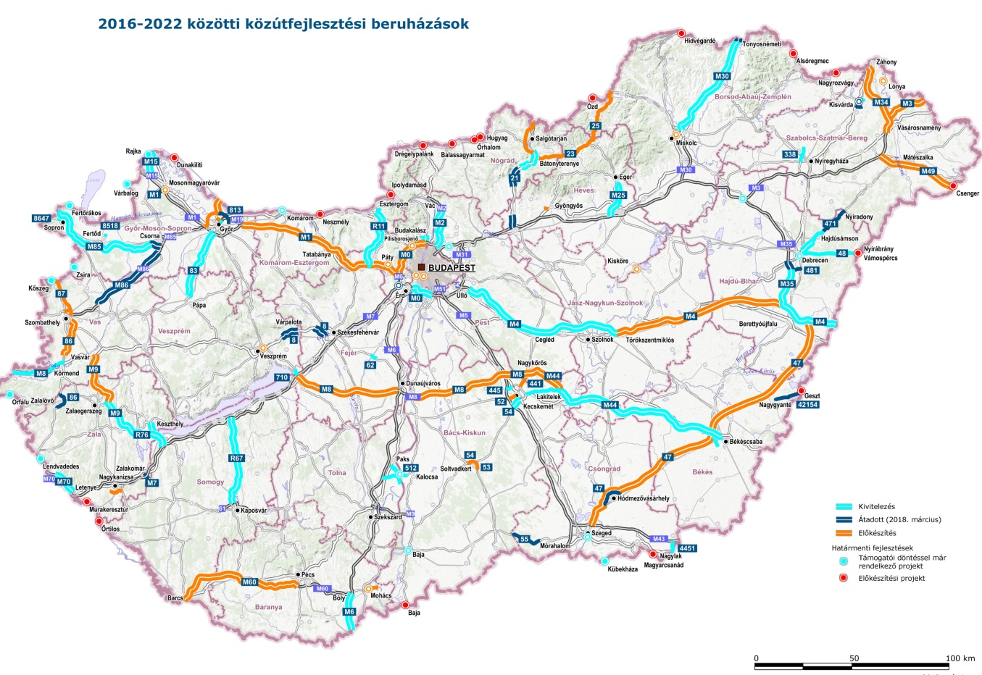
Science parks are important elements of an efficient innovation ecosystem - Science Park concepts are under development
Road development investments between 2016 and 2022
State
 Miskolc
Knowledge transfer
Knowledge transfer
 Győr
 Debrecen
Open innovation environment
 Zalaegerszeg
University
Economic players
Knowledge transfer
 Szeged
 Pécs
With acknowlegements to "The role of the universities in the innovation ecosystem" by László Palkovics, 2018

