Slide 1
Global Universities in the XXI. Century: characteristics, trends and main challenges XI. General Assembly and x. international seminar of CGBU Study in Hungary: the Hungarian experience
Péter Tordai
Director
Tempus Public Foundation

Slide 2
Characteristics: International context
Globalisation, economic crisis, identity transformation of EU
Education as a European priority
EHEA objectives (2025)
Language education
Strenghtened Erasmus+ program
European Student Card
European Universities incentive
Automatic transfer of secondary and higher education degrees
Paris Communiqué (EHEA – Paris 2018)
Increased co-operation in the renewal of teaching & learning
Increasing regionality (Nordic, Baltic, V4)

Slide 3
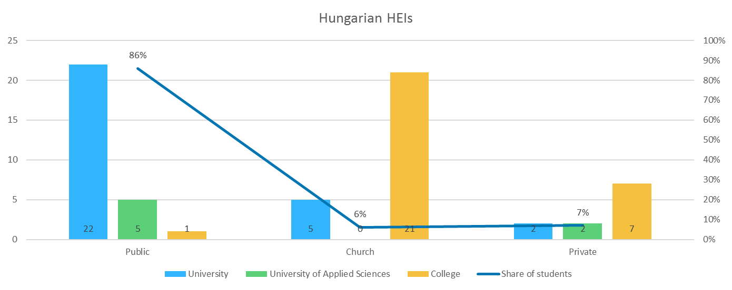
Characteristics: BASIC FACTS ABOUT HUNGARIAN HE
65 higher education institutions
44 internationally active
cca. 280 000 student population (87% public, 6% church, 7% private)
Member of European Higher Education Area (Bologna Process)

Slide 4
Characteristics: National strategy and priorities
No specific internationalisation strategy, but part of the HE strategy
By 2023
20% of the graduates shall have international learning experience
increasing the number of foreign students to 40 000 (at present cca. 32 000)
More high quality higher education programs and better services for international students
HE modernization, increasing quality of higher education for Hungarian students as well
International students on university campuses: enhancing values of the international classroom, internationalization at home, intercultural skills
Increasing attractiveness, global visibility, attracting top talents, enlarging the Hungarian scientific global network

Slide 5
Characteristics: TOOLS / programmes supporting the Internationalization of HE
Outgoing (Hungarian) student mobility;
Internationalization of Higher Education
European and non European student, staff mobility and partnerships
Stipendium Hungaricum: scholarship for incoming international students in full degree programs; Higher Education Internationalization
Bilateral State Scholarship: student, staff, researcher mobilities between partner countries of Hungary
Regional (Central-European) funds for mobility and partnerships
Increased funds for internationalisation:
Campus Mundi (ESF, 2016-2021),
Stipendium Hungaricum (national, 2013-)
Integrated co-ordination (since 2015) – Tempus Public Foundation

Slide 6
TEMPUS PUBLIC FOUNDATION
TPF: a non-profit organization, background institution of the Ministry of Human Capacities
Founded in 1996, more than 20 years of expertise
Management/coordination of international cooperation programmes and special projects - education, training and EU-related issues
Objectives: supporting HU education and training institutions in international cooperation
Implementing agency for European and national, multi-, bilateral educational programmes
Mobility and knowledge management
Stability in fundamental values
Transparent, standard operation (regular controls and checks by national authorities and the EU), ISO 9001
High professional standards
Engagement of the staff
Towards internationalisation and
Quality improvement of HU education and training system

Slide 7
Tempus public foundation’s activities

Slide 8
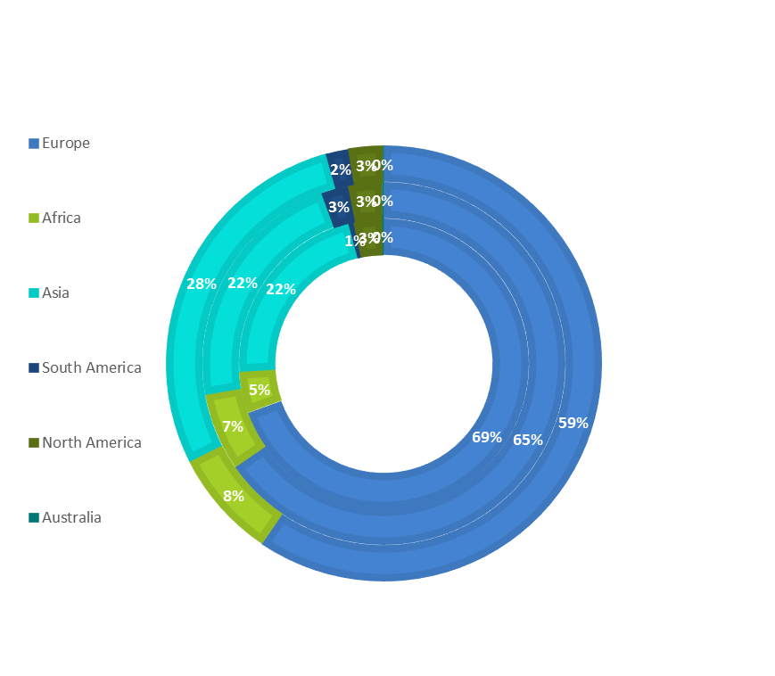
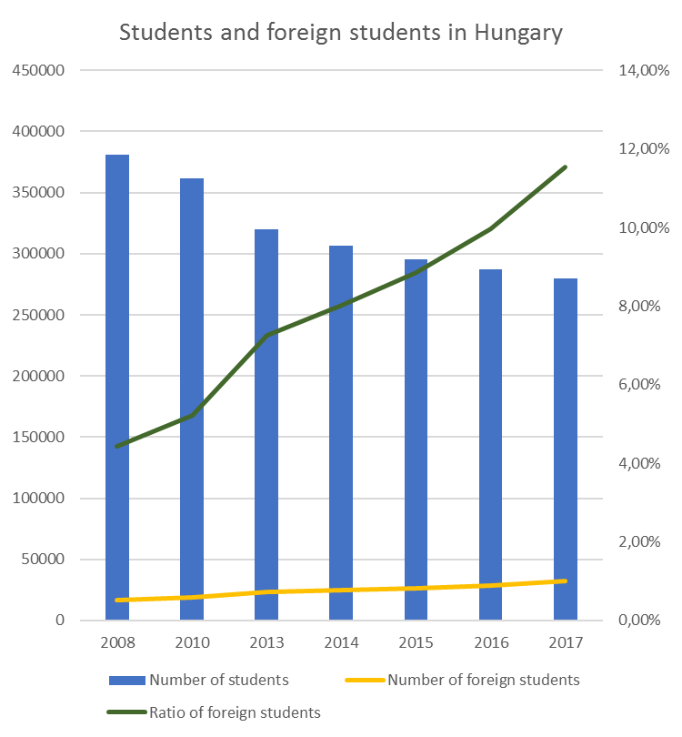
Latest trends
2012/13
2015/16
2017/18

Slide 9
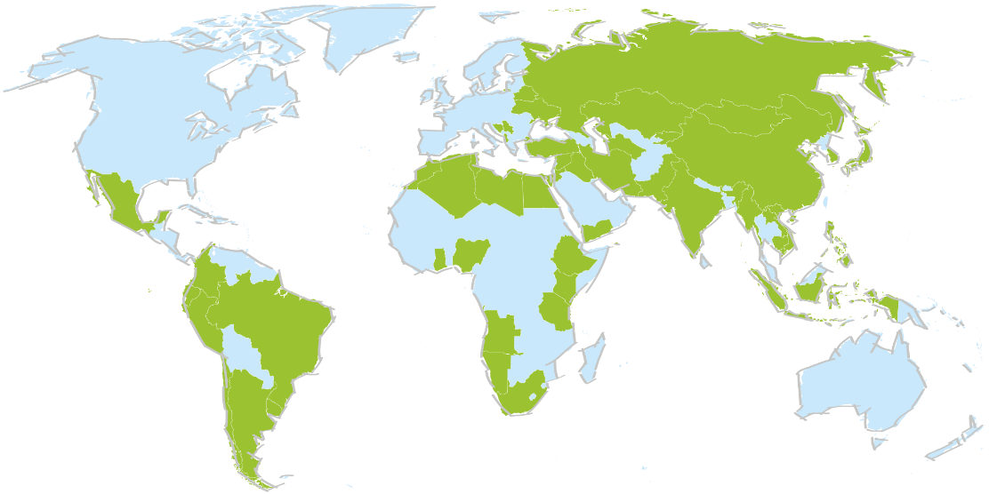
Major achievements
Internationalisation has become a priority (both at national and HEI level)
2017/2018: 32 309 international students (25 554 in study programmes taught in forgein languages)
Ratio of international students in full-time study programmes: 15%
Number of foreign language study programmes: x3
Student satisfaction is high
Drop off rate:1,5% (national average: 37%)
Academic performance: steady, around 110% of the national average
96% of students would choose Hungary again as a study destination

Slide 10
Key challenges
increase of outbound credit mobility (2017: 11%)
remove the obstacles of mobility (recognition of credits), mobility window
further quality development (teaching, student services)
internationalisation at home
resource management at HEI level (staff, academic staff, financing)
enhance the strategic approach at HEI level

Slide 11
Brazilian Stipendium hungaricum scholarship 2017-2019
Notes:
Brazilian applicants
2017-2018
2018-2019
Nominated
327
350
Scholarship holder
239
247
Postponed scholarship
55
5
preparatory and bachelor levels
109
43
master and one-tier-master level
117
117
exchange students
65
62
doctoral level
13
25

Slide 12
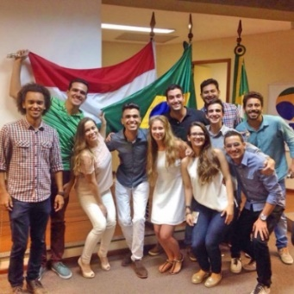
Study in Hungary in Brazil
2014 November: EuroPós, Sao Paulo – student recuitment
15 HU HEI, TPF, representatives of the Ministy of Human Capacities and the Hungarian Rectors’ Conference
2017 September- October: participating in "Salao do Estudante 2017„
3 cities: São Paulo, Rio de Janeiro, and Belo Horizonte
Side event in São Paulo: Explore Hungary information day for students and Alumni meeting
Participants: 8 HEI, TPF and representative of the HRC
2018 April – participating in FAUBAI (Rio de Janeiro)
Participating in Graduate Education II Session with a
lecture on the internationalization of HU doctoral schools
(presenting the findings of a study on Hungarian doctoral
schools)
Future plans
Faubai 2019

Slide 13
Campus mundi (hu-Br)
Out-going credit mobility
2016-2021
Study period / placement / study visit
To any country
To Brasil: only 2-4 students / year – but increasing

Slide 14
Erasmus+ International credit mobility (HU-BR)
 | Student |  |  | Staff
 | In-coming | Out-going | Total | In-coming | Out-going | Total
2016 | 4 | 7 | 11 | 7 | 7 | 14
2017 | 2 | 1 | 3 | 3 | 3 | 6
2018 | 0 | 0 | 0 | 4 | 4 | 8
Partners:
Eötvös Loránd University / Universidade Federal Fluminense, Federal University of Rio de Janeiro
Budapest University of Technology and Economics / University of Sao Paolo
Szent István University / Federal University of Mato Grosso, Federal University of Rio de Janeiro
Óbuda University / University of Sao Paolo
University of Dunaújváros / Grupo Educacional UNIS

Slide 15
Hu-BR co-operations - Conclusins
Various programmes / initiatives
Increasing number of applicants
Still a long way to go

Slide 16
Thank you for your attention! www.tka./hu/english www.studyinhungary.hu

