Slide 1
Presentation of internationalization of universities in asia
Ru-Jer Wang
Professor and President,
National Taichung University of Education
National Taichung
University of Education
Innovation Management, Search for Excellence and Sustainable Development

Slide 2
Education
Doctor of Philosophy of Manchester University, UK
Administration and academic service
President of Foundation for International Exchange and Culture Development (2014-2017)
Executive Director, Higher Education Evaluation and Accreditation Council of Taiwan (HEEACT) (2013-2014)
President of Chinese Taipei Comparative Education Society (2011-2014)
Vice-President/Acting President, National Academy for Educational Research (2011-2013)
Professor, National Taiwan Normal University (2003-2014)
Professor, National Chung Cheng University (2002-2003)
Associate Professor , National Chung Cheng University (1996-2002)
President of National Taichung University of Education, Taiwan (R.O.C.)
President of Taiwan Higher Education Society
Field of study
comparative education, educational administration, higher education, knowledge based economy and the management of educational knowledge
Innovation Management, Search for Excellence and Sustainable Development

Slide 3
Contents
1
Introduction
Two Streams of internationalization of Higher Education – Internationalization at Home and Aboard
2
Overview of Internationalization of Universities in Asia
3
The Case of Internationalization at Home in National Taichung University of Education
4
5
Concluding Remarks

Slide 4
Introduction
Recently we have seen the ever-increasing number of mobile students, currently reaching over four million a year.
vast number represents less than 2% of enrolment worldwide.
The OECD has projected that the total number of internationally mobile students will reach eight million by 2025. But Education at a Glance 2017 puts that forecasts in an interesting light with an examination of the some of the factors that are acting on broad patterns of mobility in the world today.

Slide 5
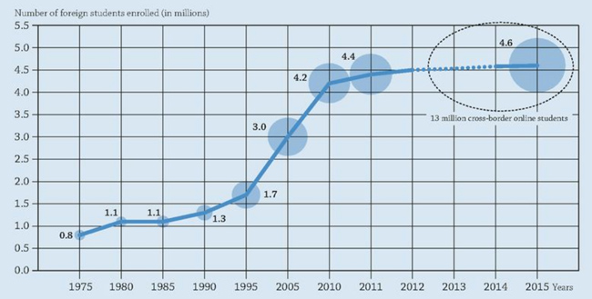
These are especially meaningful when we consider the latter years in Figure 1, where growth in outbound mobility has begun to flatten out noticeably from about 2010 on (IECF Monitor, 2018)
Figure 1 Growth in foreign enrolment in tertiary education worldwide, 1975–2015. Source: IECF Monitor (2018). OECD charts a slowing of international mobility growth.

Slide 6
Table 1 Countries with the largest amount of international students as a share of the total higher education population in 2017
Countries with the greatest amount of international students as a share of their total higher education population in 2017.
In 2017, Australia had the greatest amount of international students compared to their entire higher education population with 23.8 percent of students being international.
Country | Share of total higher education population (%)
Australia | 23.8
United Kingdom | 21.1
New Zealand | 16.3
Canada | 15.2
France | 12.4
Netherlands | 11.4
Finland | 10.6
Germany | 8.7
Sources: The Statistics Portal (2018). Countries with the largest amount of international students as a share of the total higher education population in 2017
Retrieved from
https://www.statista.com/statistics/788155/international-student-share-of-higher-education-worldwide/
Innovation Management, Search for Excellence and Sustainable Development

Slide 7
Table 2 Top host destination of international students worldwide in 2017, by number of student
Top host destination of international students worldwide in 2017, by number of students
Table 2 shows the top host destinations of international students in 2017, worldwide. In 2017, there were over 1 million international students enrolled in the U.S. higher education.
Country | Number of Students
United States | 1,078,822
United Kingdom | 501,045
China | 442,773
Australia | 327,606
France | 323,933
Canada | 312,100
Russia | 296,178
Germany | 251,542
Sources: The Statistics Portal (2018). Top host destination of international students worldwide in 2017, by number of students. Retrieved from https://www.statista.com/statistics/297132/top-host-destination-of-international-students-worldwide/
Innovation Management, Search for Excellence and Sustainable Development

Slide 8
Two Streams of Internationalization of Higher Education - internationalization at home and abroad
higher education internationalization at home
Over the past decades, the internationalization of higher education has demonstrated tremendous growth.
There are two streams of internationalization of higher education internationalization at home and abroad.
One stream includes internationalization activities that occur on the home campus, and the other stream relates to those activities that happen abroad or, in other words, across borders.
higher education internationalization across borders
Innovation Management, Search for Excellence and Sustainable Development

Slide 9
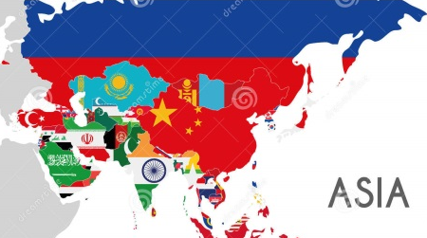
Table 3
Leading places of origin by place of origin for international students studying in the United States.
Overview of Internationalization of Universities in Asia
3.1 student mobility
Top 25 Places of Origin of International Students, 2015/16 & 2016/17
 |  |  |  |  | %
Rank | Place of Origin | 2015/16 | 2016/17 | % of Total | Change
 | World TOTAL | 1,043,839 | 1,078,822 | 100.0 | 3.4
1 | China | 328,547 | 350,755 | 32.5 | 6.8
2 | India | 165,918 | 186,267 | 17.3 | 12.3
3 | South Korea | 61,007 | 58,663 | 5.4 | -3.8
4 | Saudi Arabia | 61,287 | 52,611 | 4.9 | -14.2
5 | Canada | 26,973 | 27,065 | 2.5 | 0.3
6 | Vietnam | 21,403 | 22,438 | 2.1 | 4.8
7 | Taiwan | 21,127 | 21,516 | 2.0 | 1.8
8 | Japan | 19,060 | 18,780 | 1.7 | -1.5
9 | Mexico | 16,733 | 16,835 | 1.6 | 0.6
10 | Brazil | 19,370 | 13,089 | 1.2 | -32.4
11 | Iran | 12,269 | 12,643 | 1.2 | 3.0
12 | Nigeria | 10,674 | 11,710 | 1.1 | 9.7
13 | Nepal | 9,662 | 11,607 | 1.1 | 20.1
14 | United Kingdom | 11,599 | 11,489 | 1.1 | -0.9
15 | Turkey | 10,691 | 10,586 | 1.0 | -1.0
16 | Germany | 10,145 | 10,169 | 0.9 | 0.2
17 | Kuwait | 9,772 | 9,825 | 0.9 | 0.5
18 | France | 8,764 | 8,814 | 0.8 | 0.6
19 | Indonesia | 8,727 | 8,776 | 0.8 | 0.6
20 | Venezuela | 8,267 | 8,540 | 0.8 | 3.3
21 | Malaysia | 7,834 | 8,247 | 0.8 | 5.3
22 | Colombia | 7,815 | 7,982 | 0.7 | 2.1
23 | Hong Kong | 7,923 | 7,547 | 0.7 | -4.7
24 | Spain | 6,640 | 7,164 | 0.7 | 7.9
25 | Bangladesh | 6,513 | 7,143 | 0.7 | 9.7
Leading places of origin by place of origin for international students studying in the United States.
1.8%
73.1%
Sources: Institute of International Education (2018). Places of Origin. Retrieved from https://www.iie.org/Research-and-Insights/Open-Doors/Data/International-Students/Places-of-Origin
Innovation Management, Search for Excellence and Sustainable Development

Slide 10
3.2 Faculty Exchange
According to Institute of International Education, the top 25 places of origin of international scholars in the USA in 2014/15 & 2015/16 are shown in Table 4. Taiwan is listed in the 13rd from Table 4. The number of international scholars in the USA increased from 1,871 in 2014/15 to 2,024 in 2015/16, about 8.2 % of change of increase.

Slide 11
Table 4 Top 25 Places of Origin of International Scholars in the USA,
2014/15 & 2015/16
Rank | Place of Origin | 2014/15 | 2015/16 | % of Total | % Change
 | WORLD TOTAL | 124,861 | 134,014 | 100.0 | 7.3
1 | China | 40,193 | 44,490 | 33.2 | 10.7
2 | India | 10,937 | 12,379 | 9.2 | 13.2
3 | South Korea | 7,415 | 7,395 | 5.5 | -0.3
4 | Germany | 5,318 | 5,345 | 4.0 | 0.5
5 | Canada | 4,611 | 4,976 | 3.7 | 7.9
6 | France | 4,511 | 4,545 | 3.4 | 7.0
7 | Japan | 4,394 | 4,478 | 3.3 | -0.7
8 | Brazil | 4,249 | 4,345 | 3.2 | -1.1
9 | Italy | 3,866 | 4,036 | 3.0 | 4.4
10 | Spain | 2,886 | 3,112 | 2.3 | 7.8
11 | United Kingdom | 2,635 | 2,687 | 2.0 | 2.0
12 | Turkey | 2,218 | 2,303 | 1.7 | 3.8
13 | Taiwan | 1,871 | 2,024 | 1.5 | 8.2
14 | Mexico | 1,646 | 1,914 | 1.4 | 16.3
15 | Iran | 1,522 | 1,891 | 1.4 | 28.2
16 | Israel | 1,475 | 1,633 | 1.2 | 7.3
17 | Netherlands | 1,162 | 1,188 | 0.9 | 2.2
18 | Australia | 1,019 | 1,156 | 0.9 | 13.4
19 | Russia | 1,010 | 1,004 | 0.7 | -0.6
20 | Pakistan | 862 | 989 | 0.7 | 14.7
21 | Greece | 920 | 961 | 0.7 | 4.5
22 | Colombia | 826 | 930 | 0.7 | 12.6
23 | Egypt | 784 | 872 | 0.7 | 11.2
24 | Poland | 757 | 863 | 0.6 | 14.0
25 | Switzerland | 715 | 725 | 0.5 | 1.4
Sources: Institute of International Education (2016). "Top 25 Places of Origin of International Scholars, 2014/15 - 2015/16." Open Doors Report on International Educational Exchange. Retrieved from http://www.iie.org/opendoors

Slide 12
Table 5 Major Field of Specialization of International Scholars, Selected Years,
1999/00 - 2016/17
 | PERCENT OF TOTAL
Major Field of Specialization | 1999/00 | 2004/05 | 2009/10 | 2014/15 | 2016/17
Science, Technology, Engineering, & Math | 76.4 | 77.5 | 75.7 | 74.2 | 76.0
Agriculture | 3.6 | 3.7 | 4.0 | 4.5 | 4.6
Engineering | 11.9 | 11.6 | 13.1 | 16.2 | 17.1
Health Professions | 23.8 | 21.9 | 18.1 | 13.1 | 14.6
Math and Computer Science | 5.5 | 5.5 | 5.6 | 5.7 | 6.0
Physical and Life Sciences | 31.6 | 34.7 | 34.9 | 34.7 | 33.7
Social Sciences | 7.3 | 7.4 | 7.7 | 8.0 | 7.1
Humanities | 4.9 | 3.5 | 3.7 | 3.8 | 3.5
Business and Management | 2.5 | 2.8 | 3.8 | 3.3 | 3.2
Education | 1.4 | 1.6 | 1.7 | 1.9 | 1.8
Fine and Applied Arts | 2.1 | 1.7 | 1.7 | 1.7 | 1.8
Legal Studies and Law Enforcement* | - | - | - | 1.6 | 1.5
Communications and Journalism* | - | - | - | 0.9 | 0.8
Other Fields of Study | 5.3 | 5.4 | 5.2 | 4.3 | 4.3
TOTAL | 74,571 | 89,634 | 115,098 | 124,861 | 134,379
*Beginning in 2014/15, Communications and Journalism and Legal Studies and Law Enforcement were reported separately.
Sources: Institute of International Education (2016). "Top 25 Places of Origin of International Scholars, 2014/15 - 2015/16." Open Doors Report on International Educational Exchange. Retrieved from http://www.iie.org/opendoors

Slide 13
3.3 Internationalization ranking
These outward-looking characteristics are a core attribute of the institutions that feature in a new Times Higher Education ranking of the world’s most international universities. The ranking is drawn largely from the “international outlook” pillar of the THE World University Rankings 2016-17, which covers international staff, students and co-authors. However, it also includes a measure of universities’ international reputations, taken from THE’s annual Academic Reputation Survey.
A striking feature of the upper reaches of the 150-institution table is the prominence of universities from relatively small, export-reliant countries, where English is an official language or is widely spoken. The ranking is led by two Swiss universities: ETH Zurich – Swiss Federal Institute of Technology Zurich; and the École Polytechnique Fédérale de Lausanne. Of all the countries in the ranking, the Swiss representatives also have the greatest average proportion of international staff and internationally co-authored publications: both 62 per cent.

Slide 14
The World's Most International Universities 2017
Number | Country | Institution (ranking)
64 | United States | University of Bristol (22), Harvard University (33), Stanford University (36), Princeton University (37), Columbia University (39), Georgia Institute of Technology (41), Johns Hopkins University (45), Purdue University (46), University of Chicago (50), California Institute of Technology (52), Rice University (53), Yale University (54), University of California, Santa Barbara (60), Cornell University (60), University of California, Davis (62), University of California, Berkeley (65), University of California, Irvine (66), Carnegie Mellon University (68), University of Southern California (71), University of California, Los Angeles (73), Boston University (76), Michigan State University (77), Stony Brook University (78), University of Rochester (79), Duke University (80), Brown University (82), New York University (83), University of Illinois at Chicago (85), Northwestern University (86), University of Massachusetts (88), University of Washington (90), Texas A&M University (92), University of Michigan (94), Ohio State University (94), North Carolina State University (97), University of Illinois at Urbana-Champaign (97), University of Pennsylvania (100), etc.
15 | Germany | Free University of Berlin (44), University of Bonn (48), Humboldt University of Berlin (49), Technical University of Munich (50), Heidelberg University (56), Technical University of Berlin (57), LMU Munich (64), Karlsruhe Institute of Technology (67), University of Freiburg (69), Goethe University Frankfurt (72), University of Tübingen (74), University of Göttingen (81), RWTH Aachen University (84), University of Mannheim (92), University of Münster (111)

Slide 15
Number | Country | Institution (ranking)
13 | United Kingdom | Imperial College London (5), University of Oxford (6), University of Cambridge (8), University College London (9), London School of Economics and Political Science (10), King’s College London (11), University of Edinburgh (13), University of Warwick (17), University of Glasgow (19), University of Manchester (20), Durham University (26), University of York (28), University of Bristol (29)
11 | France | École Polytechnique (16), École Normale Supérieure (42), Pierre and Marie Curie University (43), University of Strasbourg (47), Paris Diderot University – Paris 7 (54), Paris-Sud University (58), École Normale Supérieure de Lyon (63), Paris-Sorbonne University – Paris 4 (70), Panthéon-Sorbonne University – Paris 1 (89), Aix-Marseille University (96), Paris Descartes University (99)
6 | South Korea | Yonsei University (127), Korea University (135), Sungkyunkwan University (SKKU) (138), Korea Advanced Institute of Science and Technology (KAIST) (140), Seoul National University (145), Pohang University of Science and Technology (150)
5 | Australia | Australian National University (7), University of New South Wales (14), University of Melbourne (18), Monash University (21), University of Sydney (23)
5 | Canada | University of British Columbia (12), McGill University (23), University of Alberta(31), University of Toronto (32), University of Waterloo (34)
5 | China | Peking University (120), Nanjing University (128), Renmin University of China (136), Tsinghua University (142), Fudan University (145)
4 | Japan | University of Tokyo (136), University of Tsukuba (141), Tokyo Institute of Technology (143), Tohoku University (149)

Slide 16
Number | Country | Institution (ranking)
3 | Italy | Polytechnic University of Milan (87), Polytechnic University of Turin (106), Sapienza University of Rome (112)
3 | Switzerland | ETH Zurich – Swiss Federal Institute of Technology Zurich (1), École Polytechnique Fédérale de Lausanne (2), University of Zurich (15)
2 | Demark | University of Copenhagen (29), Aarhus University (35)
2 | Hong Kong | University of Hong Kong (3), Chinese University of Hong Kong (27)
2 | Netherlands | University of Amsterdam (38), Utrecht University (59)
2 | Russian Federation | Lomonosov Moscow State University (104), Moscow Institute of Physics and Technology (126)
2 | Taiwan | National Tsing Hua University (144), National Taiwan University (148)
1 | Belgium | KU Leuven (40)
1 | Brazil | University of São Paulo (147)
1 | Israel | Hebrew University of Jerusalem (75)
1 | New Zealand | University of Auckland (25)
1 | Singapore | National University of Singapore (4)
1 | Spain | Autonomous University of Madrid (90)
Total |  | 150
Source: The World's Most International Universities 2017 . https://www.timeshighereducation.com/features/worlds-most-international-universities-2017

Slide 17
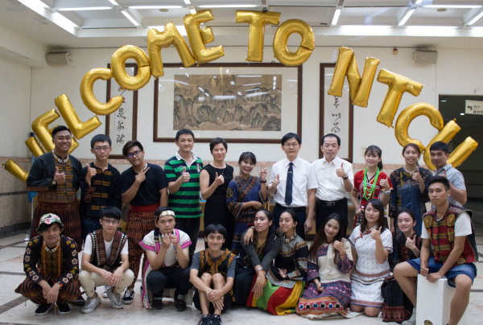
4.The Case of Internationalization at home in National Taichung University of Education
Innovation Management, Search for Excellence and Sustainable Development

Slide 18
4.The Case of Internationalization at home in National Taichung University of Education
Table 5 The Winter Camp in NTCU from 2013-2017
 | Number of participant |  | Included Sister University
 | teacher | student
2013 | 1 | 22 | Seoul National University of Education, South Korea
2014 | 2 | 22 | Seoul National University of Education, South Korea
2015 | 3 | 39 | Seoul National University of Education, South Korea Newton College, Czech Republic Leeds Trinity University, England
2016 | 2 | 43 | Seoul National University of Education, South Korea Kyoto Sangyo University, Japan Newton College, Czech Republic VIA University, Denmark Leeds Trinity University, England
2017 | 2 | 32 | Seoul National University of Education in South Korea Private University of Education, Diocese Linz in Austria Newton College in Czech Republic University of Burgundy in France Leeds Trinity University in England
(1)The Winter Camp
In 2018, NTCU invited 1 teachers and 20 students from Seoul National University of Education in South Korea, 6 students from Private University of Education, Diocese Linz in Austria, 5 students from Newton College in Czech Republic, 3 student from University of Burgundy in France and 5 students from Leeds Trinity University in England to join our winter camp.
Innovation Management, Search for Excellence and Sustainable Development

Slide 19
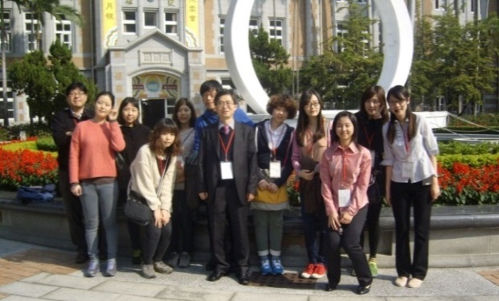
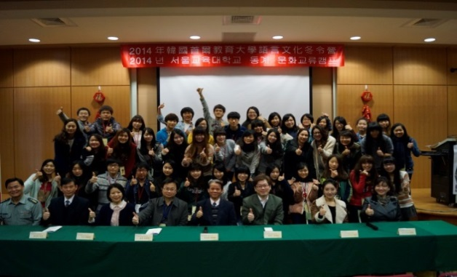
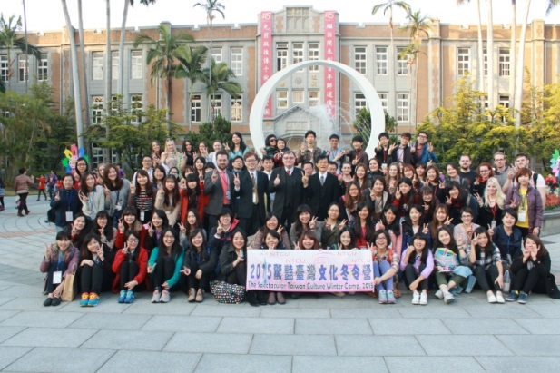
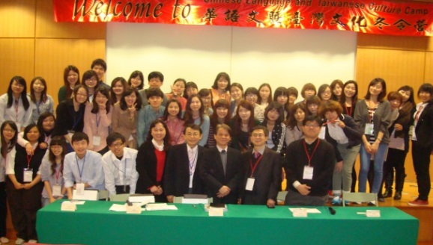
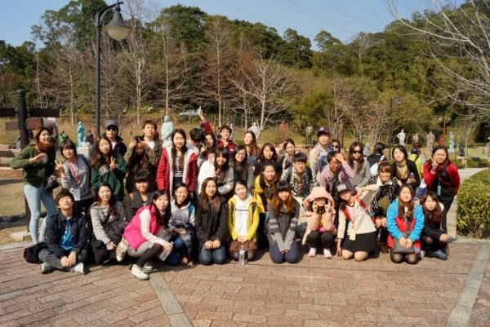
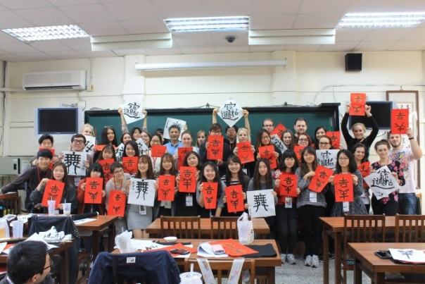
4.The Case of Internationalization at home in National Taichung University of Education
2013
(1)The Winter Camp
2014
2015
Innovation Management, Search for Excellence and Sustainable Development

Slide 20
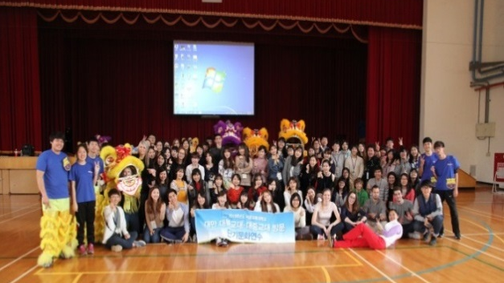
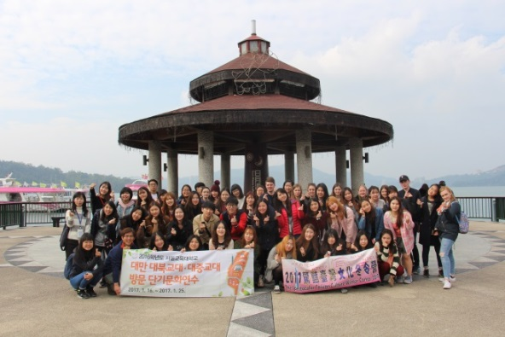
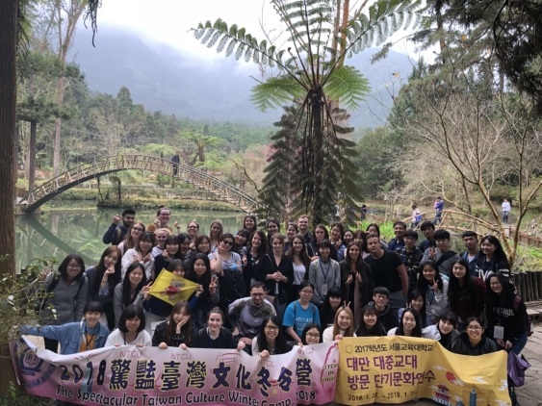
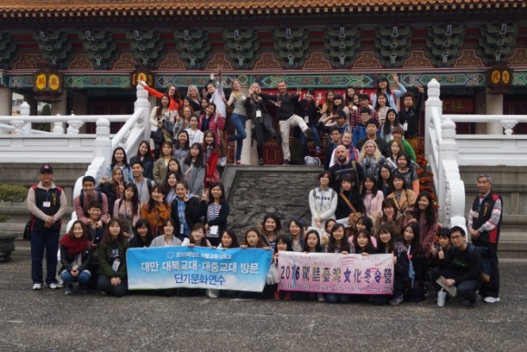
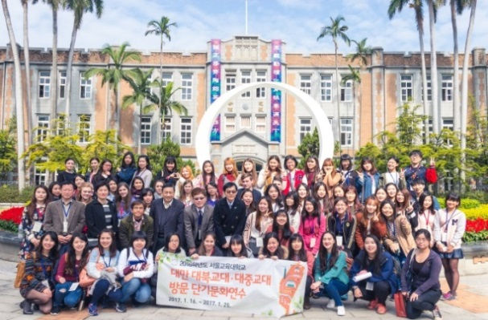
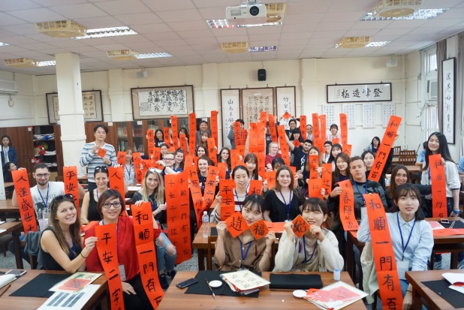
4.The Case of Internationalization at home in National Taichung University of Education
2016
(1)The Winter Camp
2017
2018
Innovation Management, Search for Excellence and Sustainable Development

Slide 21
4.The Case of Internationalization at home in National Taichung University of Education
BACKGROUND
Globalization: English as an international language in multicultural contexts
Global competence: English ability and multicultural competence
GOAL
Foster multicultural competency among students
English Education Trend: Content and Language Integrated Learning (CLIL)
Prepare students as English users with communicative ability
(2)Freshman English Project-
Freshman English
in a Multicultural Context
Innovation Management, Search for Excellence and Sustainable Development

Slide 22
4.The Case of Internationalization at home in National Taichung University of Education
(2)Freshman English Project-
Freshman English
in a Multicultural Context
Curriculum Frame
Theme | Issue | Example
Cultural Awareness | Self-Awareness | Who am I
 | Self-Appreciation | Identity
Multicultural Awareness | Recognizing Diversity | Diversity
 | Respecting Differences | Bully
Cross-Cultural Competence | Intercultural Competence | Children’s Rights
 | Intercultural Communication | Nonverbal
Citizenship and Responsibility | Civic Consciousness | Freedom of Speech
 | Global Citizenship | Environmental Protection
Innovation Management, Search for Excellence and Sustainable Development

Slide 23
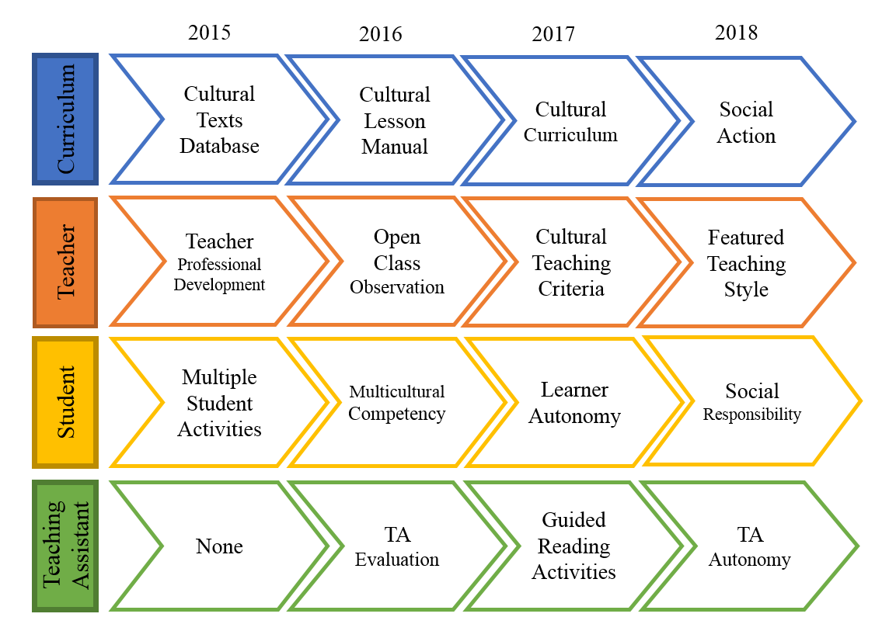
4.The Case of Internationalization at home in National Taichung University of Education
2015-2018 Summary
(2)Freshman English Project-
Freshman English
in a Multicultural Context
Innovation Management, Search for Excellence and Sustainable Development

Slide 24
4.The Case of Internationalization at home in National Taichung University of Education
(2)Freshman English Project-
Freshman English
in a Multicultural Context
Executive Plan
Four Aspects
Curriculum | Teacher | Student | Teaching Assistant
texts of cultural issues | professional development | multicultural projects | assistant’s manual
teacher’s manual | peer observation | multiply assessments | support teaching
online programs | teaching criteria | learner autonomy | support learning
curriculum evaluation | teacher self-evaluation | social action | support group
Innovation Management, Search for Excellence and Sustainable Development

Slide 25
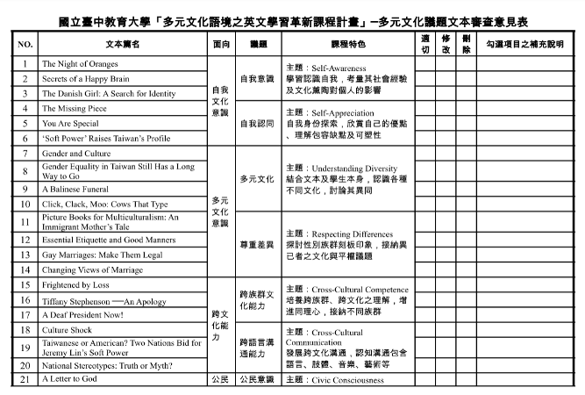
4.The Case of Internationalization at home in National Taichung University of Education
Project Outcome - The Curriculum Aspect
(2)Freshman English Project-
Freshman English
in a Multicultural Context
Online Programs: 4 Units
Curriculum Evaluation: 3 Expert Reviews
Innovation Management, Search for Excellence and Sustainable Development

Slide 26
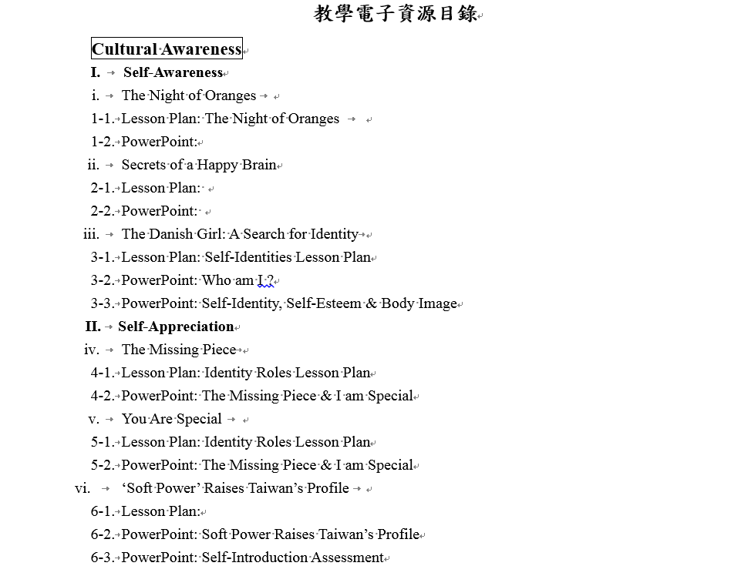
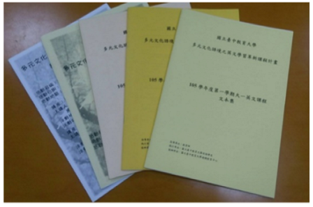
4.The Case of Internationalization at home in National Taichung University of Education
Project Outcome - The Curriculum Aspect
(2)Freshman English Project-
Freshman English
in a Multicultural Context
Cultural Texts: 30 Articles
Digital Teacher’s Manual: 22 Lesson Plans
Innovation Management, Search for Excellence and Sustainable Development

Slide 27
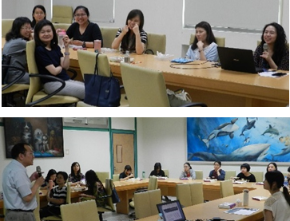
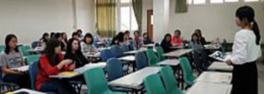
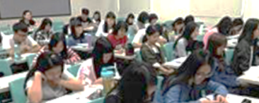
4.The Case of Internationalization at home in National Taichung University of Education
Project Outcome – The Teacher Aspect
(2)Freshman English Project-
Freshman English
in a Multicultural Context
Professional Development
Open Classrooms: Peer Observation
Innovation Management, Search for Excellence and Sustainable Development

Slide 28
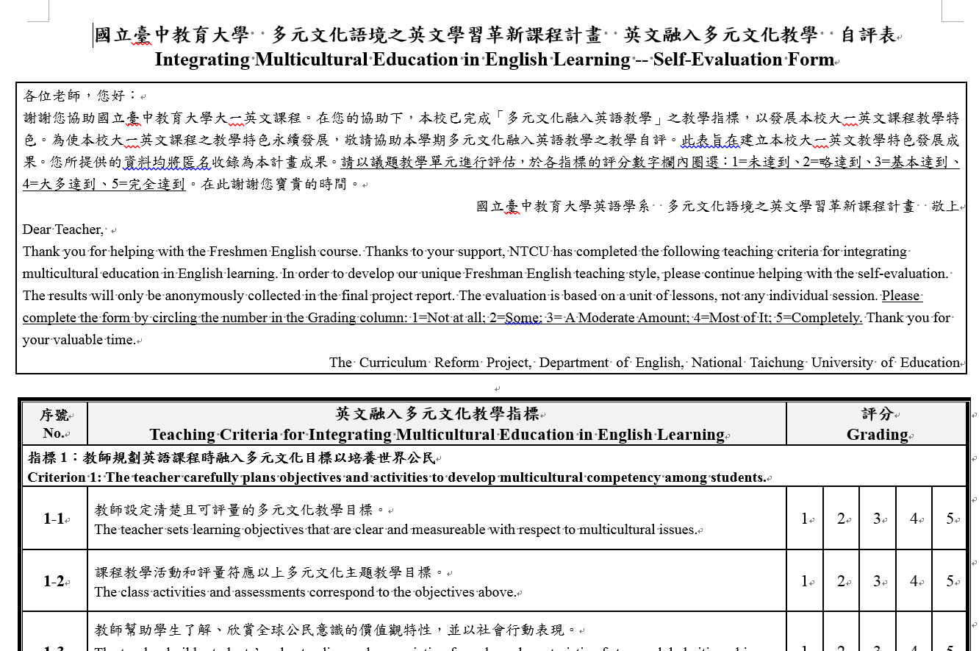
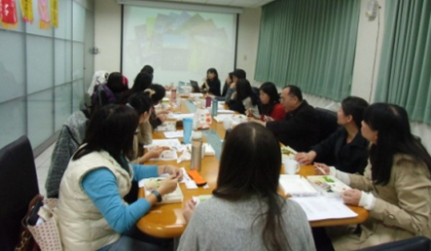
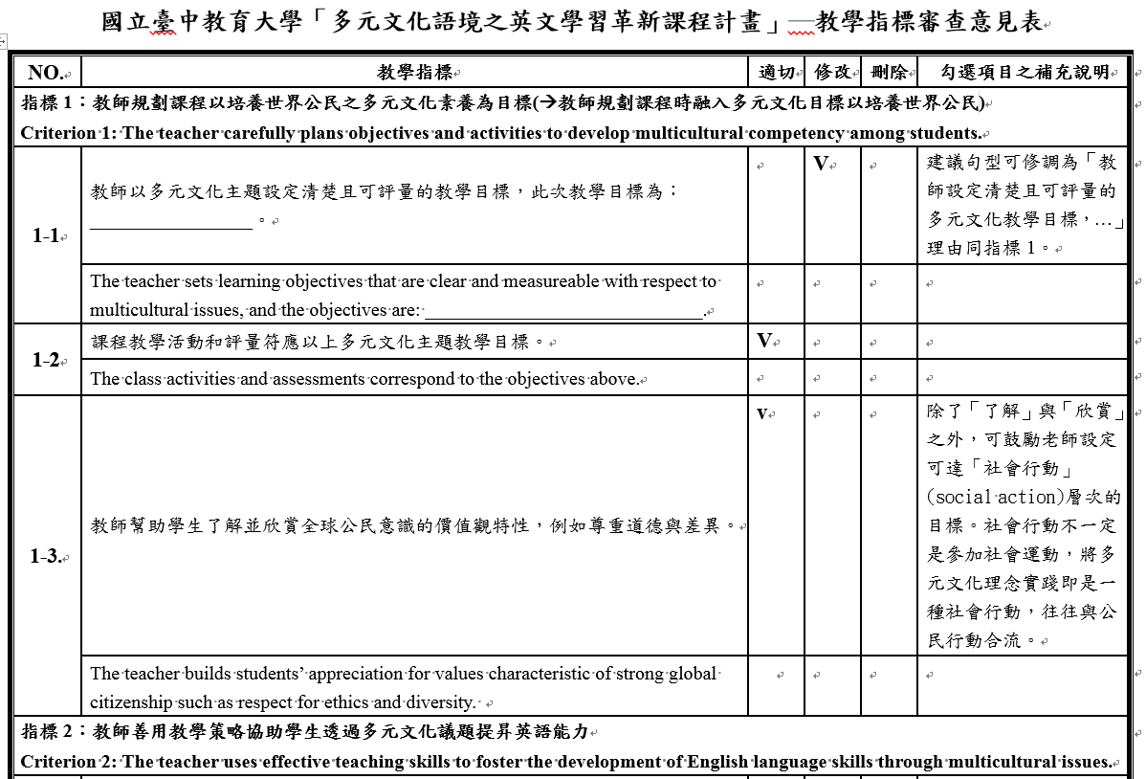
4.The Case of Internationalization at home in National Taichung University of Education
Project Outcome – The Teacher Aspect
(2)Freshman English Project-
Freshman English
in a Multicultural Context
Teacher Group:
Online Discussion
Teacher Group:
Sharing Teaching
Strategies
Teacher Self-Evaluation
Teaching Criteria: 3 Expert-Reviews
Innovation Management, Search for Excellence and Sustainable Development

Slide 29
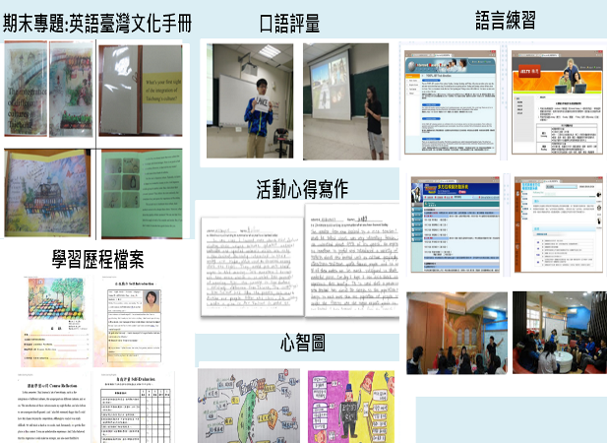
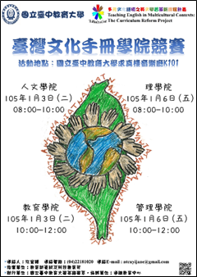
4.The Case of Internationalization at home in National Taichung University of Education
Project Outcome – The Student Aspect
(2)Freshman English Project-
Freshman English
in a Multicultural Context
Multiply Assessments
English Contests
on Multicultural Projects
Innovation Management, Search for Excellence and Sustainable Development

Slide 30
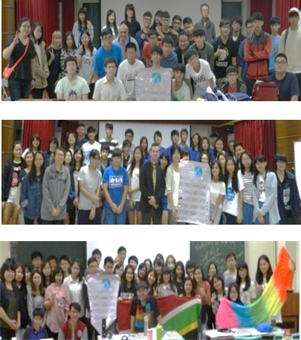
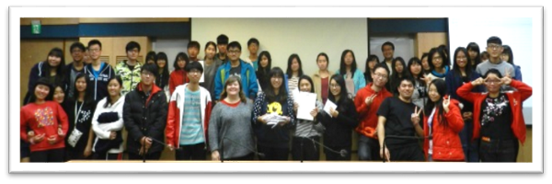
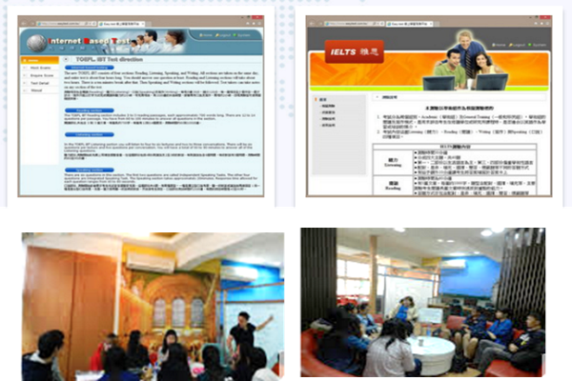
4.The Case of Internationalization at home in National Taichung University of Education
Project Outcome – The Student Aspect
(2)Freshman English Project-
Freshman English
in a Multicultural Context
Learner
Autonomy:
Self-Access Learning
Global Classrooms: 20 Sessions
Innovation Management, Search for Excellence and Sustainable Development

Slide 31
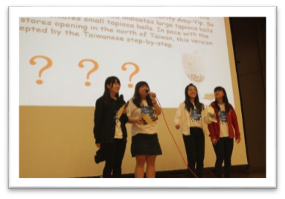
4.The Case of Internationalization at home in National Taichung University of Education
(2)Freshman English Project-
Freshman English
in a Multicultural Context
Project Outcome – The Student Aspect
Social Action: Cultures in Taiwan
Social Action: Digital Storytelling
Innovation Management, Search for Excellence and Sustainable Development

Slide 32
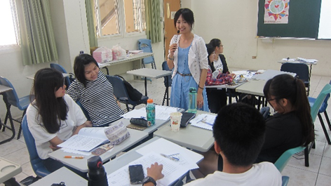
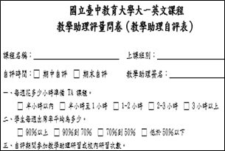
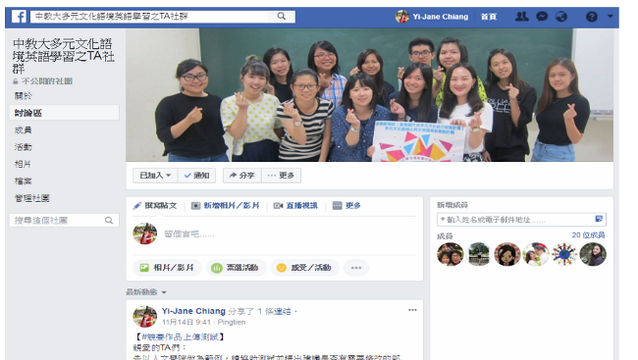
4.The Case of Internationalization at home in National Taichung University of Education
Project Outcome –
The Teaching Assistant Aspect
(2)Freshman English Project-
Freshman English
in a Multicultural Context
Teaching Assistant’s Manual
Professional Development Workshops
Teaching Assistant
Support Group
Innovation Management, Search for Excellence and Sustainable Development

Slide 33
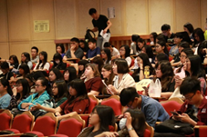
4.The Case of Internationalization at home in National Taichung University of Education
Project Outcome – The Student Aspect
(2)Freshman English Project-
Freshman English
in a Multicultural Context
Support Learning:
Helping with Final Projects
Support Learning:
Outside-Class
Guided Reading
Support Teaching:
In-Class Discussion
Innovation Management, Search for Excellence and Sustainable Development

Slide 34
5.Concluding Remarks
First of all, internationalization at home and abroad are equally important. Internationalization at home is even more important due to the fact that more than 95 percent of the higher education students do not go abroad for their study.
Second, because of globalization, it has been becoming important for university graduates to be international for meeting needs of the emerging globalized employment market. Thus to initiate programs concerned for including all the students for improving their global literacy or intercultural understanding.
Internationalization
at Home
Finally, to internationalize teaching and research is also essential for universities in order to meet needs of globalized industry and society.
Innovation Management, Search for Excellence and Sustainable Development

Slide 35
Thanks for Your Kind Attention~
Innovation Management, Search for Excellence and Sustainable Development

