Slide 1
Innovation and Entrepreneurship at Hungarian Universities:
The Case of Széchenyi István University
Dr. Tibor Dőry
Head of Department, Associate Professor
Széchenyi István University
Mobilis Science Centre
“GLOBAL UNIVERSITIES IN THE XXI CENTURY: CHARACTERISTICS, TRENDS AND MAIN CHALLENGES”
Budapest University of Technology and Economics, 24 – 27 September 2018

Slide 2
Key trends that impact universities
Pressures of the public for easier access to higher education
Expectations of governments on involvement and contribution of university to socio-economic development of the country
Universities are no longer regarded only as parts of the national education system, protected by the state
Universities fight for students, research and financing, they devote more attention to development of relations with external stakeholders, which demands a complete change of their previous methods of management, financing, internal structure and external relations, as well as the methods of performing activities (van Ginkel 2002).

Slide 3
Entrepreneurial universities
University is becoming entrepreneurial in order to address the needs of its own environment, and contribute to regional and national economic development (Gibb, 2012), but also to improve its own financial situation and the position of its employees.
Entrepreneurial university refers to the university, which is able to survive and adapt in highly complex and uncertain conditions of the environment in which it operates (Clark, 2001)

Slide 4
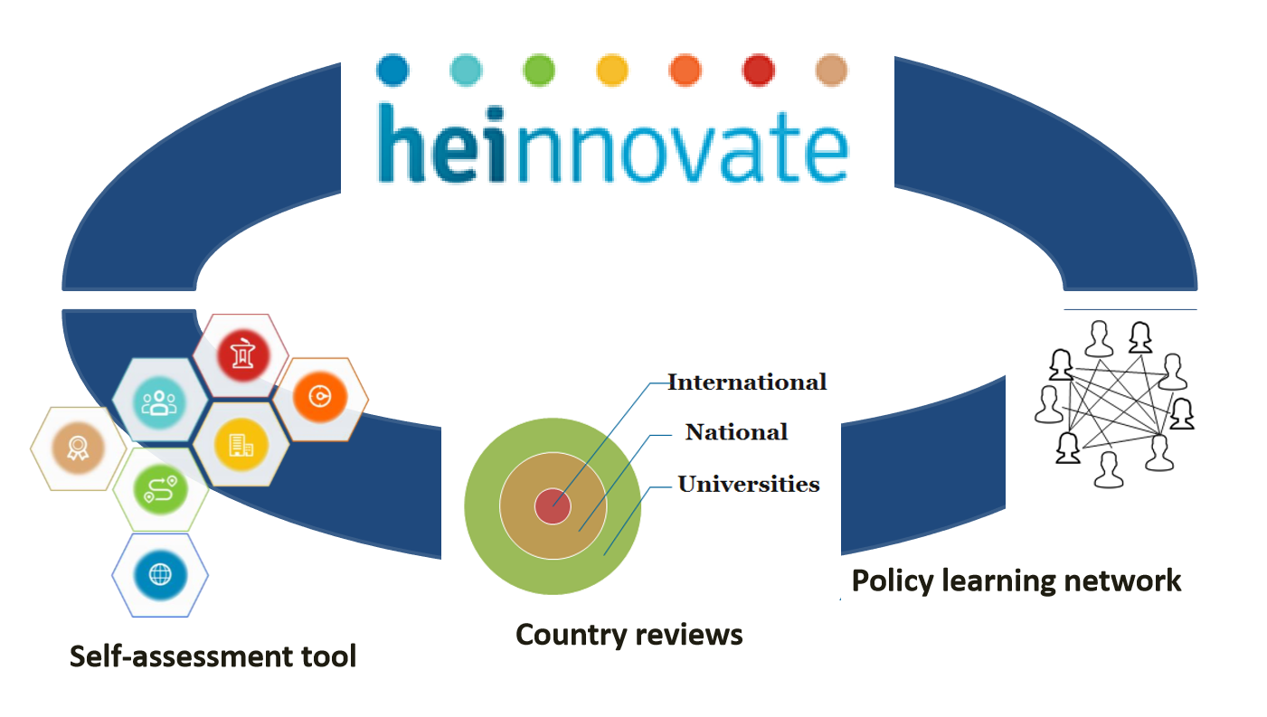
HEInnovate – an OECD-EC initiative The guiding framework
Website: https://heinnovate.eu/en

Slide 5
HEInnovate – a self-assessment tool

Slide 6
HEInnovate in Hungary
Diverse set of five universities selected i.e. traditional, specialised and new, such as Széchenyi István University
Activities included:
Awareness raising workshops
Online survey, i.e. HEInnovate tool
Study visits of review team
Discussion and dissemination of conclusions of the review team
Highly motivated TTO managers took a lead and facilitated the review process

Slide 7
HEInnovate recommendations for higher education institutions in Hungary
Develop a common understanding of the third mission and the entrepreneurial agenda specific to the HEI’s profile and expectations.
Appoint a senior manager with responsibility for entrepreneurship, innovation and the third mission.
Introduce viable resource allocation mechanisms to support entrepreneurship, innovation and the third mission, including incentives, an innovation fund and horizontal support services.
Introduce professional development and mobility programmes for staff related to entrepreneurship, innovation and the third mission.
Enhance the involvement of students and young researchers in entrepreneurship, innovation and the third mission.
Provide basic support for new venture creation, well-embedded in the wider start-up ecosystem.
Build capacity at institutional and individual levels to understand, document and measure impact.
Source: OECD (2018)

Slide 8
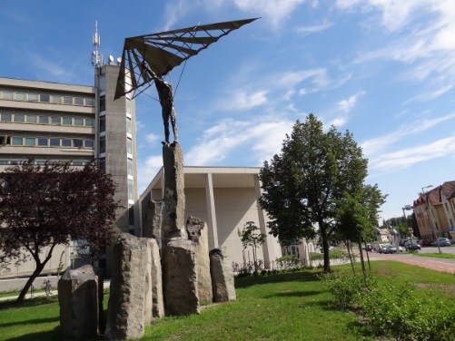
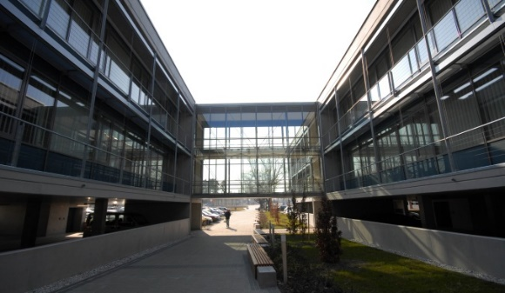
The case: Széchenyi István University
Motto: „The Future is being built in Győr”
Győr is also the site of a high-powered University with 12,000 students and
9 schools:
Audi Hungaria School of Automotive Engineering**
The School of Architecture, Civil Engineering and Transport Sciences
The School of Agriculture and Food Sciences
The School of Economics
The School of Humanities, Education and Social Sciences
The School of Mechanical, Electrical Engineering and Information Technology
The School of Performing Arts
The School of Law and Political Sciences
The School of Health and Sport Sciences
4 Doctoral Schools:
and a Research Centre for the Vehicle Industry

Slide 9
The „bridges” strategy of Széchenyi István University

Slide 10
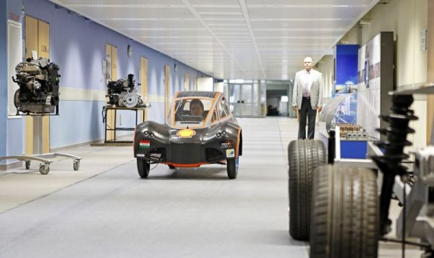
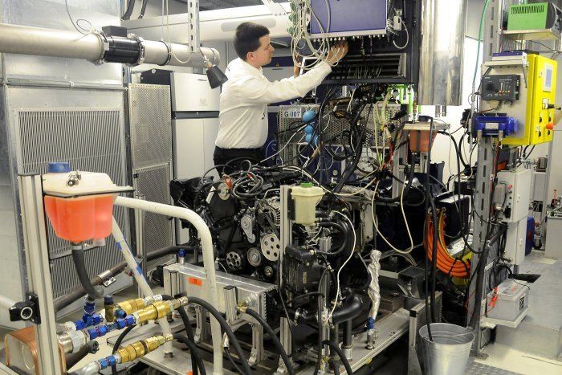
Models of co-operation between university and businesses
Lectures in foreign languages
Company-specific departments and institutions
Company-specific research group
Forms of co-operation
Company oriented subjects
Company oriented subjects
Research projects
Research projects
Research projects
Development of infrastructure
Development of infrastructure
Development of infrastructure
Development of infrastructure

Slide 11
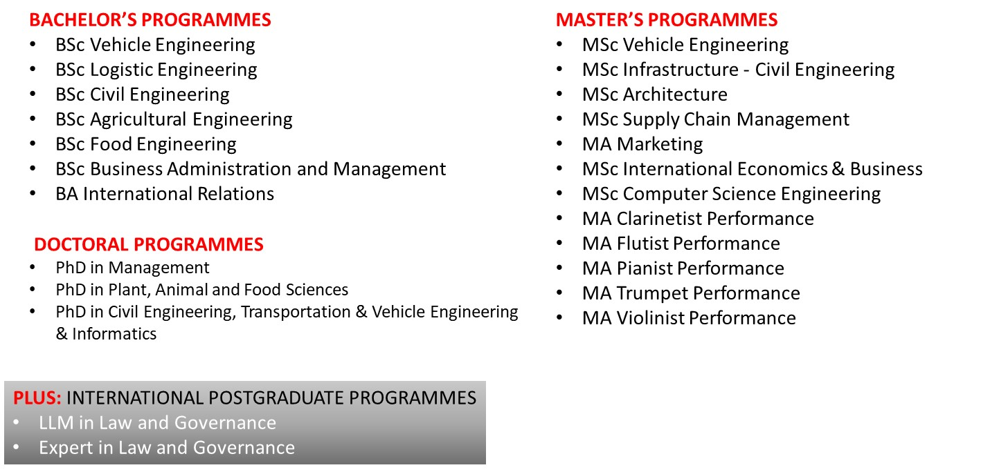
2019 / 2020: International full degree programmes (English-taught)

Slide 12
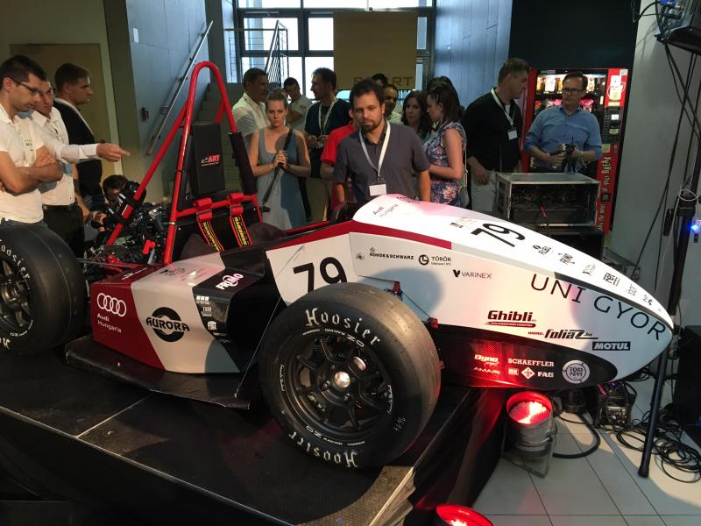
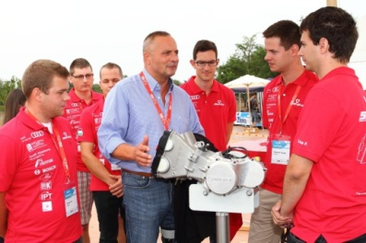
Specificity of Széchenyi István University
Ambition to become a research university and appear in international rankings in the years to come
Intensive collaboration with the business community
Companies (in particular AUDI Hungaria located in Győr) facilitate strongly the development of the university through dual education, research projects, needs for continuous education and MBA / PhD programmes
Focus on students’ projects, support and hosting of student competitions
Key factor of continuous development: Triple Helix type of collaborations are daily routine
Notes:
National Conference of Mechanical and Mechatronic Engineering Students
National Conference of IT Students
SZEnergy team
SZEngine - Formula Student engine development team
Formula Student Racing Team
Court Case Competitions
Concrete Canoes Competition
Pasta-bridge Construction Competition
National Competition of Financial Cases

Slide 13
Outlook: the way ahead
Support of intrapreneurship and „enabler” persons and scientific excellence vs. „publish or perish” principle
Development of different mind-set and more entrepreneurial university staff through entrepreneurial actions (e.g. Zero budget planning)
Our entrepreneurial approach: „get out of the building”:
Discussion of business needs/company issues, challenges with entrepreneurs, company managers, experts
Short term staff exchanges help hands on experiences with modern technologies (i.e. Audi Hungaria internship program)
Involvement of students into company projects (i.e. creation of learning environment for students)

Slide 14
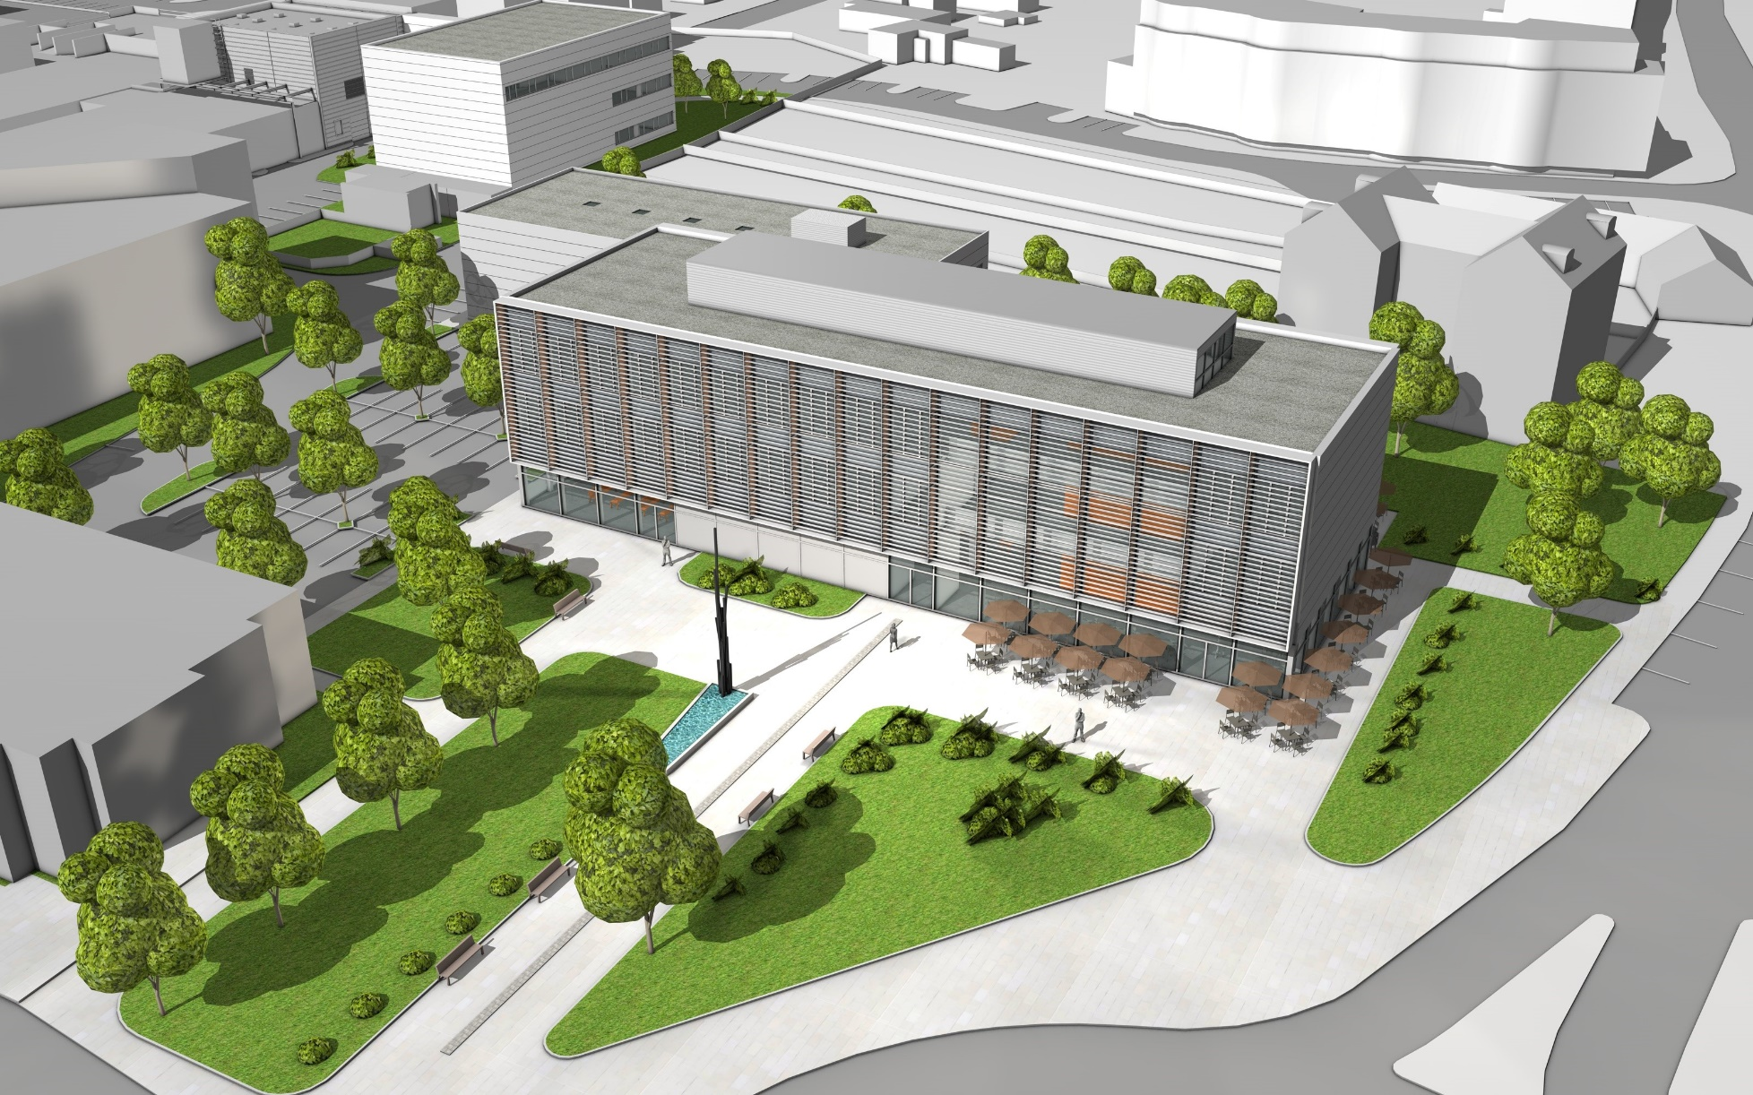
Future: Higher education and industry collaboration centre (FIEK)

Slide 15
Thank you for your attention!
doryti@sze.hu

