Slide 1
UESC: Collaboration between universities and companies
Ticiana Grecco Zanon Moura
Advisor of International Relations
arint@uesc.br

Slide 2
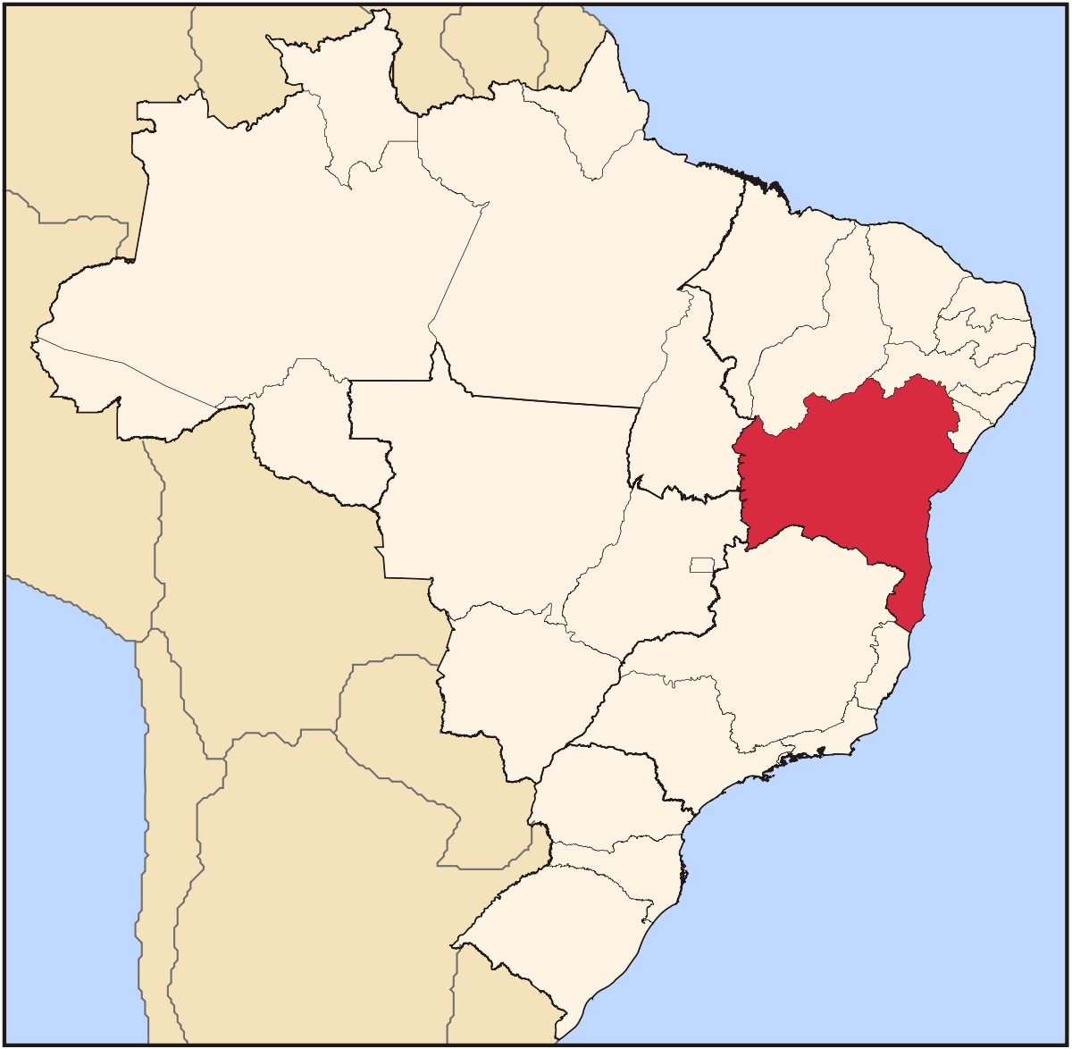
UESC: State University of Santa Cruz.
Founded in 1991.
37 undergraduation courses and 8,585 students.
35 graduate programs and 1,051 students.
74 municipalities.

Slide 3
International Actions Dynamics
International Actions Initiative
Proposition to financers and implementation at UESC
Officialization: Agreement, accounting, ...
Process Flow
Academic and Administrative Units of UESC
External Fundings
Rectorship, Arint ...

Slide 4
UESC structures that support the colaboration
ARINT (International Relations Office):
in cooperation with other units of the University, is responsible in promoting international cooperation with public and private entities.
NIT (Technology Transfer and Innovation Office):
objective to promote innovation and adequate protection of inventions generated in the internal and external ambit of UESC and its transfer to the productive sector.

Slide 5
16 countries 2018
14 Countries 2014
Agreements
Argentina and Peru
30 Foreign Institutions

Slide 6
French Institutions and UESC
La Rochelle, since 2000:
Undergraduate program LEA, Internship
Cirad, since 2002:
Graduate Program in Genetics and Molecular Biol.
UPV, Paul Valéry Montpellier, since 2012
UJF, Université Joseph Fourier, since 2014
Institutions of different countries:
http://www.uesc.br/arint/index.php?item=conteudo_convenios.php

Slide 7
In and outflows of students at UESC
Outflows:
Graduation Courses: 10 students per year.
Post-graduate Programs : 11 students per year.
Inflows:
Graduation and post-graduation: 14 students per year.
Visiting Professors: 17.

Slide 8
NIT – Technology Transfer and Innovation Office
Propose and ensure the maintenance of institutional policies to protect inventions within UESC;
Promote the protection of inventions generated in the UESC's Region;
Promote the integration of the UESC with the productive sector for the generation and transfer of technology;
Manage the processes of allocation of scholarships and aid related to Technological and Social Innovation within UESC.

Slide 9
NIT supports the formation of companies incubated at UESC

Slide 10
Activities of NIT
23 agreements with Brazilian companies and 38 projects in progress.
Registration of 46 brands, 34 patents and 8 softwares.
Collaboration with a professional master degree.
Coordination of the South Bahia Technology Park.
Support the negotiation of intellectual property clauses, mapping of skills and infrastructure for formation alliances and service provision.
Prospecting on patent bases.
Identify opportunities to attract companies to the technological park.

Slide 11
Examples of seminars to businessmen and students

Slide 12
Main objective: stimulate actions of entrepreneurial education to elementary and middle school students of the community of Salobrinho.

Slide 13
Thank you!

Slide 14
Students and Professors, meet the regulations in UESC
Academic mobility: students and professors
Dual Degree and Mobility
Post-Graduate
Graduação

Slide 15
BEST CASE: CIRAD and UESC
UESC as and environment of rapid consolidation as a scientific researcher
Cedida pelo CIRAD à UESC desde 2002 até o presente
Orienta MS e DS
Excelent research quality and productivity

Slide 16
CIRAD E UESC
Great relevance in the Internationalization of UESC
Scientific Co-Production
UESC-CIRAD Cooperation
Vice-coordinator of the PPG-GBM 2008-2010
Program Colegiate
Strategy of Research and Publication Commission
....

Slide 17
OVIEDO E UESC
Great relevance in the Internationalization of UESC
Scientific Co-Production
Pós-doutorados (2 profs da UESC em Oviedo)
Um doutorado completo (Ticiana)
Mobilidade de estudantes
Alunos da UESC em Oviedo
Aluno de Oviedo na UESC

Slide 18
Museu de Zoologia Koening e UESC
Mobilidade de estudante e professor
Uma licença sabática
Um estudante da UESC
Produção científica
8 artigos

Slide 19
Agreements
Academic, scientific, technical and cultural cooperation agreements.
Examples:
Pioneer actions,
...that live on!
2002 Cirad →
2000 La Rochelle →
2005 Medical Physics →
...
2014 renewed →
2009, 2014 LEA →
2014 renewed →
...
Research and Researcher
Internship
Research
...
Sustained Internationalization

